Slide 2
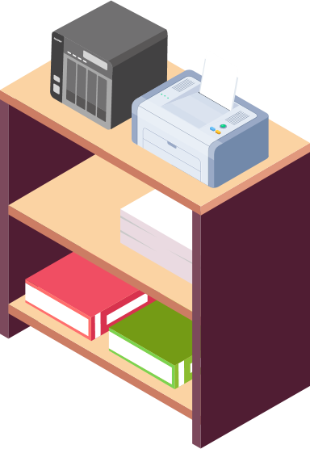
Why Choose a Desktop NAS over a Rackmount One
No server room in the company
Internal use in a department
NAS has outdoor needs

Slide 3
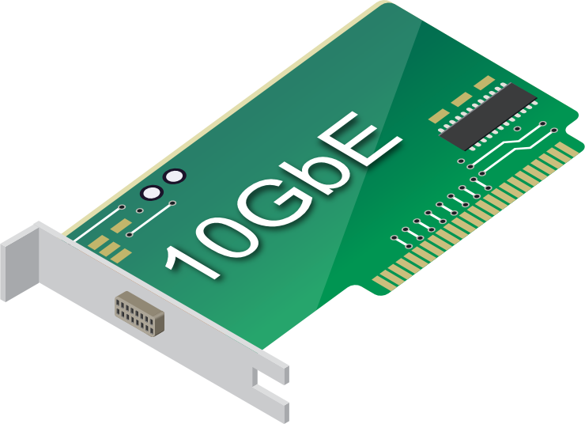
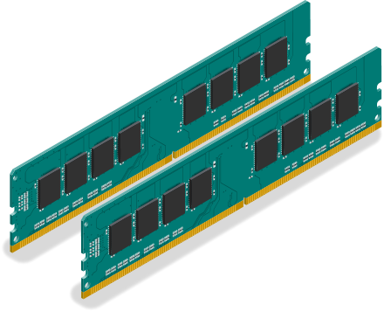
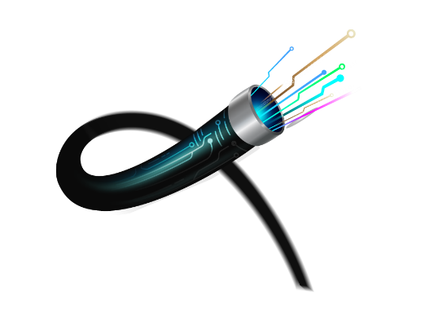
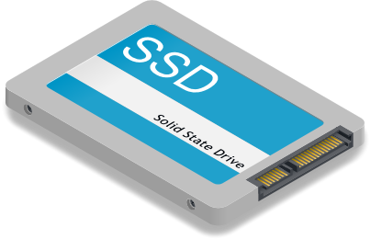
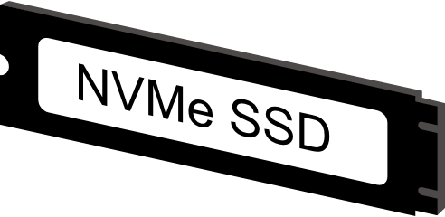
Smart Investment: Expand when Necessary
When purchasing a business entry level NAS, you should not only consider current requirements, but also reserve the expandability to future-proof your investment
Storage Expansion
Network Expansion
Performance Expansion
10GbE

Slide 4
Enterprise OS
QuTS hero with ZFS

Slide 5
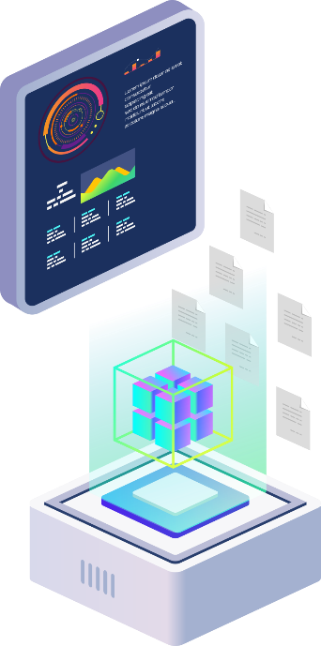
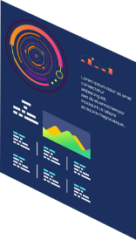
Why we choose ZFS file system for our enterprise NAS
The 3rd QuTS hero dedicated machine launched by QNAP
Because we know that enterprises all value these ...
Enterprises implement a lot of All Flash solutions, and SSD wear out has become the key to IT cost structure
Digital transformation relies on massive data analysis and requires PB-level storage space
Instant disaster recovery capability & complete data protection are the competitiveness indexes of an enterprise
Corporate data cannot tolerate unintentional error; it is essential to ensure data integrity.

Slide 6
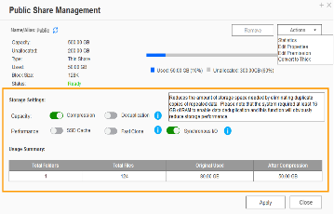
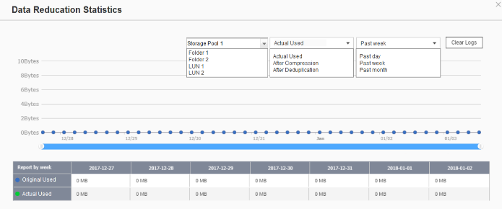
Powerful data reduction: Extend the SSD endurance
only available when inline dedup/compress enabled
ZFS file system with inline deduplication & inline compression features.
The ZFS file system can be the best choice to pair with the all-flash and SSD storage because it reduces the data size and pattern that need to be written to the SSD directly.
Write
A
B
C
D
A
B
C
D
A
B
C
D
D
C
A
B
D
C
A
B
Original Data
Compressed Data
Deduplicated Data
SSD Pool
Compression
Deduplication
Write to SSDs as sequential as much as possible.
Write to SSDs as sequential as much as possible.

Slide 7
Amazing massive storage
The best data carrier of big data analysis/edge computing/AI inference
Only PB-level shared folder is enough to store the huge data matrix .
200TB is not enough
Data
Model building
Model validation
Parameter adjustment
Deep Learning

Slide 8
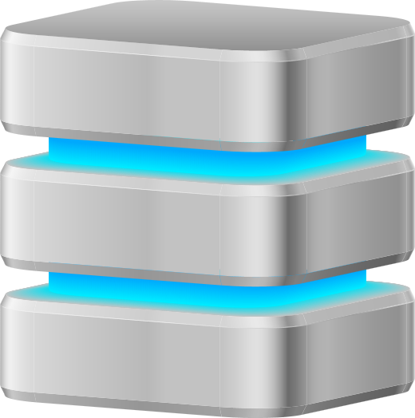
Silent data corruption & self-healing
Application
Application
Application
ZFS RAID
ZFS RAID
ZFS RAID
Avoid data loss that occurred on the running system.

Slide 9
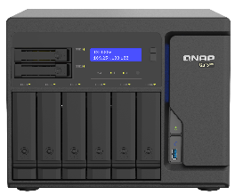
Three-layer backup solution : Provide you the most complete data backup protection
HBS 3 :
RPO : daily / schedule
File level, multi-version management
Snapshot & Replica:
RPO : hourly / 24 hr / 365 day
Block level, multi-version management; ZFS provides the most lightweight snapshot without affecting storage performance at all.
SnapSync:
Real-time
SnapSync
Real-time
SnapSync
Block level, Mirror the data copy and always kept up to date.
RPO : Real-time

Slide 10
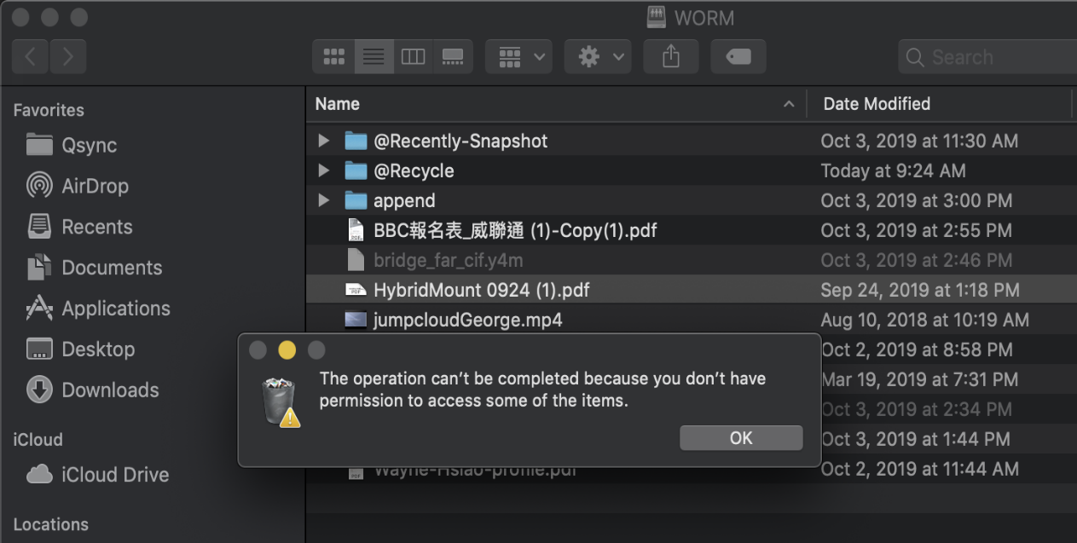
WORM (Write Once Read Many times)
WORM is used to avoid modification of saved data. Once this feature is enabled, data in shared folders can only be read and cannot be deleted or modified to ensure data integrity.
Enterprise Mode: Remove the shared folder through QTS hero UI or SSH commands (QCLI).
Compliance Mode: Have to take the Storage Pool offline and remove the Pool if want to destroy data.

Slide 11
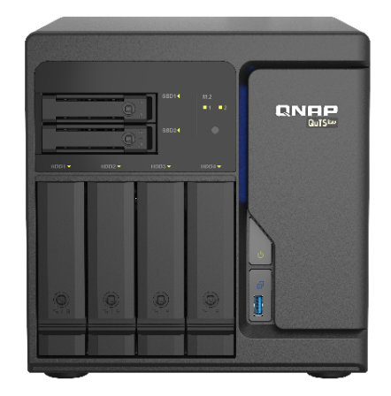
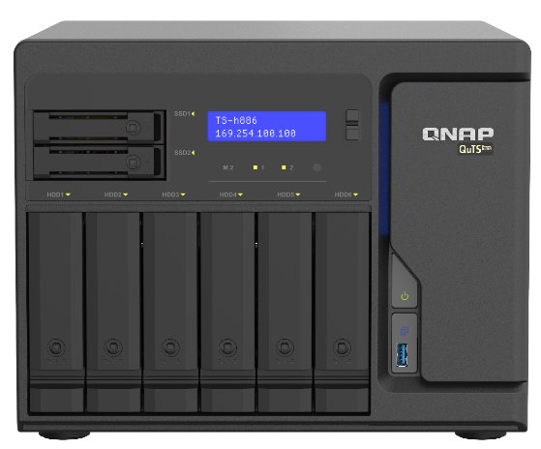
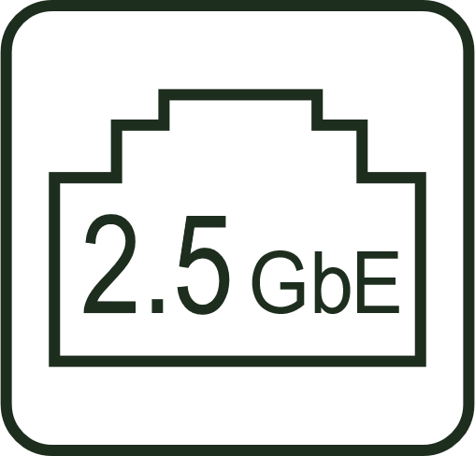
TS-h686/TS-h886 – Affordable Xeon D NAS
4 x 2.5GbE!
4 x 2.5GbE!
x 4
x 4
TS-h686-D1602-8G
Intel Xeon D-1602 2C4T processor
8GB DDR4 ECC RAM (2x 4GB)
2 x NVMe M.2 SSD port (Gen3 x4)
4 x 2.5GbE LAN port
2 x PCIe Gen3 x8 slot
Built-in QuTS hero OS
TS-h886-D1622-16G
Intel Xeon D-1622 4C8T processor
16GB DDR4 ECC RAM (2x 8GB)
2 x NVMe M.2 SSD port (Gen3 x4)
4 x 2.5GbE LAN port
2 x PCIe Gen3 x8 slot
Built-in QuTS hero OS

Slide 12
Intel Xeon D Enterprise Processor
Intel® Xeon® D-1622
4-core / 8-thread processor
2.6 GHz, max. boost to 3.2 GHz
Intel® Xeon® D-1602
2-core / 4-thread processor
2.5 GHz , max. boost to 3.2 GHz

Slide 13
Support ECC Memory (Error Correcting Code)
Running reliably without data corruption
Intel Xeon processors support ECC which automatically detects and repairs single-bit error on-the-fly. ​
Supports up to 128GB

Slide 14
ECC Memory is Important for ZFS
ZFS "Trusts" the contents of memory
Data checksum is done after reading from memory.
Corrupt in-memory-data will cause ZFS to use the wrong data to checksum and store in the hard drive
Data source: https://research.cs.wisc.edu/wind/Publications/zfs-corruption-fast10.pdf

Slide 15
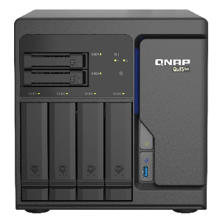
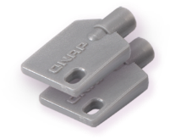
TS-h686/ TS-h886 Front View
2.5”SATA
6Gb/s SSD tray
HDD and M.2 port LEDs
TS-h686
LCD Panel
3.5"/ 2.5”SATA
6Gb/s HDD/SSD tray
Power button
Lockable tray with 2 keys provided
USB 3.2 Gen 1 & OTC button
TS-h886

Slide 16
Rear View
Slot 2: PCIe Gen3 x8
Slot 1: PCIe Gen3 x8
2 x PCIe slot
4 x 2.5GbE LAN port
TS-h686
Smart system cooling fan(s)
2 x USB 3.2 Gen 1 port
250W Power supply
TS-h886

Slide 17
Internal Design
1 x PCIe Gen3 x8 slot (HDD side)
1 x PCIe Gen3 x8 slot (CPU side)
2 x NVMe Gen3 x4 M.2 port (2280/22110)
Intel Xeon D processor
4 x DDR4 long-DIMM slot
1 x 6cm CPU cooling fan
Notes:
修改筆記: 中英文數字間加空格

Slide 18
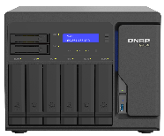
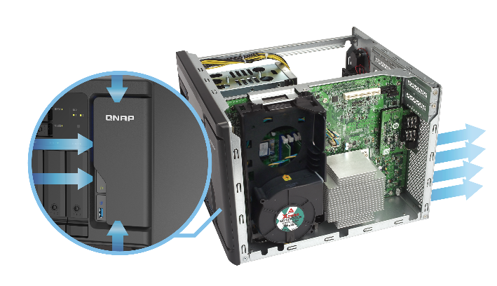
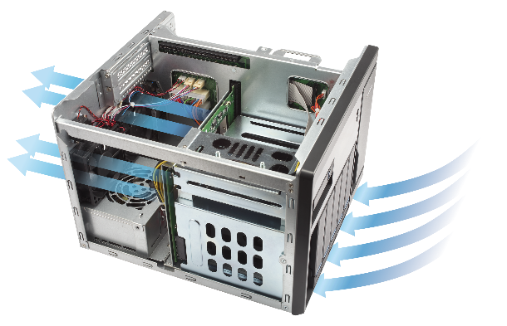
Multi-zone Heat Dissipation for Low-noise Operation
On the road
70
The multi-zone heat dissipation utilized in the TS-hx86 enables the dynamic adjustment of the system fan and CPU fan speeds in different zones of the system. It works smoothly and quietly on your desk.
Talk loudly
60
Office
50
CPU Zone
HDD Zone
40
Library
Suburbs
30
TS-h886
21.8
Studio
20
Sound Pressure (dB A)
Sound pressure test：sound pressure is measure at the front bystander position with low fan speed.

Slide 19
Built-in Four 2.5 GbE LAN Ports
New motherboards & Wi-Fi routers are equipped with 2.5GbE.
2.5GbE Benefits:
Up to 2.5x performance
Use the existing wiring infrastructure to support 2.5GbE
4 x 2.5GbE
(compatible with 1 GbE)
1 x 2.5GbE Windows file transfer
300
291
265
250
200
150
100
50
(MB/s)
(MB/s)
0
Read
Write

Slide 20
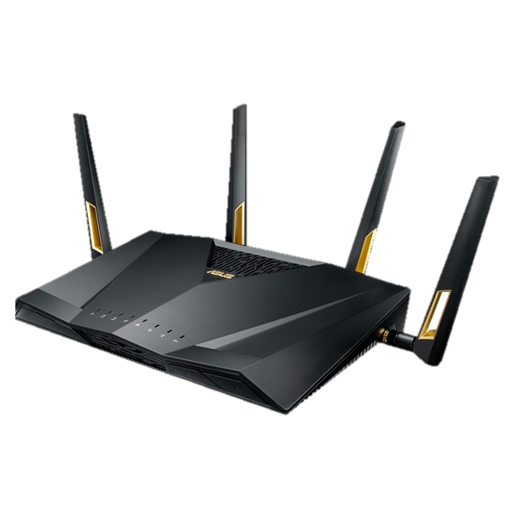
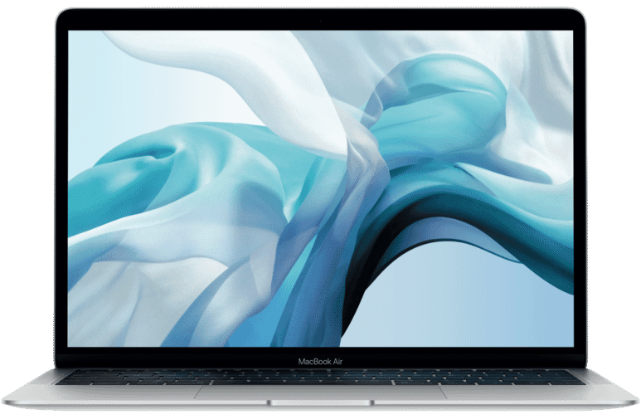
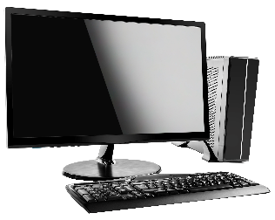
QNAP 2.5GbE 5-Port Network Switch
Set up a multi-user collaboration workflow
Can use current RJ45 Cat5e cable, saving money for replacing cable
WiFi 6 AP
2.5GbE
2.5GbE
2.5GbE
2.5GbE
TS-h686
QSW-1105-5T

Slide 21
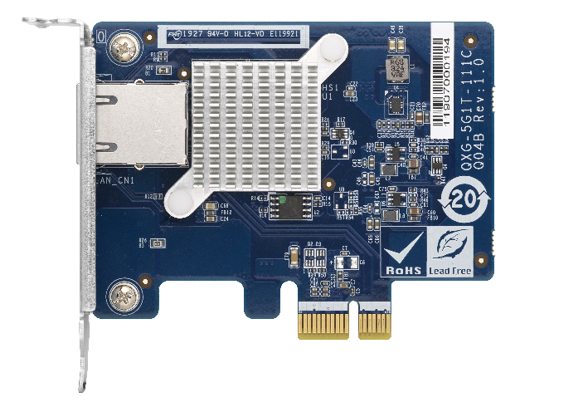
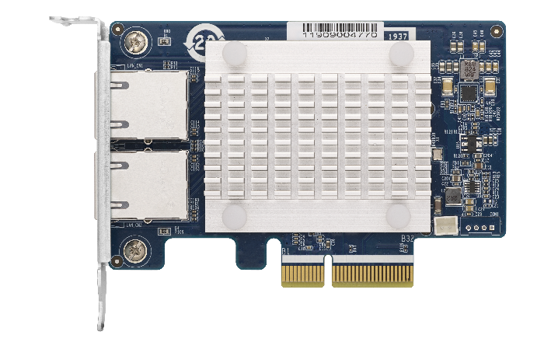
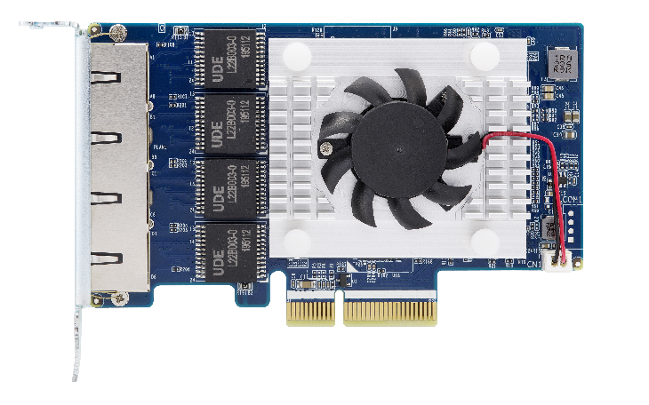
Upgrade Network Bandwidth with 5GbE Adapter
Versatile options
Support single-port, dual-port, and qual-port adapters
Single port：QXG-5G1T-111C
Dual port：QXG-5G2T-111C
Quad port：QXG-5G4T-111C

Slide 22
Built-in Two PCIe Gen3 x4 M.2 SSD slots
Support PCIe Gen3 x4 M.2 SSD, providing up to 3.2 GB/s bandwidth per slot
Boost random IOPS for multiple concurrent connections
NVMe SSD v.s. SATA SSD
Samsung 970 EVO Plus
(Gen3 x4)
Samsung 860 Pro
(SATA 6Gb/s)
600,000
620,000
500,000
560,000
400,000
300,000
200,000
(IOPS)
100,000
100,000
90,000
0
Random
Read
Random
Writer
Random
Read
Random
Writer
* Performance information is from Samsung official website
Notes:
22

Slide 23
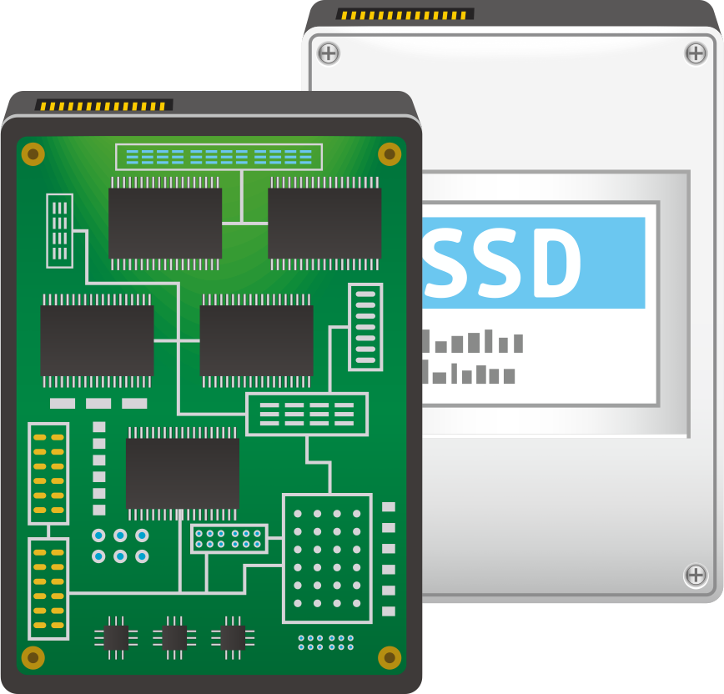
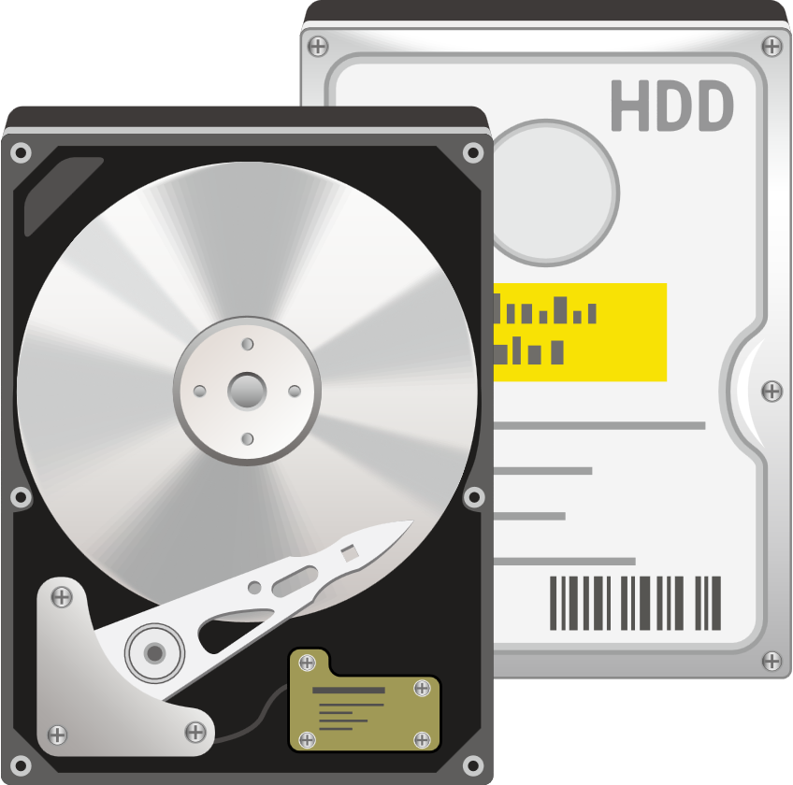
Tiered storage configuration for a QuTS hero NAS
Step1: system drive
Creating an SSD RAID with at least two SSDs for the system drive is recommended.
Step2: read/wrie cache
Use NVMe M.2 SSD for a read/write cache.
Step3: data storage
Allocate HDDs/SSDs to create a RAID for storing files and application data.
SSD
SATA HDD
System Drive
Read/Write Cache
Data Storage

Slide 24
Two PCIe Gen3 x8 Slots Provide the Horsepower for Expansion
Each PCIe Gen3 x8 slot provides up to 64 Gb/s bandwidth
Two expansion slots offer the flexibility for expansion
PCIe slot 2：
Support half high, half length (HHHL) PCIe card
PCIe slot 1：
Support full high, full length (FHFL) PCIe card

Slide 25
Complete Expansion Solutions

Slide 26
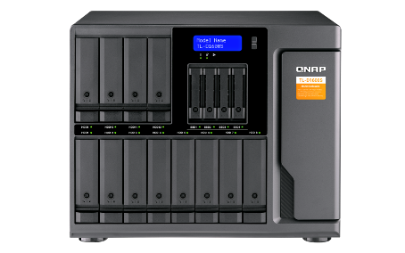
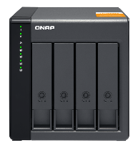
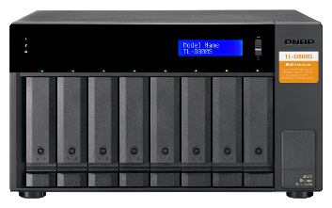
Storage Expansion: TL SATA JBOD - economical and flexible expansion enclosures
By installing QNAP QXP expansion card, NAS can access the TL SATA JBOD with high performance
A single SFF-8088 cable for up to 4 x SATA 6Gb/s = 24 Gb/s transfer speed. Using multiple cables can achieve up to 64 Gb/s between the host and JBOD.
TL SATA JBOD
TL-D400S
TL-D800S
TL-D1600S

Slide 27
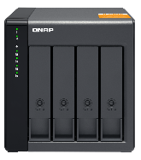
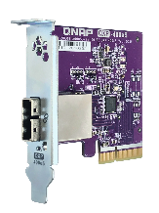
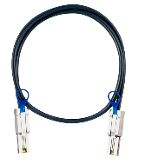
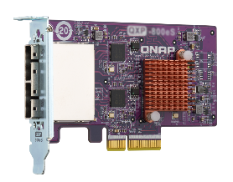
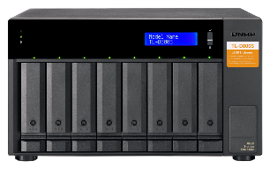
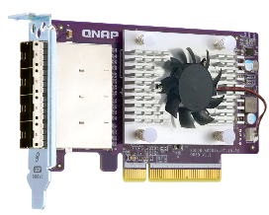
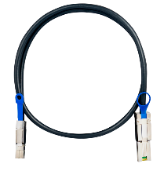
Ready to use by including a QXP PCIe SATA expansion card and SFF cable(s)
+
+
+
+
TL-D400S
1 x QXP-400eS-A1164
PCIe 4-port SATA card
1 x 1M SFF-8088 cable
TL-D800S
QXP-800eS-A1164
PCIe 4-port SATA card
2 x 1M SFF-8088 cable
+
+
TL-D1600S
1 x QXP-1600eS
PCIe 16-port SATA card
4 x 1M SFF-8088 to SFF-8644 cable

Slide 28
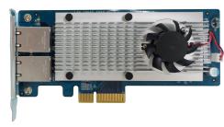
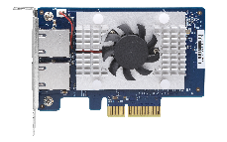
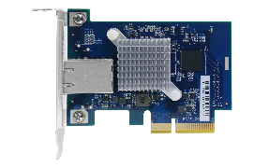
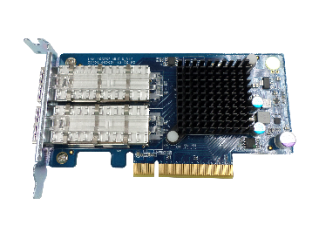
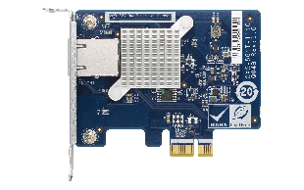
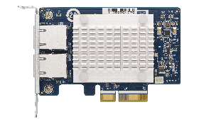
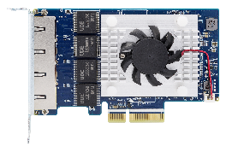
Network Expansion： Versatile Network Expansion Accessories
10GbE Network Card
Fibre Channel
2 x SFP+
2 x RJ45
2 x RJ45
1x RJ45
QXG-10G2SF-CX4
LAN-10G2T-X550
QXG-10G2T-107
QXG-10G2T-107
QXG-32G2FC/QXG-16G2FC
5GbE Network Card
40/25GbE Network Card
1 x RJ45
2 x RJ45
4 x RJ45
40Gb/s
25Gb/s
QXG-5G1T
QXG-5G2T
QXG-5G4T
LAN-40G2SF-MLX
QXG-25G2SF-CX4

Slide 29
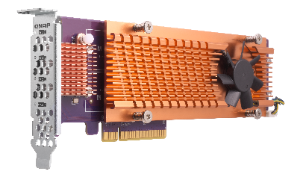
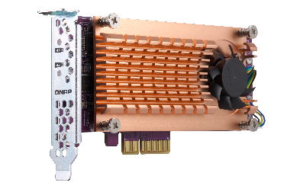
Performance Expansion： Expand more NVMe SSD with QM2 Card
Need more NVMe M.2 SSD for acceleration？Sure！Achieve that with QNAP QM2 cards
Without changing existing configurations
QM2-4P-384
(Gen 3 x8)
4 x M.2 2280 PCIe Gen 3 x4 NVMe SSD slot
QM2-2P-384
(Gen 3 x8)
2 x M.2 22110/2280 PCIe Gen 3 x4 NVMe SSD slot
Note: QM2-4P-384 can only be installed in PCIe slot 1

Slide 30
QuTS Hero
Applications

Slide 31
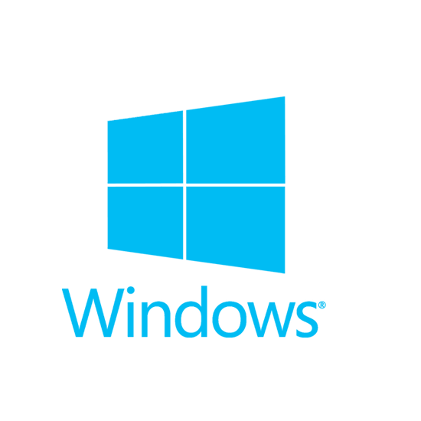
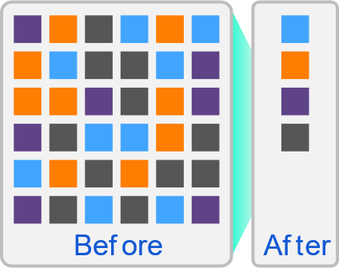
Complete Backup 3-2-1 with HBS 3.0
HBS 3 (Hybrid Backup Sync 3)
From local NAS
(via HBS 3)
From remote NAS ( via File Station )
Carry and Use (QuDedup Extract Tool)
Backup/Restore
.qdff
Tokyo
Taipei
.qdff
TCP BBR
File station with QuDedup (soon)
.qdff
New York
.qdff
CIFS / NFS / FTP
.qdff
Taipei
File station with QuDedup (soon)
Beijing
Access from Cloud

Slide 32
HybridMount provides two modes for file-based cloud storage gateway
 | File Station Mount | File Cloud Gateway
Setup Method | Mount cloud drives | Select “File Cloud Gateway” mode and create a dedicated cache space
Connections | No limit | 2 free and perpetual connections. Purchase license for more connections
Access Performance | Depends on network speed | High performance thanks to caching
Access in File Station | Supported | Supported
Access through SMB / NFS / AFP | Not supported | Supported
Sync with the cloud | Sync only when browsing | Sync constantly for quick access
Integration with QTS Apps | Not supported | Supported ...
Online collaboration
File data analysis
Slower
Internet
NAS
cache
1
2
3
Meta
data
LAN
Faster

Slide 33
Enterprise LUN backup: VJBOD Cloud block-based gateway
VJBOD Cloud Gateway
Initiator
iSCSI
Target
Local user
Cloud object storage space
Initiator
iSCSI
Cloud LUN
Client
Application
Server
SMB/NFS/AFP/
FTP/WebDAV
Cloud Volume
/Shared folder
Snapshot
snapshot
Local user

Slide 34
Boxafe: Comprehensive Backup Solution for Google™ G Suite and Microsoft 365®
Keep important data in your hands.
Move older data out of the cloud to reduce cost
Google™ G Suite
Microsoft 365®
Gmail
Backup all your emails and attachments in Gmail
Outlook
Backup all your emails and attachments in Outlook
Google Drive
Backup all your file versions in Google Drive and supports My Drive and Shared Drive (coming soon)
Contacts (People)
Backup all your contacts in Outlook People
Calendar
Backup all your events and attachments in Outlook Calendar
Contacts
Backup all your contacts in Google Contacts
Calendar
Backup all your events and attachments in Google Calendar
OneDrive
Backup all your files in OneDrive and support SharePoint (coming soon)

Slide 35
Install a Graphics Card for HDMI Output and GPU-accelerated Computing
The TS-hx86 series offers a PCIe Gen3 slot to support low-profile graphics cards that do not need additional power to boost performance of applications such as video editing , 4K UHD transcoding, imaging processing in QTS and performance of virtual machines via GPU passthrough.
GPU Dimension in TS-h686
GPU Dimension in TS-h886
W x H x L: 126mm x 40mm x 261mm
W x H x L: 119mm x 45mm x 266mm
L
H
L
H
W
W

Slide 36
GPU-accelerated Software
File Station
QuMagie
Photo Station
Video Station
Media Stream Add-on
On-the-fly transcoding & offline transcoding
On-the-fly transcoding & offline transcoding
On-the-fly transcoding
On-the-fly transcoding
Video stream transcoding
HD Station
HD Player
QVR Pro
QuAI
Virtualization Station
Local display and decode
Local display and decode
Local display and decode
AI inference acceleration
GPU passthrough

Slide 37
GPU-accelerated Application- Multimedia Workers
Material Ingest
Media streaming Add-on
Stream acceleration
AppTV/ Chrome Cast/ smart TV
File Station
Video preview acceleration
HD Station
HDMI ouput
File Station
Offline transcoding and sharing

Slide 38
GPU-accelerated Application- AI Inference NAS
The last step of the AI is built up an inference host according to the Deep Learning model. GPU cards have been widely adopted to accelerate the inference process. QNAP QuAI SDK and GPU assist accelerate technology has been used in Medical Inference successfully.

Slide 39
GPU-accelerated Applications - Virtualization Station
With Virtualization Station, you can create multiple virtual machines to run various operating systems such as Windows, Linux, UNIX and Android on a QNAP NAS.
Operate VM via remote desktop
VM Import/Export
VM backup and snapshot
Virtual switch: support multiple network modes
Support USB device connection
GPU passthrough with an external graphics card for VM

Slide 40
is your best choice!
Copyright © 2020 QNAP Systems, Inc. All rights reserved. QNAP® and other names of QNAP Products are proprietary marks or registered trademarks of QNAP Systems, Inc. Other products and company names mentioned herein are trademarks of their respective holders.

