Slide 2
QXP FC adapters for QuTS hero NAS
Fibre Channel benefits
QNAP dual-port 32GFC QXP-32G2FC &
16GFC QXP-16G2FC Fibre Channel adapters
Use QNAP QuTS hero NAS for block-based FC
SAN applications
QNAP QTS & QuTS hero NAS solutions for FC

Slide 3
The benefits of businesses using FC SAN
Good connectivity
Good expandability
In a Fibre Channel Storage Area Network (SAN) architecture, any server can be directly connected to any storage device, and any storage device can be directly connected to each other.
Enterprises can easily expand storage without increasing the load on the server and the local area network.
Good data sharing ability
Fast and stable performance
Since the storage device is no longer connected to a specific server, resources can be shared by many servers and the main network performance is not affected when a large number of files are transmitted.
Continue to use the same video editing software with FC SAN storage as a local drive for high and stable performance.

Slide 4
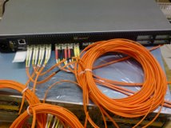
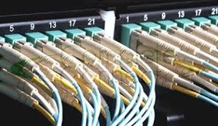
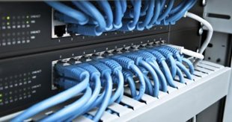
iSCSI vs. Fibre Channel Architecture
Fibre Channel does not need to pass through Ethernet, and the physical layer in the system is less than iSCSI. When expanding the block-level storage network, Fibre Channel can be used to avoid network load.
Operating System/Application
SCSI Layer
SCSI Layer
FCP
(FC fibre cable)
TCP
iSCSI needs to expand the block-level storage
network via Ethernet. (fibre or ethernet cable)
IP
Ethernet
FC
iSCSI
Fibre Channel

Slide 5
QXP-32G2FC dual-port 32Gbps fibre channel HBA
Part number:
QXP-32G2FC
Includes the necessary brackets for all NAS models.
2 x 32Gbps FC ports
Gen 6 fibre channel HBA, supporting 32Gbps/16Gbps/8Gbps speed.
Low profile 10.68 x 6.89 cm (4.20 x 2.71 inches) .
Bundled with 2 x 32Gbps SFP+ short wavelength short distance multi-mode fibre channel transceivers.
Not supported on non-QNAP NAS QTS and QuTS hero operating systems such as Windows and Linux.
FC LC cables are not included.

Slide 6
QXP-16G2FC dual-port 16Gbps fibre channel HBA
Part number:
QXP-16G2FC
Includes the necessary brackets for all NAS models.
2 x 16Gbps FC ports
Enhanced Gen 5 fibre channel HBA, supporting 16Gbps/8Gbps/4Gbps speed.
Low profile 10.68 x 6.89 cm (4.20 x 2.71 inches).
Bundled with 2 x 16Gbps SFP+ short wavelength short distance multi-mode fibre channel transceivers.
Not supported on non-QNAP NAS QTS and QuTS hero operating systems such as Windows and Linux.
FC LC cables are not included.

Slide 7
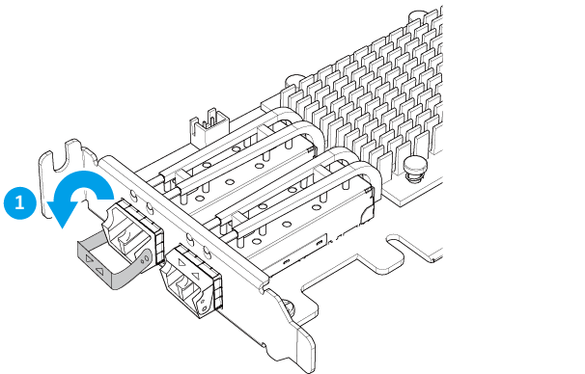
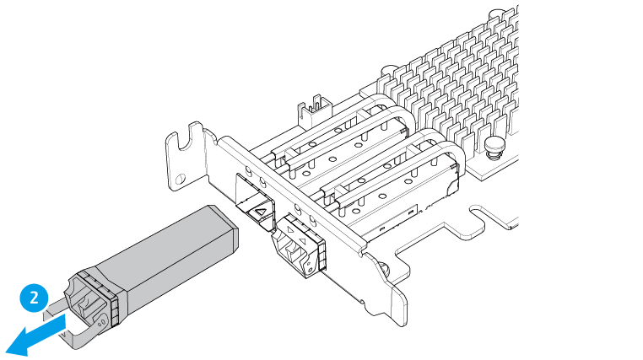
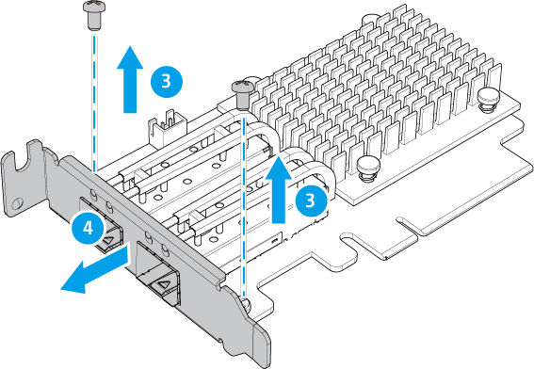
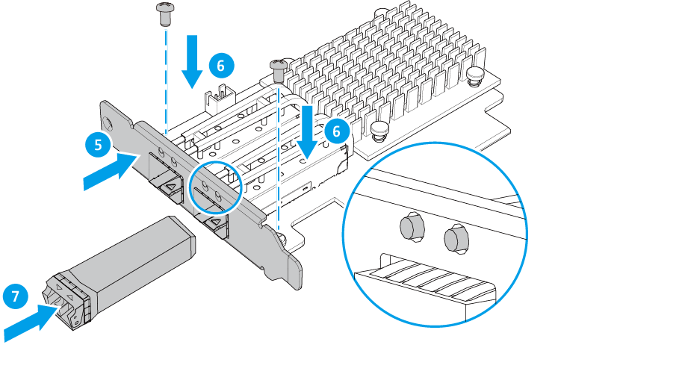
Replace the bracket for a different NAS Model

Slide 8
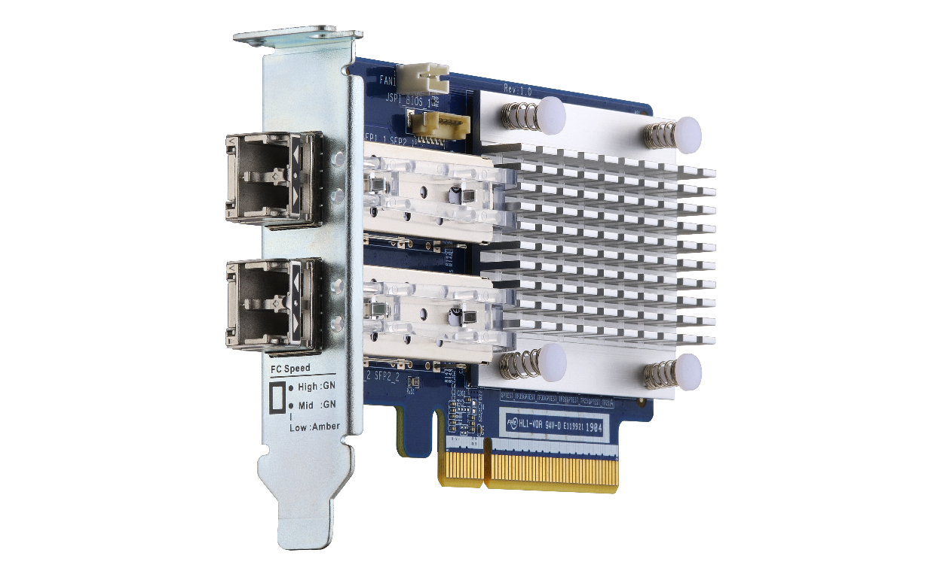
LED indicators for various status display
 | LED 1 (Green) | LED 2 (Green / Amber)
Speed: High | On/Flashing* | Off
Speed: Mid | Off | Green /Flashing*
Speed: Low | Off | Amber/Flashing*
FW not initialized | On | On (Both)
FW initialized | Flashing | Flashing (Both)
*Note: LED flashing occurs during I/O activity.
LED 1
LED 2
LED 1
LED 2

Slide 9
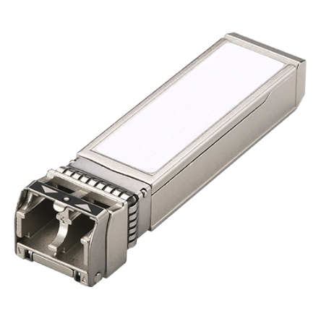
32Gbps and 16Gbps FC transceiver accessories
You can buy additional FC transceivers if the included ones are broken or missing.
32Gb fibre channel SFP+ transceiver
16Gb fibre channel SFP+ transceiver
Part number:
TRX-32GFCSFP-SR
Part number
TRX-16GFCSFP-SR
Tri-speed: 28.05Gbps/14.025Gpbs/8.5Gbps
Support multimode LC FC cables with 32Gbps up to 100 meters (328.08 ft.)
Tri-speed: 14.025Gbps/8.5Gpbs/4.25Gbps
Support multimode LC FC cables with 16Gbps up to 125 meters (410.10 ft.)

Slide 10
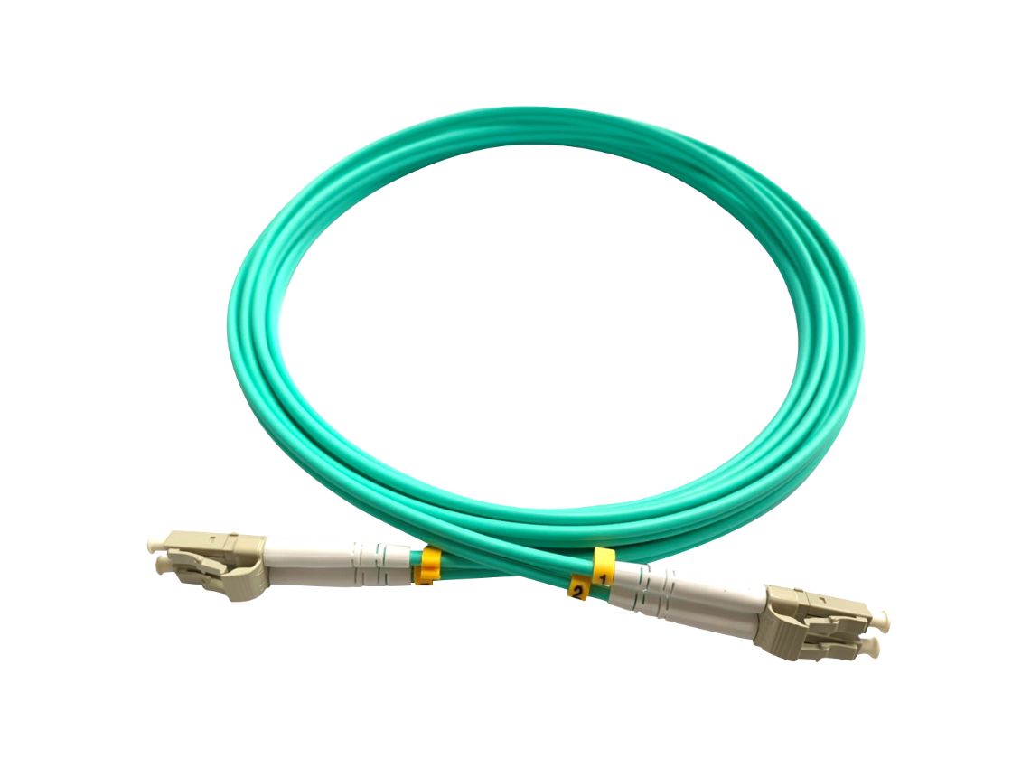
How to choose the right FC cable
Speed | Multimode optic cable and distance (m)
 | OM1 | OM2 | OM3 | OM4
4GFC | 70 | 150 | 380 | 400
8GFC | 21 | 50 | 150 | 190
16GFC | --- | 35 | 100 | 125
32GFC | --- | 20 | 70 | 100
LC (Little Connector)

Slide 11
QuTS hero for the optimal FC SAN performance
QuTS hero NAS are optimized for FC operation with advanced features that ensure the best performance with exceptional user experience for enterprise requirements.
TS-h977XU-RP
TS-h1283XU-RP
TS-h1277XU-RP

Slide 12
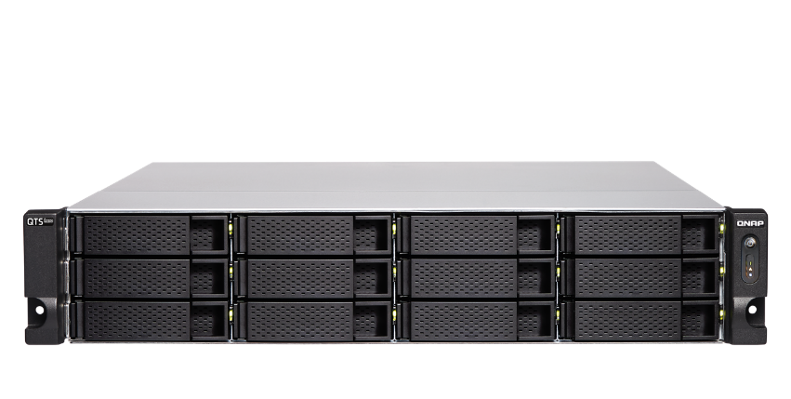
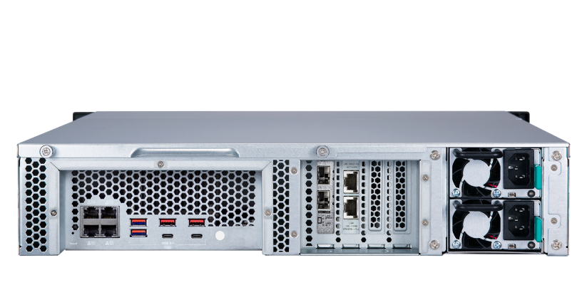
TS-h1283XU-RP with Xeon CPU and 10GbE
TS-h1283XU-RP-E2236-32G
TS-h1283XU-RP-E2236-128G
2U 12-bay rackmount NAS
Intel Xeon E-2236 6 cores/12 threads 3.4GHz processor, max boost to 4.8GHz
32GB DDR4 ECC RAM (16GB x2)，expand up to 128GB
2 x 10GbE SFP+, 2 x 10GBASE-T,
4 x 1GbE ports
2U 12-bay rackmount NAS
Intel Xeon E-2236 6 cores/12 threads 3.4GHz processor, max boost to 4.8GHz
128GB DDR4 ECC RAM (32GB x4)
2 x 10GbE SFP+, 2 x 10GBASE-T,
4 x 1GbE ports

Slide 13
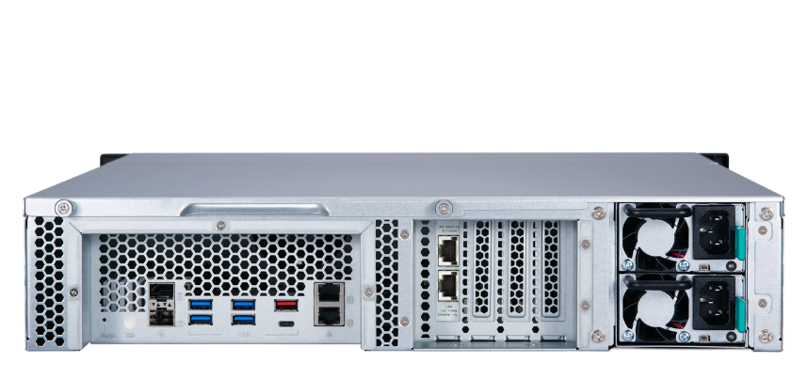
TS-h1277XU-RP with Ryzen CPU and 10GbE
TS-h1277XU-RP-3700X-32G
TS-h1277XU-RP-3700X-128G
2U 12-bay rackmount NAS
AMD Ryzen 7 3700X 8 cores/16 threads 3.6GHz processor, boost to 4.4GHz
32GB DDR4 RAM (16GB x2)
2 x 10GbE SFP+, 2 x 10GBASE-T, 2 x 1GbE ports
2U 12-bay rackmount NAS
AMD Ryzen 7 3700X 8 cores/16 threads 3.6GHz processor, boost to 4.4GHz
128GB DDR4 RAM (32GB x4)
2 x 10GbE SFP+, 2 x 10GBASE-T, 2 x 1GbE ports

Slide 14
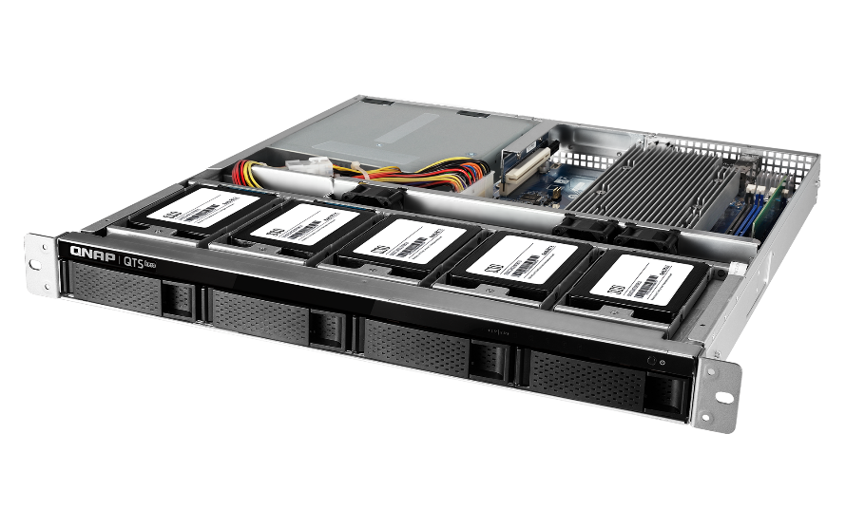
TS-h977XU-RP with Ryzen CPU and 10GbE
TS-h977XU-RP-3700X-32G
1U 9-bay rackmount NAS
5 x 2.5-inch SATA SSD ports
AMD Ryzen 7 3700X 8 cores/16 threads 3.6GHz processor, boost to 4.4GHz
32GB DDR4 RAM (16GB x2)
2 x 10GbE SFP+, 2 x 10GBASE-T,
2 x 1GbE ports

Slide 15
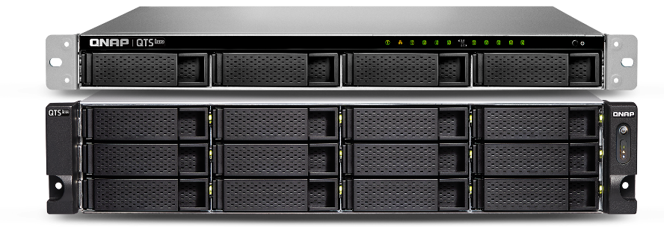
QTS hero: Unified Hybrid Storage
QTS hero: Unified Hybrid Storage
Affordable Hybrid Storage
Data self-healing
ZFS on Linux
Flash endurance
Cloud ready
Unified
Virtualization ready
65536 snapshots

Slide 16
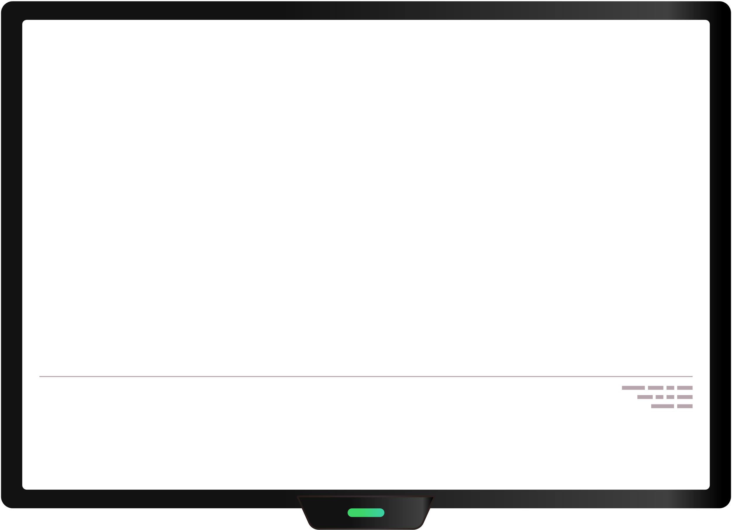
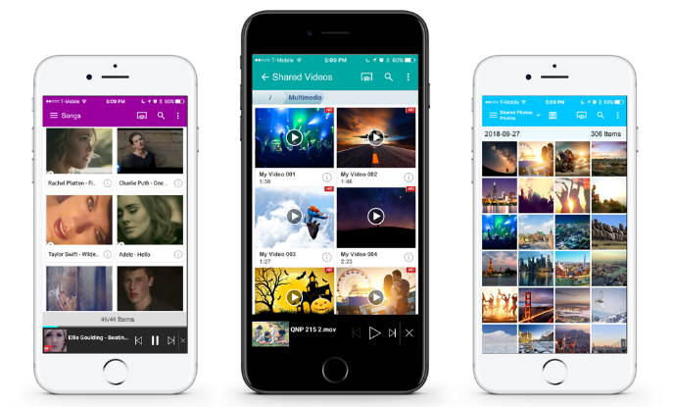
Combines applications and converged business services
BLOCK
FILE
Unified
Storage
Deduplication
Compression
Virtualization
SnapSync
Snapshot
VMware ESX
VMware ESX
Multimedia​​ App Extensibility
Enterprise​​
Business Continuity

Slide 17
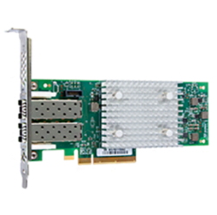
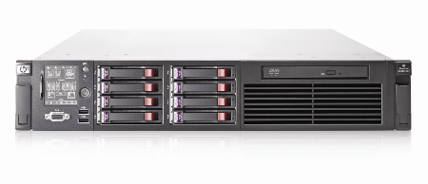
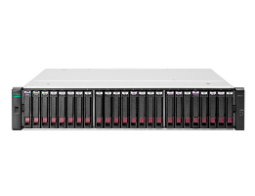
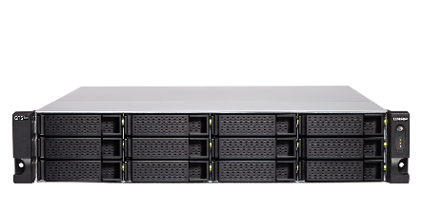
Lowering the cost to add a NAS to a FC SAN
Windows / Linux / VMware host (initiator mode) + NAS (target mode):
Marvell® QLogic® 2742
(32Gb) Fibre Channel adapter
ATTO Celerity 32Gb
Fibre Channel adapter
Windows / Linux / VMware host
FC
SAN
Fibre channel switch
Other FC SAN storage
Fibre channel
QNAP QXP-32G2FC Fibre channel adapter
TS-h1283XU-RP
TS-h1283XU-RP
QNAP QXP-32G2FC Fibre channel adapter

Slide 18
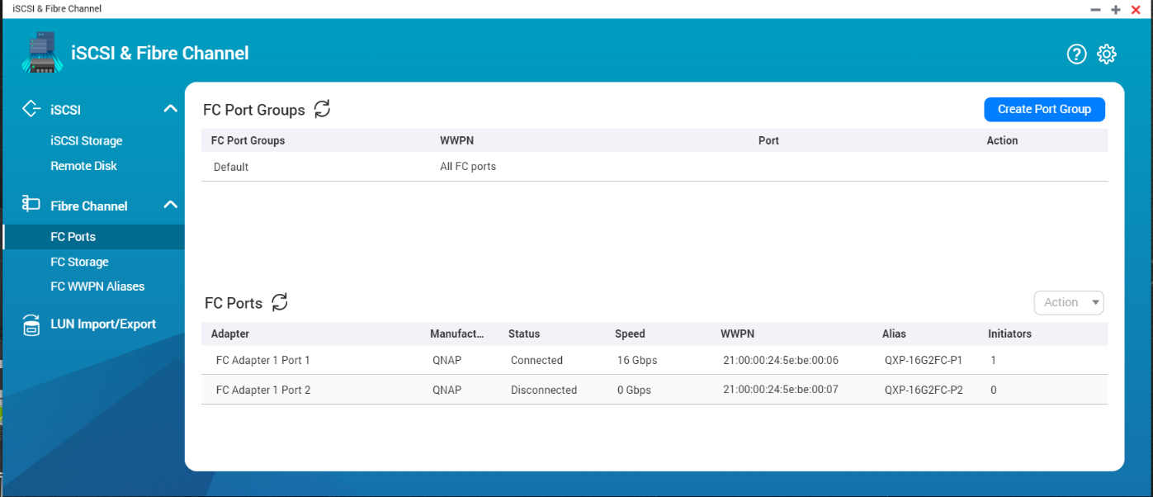
iSCSI and Fibre Channel Manager in QuTS hero
You can easily add your NAS to a SAN environment. Once a Marvell®, ATTO® or QNAP Fibre Channel card has been installed in the QNAP NAS, you can set a Fibre Channel Target using the iSCSI & Fibre Channel app. In addition, the LUN Masking and Port Binding features provide an additional layer of security for your data.

Slide 19
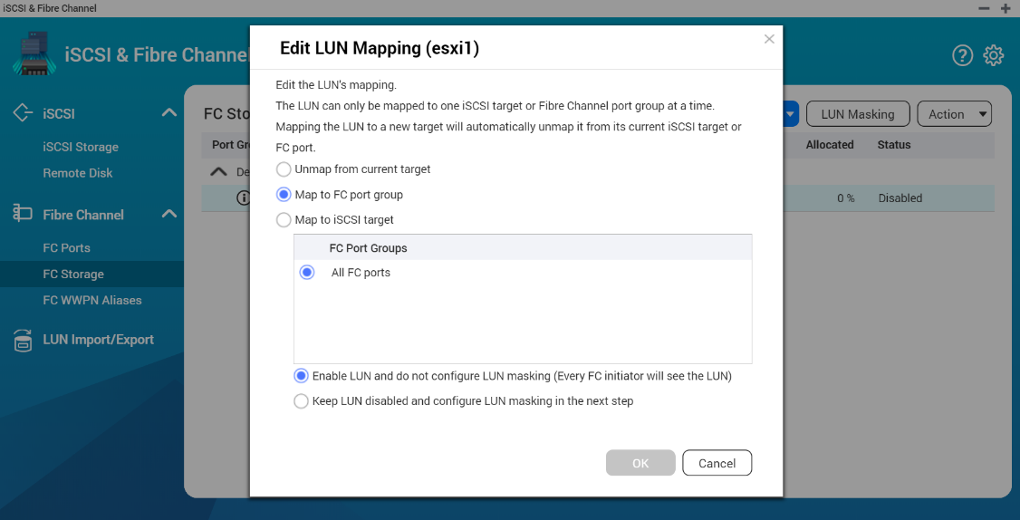
Set up the FC Connection on NAS QTS
Flexible settings
1. LUN Mapping : LUN can be mapped to iSCSI or FC.
2. LUN Masking: Set which server access LUN.
3. FC Port Binding: which server can access which ports.
Easy to identify
You can edit Fibre Channel's WWPN aliases.

Slide 20
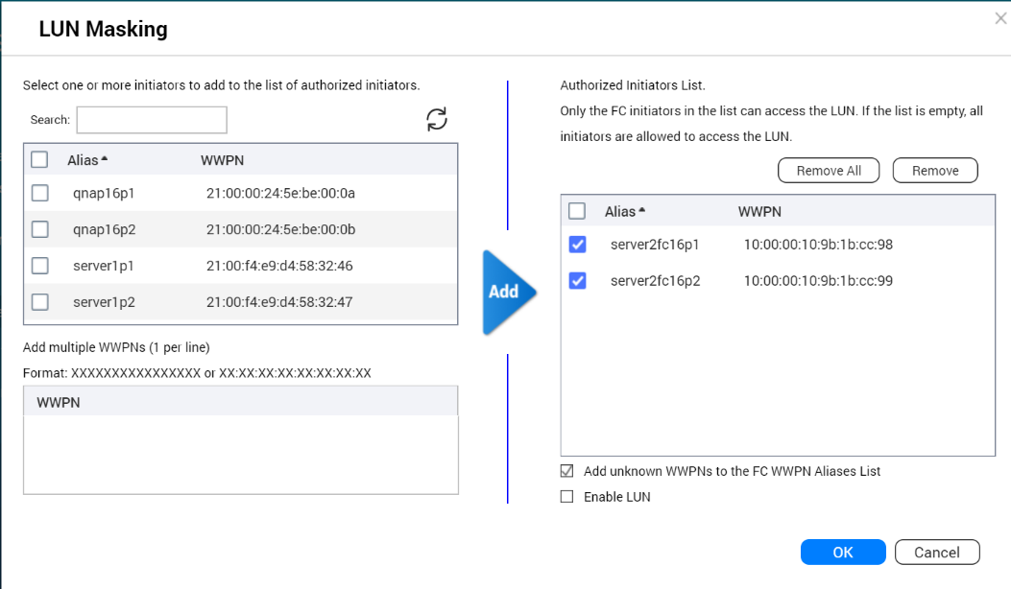
Set LUN Masking
LUN masking:
Specify which server can access which LUN.

Slide 21
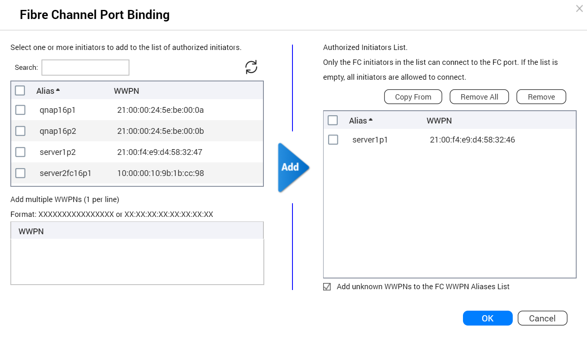
Set up FC port binding for better security
FC port binding:
Set which server can bind which ports.

Slide 22
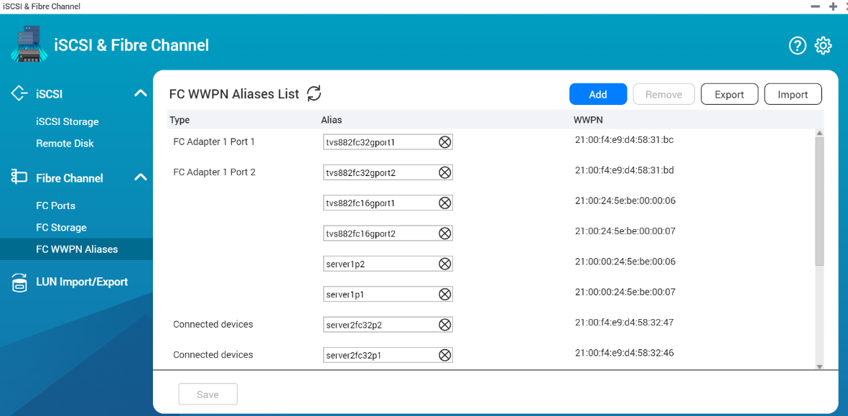
Identify the server and fibre channel connections through the alias list
Edit alias:
Specifies a list of WWPN aliases for Fibre Channel. The user can easily identify the server and Fibre Channel ports in the storage area network.

Slide 23
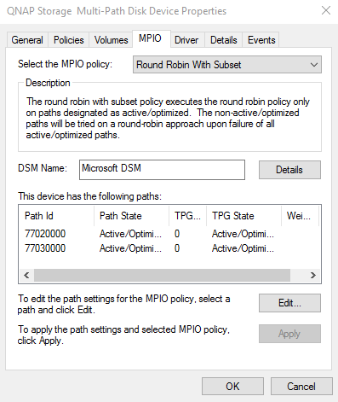
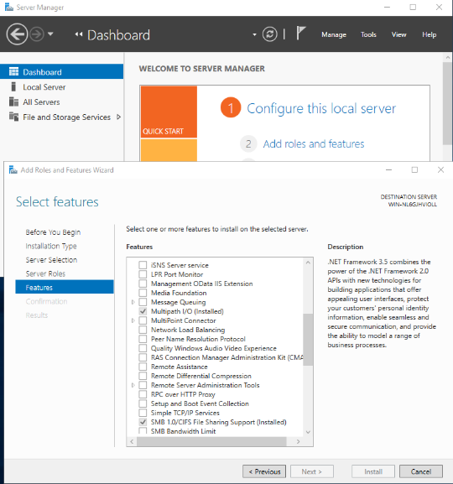
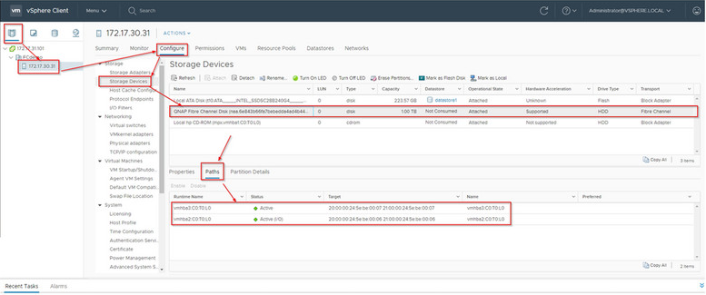
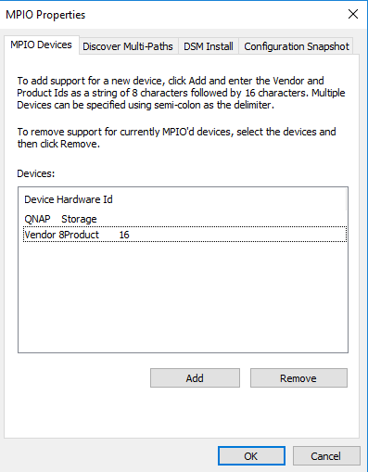
Support server FC multi-path I/O
Windows Server
VMware vSphere

Slide 24
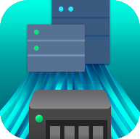
FC & QuTS hero ZFS, Perfect Match for the Professional Applications
iSCSI & Fibre Channel
management
Simple and fast creation
of a Fibre SAN environment
ZFS high performance
high reliability
Inline data deduplication,
compression, compaction
Data integrity and reliability
Efficent Snapshot
Snapshot manegemnet
Near-limitless,
instant snapshots

Slide 25
Enterprise Fibre Channel SAN for CDM Application
VMware
VMware
Developer Workstation
access data via iSCSI
FC
Production Server
Backup Server
LAN
Data
QNAP NAS
QNAP NAS
SAN Fabric
DB
LUN
LUN
Snapshot Replica for offsite backup
SAN Storage
Instant Snapshot
Efficient Replication
DB
LUN
LUN
LUN

Slide 26
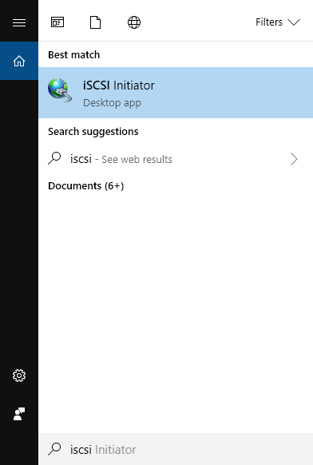
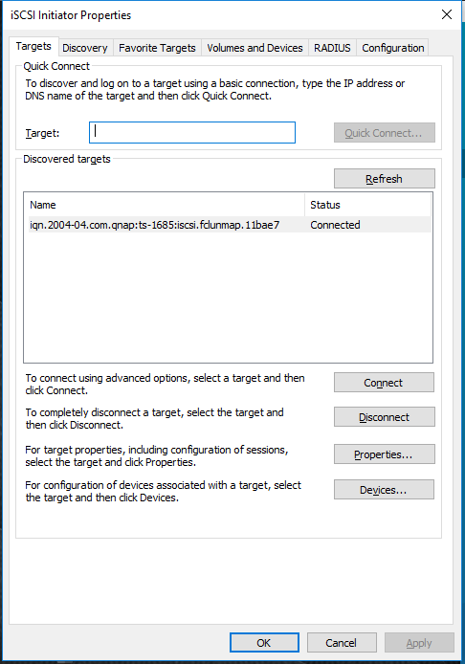
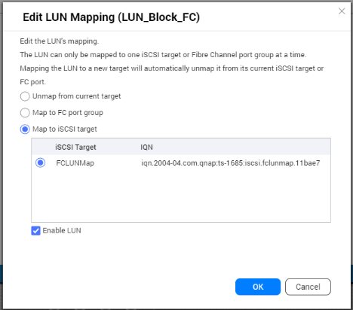
[CDM] Easily analyze LUN data risk-free
QNAP FC NAS
Open iSCSI Initiator on Windows
Connect to the
iSCSI LUN
(1) Create a snapshot of an FC LUN on the QNAP NAS (e.g. a database)
(2) Clone the snapshot
(3) Create the LUN copy and map this copy to iSCSI or FC while the original LUN remains online!
(4) Perform the necessary operations on this new LUN with no consequences on the original LUN

Slide 27
32G FC Realizes High Speed Ingest and Achieves Highly Efficient Video Editing Workflow
Video Sources
8-hour 8k video ~ 4400 GB for Seq. write
32G FC: 3500MB/s => 24 min
10G Ethernet: 1200MB/s => 60 min
NLE Station
e.g. Final Cut Pro
32G FC
INGEST Work-Station
NLE Station
LUN
QNAP NAS
NLE Station
Transcode System
NLE Station

Slide 28
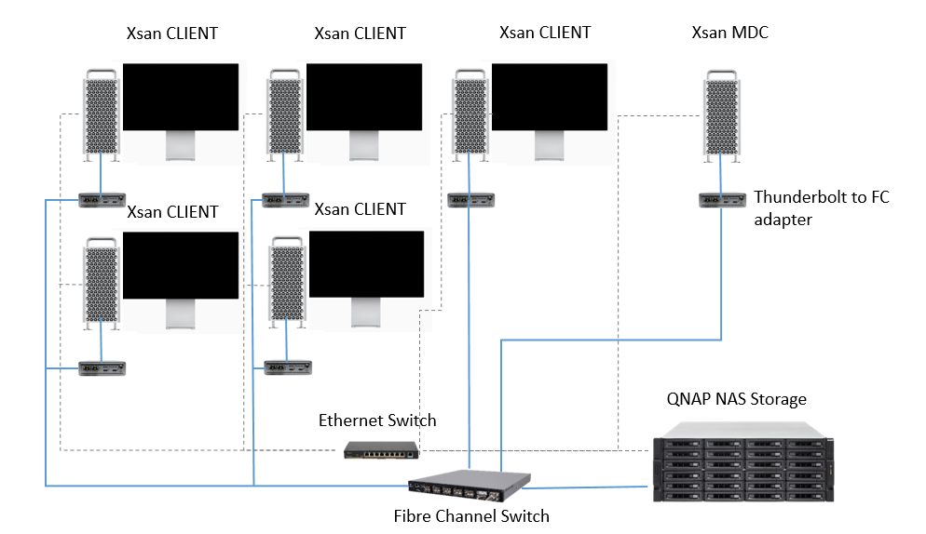
FC and QNAP NAS Enable the Same LUN Collaboration with XSAN
Search key words: “QNAP” “XSAN”
Setting up a Basic Xsan Environment with QNAP NAS Storage and Fibre Channel
XSAN LUN
CLIENT 1
CLIENT 2

Slide 29
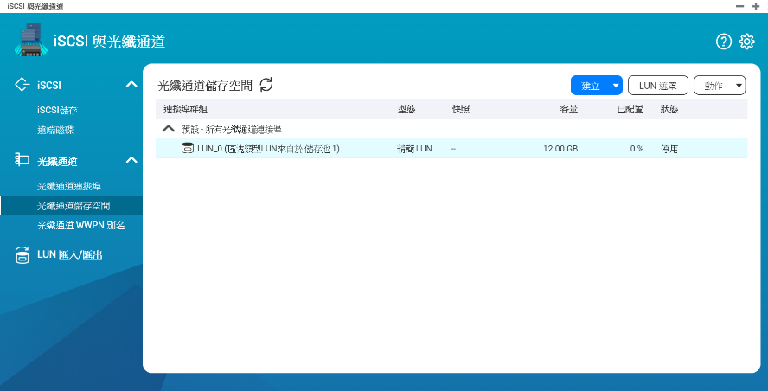
Demo

Slide 30
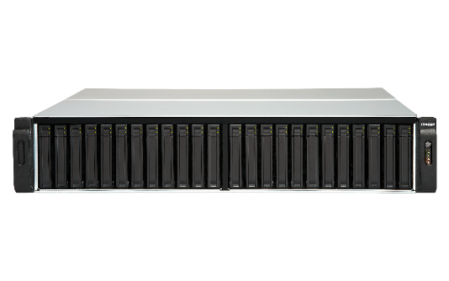
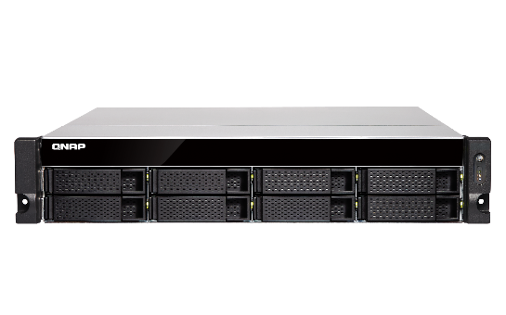
QNAP Rackmount NAS with QTS can also support QXP fibre channel adapters
NAS Models with Intel processors
TES-3085U (QTS), TES-1885U (QTS), TDS-16489U
TS-2483XU, TS-1683XU-RP, TS-1283XU-RP, TS-983XU-RP, TS-983XU, TS-883XU-RP, TS-883XU
TVS-EC2480U/1680U/1580MU/1280U, TS-EC880U
TVS-2472XU-RP, TVS-1672XU-RP, TVS-1272XU-RP, TVS-972XU-RP, TVS-972XU, TVS-872XU-RP, TVS-872XU
NAS Models with AMD processors
TS-2477XU-RP, TS-1677XU-RP, TS-1277XU-RP, TS-977XU-RP, TS-977XU, TS-877XU-RP, TS-877XU

Slide 31
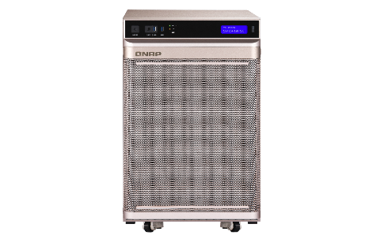
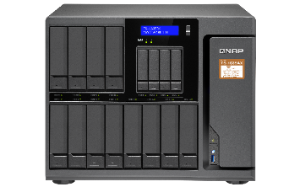
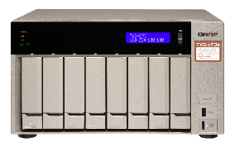
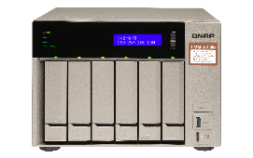
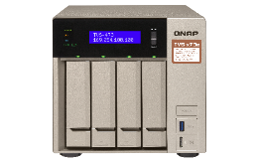
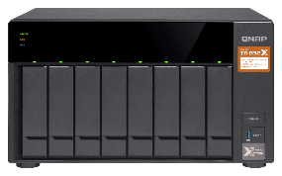
QNAP desktop NAS with QTS can also support QXP fibre channel adapters
NAS Models with Intel processors
TS-2888X
TS-1685
TVS-1282, TVS-882, TVS-682
TVS-872XT, TVS-672XT, TVS-472XT
TVS-872N, TVS-672N
NAS Models with AMD processors
TS-1677X, TS-1277, TS-877, TS-677

Slide 32
Fibre channel for higher performance and lower CPU utilization
TS-2483XU-RP speed / CPU usage |  | Fibre channel RAID 0 performance
 |  | 1 x 32GFC | NAS CPU | 2 x 32GFC | NAS CPU
Throughput (MB/s) | SW-1M | 3082 | 13% | 3559 | 20%
 | SR-1M | 3125 | 9% | 5253 | 18%
 | SW-512K | 3101 | 12% | 4065 | 18%
 | SR-512K | 3130 | 13% | 5233 | 21%
IOPS | RW-4K | 129528 | 19% | 165295 | 27%
 | RR-4K | 51590 | 10% | 98389 | 20%
Test environment：TS-2483XU-RP
F/W: QTS 4.4.1
CPU: Intel(R) Xeon(R) E-2136 CPU @ 3.30GHz
SSD: 16 x ADATA SU900 + 8 x Intel SSDSC2BB240G4,RAID 0
RAM: 16GB
Thick volume; Block-based LUN; AIO enable; MPIO
FC32G: QNAP QXP-32G2FC
PC Environment
CPU: Intel(R) Xeon(R) CPU E5-2630 v3 @ 2.40GHz, 2401 Mhz, 8 Core(s), 16 Logical Processor(s)
OS: Windows Server 2016 Datacenter Build 14393
Memory: 128 GB.
FC32G: Marvell QLogic QLE2742-SR-CKFibre Channel Adapter
IOmeter Global Configuration: Maximum Disk Size: RAM*4/ Ramp Up Time: 30 seconds Seq / Run Time: 3 Minutes / 2-workers/ 64-outstanding Random / Run Time: 3 Minutes / 4-workers/ 32-outstanding

Slide 33
FC reduces CPU loading compared to iSCSI
Test environment: TS-1283XU-RP
Speed/CPU |  | iSCSI |  | FC
 |  | 25GbEx1 | CPU% | 32G | CPU%
Throughput (MB/s) | SW-1M | 2709 | 56% | 2944 | 39%
 | SR-1M | 2755 | 32% | 2772 | 30%
 | SW-512K | 2707 | 61% | 2951 | 37%
 | SR-512K | 2825 | 43% | 2872 | 35%
IOPS | RW-4K | 154793 | 81% | 155197 | 77%
 | RR-4K | 108263 | 69% | 113162 | 67%
F/W: 4.4.1
CPU: Intel(R) Xeon(R) E-2124 CPU @ 3.30GHz
Tested SSD: Samsung SSD 850 PRO 512GB SATA*12, RAID 0
RAM: 8 GB (4GB x 2)
Block-based LUN; AIO enable
FC 32G: QLogic Fibre Channel Adapter-QLE2742-SR-CK
25GbE: QXG-25G2SF-CX4, MTU 9000
IOmeter Global Configuration: Maximum Disk Size: RAM*4/ Ramp Up Time: 30 seconds Seq / Run Time: 3 Minutes / 2-workers/ 64-outstanding Random / Run Time: 3 Minutes / 4-workers/ 32-outstanding
PC Environment
CPU: Intel(R) Xeon(R) CPU E5-2630 v3 @ 2.40GHz
OS: Windows Server 2016 Database Evaluation.
Version: 10.0.14393 Build 14393
Memory: 128 GB.
FC 32G: QLogic Fibre Channel Adapter-QLE2742-SR-CK
25GbE: QXG-25G2SF-CX4, MTU 9000

Slide 34
Fibre channel performance is good
Speed/CPU |  | FC
 |  | 2 x 32GFC | CPU%
Throughput (MB/s) | SW-1M | 3133 | 30%
 | SR-1M | 4797 | 25%
 | SW-512K | 3154 | 29%
 | SR-512K | 2772 | 28%
IOPS | RW-4K | 92632 | 40%
 | RR-4K | 195360 | 36%
Test environment: TS-2483XU-RP
F/W: 4.4.1.0955 build 20190603
CPU: Intel(R) Xeon(R) E-2136 CPU @ 3.30GHz
SSD: Samsung SSD 850 PRO 512GB SATA*24,RAID 5
RAM: 16GB, 8GB*2
Thick volume; Block-based LUN; AIO enable; MPIO
FC32G: QLogic Fibre Channel Adapter
PC Environment
CPU1: Intel(R) Xeon(R) CPU E5-2630 v3 @ 2.40GHz, 2401 Mhz, 8 Core(s), 16 Logical Processor(s)
OS: Windows Server 2016 Datacenter Evaluation Build 14393
Memory: 128 GB.
FC32G: QLogic Fibre Channel Adapter
Note: the test environment is RAID 5.
IOmeter Global Configuration: Maximum Disk Size: RAM*4/ Ramp Up Time: 30 seconds Seq / Run Time: 3 Minutes / 2-workers/ 64-outstanding Random / Run Time: 3 Minutes / 4-workers/ 32-outstanding

Slide 35
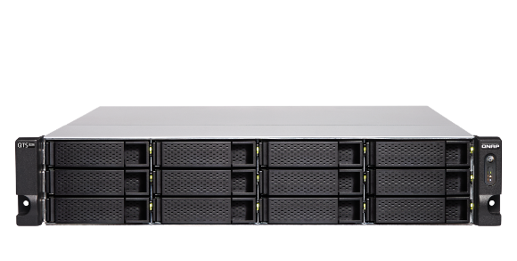
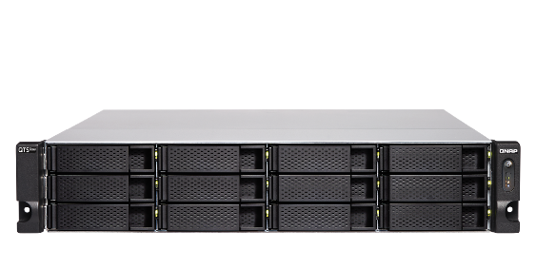
Choose the right QuTS hero models based on your fibre channel environment
TS-h977XU-RP
16GFC
TS-h1277XU-RP
16GFC
TS-h1283XU-RP
32GFC
4 x 3.5” SATA + 5 x 2.5” SATA
AMD Ryzen™ 7 3700X 8C/16T 3.6 GHz (up to 4.4 GHz)
32GB DDR4 RAM, expandable to 128GB
2 x 10GbE SFP+, 2 x 10GBASE-T, 2 x 1GbE
12 x 3.5” SATA
AMD Ryzen™ 7 3700X 8C/16T 3.6 GHz (up to 4.4 GHz)
32GB & 128GB DDR4 RAM, expandable to 128GB
2 x 10GbE SFP+, 2 x 10GBASE-T, 2 x 1GbE
12 x 3.5” SATA
Intel® Xeon® E-2236 6C/8T 3.4GHz (up to 4.8 GHz)
32GB & 128GB DDR4 ECC RAM, expandable to 128GB
2 x 10GbE SFP+, 2 x 10GBASE-T, 4 x 1GbE

Slide 36
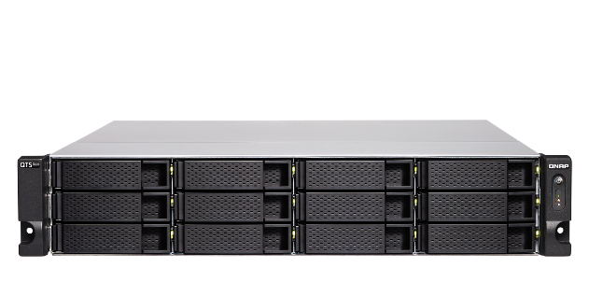
QXP-16G2FC & QXP-32G2FC FC adapters Reliable, scalable, and budget-friendly QuTS hero NAS FC SAN solution
Copyright © 2020 QNAP Systems, Inc. All rights reserved. QNAP® and other names of QNAP Products are proprietary marks or registered trademarks of QNAP Systems, Inc. Other products and company names mentioned herein are trademarks of their respective holders.

