Slide 2
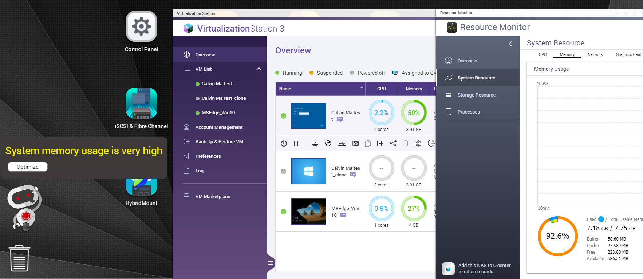
Have you ever created two VMs and the system is severely lagging?

Slide 3
Out of memory will impact system computing
Purchase memory
Out of memory
Purchase PC
Memory can't be expanded
Purchase more PC
NAS runs too slow
Temporarily need to open multiple VMs

Slide 4
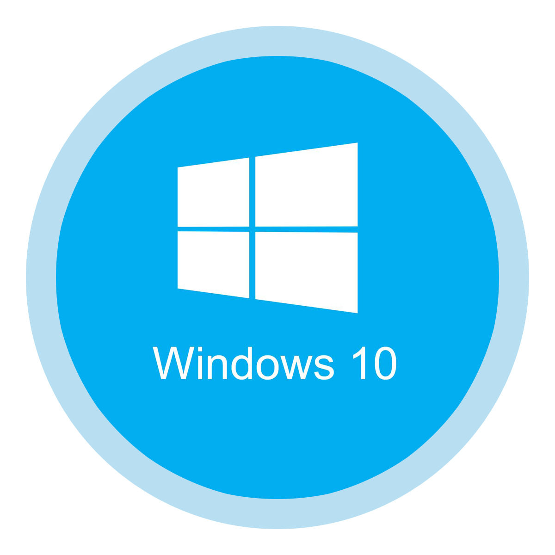
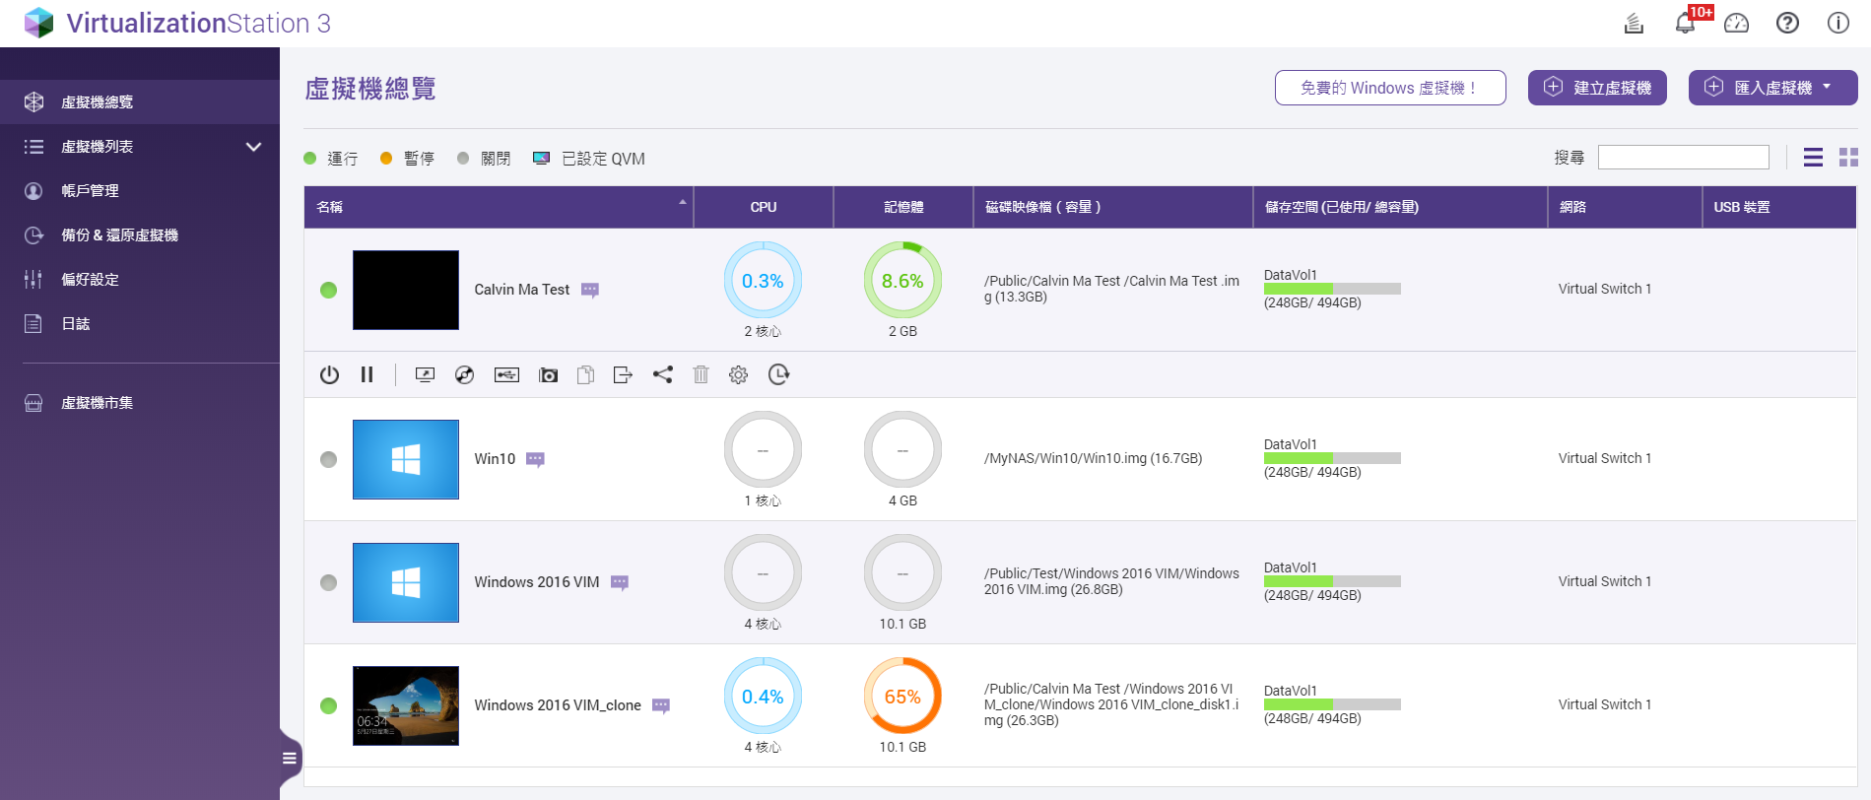
The actual status of running multiple VMs
Application
Application
!
+
File System
File System
Application
Application
Application
Guest OS
Guest OS
File System
File System
File System
Guest OS
Guest OS
Guest OS
Virtualization Station
Host OS
Hardware

Slide 5
How to fix out of memory on NAS?
Memory Share - KSM
(Kernel Samepage Merging)
Share VM memory to reduce host system usage
Memory Ballooning
Dynamic allocation of memory each VM
Install from the same ISO or via VM cloning.
When load is light: inflate
When load raises: deflate
Windows
Windows
Windows
Windows
Windows
Windows
…
Windows
RedHat
Ubuntu
Guest
Mem
Guest
Mem
Guest
Mem
W
Shared
Mem
(RO)
W
Guest
Mem
Guest
Mem
Guest
Mem
Guest
Mem
Guest
Mem
Copy-on-write
Host Memory
Host Memory
Host Memory
Host Memory
Host
Host
Host
Host

Slide 6
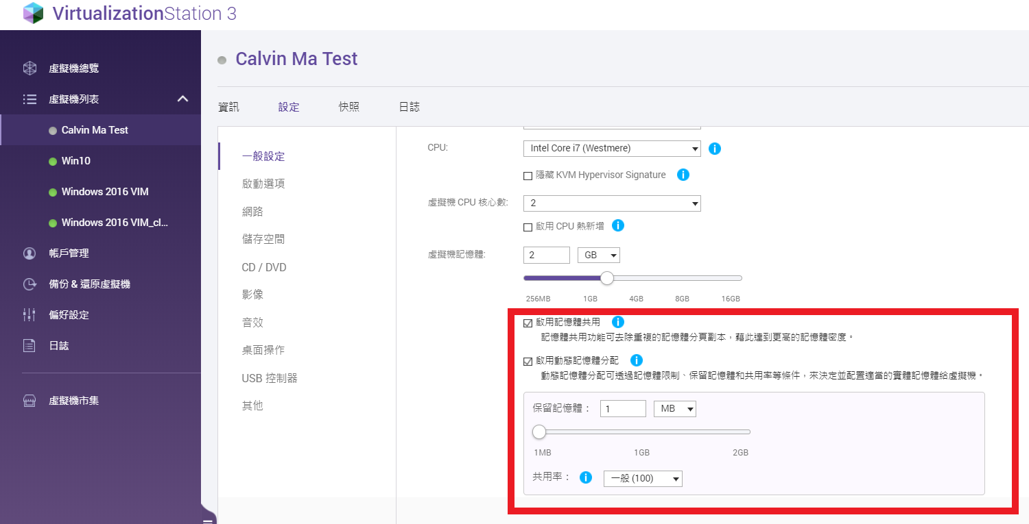
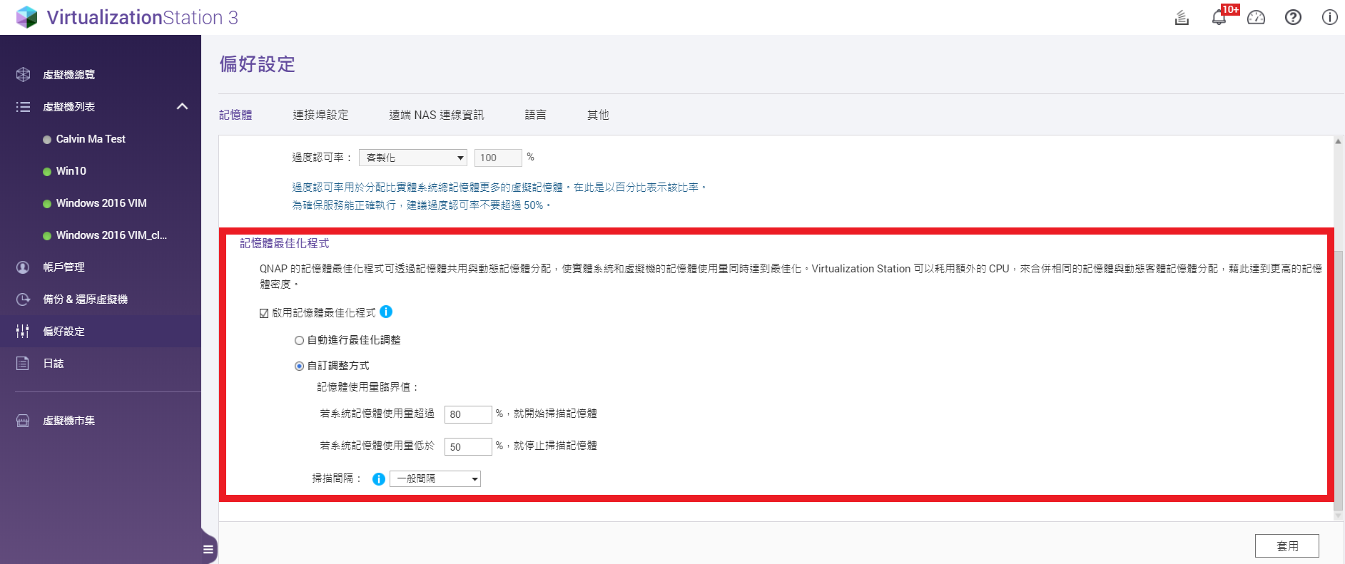
Combine KSM and Memory Ballooning. Of course! You can choose flexibly as well!
Balloon Settings / No Share
VM
(Shard)
VM
(No Share)
VM
(Balloon)
KSM Settings / Config
MOM
(Memory Overcommitment manager)

Slide 7
How to optimize the memory usage of a VM?
Monitor
Conf.
Monitor
Collect host/VM
Resource statistics
Evaluate
User-defined policy
Action!
Ex: KSM/Ballooning
MEM
MEM
MEM
Guest VM
Guest VM
Guest VM
..….
Guest VM
CPU
Memory
Network
Storage
Host

Slide 8
Virtualization Station MOM Advantages and Benefits
MOM benefits :​
Use memory flexibly and get the most value for every cost of investing in equipment.
Settings - Apply - Just One click to Finish.
Before purchasing hardware equipment, you can make an evaluation and reference.
When you need to start VM services temporarily, you can use it as a flexible memory management.
MOM use timing : ​
It is suitable for multiple VM services, and the files used by multiple services are mostly duplicates.
​
MOM advantages :​
Optimize and allocate virtual machine memory.

Slide 9
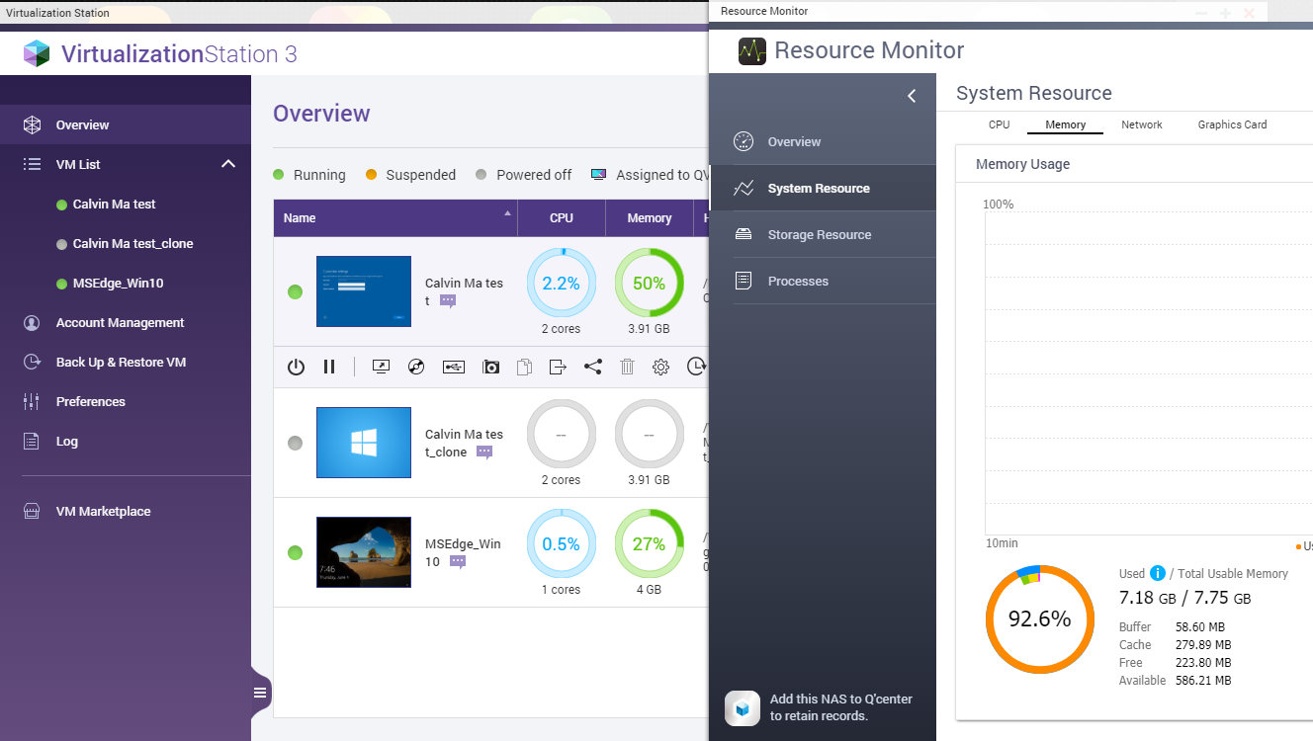
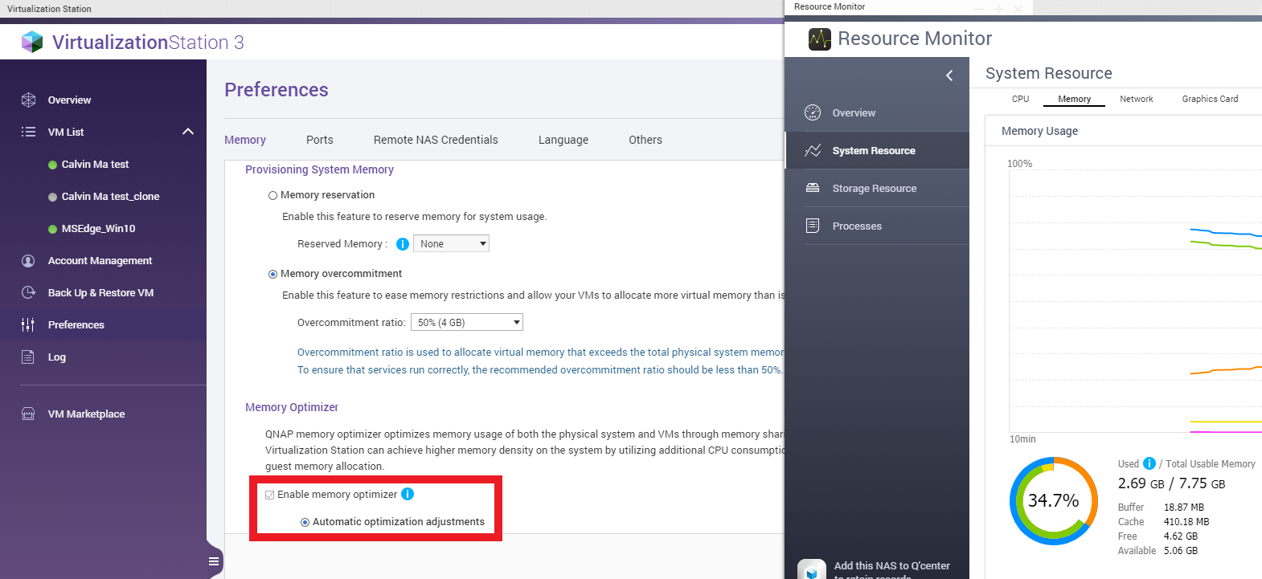
Enable it! Memory usage will gradually decrease...

Slide 10
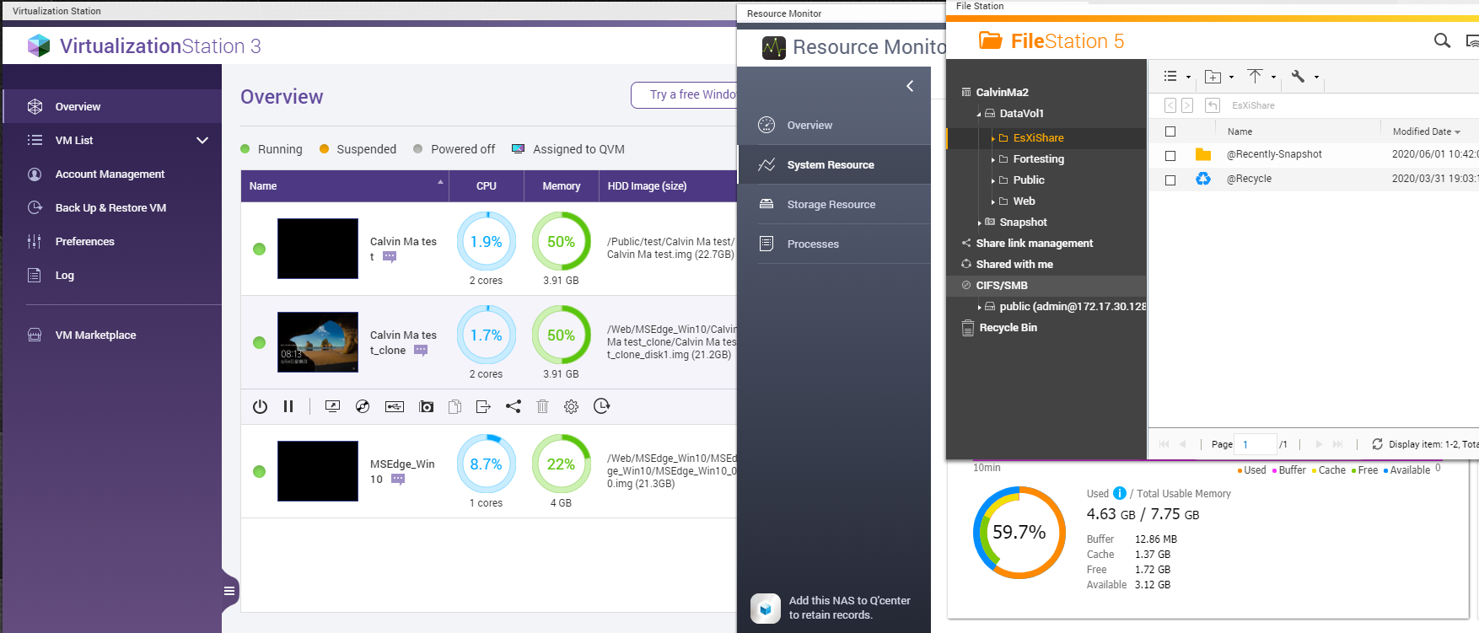
VM's memory v.s. System memory , System still stable and running apps smoothly!

Slide 11
Virtualization Station
MOM Demo

Slide 12
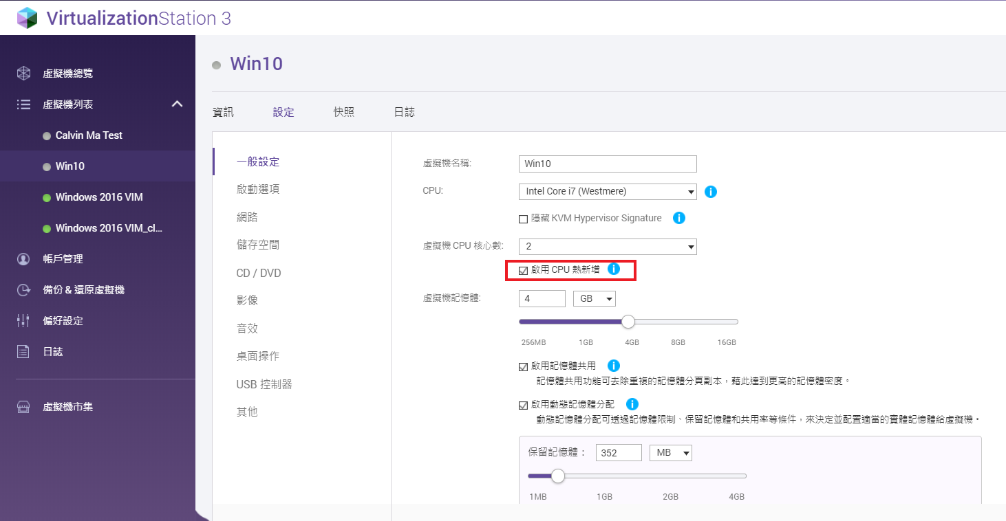
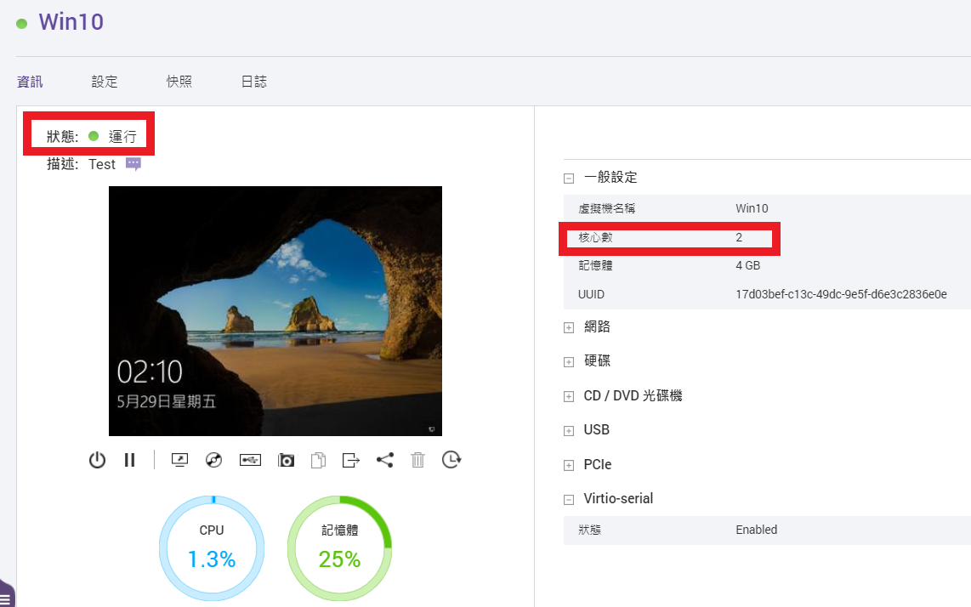
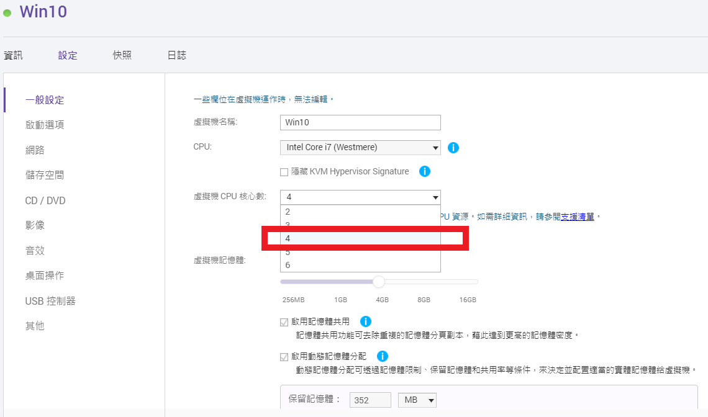
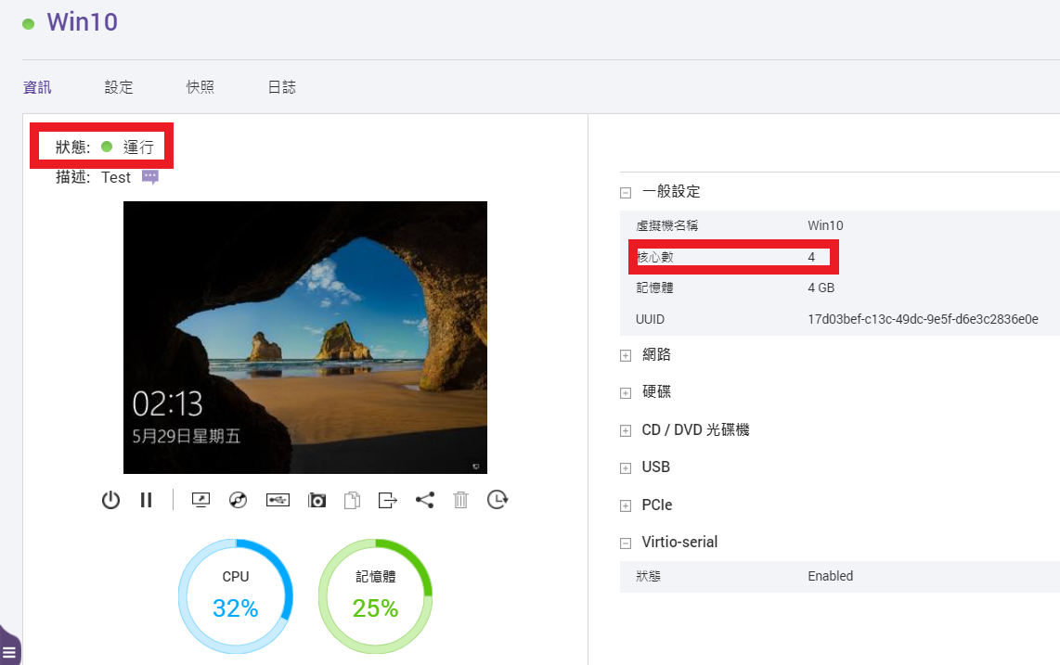
Dynamically improve VM performance with CPU Hot Add
The setting can be checked only when the VM is turned off
Benefit : Based on the current use of the VM, user can hot add the number of CPU cores immediately. If you need to reduce it, you can click the setting after the virtual machine is turned off.
Use Timing : When the virtual machine cannot run due to performance issues, the number of CPU cores can be hot add immediately.
Advantage : The number of CPU cores can be hot added dynamically while the virtual machine is running.
1
2
3
4

Slide 13
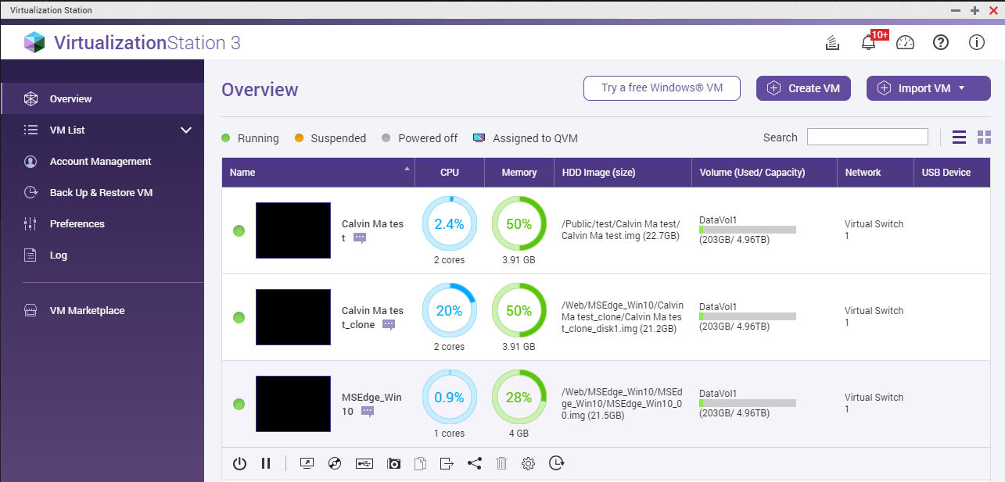
Virtualization Station Introduction of key functions

Slide 14
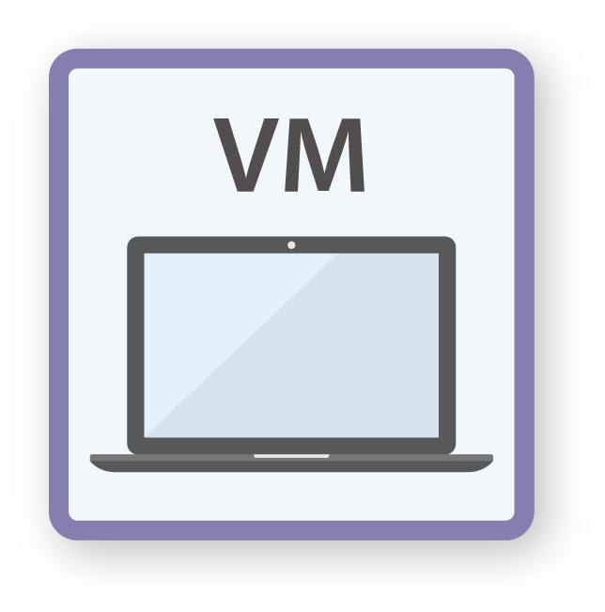
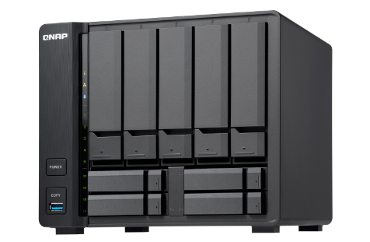
Disaster Recovery (DR): Leveraging Snapshot & Backup
Revert a snapshot to the normal status of VM
Restore a remote VM backup directly

Slide 15
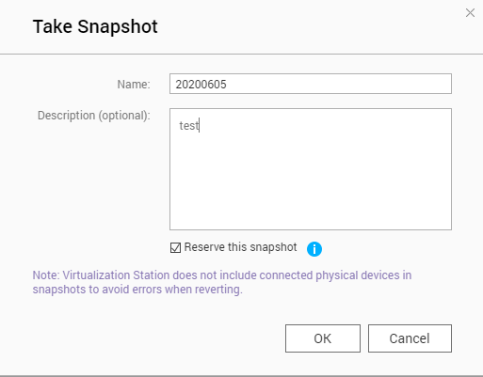
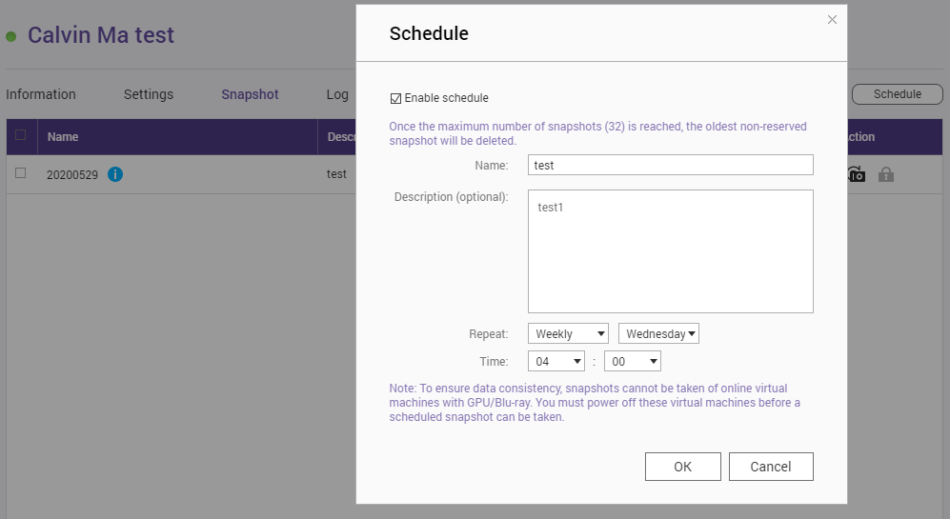
Disaster Recovery – Snapshot
Supports Copy-on-write without shutting down the VM.
Quickly revert to a known state.
Snapshot scheduling.
Snapshot reserve and retention.

Slide 16
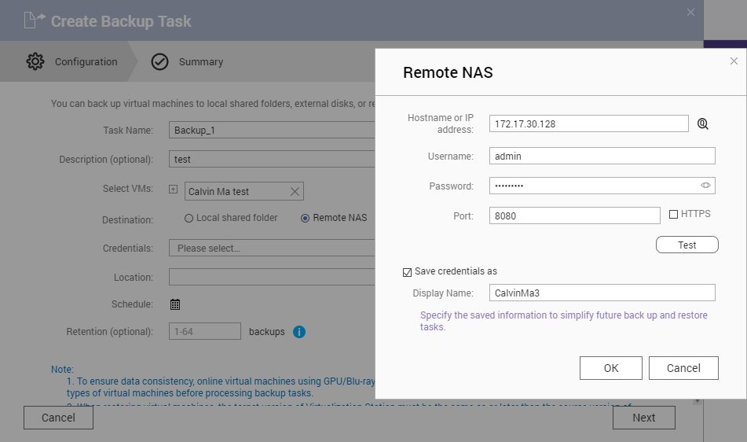
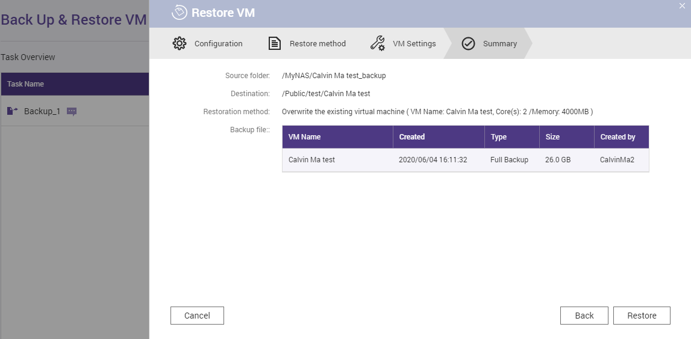
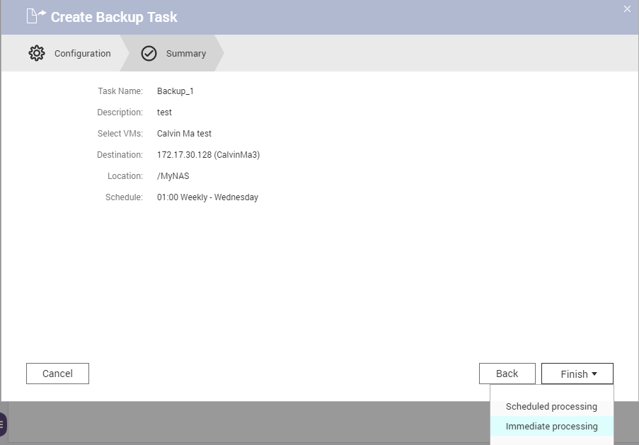
Disaster Recovery – Backup
Supports backing up VM locally/remotely.
Non-stop VM back up.
Restore VM backup remotely.
Backup scheduling.

Slide 17
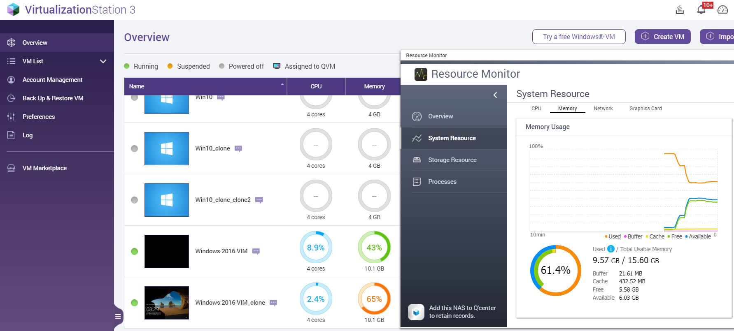
Quick Clone of Virtual Machine
No need to restart and install the virtual machine, copy directly from the local.
Clone virtual machine can be used directly, and also use with MOM to save memory usage.

Slide 18
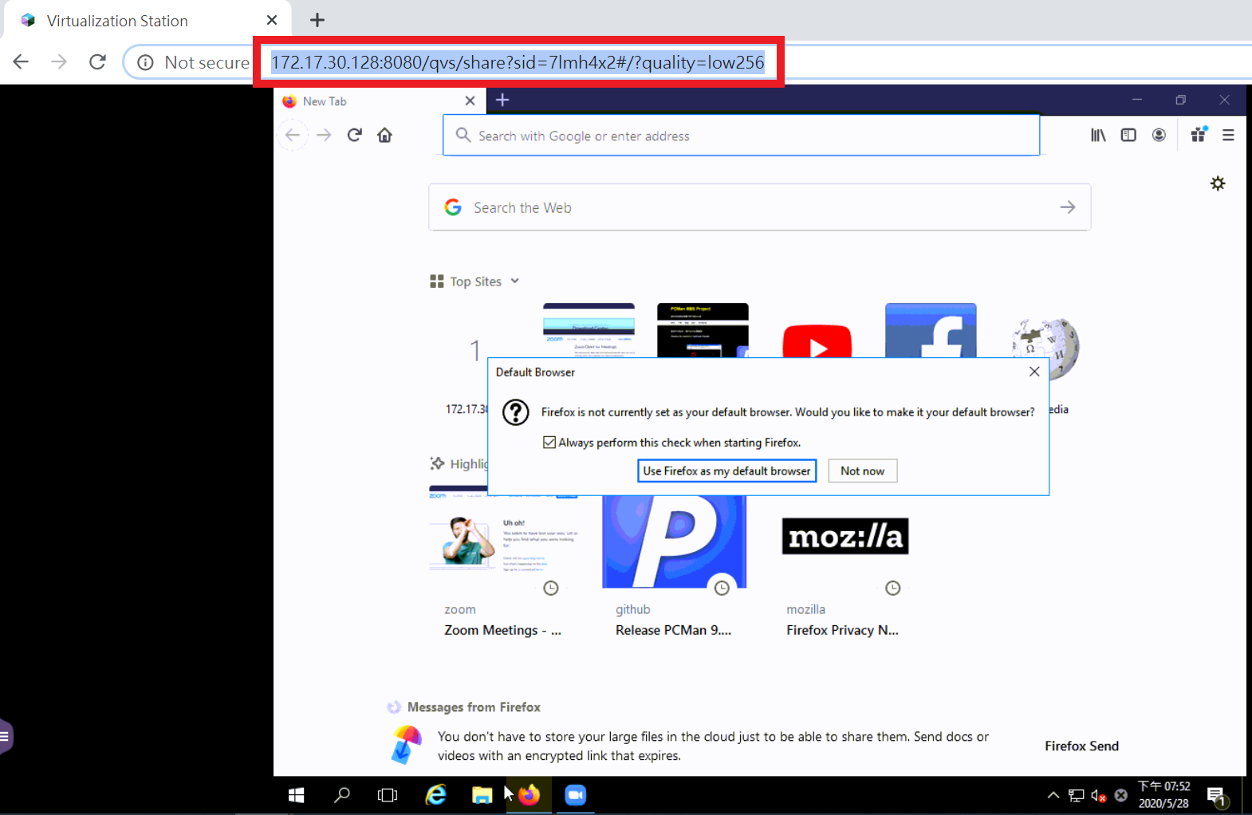
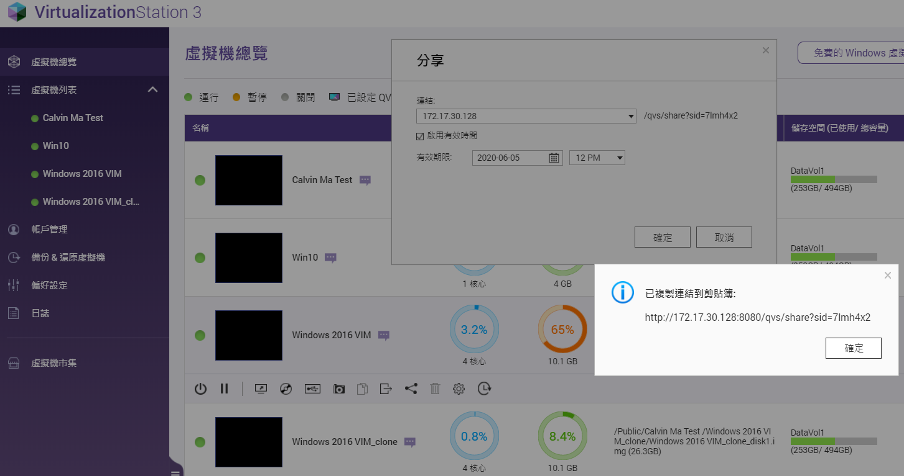
Convenient sharing of virtual machines
Generate quick links directly, click it to connect VM directly , no need to create NAS UI.
Effective period can be set to the link.

Slide 19
Virtualization Station
Clone with MOM Demo

Slide 20
© 2020 Copyright is owned by QNAP Technology Co., Ltd. QNAP Technology reserves all rights. A trademark or mark used or registered by QNAP Technology Co., Ltd. The products and company names mentioned in the file may be trademarks owned by other companies.

