Slide 1


Slide 2
Overview
New member of Guardian Smart Edge PoE Switch series
Voice from customers on the existing QNAP Guardian switch
Performance upgrade on QGD-1602P
Features & Advantages
    20GbE internal bandwidth capacity
    PoE Features
    Virtualization
    QuWAN SD-WAN solution
Flexible deployment topology
Notes:
數位轉型，帶來的是利潤而不是負擔
工具：Guardian
更少的投資，帶來更多的利益
輕鬆，過去做不到的，一台設備就能協助你完成數位轉型。

Slide 3

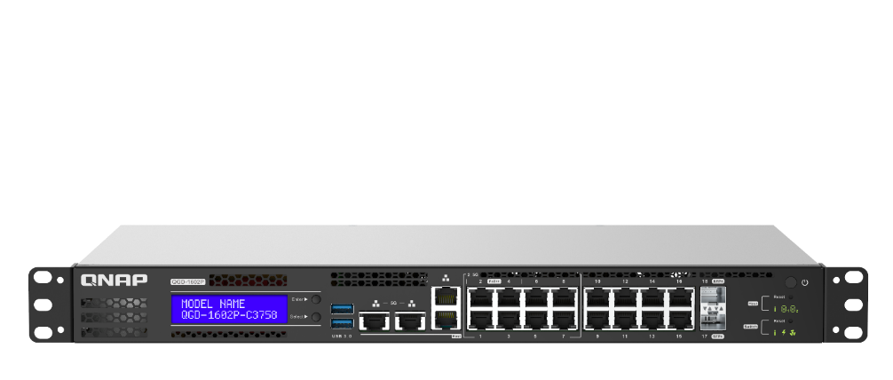


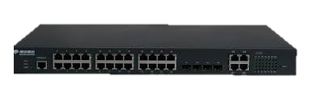

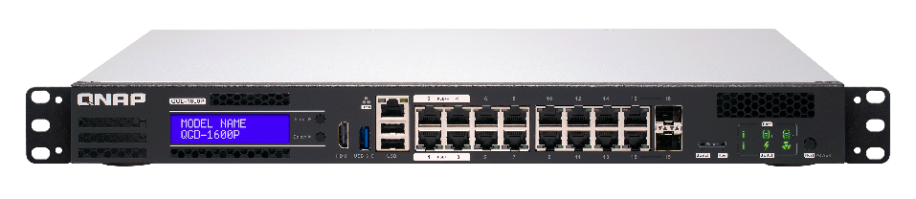
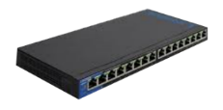
Power Sourcing Equipment (PSE) product evolution
3rd Generation
Guardian Smart Edge PoE Switch
QGD-1602P
10GbE SFP+
Intel Atom® C3558/C3758
Intel QAT
Virtual machine with QTS
Hybrid cloud storage
IEEE 802.3bt Ready
SD-WAN (QuWAN)
2ND Generation
L2/ L3 Managed PoE Switch
1ST Generation
Unmanaged PoE switch
QGD-1600P
Intel Celeron® J4125
Equipped with QTS
Virtual machine
Hybrid cloud storage
IEEE 802.3bt Ready

Slide 4




Voice from customers on the existing QNAP Guardian switch
We need more Ethernet bandwidth for my LAN applications
Is it possible to increase internal bandwidth between QTS host and switch?
Can we have more CPU speed/cores for virtualization?
Why is there only one host port?
2.5GbE NAS/Computers are now common.
Many Wi-Fi router/AP now support 2.5GbE.
Internal bandwidth capacity is 2GbE on previous model for multiple virtual machines to access the switch via internal interface.
Only one host port available for QTS on different networking topology deployment.
4-core Intel Celeron® CPU is only option on previous model.
Notes:
數位轉型，帶來的是利潤而不是負擔
工具：Guardian
更少的投資，帶來更多的利益
輕鬆，過去做不到的，一台設備就能協助你完成數位轉型。

Slide 5
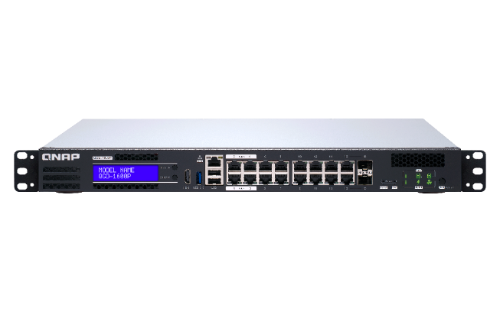
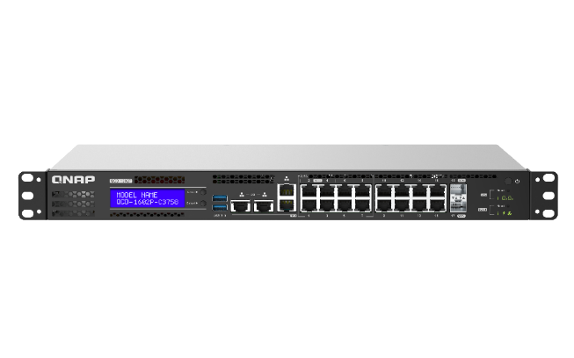


QGD-1600P vs QGD-1602P
QGD-1600P
QGD-1602P
Performance upgrade!
Intel® Celeron® J4115
4-core 1.8 GHz processor
Intel® Atom® C3558/C3758 4-core/
8-core 2.2 GHz processor
14 x 1GbE RJ45 Ethernet ports
2 x 1GbE RJ45/SFP Combo ports
8 x 1G/2.5GbE RJ45 Ethernet ports
8 x 1GbE RJ45 Ethernet ports
2 x 10GbE SFP+ ports
1 x 1GbE RJ45 host port
2 x 1G/2.5G/5GbE host ports
2 x 1GbE host ports
4 x 802.3bt PoE ports up to 60W
12 x 802.3af/at PoE ports
4 x 802.3bt PoE ports up to 90W
12 x 802.3af/at PoE ports
2GbE Internal bandwidth capacity
20GbE Internal bandwidth capacity
Improved features
Max. 8GB memory
Max. 64GB memory

Slide 6
  Guardian's hardware advantages

Slide 7

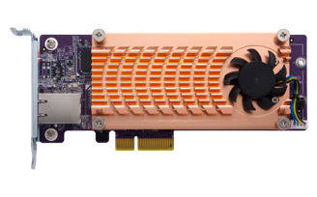



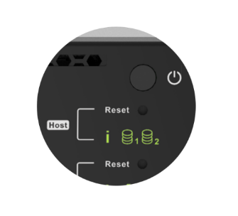
QGD-1602P hardware architecture
System power button (Rear)
Power Supply
CPU
RAM
System Power
PoE Power Max:
C3558:380W / C3758:220W
Intel Atom C3558/C3758
4/8-core
2 x 2.5" SSD/HDD
8GB RAM
(up to 64GB)
Host power controller
System power controller
2 x Internal 10GbE
Switch
2 x M.2 NVMe
2 x PCIe Gen 3
2 x 10GbE SFP+
Microchip VSC7448
PoE
Controller
USB 3.0
Host Interface
x 2
4 x RJ45
Improved features
2 x 1GbE
2 x 5GbE
16 x RJ45
8 x 1GbE
8 x 2.5GbE
Host power button

Slide 8


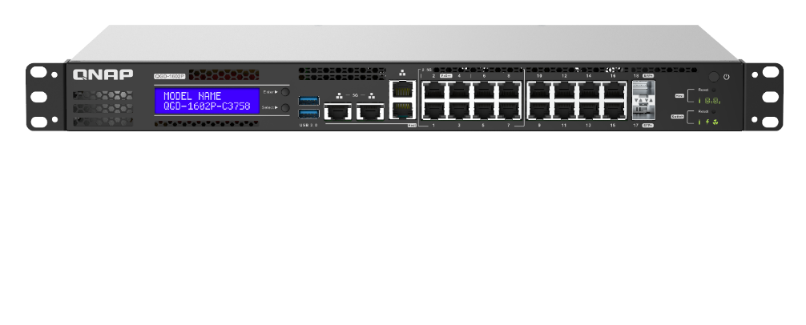
20GbE internal bandwidth capacity
Host
Switch
Internal 10GbE
Internal 10GbE
Intel® Atom® C3558/C3758
4/8-core
Microchip VSC7448
Internal 10GbE
Internal 10GbE
Virtual machine

Slide 9







Intel® QAT on QGD-1602P
The QGD-1602P supports Intel® QuickAssist Technology (Intel® QAT). It offer up to 20 Gbps cryptography and compression, offload security and compression algorithms for better performance on VPN traffic via IPsec.
IPsec
Intel® QAT

Slide 10

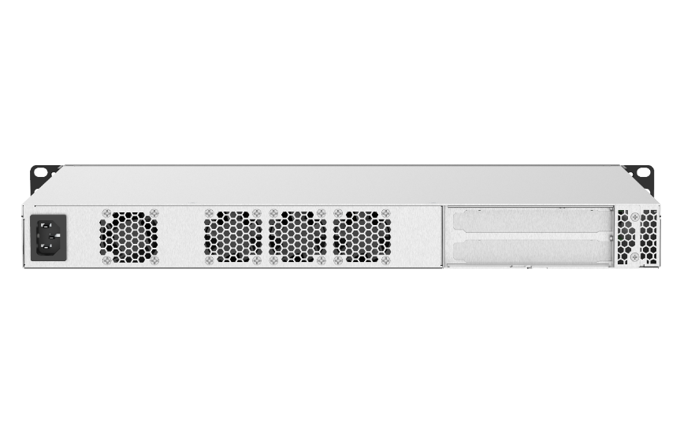
QGD-1602P hardware features
Front
LCM
2 x 1G/2.5G/5GbE
Multi-Gigabit host ports
8 x 2.5GbE
Multi-Gigabit switch ports
Host Power button
2 x 10GbE SFP+ ports
USB 3.0
2 x 1GbE host ports
8 x 1GbE switch ports
Separated Host/Switch system indicator and reset button
Back
System power
PCIe Gen3 slot x 2

Slide 11

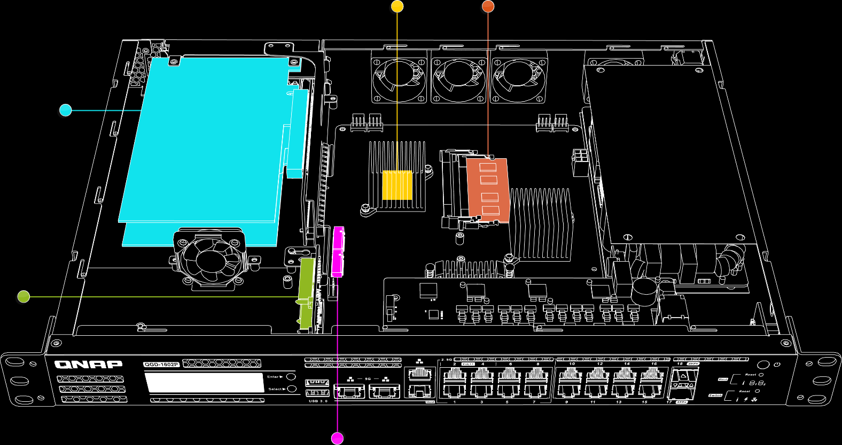
QGD-1602P Internal View
Intel® Atom ® Processor
DDR4 Memory
2 x PCIe Gen3 x2 (x4 connector) Slots
2.5-inch
HDD / SSD slots
2 x M.2 NVMe SSD slots

Slide 12
  PoE Features

Slide 13
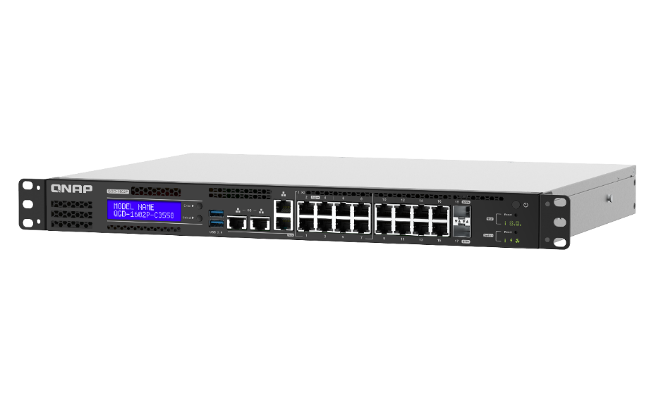
Guardian Smart Edge PoE Switch
PoE Advantages
1
Supports the new generation of IEEE 802.3bt power supply standard
5
Camera device remote restart
2
6
PoE scheduling
Power supply priority configuration
3
High total power supply rating design 380 watts PoE power supply budget at max
7
Remote intelligent monitoring and management interface
4
Support 4 Port 90 watt (PoE++)
12 Port 30 watt (PoE+)
Improved features

Slide 14
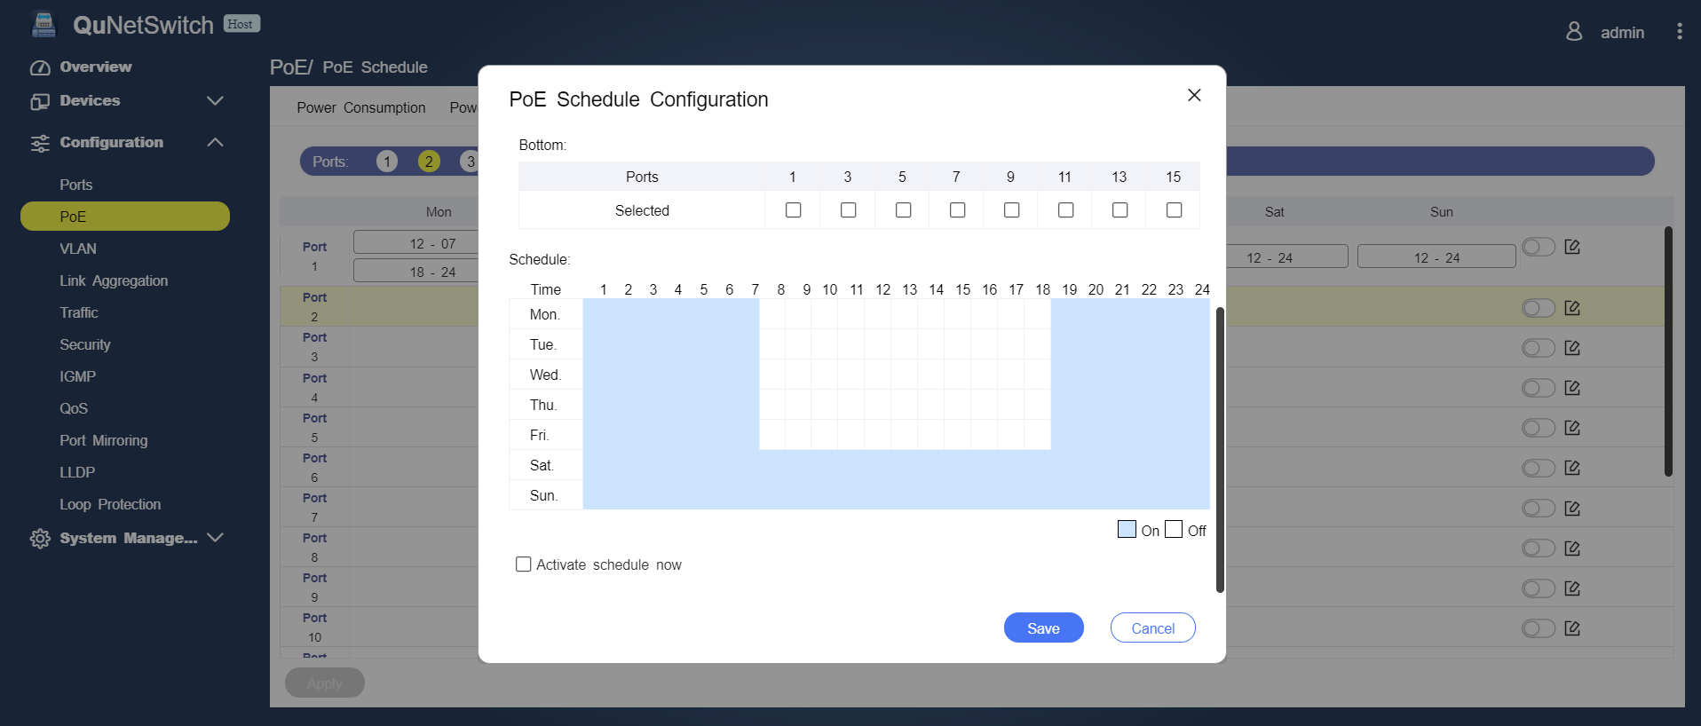
Support PoE power scheduling management
With PoE scheduling function, it can supply power only on the specified working day and time to save energy and electricity, and to save extra power cost for you!

Slide 15
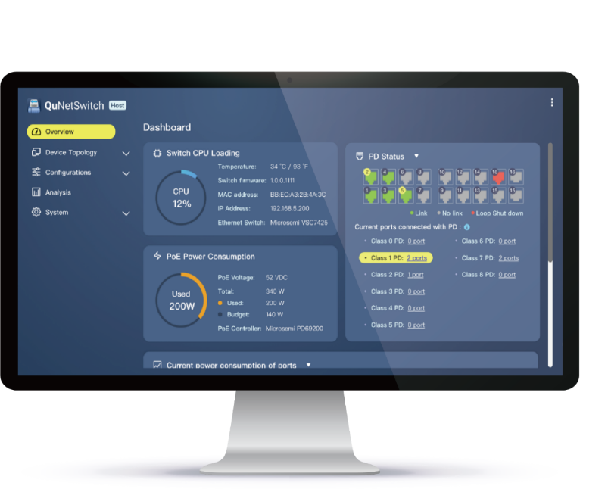


Support remote login management interface
Guardian supports the PoE remote management interface, allowing you to remotely log in and manage your PoE devices wherever you are, for real-time monitoring of your devices' power usage.

Slide 16
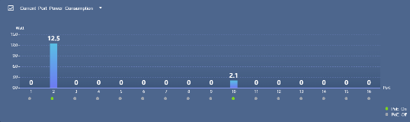
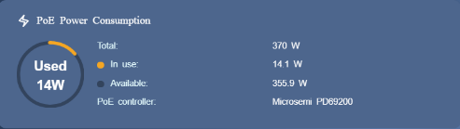
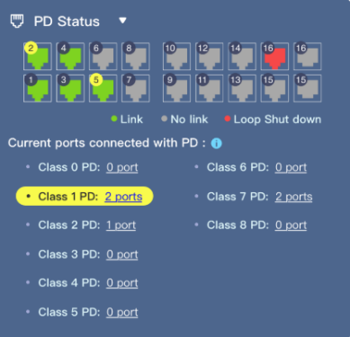
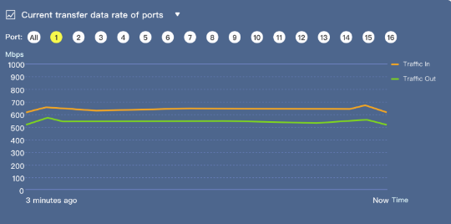
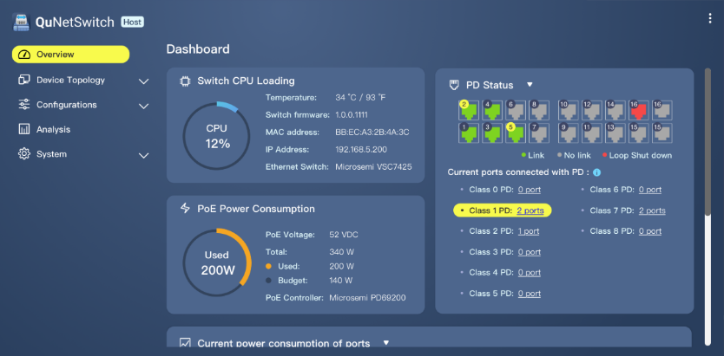
Rich dashboard for data display
Guardian provides rich graphical PoE data information, including real-time power consumption status, available wattage information, and various PoE operation status, so that enterprises can effectively grasp the power usage status of the equipment.
Graphical Display

Slide 17
  L2 Network Management

Slide 18
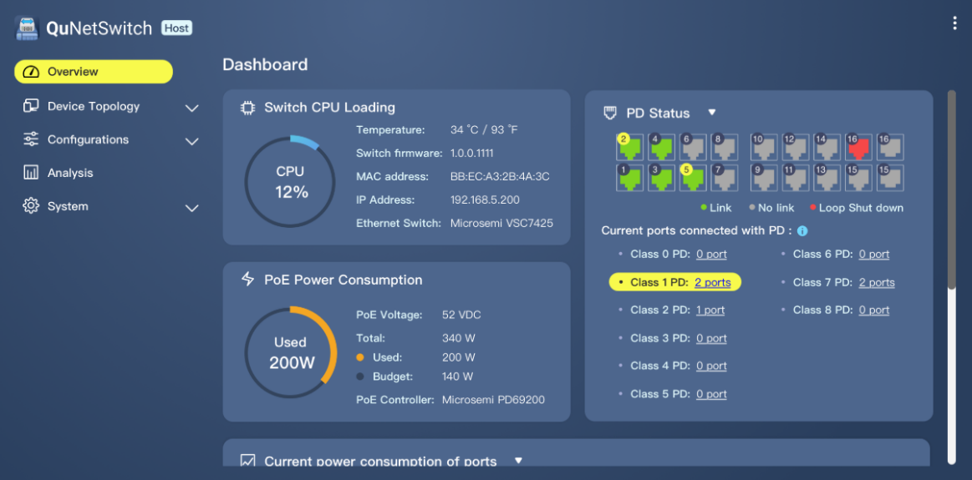
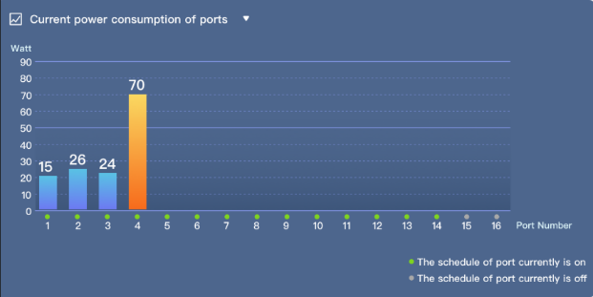
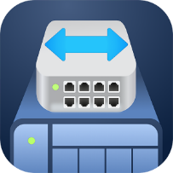
QuNetSwitch's friendly and intuitive graphical management interface
Guardian provides an intuitive and friendly web management interface that allows users to easily perform device monitoring, configuration, firmware updates, and advanced network management functions.

Slide 19
Complete Layer 2 network management function
IGMP Snooping
VLAN
Optimizing multicast performance helps in-line media streaming, VoIP and other bandwidth-intensive applications that are sensitive to time delays.
Enhance network security by isolating traffic within the enterprise based on requirements such as administrators, general users, employees, or visitors.
Link Aggregation (LACP)
Quality of Service
Combine two physical lines to form a high-speed virtual data transmission path, increasing transmission speed and enhancing network connection reliability.
Different network usage priorities can be configured according to the port or VLAN group to ensure the quality of service and optimize network transmission efficiency.

Slide 20
Complete Layer 2 network management function
Access-Control List (ACL)
Loop detection and protection
The device supports access control mechanisms, so you can set multiple access rules & specify specific protocols, IP addresses, subnet masks, and port access conditions.
When the network generates a loop, the network that generates the loop will be closed, effectively avoiding network interruption.
Port Mirroring
Jumbo frame
Allows network administrators to capture data (packets) for specific ports to monitor the network or troubleshoot.
The device supports the Jumbo Frame huge packet setting, which helps improve overall data transmission efficiency.

Slide 21
  Virtualization and SD-WAN solution

Slide 22











Run virtual machines and containers: multiple applications in a box
Virtualization Station and Container Station lead a full range of hybrid virtual application solutions. For your versatile needs, you can rely on QNAP's complete virtualization application support. Choosing the right deployment strategy for your virtualization needs can be easy!
Virtualization Station
Container Station
Notes:
Virtualization Station 可讓您在 QGD-1600P上運行多個 Windows®、Linux®、UNIX® 及 Android™ 虛擬機 (Virtual Machine)，並透過瀏覽器或 Virtual Network Computing (VNC) 連線管理虛擬機。企業組織可利用 NAS 上的多個虛擬機執行不同的伺服器應用。
Container Station 整合 LXC 與 Docker® 兩項輕量級技術。您可在 Docker Hub® 線上市集下載來自全球各地數以千計的應用程式，輕鬆匯入/匯出軟體容器與設定存取權，享有安裝簡便，可移動、有效率的諸多好處。

Slide 23

Guardian All-in-one VM solution
Traditional NAS + Switch
Guardian solution
RouterOS
VM
VM
RouterOS
VM
VM
Virtualization Station
Guardian vSwitch Mode
Virtual Switch
Virtual Switch
NIC
NIC
WAN
LAN
Internet
LAN Networking Devices
Internet
LAN Networking Devices

Slide 24
QuWAN - SD-WAN solution on Guardian
QGD-1602P supports the installation of QNAP SD-WAN solution – QuWAN.
QuWAN allow SMB branch offices, restaurants & chain stores to set up SD-WAN easily.
Office A
US
Office B
Japan
Office C
Germany

Slide 25
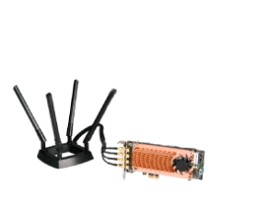




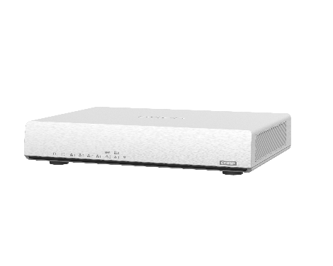

Guardian x QWA-AC2600
SD-WAN solution
Establish SD-WAN via QuWAN between each office.
Share the wireless network to the device with the QWA-2600AC wireless network card.
Wi-Fi
NAS
IP Cam
IoT
Access Control
IP Cam
Device
QWA-2600AC as Wi-Fi access point mode
HQ QGD-1602P
WAN1
WAN2
Branch QGD-1602P
Secure company system access
WAN3
Wi-Fi 6
WFH QHora-301W

Slide 26


Guardian x QuWAN x pfSense solution
QuWAN
Virtual Switch
Ethernet Port 1
QuWAN WAN​
Virtual Switch
Ethernet Port 2
QuWAN LAN​
pfSense VM
pfSense WAN
Virtual Switch
Ethernet Port 3
pfSense LAN
QGD-1602P

Slide 27





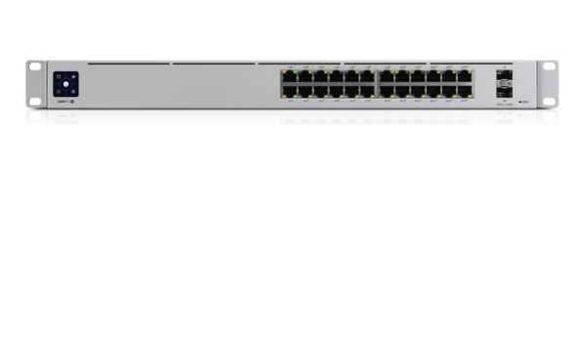


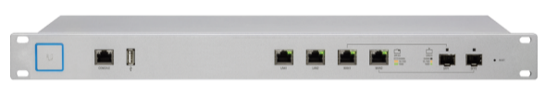

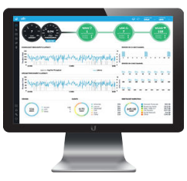

Guardian Wireless AP Integrated Solution
Traditional Deployment
Guardian solution
UniFi Cloud Key
UAP-AC-PRO
UAP-XG
UAP-AC-M
UAP-AC-PRO
UAP-XG
UAP-AC-M
Advantages
One machine covers all features, saving a lot of space
Highly expandable capabilities to meet future growth needs
Integrated solution
myQNAPcloud
UniFi
Controller
pfSense
(DHCP Server)
USW-Pro-24-POE
LAN
Guardian Smart PoE Switch
USG-PRO-4
WAN
Remote Access to UniFi Controller
Remote Access to UniFi Controller
Hybrid Cloud
Internet

Slide 28
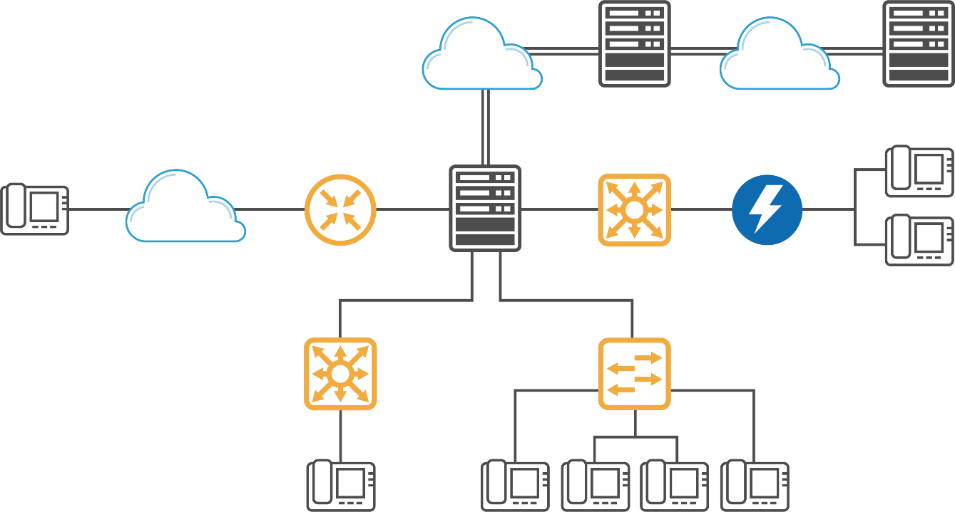
Guardian brings IP Phone integrated solution
Traditional VoIP Phone Deployment
IP PBX
IP PBX
Internet
Internet
Location B
Location C
IP PBX
Internet
Router
Location A
Voice Gateway
PSTN
Voice Gateway
Notes:
http://www.sipnet.com.tw/voip-sip/fxs-fxo.htm

Slide 29
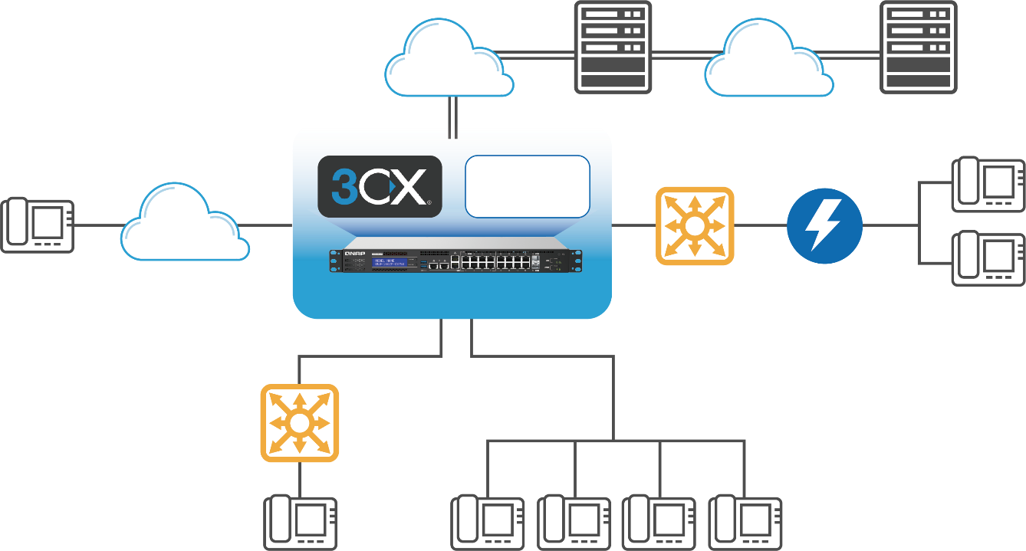
Guardian brings IP Phone integrated solution
IP PBX
IP PBX
Guardian solution
Internet
Internet
Location B
Location C
Router
Internet
Location A
Voice Gateway
PSTN
Voice Gateway

Slide 30
  Flexible networking topology for deployment

Slide 31
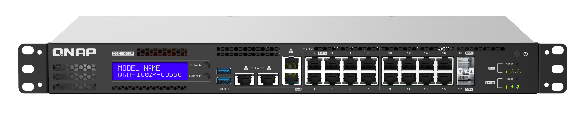

Flexible Guardian choice for VM deployment
Model | CPU cores | Memory | Recommended VM deployment
QGD-1600P | 4 | 8GB max | 2
QGD-1602P-C3558 | 4 | 64GB max | 4
QGD-1602P-C3758 | 8 | 64GB max | 6

Slide 32




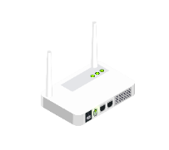


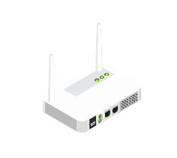

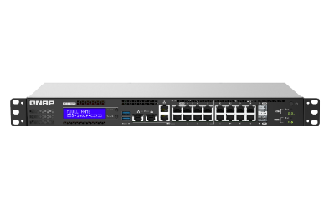



Guardian solution for
Restaurant and Retail Store
PoE
4K PTZ Surveillance
Powering multiple cameras and integrating QVR Pro solution
Electronic menu
Provide power and networking capabilities
Point of Sales
Consumption behavior analysis and data storage
WiFi 5/6 PoE Access point
PoE powered and supports installation of AP Controller software
Digital Signage
Provide power and content management
2.5GbE NAS for Data storage/backup
Save customer data, work documents, letter materials
QuWAN
To create SD-WAN network with headquarters and other stores
Improved features

Slide 33




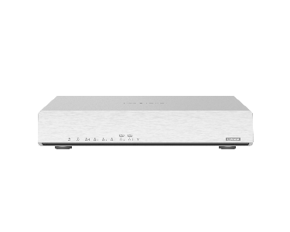




Flexible networking topology for deployment
Virtual Machine
2 x 10GbE internal
QVR Pro
Customer’s laptop/phones
4 x 2.5GbE PoE (802.3bt)
POS
Electronic menu
Internet
Wi-Fi 6 QHora-301W at AP mode
4K PTZ Surveillance Camera
8 x 1GbE PoE (802.3at)
2 x 10GbE SFP+ ports

Slide 34
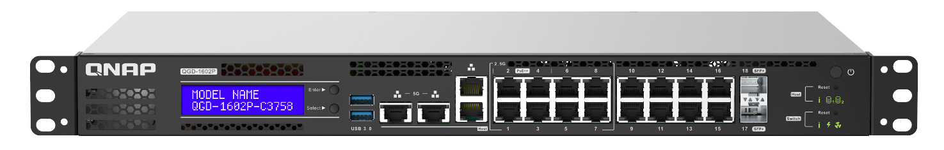

Flexible networking topology for deployment
Virtual Machine
2 x 10GbE internal
QVR Pro
PoE
Surveillance Camera
POS
Electronic menu
5GbE Host port
4 x 2.5GbE PoE (802.3bt)
Internet
PoE 4x4
Wi-Fi access point
Customer’s laptop/phones
8 x 1GbE PoE (802.3at)

Slide 35

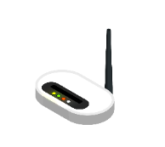
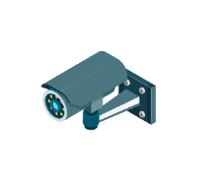
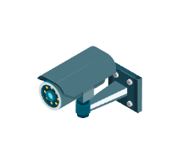









Guardian solution for
SMB and workstation
PoE
4K PTZ Surveillance
Powering multiple cameras and integrating QVR Pro solution
Wi-Fi 5/6 PoE AP
PoE powered and supports installation of AP Controller software
2.5/5/10GbE Network device
Provide Network management and Internet access requirements for devices
Firewall
Protect corporate internal network from external intrusions and internal network attacks
Wake on Lan
allows a computer/ NAS to be turned on or awakened by a network message
QuWAN
To create SD-WAN with headquarters and other stores
Improved features

Slide 36

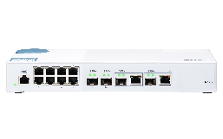





Flexible networking topology for deployment
Virtual Machine
VLAN
2 x 10GbE internal
QVR Pro
VLAN1
VLAN2
QSW-M408
10GbE L2 switch
Internet
2 x USB 3.0
8 x 1GbE PoE (802.3at)
PC with 2.5GbE
QHora-301W (AP mode)
TR-004U
RAID expansion
Surveillance Camera
VoIP phone
VLAN1
VLAN2
2 x 10GbE SFP+ ports
8 x 2.5GbE ports
Printer

Slide 37


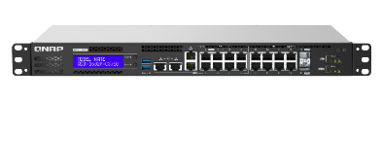
Guardian solution for
SMB and workstation
PoE
4K PTZ Surveillance
Powering multiple cameras and integrating QVR Pro solution
Wi-Fi 5/6 PoE AP
PoE powered and supports installation of AP Controller software
2.5/5/10GbE Network device
Provide Network management and Internet access requirements for devices
Transparent Firewall via pfSense
Protect internal network via transparent firewall without making any IP address changes on other devices.
Multi-WAN via RouterOS
Load Balancing or Failover
Improved features

Slide 38
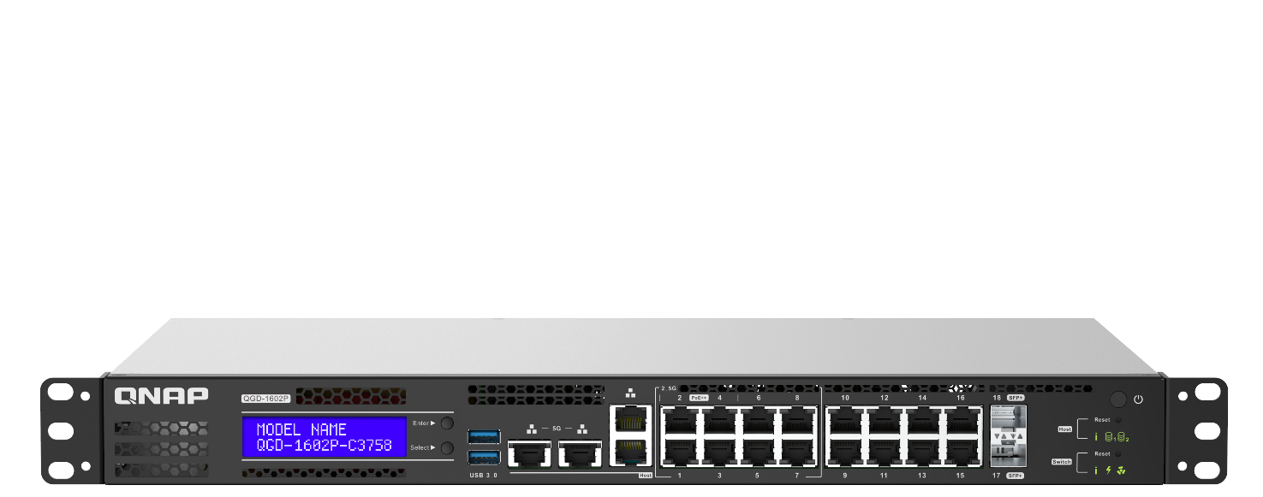



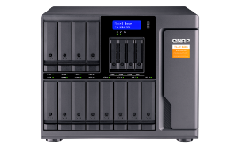
Flexible networking topology for deployment
Virtual Machine
VLAN
2 x 10GbE internal
VLAN1
VLAN2
Internet
Internet
2 x PCIe Gen 3
802.3at/bt PoE wireless AP
8 x 1GbE PoE (802.3at)
16-bay TL-D1600S
Surveillance Camera
VoIP phone
WAN2
WAN1
2 x 10GbE SFP+ ports
Printer
8 x 2.5GbE PoE (802.3bt/at)

Slide 39
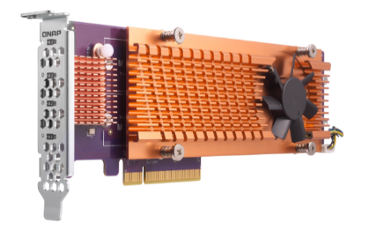
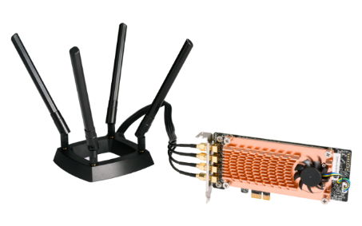
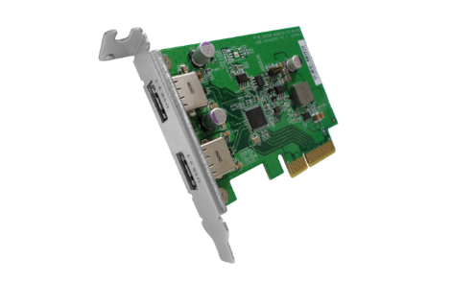
Extend Guardian functionality with the PCIe slot
The Guardian QGD-1602P features two PCIe Gen 3 expansion slots, and you can flexibly configure a variety of QNAP PCIe expansion cards as needed.
QM2
QWA-AC2600
USB 3.1 Gen 2 (10Gbps)
SSD
QM2-2S-220A
QM2-2P-244A
QM2-2P-344
QM2-2P-384
SSD+NIC
QM2-2S10G1TA
QM2-2P10G1TA
QWA-AC2600
USB-U31A2P01

Slide 40
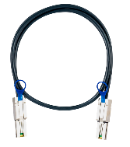
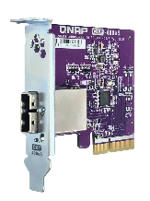

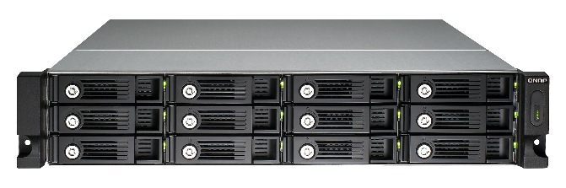
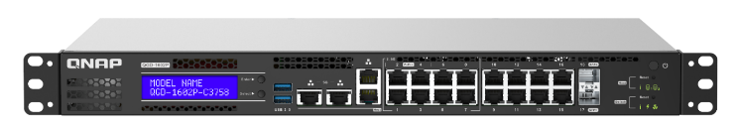


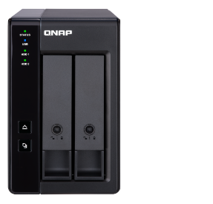




QNAP TR & TL expansion units for storage expansion or as a backup destination
QNAP TL JBOD and TR RAID expansion units can expand the QGD-1602P storage capacity. They supports either the configurations of the storage pool, or the snapshots storage from volume and LUN.
Be the
Snapshot Vault
2 x PCIe Gen3
Be the
Storage Expansion
TL & TR expansion units
QGD-1602P
2 x USB 3.2 Gen 1
TR 002
TR 004
TL-D800C
TL-R1200C-RP
TR 004U
Notes:
iSCSI initiator, VJBOD, USB JBOD (3.0, 3.1), USB External RAID Device, External Storage Device (USB Disk), HybridMount, VJBOD Cloud.
Thunderbolt JBOD, SAS JBOD, TL SATA JBOD

Slide 41







Easy expansion of storage space via USB
USB 3.2 Gen 2 10Gbps JBOD
Software RAID
QNAP JBOD Manager utility for Windows / Mac/ Ubuntu
USB 3.2 Gen1 5 Gbps / Gen2 10G bps RAID
Hardware RAID 0/1/5/10, configurable via a dip switch or via software
QNAP External RAID Manager utility for Windows / Mac/ Ubuntu
8-bay TL-D800C
2-bay TR-002
4-bay TR-004
4-bay TR-004U
12-bay TL-R1200C-RP
Notes:
iSCSI initiator, VJBOD, USB JBOD (3.0, 3.1), USB External RAID Device, External Storage Device (USB Disk), HybridMount, VJBOD Cloud.
Thunderbolt JBOD, SAS JBOD, TL SATA JBOD

Slide 42









High performance expansion of storage space via PCIe
+
+
+
+
4-bay TL-D400S
1 x QXP-400eS-A1164
PCIe 4-port SATA card
1 x 1M SFF-8088 cable
8-bay TL-D800S
1 x QXP-800eS-A1164
PCIe 8-port SATA card
2 x 1M SFF-8088 cables
4-bay TL-R400S
16-bay TL-D1600S
+
+
4 x 1M SFF-8088 to SFF-8644 cables
12-bay TL-R1200S-RP
1 x QXP-1600eS
PCIe 16-port SATA card
3 x 1M SFF-8088 to SFF-8644 cables

Slide 43


Manage expansion units with QTS
The TL JBOD and TR RAID units can be monitored and managed in the QTS storage and snapshot manager.
Enclosure & QTS Disk related features:
Temperature warning
S.M.A.R.T test
Seagate Ironwolf IHM*
Disk Scan*
Disk Erase
Disk performance test
* Not supported with the TR-002, TR-004, and TR-004U.

Slide 44





Enclosure management fully integrated into QTS
When SSD becomes more popular, the temperature management of the enclosure is more important than before.
Monitor the FAN speed via NAS UI and configure the threshold of temperature warning.

Slide 45



One enclosure for two different uses: internal expansion or external disk mode
RAID & Storage Pool
External Disk mode
All disks of TR & TL expansion units would be identified by Storage & Snapshot manager, then configure as a RAID of storage pool.
The storage is individual for each disk, it will show 8 independent external disks with TL JBOD or as a single disk with IR RAID unit. This mode is also for cross-platform compatibility among various O.S.
開啟儲存與快照總管 >
進入儲存 / 快照
選擇建立 >
新儲存池或新磁碟區
TL & TR units cannot be configured as a RAID group with those internal disks from NAS.
TR units can only support RAID 0/1/5/10 and JBOD modes.

Slide 46

QNAP storage expansion solutions summary
 | TL SATA JBOD | TL USB JBOD | TR RAID
Connectivity | PCIe (Multi-ch SATA) | USB 3.2 Gen 2 | TR-002: USB 3.2 Gen 2 TR-004: USB 3.2 Gen 1 TR-004U: USB 3.2 Gen 1
Number of bays | 4: TL-D400S, TL-R400S 8: TL-D800S 12: TR-R1200S-RP 16: TL-D1600S | 8: TL-D800C 12: TL-R1200C-RP | 2: TR-002: 2 4: TR-004, TR-004U
Supported O.S | QNAP QTS, Windows, Linux/Ubuntu | QNAP QTS, Windows, Mac, Linux/Ubuntu | QNAP QTS, Windows, Mac, Linux/Ubuntu
Cerate QTS storage pool | Yes
QTS operations such as disk scan | Yes | Yes | X
H/W RAID Protection | X |  | Yes (RAID 0/1/5/10)
RAID level migration & capacity expansion | Yes | Yes | X
Max units supported by QGD-1602P | 2 | 1* | 2*
* The combined number of connected TR and TL USB expansion units cannot exceed 2.

