Slide 2

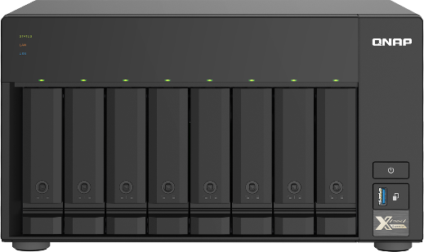
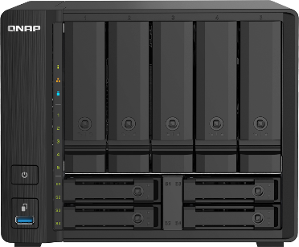
Quad-core 10GbE TS-832PX & TS-932PX with new 2.5GbE ports
More devices in the office and more data storage and higher speed requirement for agility.
Both TS-832PX & TS-932PX come with dual 10GbE SFP+ and dual 2.5GbE RJ45 ports
Value-added software applications for efficient file sharing, backup, containerized apps, and hybrid cloud

Slide 3
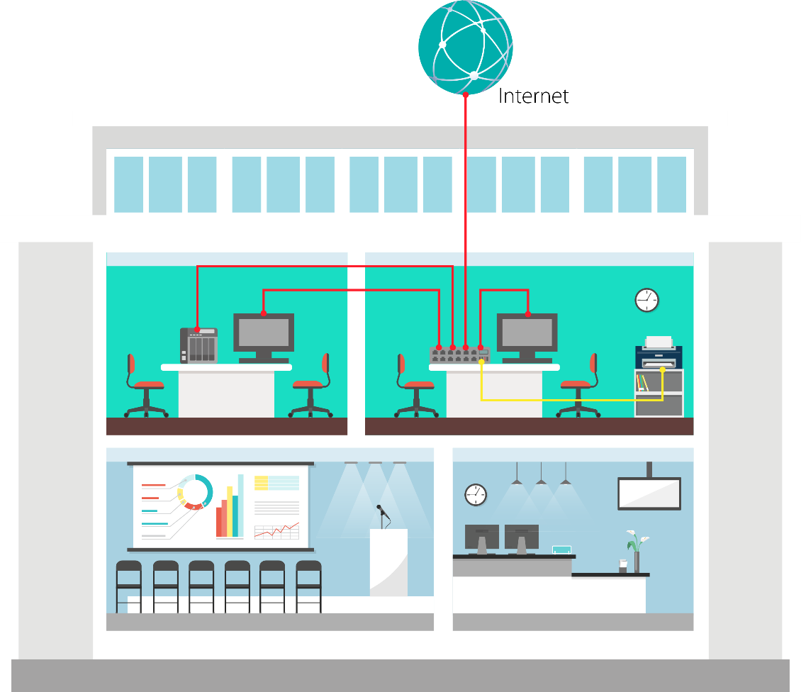

More connected devices in the SOHO & SMB environments
Deploying 2.5GbE+ for an efficient work environment
1GbE
2.5GbE
Faster network speed requirements
Larger file sizes of audio / video
Higher Internet speed from ISP

Slide 4

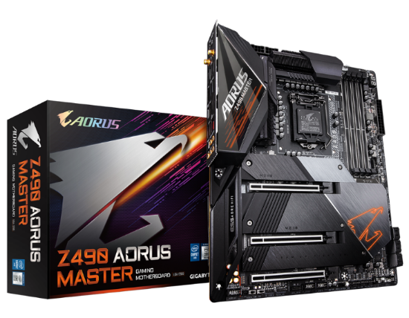
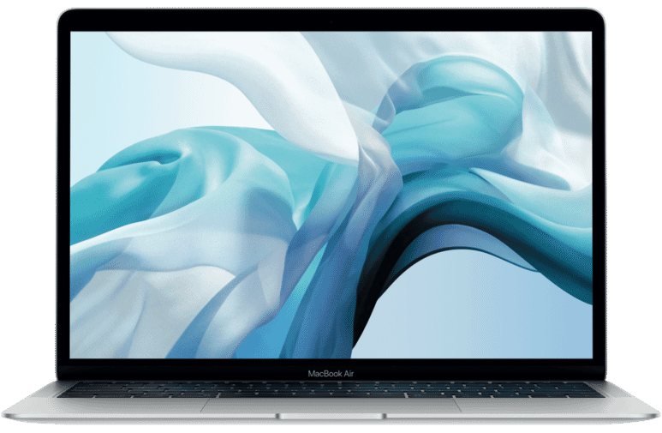
Slower office computers can also affect work efficiency
In 2018 ~2019 motherboard vendors launched 10GbE & 5GbE Multi-Gig products
(2.5GbE-compatible). In 2020 these vendors have launched more affordable 2.5GbE products.
More and more laptops and desktops provides high-speed Thunderbolt 3 or 2.5GbE-compatible ports.
Gigabyte Z490 AORUS MASTER
Thunderbolt 3 and/or 10GbE/5GbE/2.5GbE Multi-Gig laptop or desktop

Slide 5
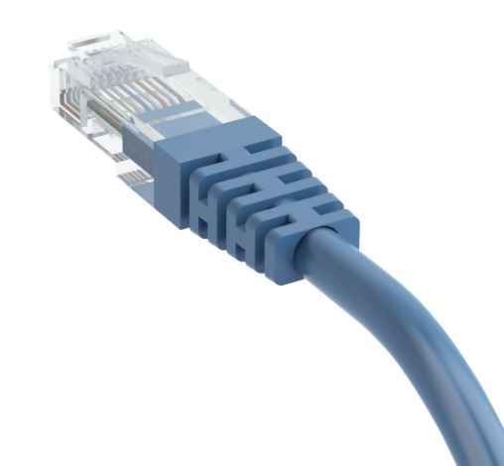
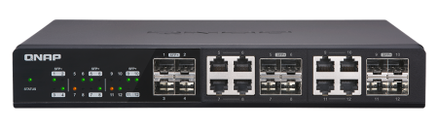
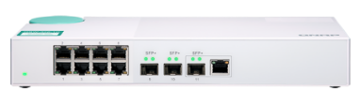
Save money with existing wiring infrastructure by 2.5GbE
QNAP 10GbE switches supporting 2.5GbE
 | CAT 5e | CAT 6 | CAT 6A
100M | ✓ | ✓ | ✓
1G | ✓ | ✓ | ✓
2.5G | ✓ | ✓ | ✓
5G | ✓ | ✓ | ✓
10G | X | ✓(55m) | ✓
QSW-M408-4C (Managed)
QSW-M408-2C (Managed)
4 x 10G/5G/2.5G
RJ45 Multi-Gig
2 x 10G/5G/2.5G
RJ45 Multi-Gig
QSW-1208-8C
QSW-308-1C
8 x 10G/5G/2.5G
RJ45 Multi-Gig
1 x 10G/5G/2.5G
RJ45 Multi-Gig

Slide 6
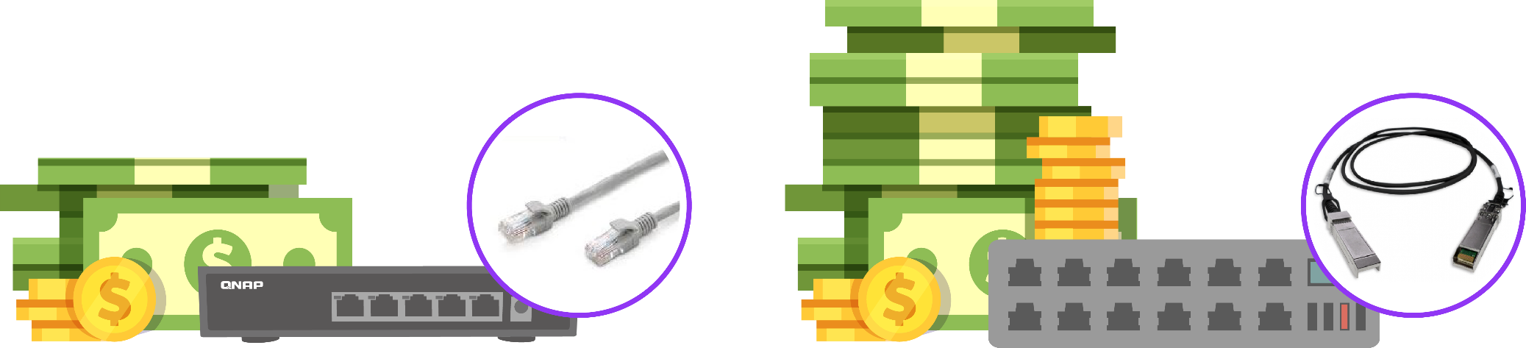
Cost-effective QNAP QSW-1105-5T 5-port 2.5GbE switch
Spend less than the cost of a 10GbE switch and get the upcoming QNAP 5-port 2.5GbE switch QSW-1105-5T, achieving a balance between cost and speed.
Leveraging current cabling infrastructure with CAT5e without re-wiring.
Affordable CAT5e cables
are everywhere
More expensive 10GbE RJ45 or SFP+ cables and transceivers
2.5GbE solution
10GbE solution

Slide 7
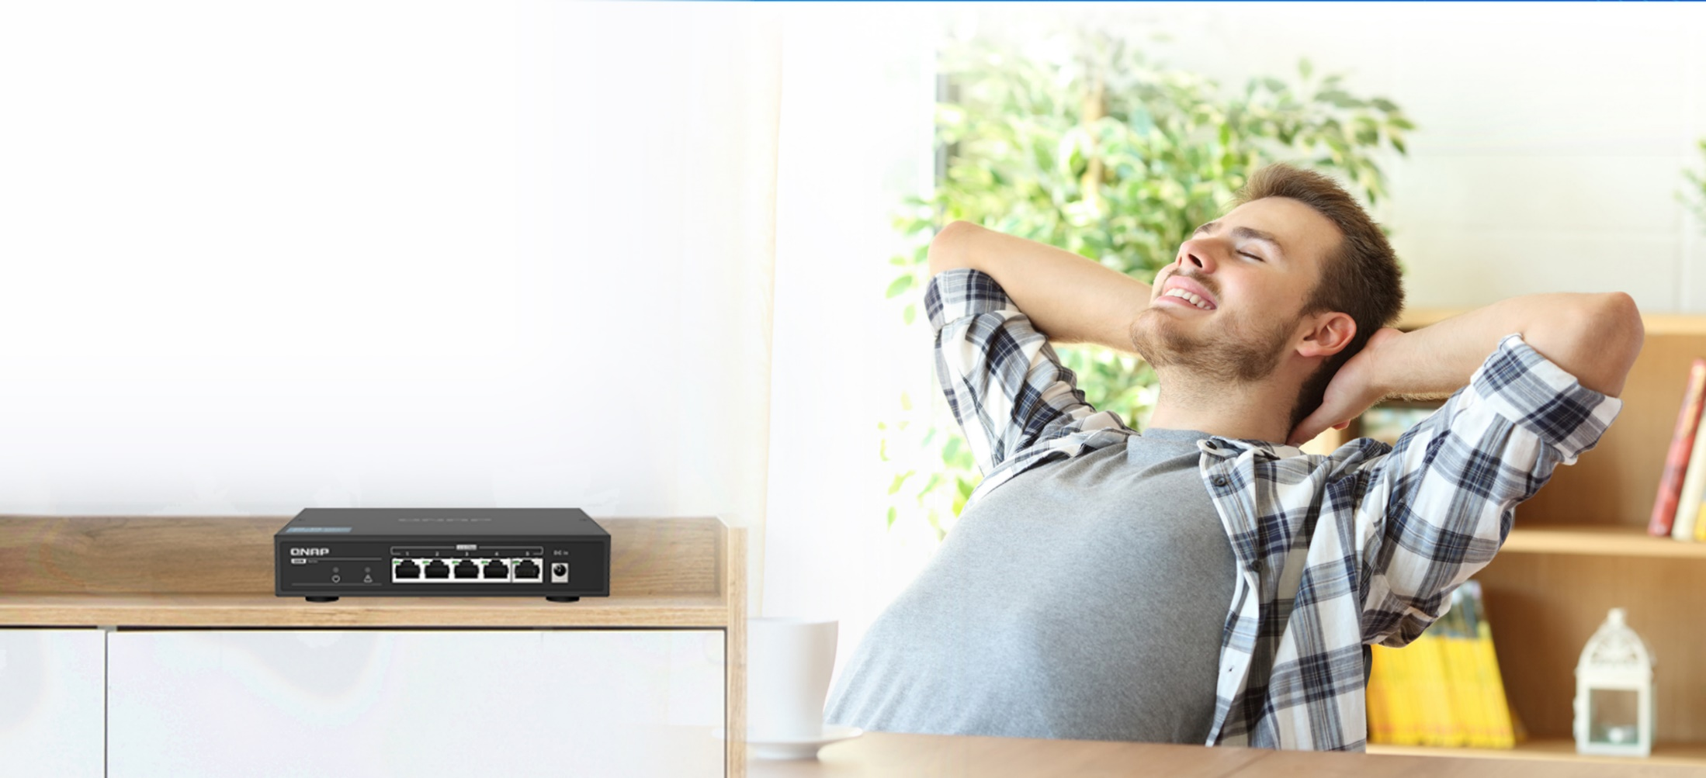
Fanless and unmanaged 2.5GbE switch with metal housing
Zero noise with the fanless design
Solid metal housing for long-term usage in various environments
No learning curve, just plug and use
Network loop detection warning
Available
in 2020 Q3!
QSW-1105-5T

Slide 8
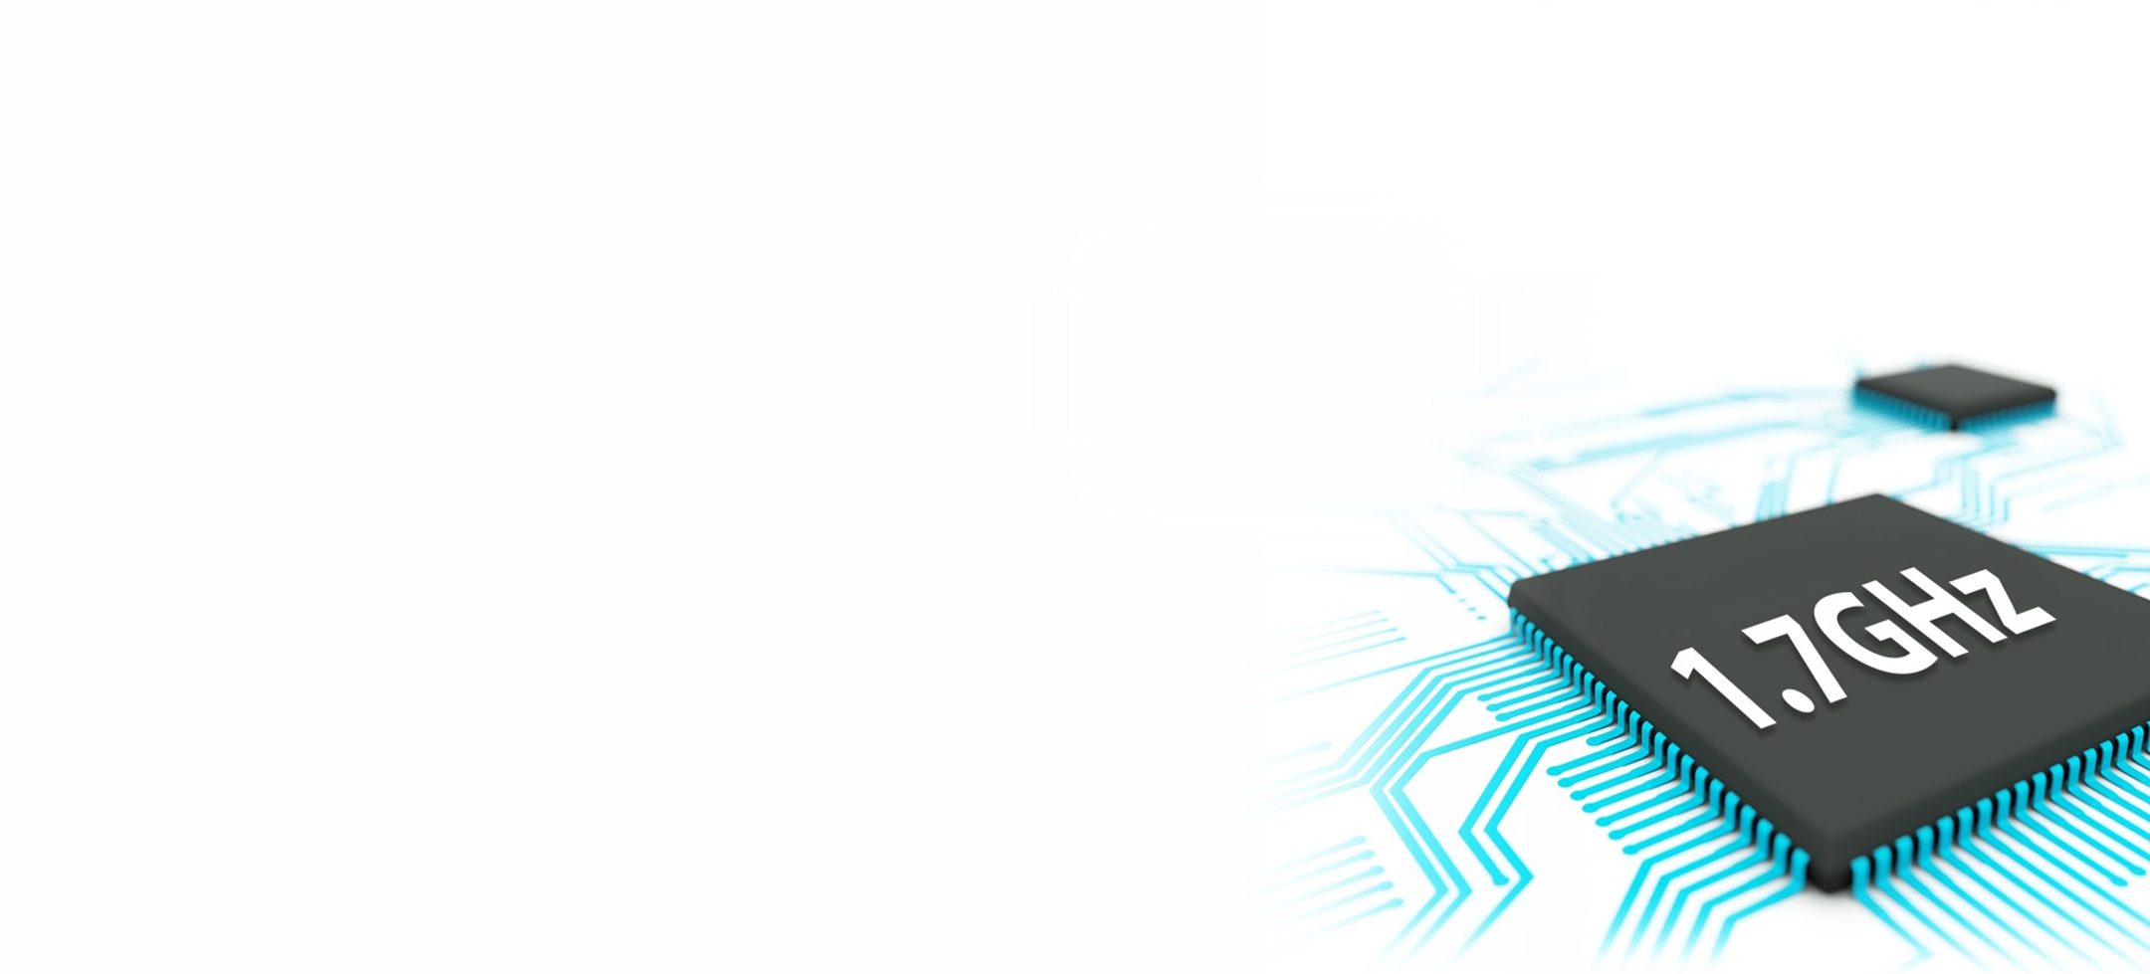

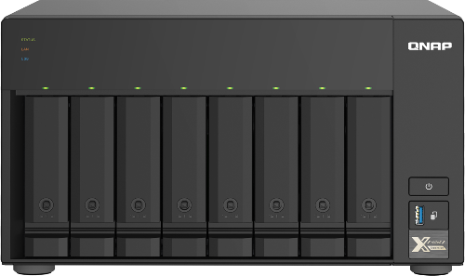
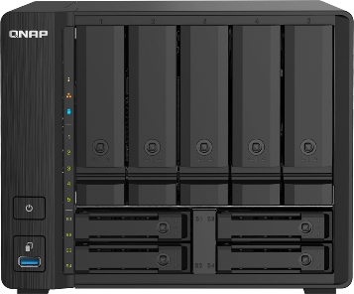
Storage devices also need 2.5GbE to catch up the speed
Integrated I/O
Annapurna Labs SoC integrates 10GbE, SATA 6Gbps, PCIe lanes in a small 27 x 27 mm BGA form
AArch64 arch.
ARM Cortex-A57 Quad-core 1.7GHz AL-324 CPU with 64-bit instructions for high performance and energy saving
2 x 10GbE SFP+ and 2 x 2.5GbE RJ45 with enhanced floating-point operations and 31 64-bit registers for reduced redundant data access
10GbE & 2.5GbE
Cryptography
Operates with 128-bit SIMD registers for multiple encryption/decryption instructions per cycle
TS-832PX
TS-932PX
Notes:
Slot x

Slide 9

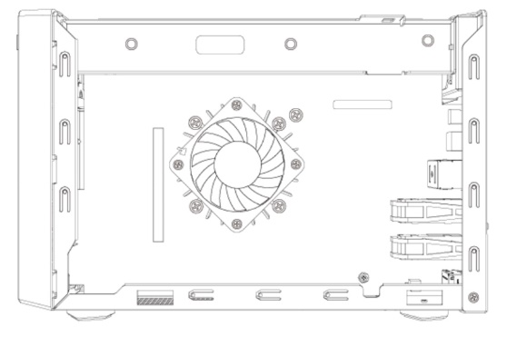
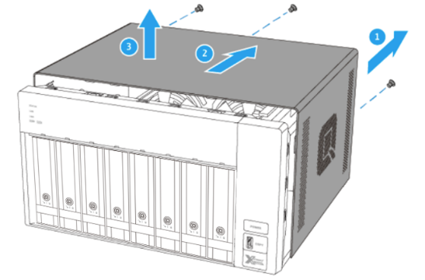

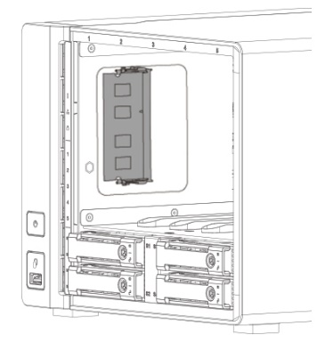
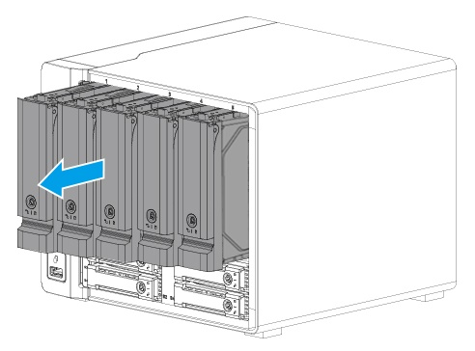
Upgrade up to 16GB DDR4 memory
Memory up to 16GB
1 x DDR4 SO-DIMM slot
TS-832PX
QNAP
Accessories
4GB, 8GB,
16GB RAM
TS-932PX
TS-832PX-4G: 1 x 4GB DDR4 SODIMM
TS-932PX-4G: 1 x 4GB DDR4 SODIMM

Slide 10
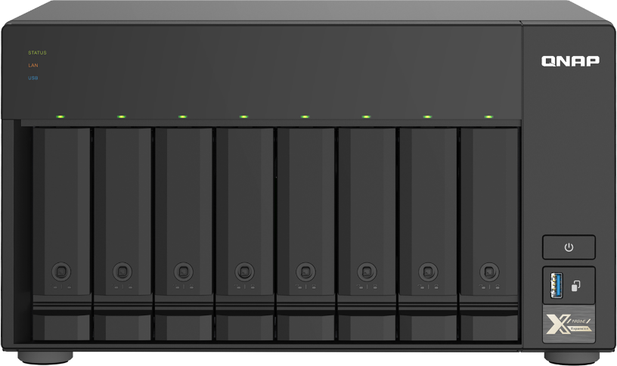

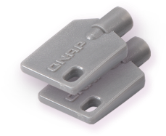
TS-832PX & TS-932PX front views
8 x 3.5-inch/2.5-inch SATA 6Gb/s drive bays
5 x 3.5-inch/2.5-inch SATA 6Gb/s drive bays
Indicators:
Status, LAN, USB, HDD/SSD
Indicators:
Status, LAN,
USB
Power button
HDD1~8
status
USB copy button
USB 3.2
Gen 1 port
4 x 2.5-inch SATA 6Gb/s SSD bays
Lockable drive trays with 2 keys included
(for HDD + SSD hybrid setup)

Slide 11
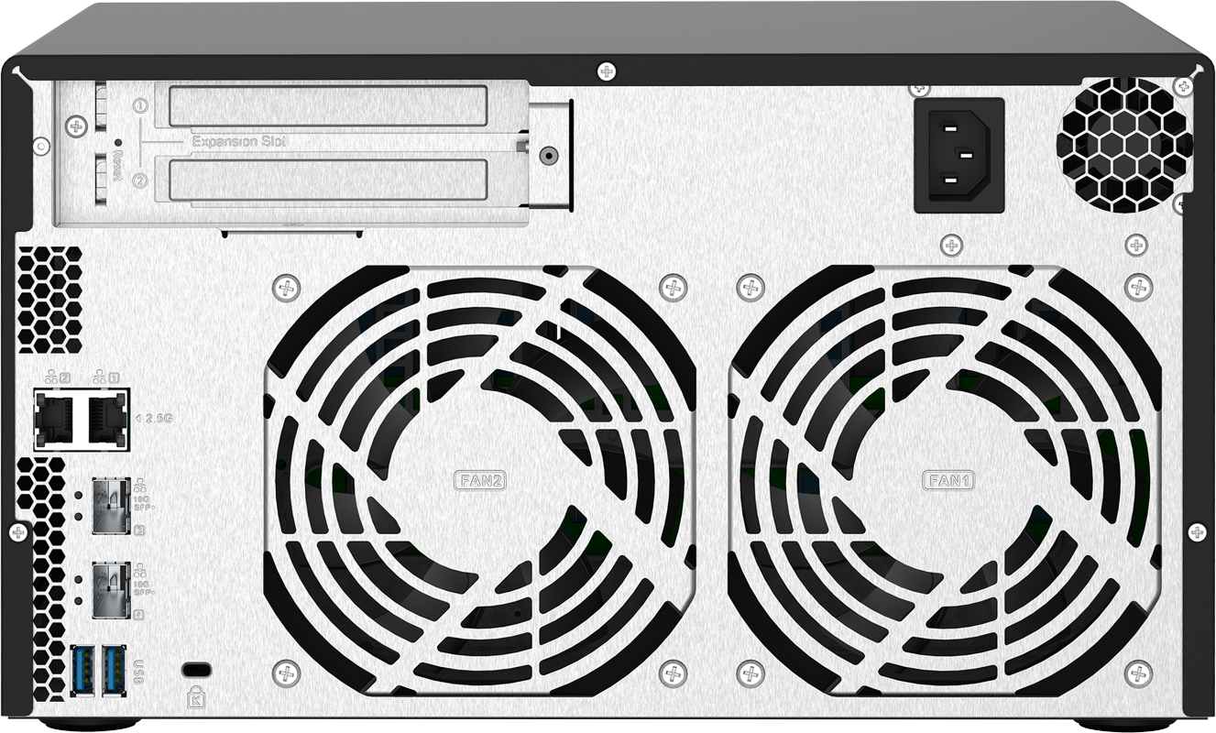
8-bay TS-832PX rear view
1 x full-height PCIe Gen2 x2 slot
Reset button
AC 100-240V
power input
Kensington
security slot
2 x 2.5GbE Multi-Gig
RJ45 port
2 x 12 cm smart fan
2 x 10GbE
SFP+ port
2 x USB 3.2
Gen 1 port

Slide 12
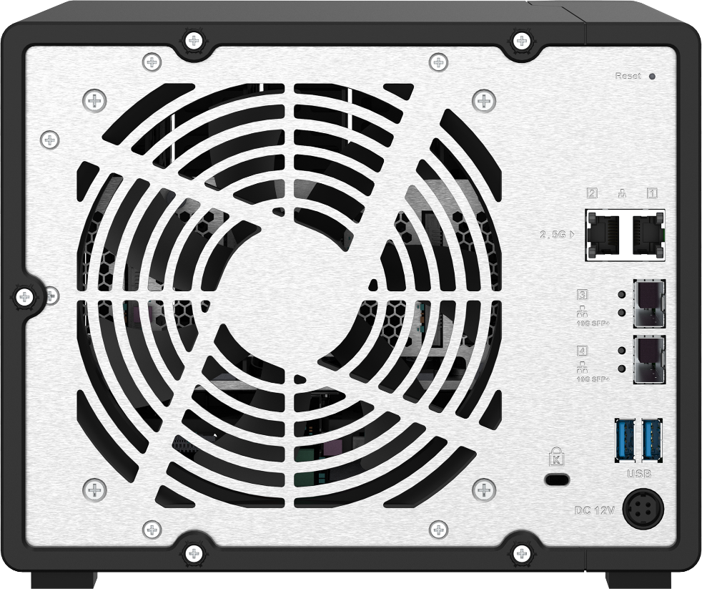
9-bay TS-932PX rear view
Reset button
1 x 14 cm
Smart fan
2 x 2.5GbE Multi-Gig
RJ45 port
2 x 10GbE
SFP+ port
2 x USB 3.2 Gen 1 port
Kensington
security slot
DC 12V
power input

Slide 13
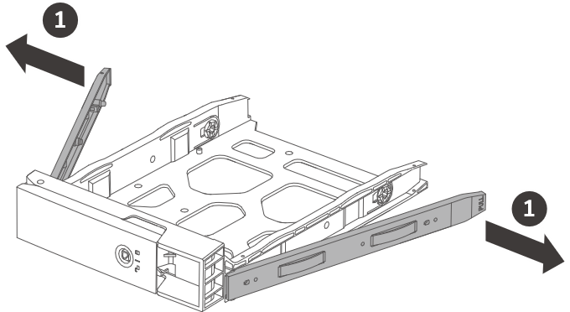
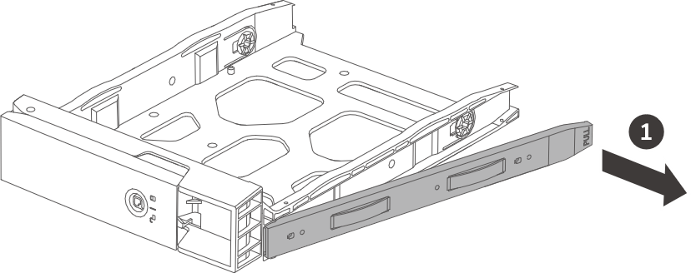
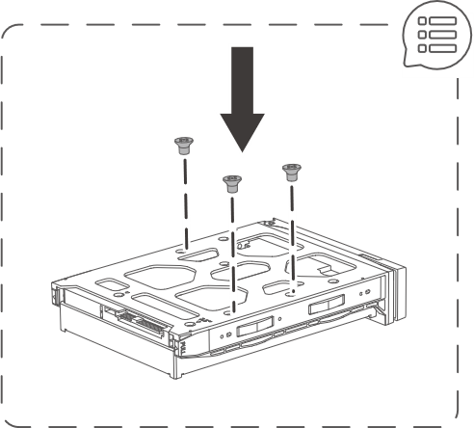
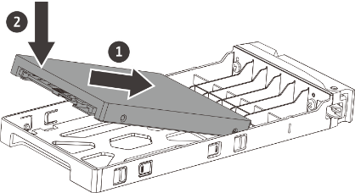
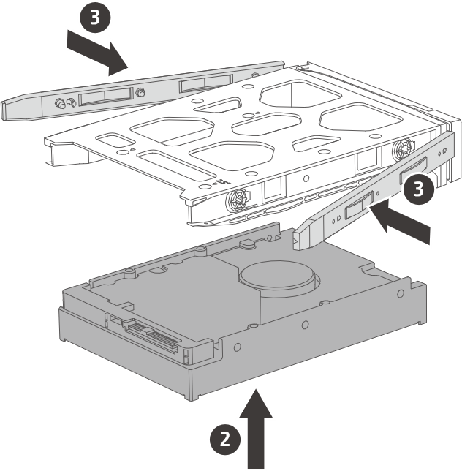
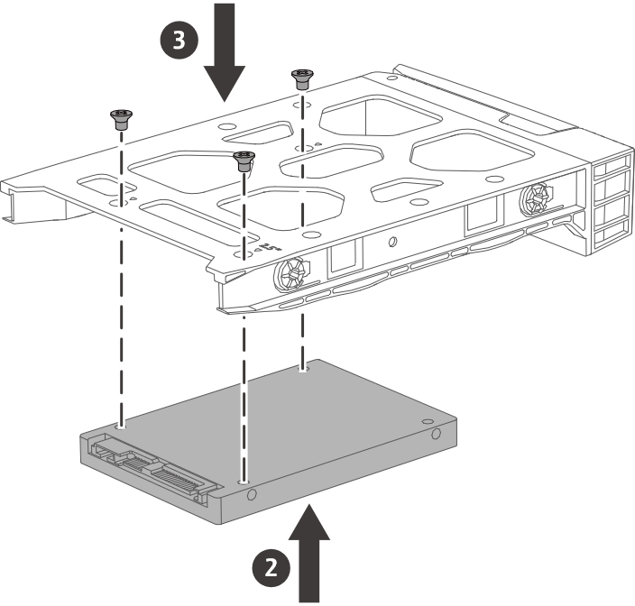
Easy-to-install HDDs and SSDs
3.5-inch HDD: tool-less
2.5-inch HDD / SSD
3.5-inch tray
2.5-inch tray (TS-932PX)
Tool-less
Use screws when transporting NAS with drives.

Slide 14
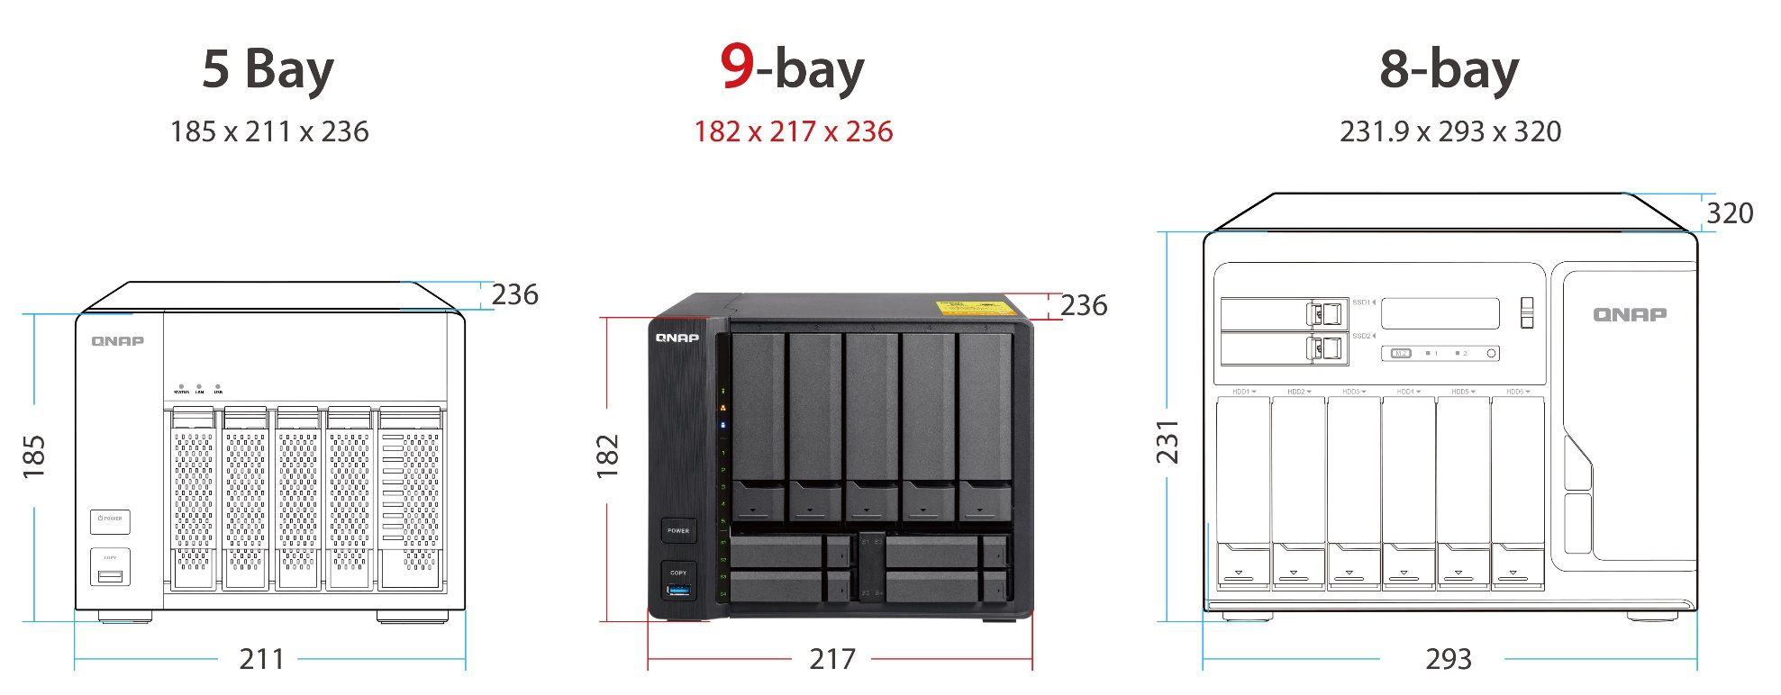


TS-932PX is as small as a 5-bay but with 9-bay capacity

Slide 15
How to bring out
2.5GbE & 10GbE performance
Speed

Slide 16


Both with dual 10GbE SFP+ & 2.5GbE ports
2 x 10GbE SFP+ & 2 x 2.5GbE Multi-Gig RJ45 ports delivering a major speed increase for fast backup & restoration, large-data applications, and container application tasks.
2 x 2.5GbE
Multi-Gig RJ45
2 x 10GbE
SFP+

Slide 17
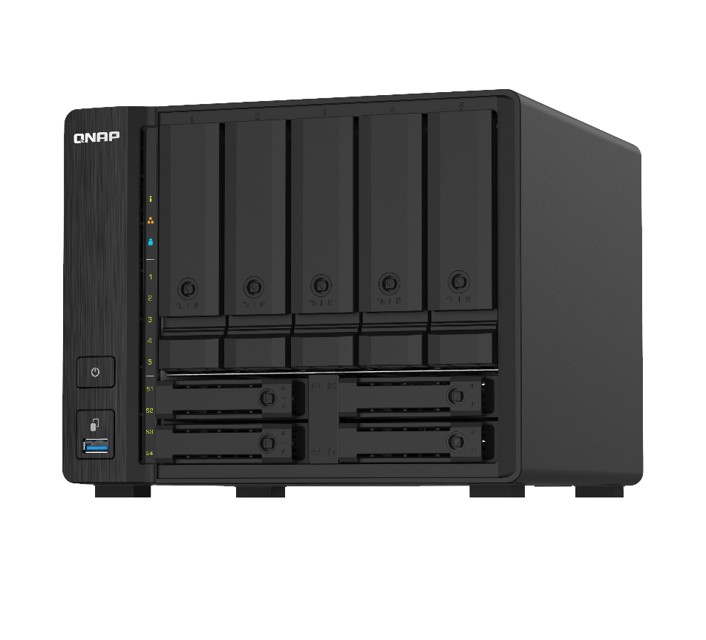

The best way to utilize high-performance SSDs
5 x 3.5-inch HDDs
(high capacity)
Performance
Performance and capacity
All in one for SMB
2 x SSD for caching, RAID1
High capacity file & media server
4 x SSDs for Qtier, RAID 5
Boost performance of accessing small files
Boost overall performance

Slide 18
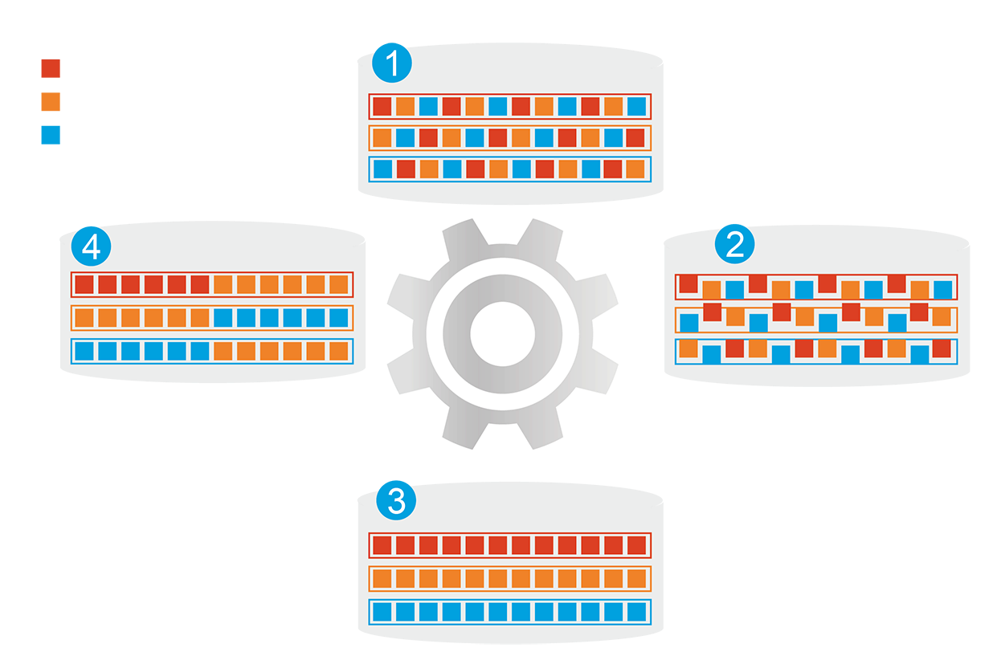

Qtier auto-tiering for speed and capacity
1
Before tiering
Frequently access-ed data is not optimized
Automatically moves data between different tiers
Frequently accessed data
分層前
頻繁存取資料效能未優化
Less-frequently accessed data
Rarely-accessed data
4
Changes in data access pattern
2
Start data tiering
SSD cache capacity is not limited by RAM size
開始分層
Qtier
Engine
3
After tiering
Data optimized
分層後
頻繁存取資料效能已優化

Slide 19
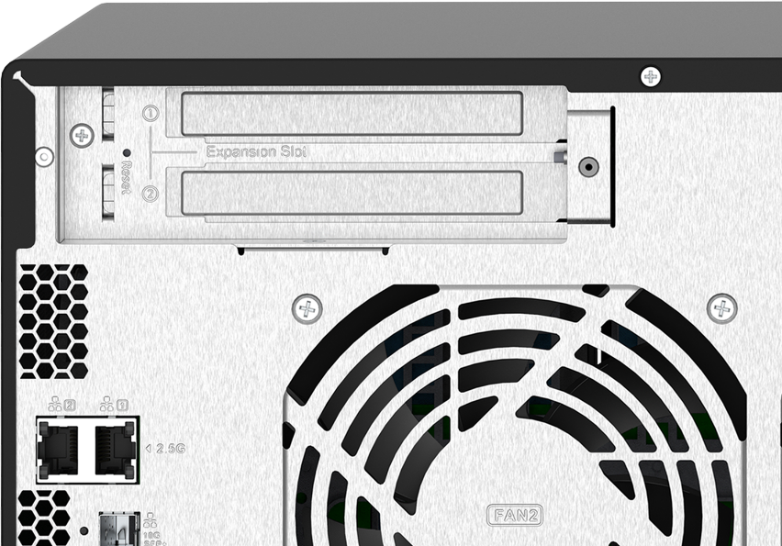
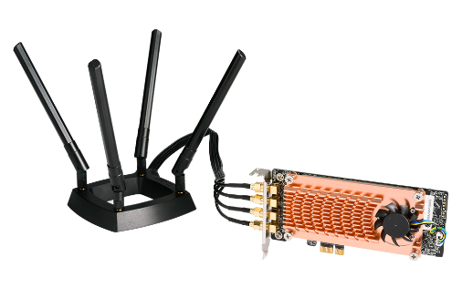
TS-832PX with a PCIe slot for flexible network deployment
TS-832PX provides a full-height PCIe Gen2 expansion slot
QXG-5G1T-111C
1 x 5G/2.5G/1G/100M port
1 x PCIe Gen2 x2
QXG-10G1T
1 x 10G/5G/2.5G/1G/100M port
QWA-AC2600
Wi-Fi 5 2.4GHz/5GHz AP

Slide 20
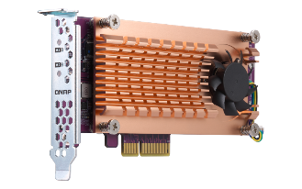
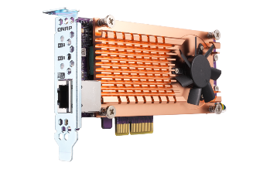
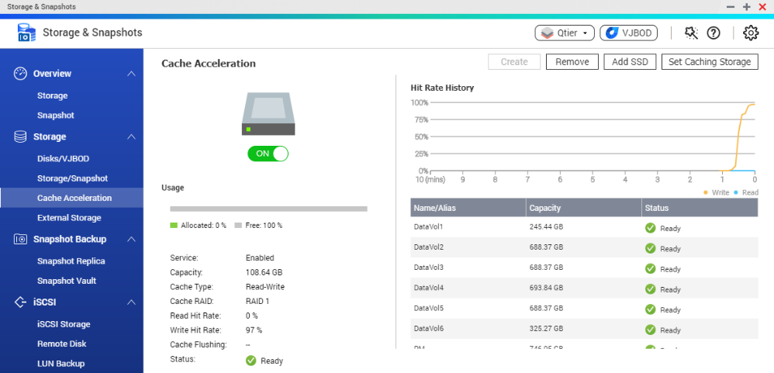
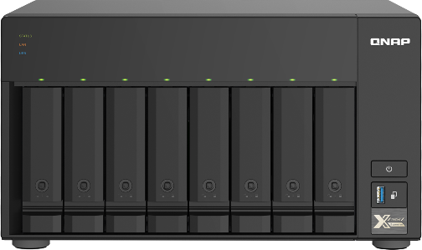
TS-832X with a QM2 PCIe adapter to add
M.2 SSDs for SSD cache
QM2-2S-220A
2 x M.2 SATA 6Gb/s ports
QM2-2S-10G1TA
2 x M.2 SATA 6Gb/s ports
1 x 10G/5G/2.5G/1G ports
QM2-2P-244A
2 x M.2 NVMe PCIe Gen2 ports
QM2-2P10G1TA
2 x M.2 NVMe PCIe Gen2 ports
1 x 10G/5G/2.5G/1G ports

Slide 21
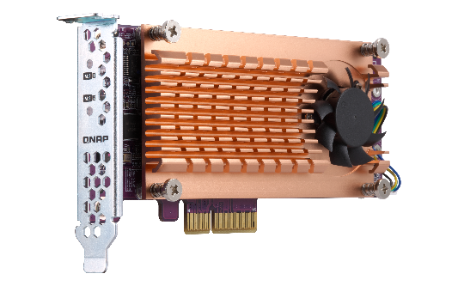
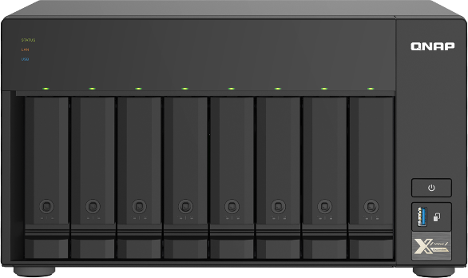
Optimize performance and capacity with Qtier
8 x 3.5-inch HDDs for high-capacity storage
Install a QM2 adapter with dual M.2 SATA or NVMe SSDs and setup Qtier
Benefited from 8 x 14TB HDD + 2 x 1TB M.2 SSD capacity and performance boost!

Slide 22
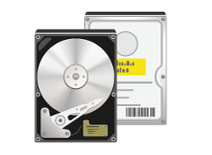

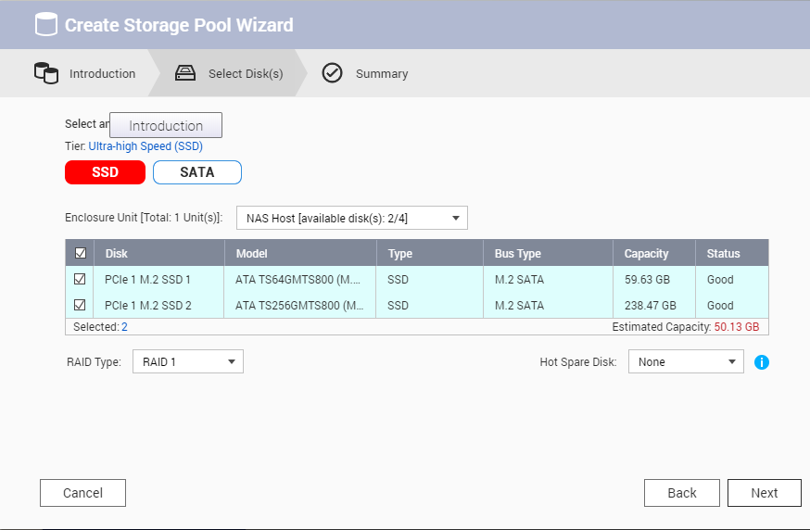
Upgrade to Qtier anytime when performance is needed
Scenario
When the HDD-based storage pool cannot provide enough performance…
1
２
Step
Step
Install a QM2 adapter and M.2 SSD
Select SSDs and upgrade
to Qtier pool

Slide 23
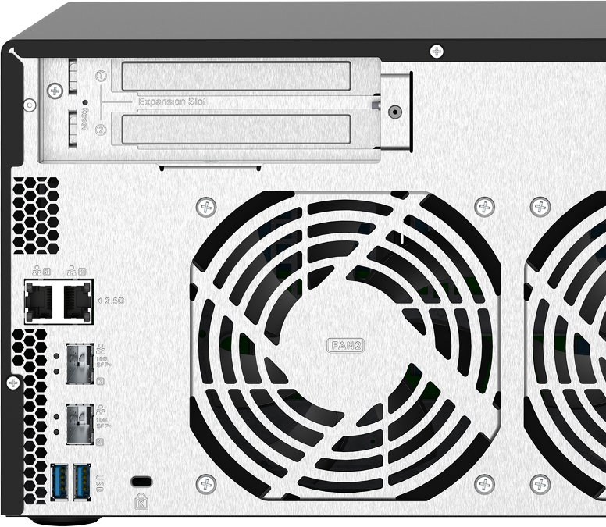
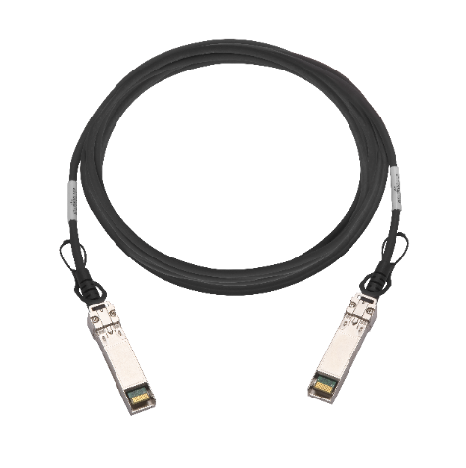
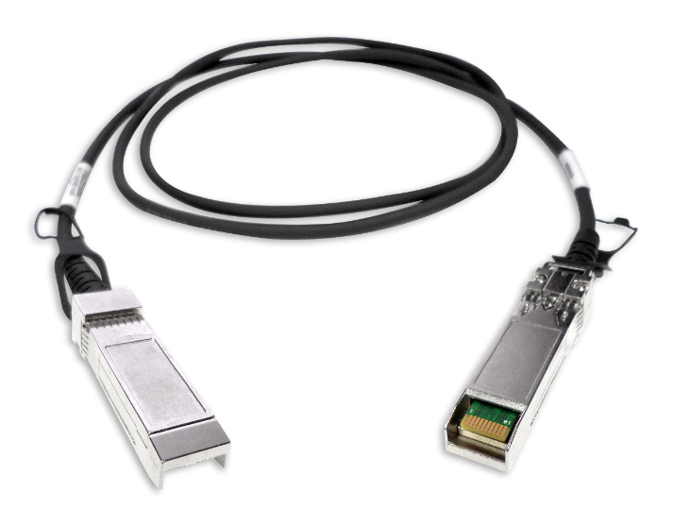
Short-distance 10GbE SFP+ DAC cable for direct connection without a transceiver
1.5M SFP+ 10GbE
direct attached copper (DAC) cable
3.0M SFP+ 10GbE
direct attached copper (DAC) cable
Part number:
CAB-DAC15M-SFPP-DEC02
Part number:
CAB-DAC30M-SFPP-DEC02

Slide 24
2.5GbE provides much faster speed over 1GbE
1 x 2.5GbE Windows sequential transfer
1 x 2.5GbE Windows sequential transfer,
NAS encrypted volume
250
295
295
293
289
254
255
253
254
200
150
100
(MB/s)
50
0
TS-832PX
read
TS-832PX
write
TS-932PX
read
TS-932PX
write
TS-832PX
read
TS-832PX
write
TS-932PX
read
TS-932PX
write
Test environment:
NAS | TS-832PX & TS-932PX, QTS 4.4.2, 8 or 9 x Samsung 850 Pro 512GB, RAID 5, thick volume
Client PC | Windows 10 Pro, Intel Core i7-6700 3.4 GHz, 32GB RAM
IOmeter | RAM*4, 30-sec ramp up time, 3-min seq. run time, 2 workers, 64-outstanding, 1MB, SMB transfer
Tested in QNAP Labs. Figures may vary by environment.​

Slide 25
2 x 2.5GbE ports for the multi-user/device environment for the future business growth
In addition to Jumbo Frame support, port trunking / link aggregation provides enhanced performance.​
2 x 2.5GbE Windows sequential transfer
2 x 2.5GbE Windows sequential transfer,
NAS encrypted volume
589
500
579
490
493
485
486
400
300
367
300
200
100
0
TS-832PX
read
TS-832PX
write
TS-932PX
read
TS-932PX
write
TS-832PX
read
TS-832PX
write
TS-932PX
read
TS-932PX
write
Test environment:
NAS | TS-832PX & TS-932PX, QTS 4.4.2, 8 or 9 x Samsung 850 Pro 512GB, RAID 5, thick volume
Client PC | Windows 10 Pro, Intel Core i7-6700 3.4 GHz, 32GB RAM
IOmeter | RAM*4, 30-sec ramp up time, 3-min seq. run time, 2 workers, 64-outstanding, 1MB, SMB transfer
Tested in QNAP Labs. Figures may vary by environment.​

Slide 26
Achieve the best performance with the integrated 2 x 10GbE SFP+
2 x 10GbE Windows sequential transfer
2 x 10GbE Windows sequential transfer,
NAS encrypted volume
2500
2349
2289
2000
1779
1810
1500
1000
814
799
500
618
579
(MB/s)
0
TS-832PX
read
TS-832PX
write
TS-932PX
read
TS-932PX
write
TS-832PX
read
TS-832PX
write
TS-932PX
read
TS-932PX
write
Test environment:
NAS | TS-832PX & TS-932PX, QTS 4.4.2, 8 or 9 x Samsung 850 Pro 512GB, RAID 5, thick volume
Client PC | Windows 10 Pro, Intel Core i7-6700 3.4 GHz, 32GB RAM
IOmeter | RAM*4, 30-sec ramp up time, 3-min seq. run time, 2 workers, 64-outstanding, 1MB, SMB transfer
Tested in QNAP Labs. Figures may vary by environment.​

Slide 27
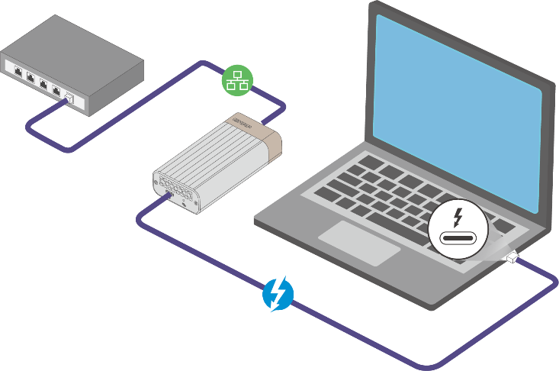

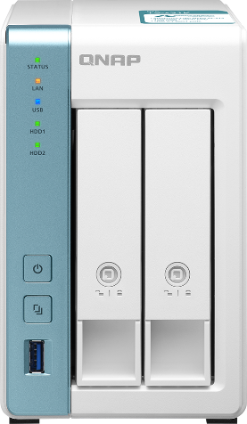
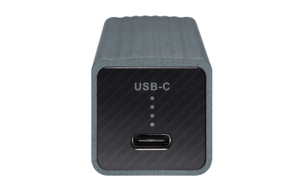



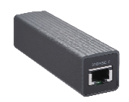
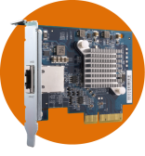
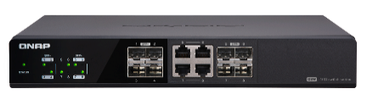

NAS/PC/Mac can also use Thunderbolt 3, USB or PCIe accessories to achieve 10GbE/5GbE/2.5GbE speed
10GbE
QNAP
QNA-UC5G1T:
USB 3.2 Gen1 to
5GbE/2.5GbE/1GbE
adapter
QNA-T310G1T (RJ45)
QNA-T310G1S (SFP+)
Thunderbolt 3
5GbE
Cat 5e
QXG-10G1T
or QNA-UC5G1T
TS-231K
5GbE
Cat 5e
2.5GbE & 5GbE with current wiring setup
QNAP 10G 8C switch
2.5GbE & 5GbE with current wiring setup

Slide 28
1. Memory upgrade
Demo
2. 2.5GbE & 10GbE
performance test

Slide 29
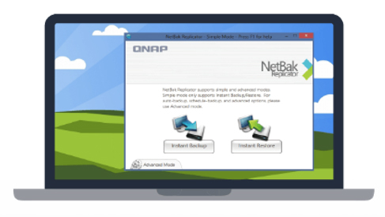

Backup the data from your computers
macOS
Time
Machine
Scheduled or instant backup to counter against viruses and ransomware
Windows
NetBak
Replicator
TS-932PX

Slide 30








Additional backup of Time Machine data
Copy Time Machine Backup file to NAS via HBS 3, and then synchronize the data from NAS to an external device or the cloud, eg. TR-004 USB RAID DAS or TL-D800C USB JBOD DAS.
Mac Time Machine
TS-932PX
TR-004
Create the backup job:
Select Time Machine Backup as source
Select TR-004 as destination
Setup scheduled backup of NAS Time Machine data

Slide 31



HBS 3 for data backup and recovery
Use HBS 3 (Hybrid Backup Sync 3) to easily transfer your data to local, remote and cloud storage spaces as a comprehensive data storage and disaster recovery plan.
Notes:
Carry and use 在不同地點

Slide 32









QNAP snapshot for file recovery, up to 256 versions
1. Fully supports all storage configurations at the storage pool level.
2. Easily take, manage and restore snapshots.
3. Using the mature Ext4 file system for "out of volume" snapshots.
RAM size | Maximum total snapshot numbers per NAS | Maximum snapshot number per volume/LUN
4GB and above | 256 | 64
File level
Removeable drives
Block level
A’
B’
C’
D’
E’
Local drives
Cloud / NAS
A
B
C
D
E

Slide 33












Qsirch 4.0 makes it easy to search for files
Search within NAS and on the Internet
Large file preview pane
Advanced search for complex keyword search
35+ powerful filter conditions
Easy steps from previewing to sharing
1
Web
2
Mobile
3
Mac Finder
4
Browser extension

Slide 34




Connect to home or office NAS with myQNAPcloud and QNAP ID (QID)
Anytime / Anywhere
Register and login with Email or phone number

Slide 35







Connect to Dropbox, One Drive, Google Drive and more
Qfile
File Station
Mobile
Computer
Local NAS
Remote NAS
Cloud Storage

Slide 36










QNAP QVPN and QBelt protocol for anywhere access
Secure Encrypted Connection:
DTLS + SSL +
AES-256 encryption
Works on desktop and mobile devices:
New QBelt protocol:
Decreases the chance of being detected
Windows, macOS, Android, iOS

Slide 37

QuMagie photo management with object and face auto-classification
Album view
Folder view
Albums and Smart Albums

Slide 38








Surveillance Station 24x7 with IP cameras
Surveillance Station 5.1
Recording channels
Free: 2
Max: 25
Vmobile
TS-832PX

Slide 39


Quad-core 1.7GHz w/ max 16GB RAM, best for Container Station to show your creativity
AI, IoT, Commonly-used Container Recommendation
  One-click installation wizard helps you quickly setup
Supports Docker Compose YAML format to create applications
Easily import/export containers
Imports images or containers from PC or NAS
Exports images or containers to NAS as backup
Built-in Docker Hub Marketplace
Easily downloadable tools

Slide 40





















HybridMount provides two modes for file-based cloud storage gateway
 | File Station Mount | File Cloud Gateway
Setup Method | Mount cloud drives | Select “File Cloud Gateway” mode and create a dedicated cache space
Connections | No limit | 2 free and perpetual connections. Purchase license for more connections
Access Performance | Depends on network speed | High performance thanks to caching
Access in File Station | Supported | Supported
Access through SMB / NFS / AFP | Not supported | Supported
Sync with the cloud | Sync only when browsing | Sync constantly for quick access
Integration with QTS Apps | Not supported | Supported
Online collaboration
File data analysis
Slower
Internet
NAS
cache
1
2
3
META
DATA
LAN
Faster

Slide 41




Business-class LUN backup:
VJBOD Cloud block-based gateway
VJBOD Cloud Gateway
Initiator
Local user
iSCSI
Target
Cloud object storage space
Initiator
iSCSI
Cloud LUN
Client
Application
Server
SMB/NFS/AFP/
FTP/WebDAV
Cloud Volume
/Shared folder
Local user
Snapshot
Snapshot

Slide 42


Use network-based VJBOD to expand other NAS capacity
Setup free space for multiple QNAP NAS devices to connect
iSCSi
QNAP x86 NAS (Intel/AMD CPUs)
TS-832PX

Slide 43
Economical and flexible QNAP expansion enclosures for multi-platform usage
QNAP TR RAID & TL JBOD have many advantages
Bigger capacity
  2, 4, 8, 16-bay choices
  NAS can support up to two units
Better compatibility:
for NAS or PC/server
  Expand NAS or server storage capacity or data migration between different hosts
  QNAP External RAID Manager and JBOD Manager for monitoring the JBOD status
Faster speed
  Popular USB 3.2 Gen 1 5Gb/s, USB 3.2 Gen 2 10Gb/s and PCIe with multi-channel SATA up to 64Gb/s*
USB interface
PCIe interface with SFF-8088 multi-channel SATA
TR-002
TR-004
TL-D800C
TL-D400S
TL-D800S
TL-D1600S
*TS-832PX be installed with a USB 3.2 Gen 2 PCIe adapter to support USB 3.2 Gen 2 10Gbps
TS-932PX does not have a PCIe slot. Therefore it does not support TL-D400S, TL-D800S, TL-D1600S JBOD, which requires a QXP SATA PCIe adapter.

Slide 44







QNAP TR & TL enclosures support
2 usages on NAS
TS-832PX and TS-932PX supports up to two QNAP TR or TL enclosures.
Internal mode with storage pool support or external mode with cross-platform compatibility with Windows/Mac computers.
Usage 1: Expanding the NAS with
a new volume
Usage 2: Work as a backup destination for snapshot replica
TR & TL units
TS-932PX
TR & TL units

Slide 45




One enclosure for two different uses: internal expansion or external disk mode
RAID & Storage Pool
External Disk Mode
All disks of TR & TL expansion units would be identified by Storage & Snapshot manager, then configure as a RAID of storage pool.
The storage is individual for each disk, it will show 8 independent external disks with TL JBOD or as a single disk with IR RAID unit. This mode is also for cross-platform compatibility among various O.S.
TL & TR units cannot be configured as a RAID group with those internal disks from NAS.
TR units can only support RAID 0/1/5/10 and JBOD modes.

Slide 46



3-year extended warranty option
Provide up to 5 years of warranty coverage
Standard warranty
2-year standard warranty service that comes in effect at the time of purchase.
Free repair and part replacement for products under normal use during warranty period. (Spare parts and consumables are excluded)
Extended warranty
Extending your warranty with this paid service, available within 90 days of the initial unit purchase.
Offers identical service to standard warranty.
Part number:
EXTW-YELLOW-3Y

Slide 47

Less to spend. Lots to like.
2.5GbE, 10GbE SFP+, 4-core 1.7GHz, PCIe expansion or dedicated SSD bays
Copyright© 2020 QNAP Systems, Inc. All rights reserved. QNAP® and other names of QNAP Products are proprietary marks or registered trademarks of QNAP Systems, Inc. Other products and company names mentioned herein are trademarks of their respective holders.​​​

