Slide 2
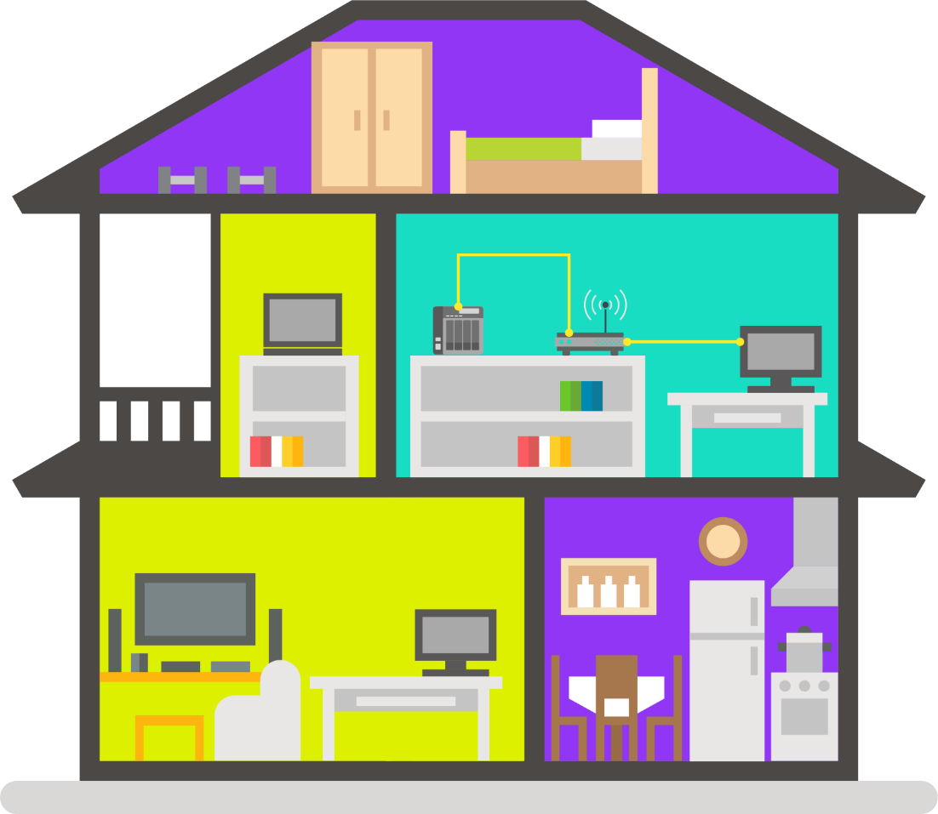
Home deploy- before
Simple network deploy
Basic internet access request
ADSL Modem
1GbE

Slide 3
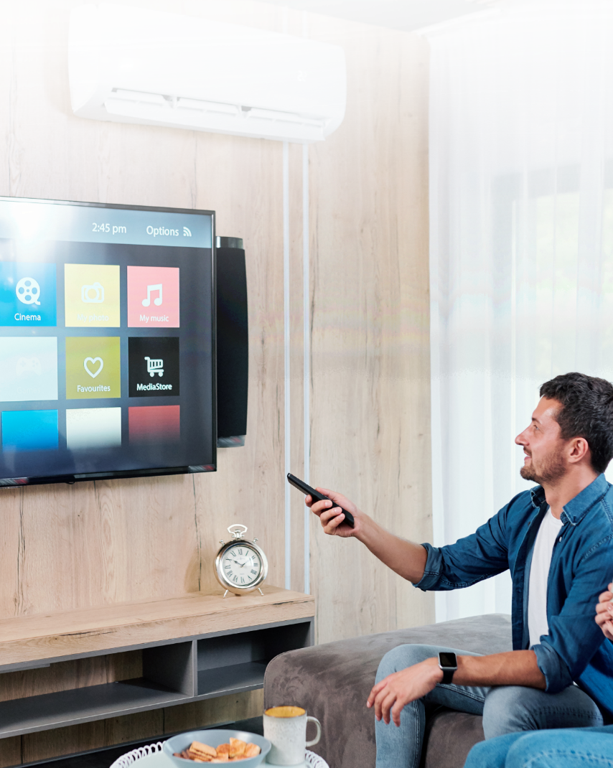
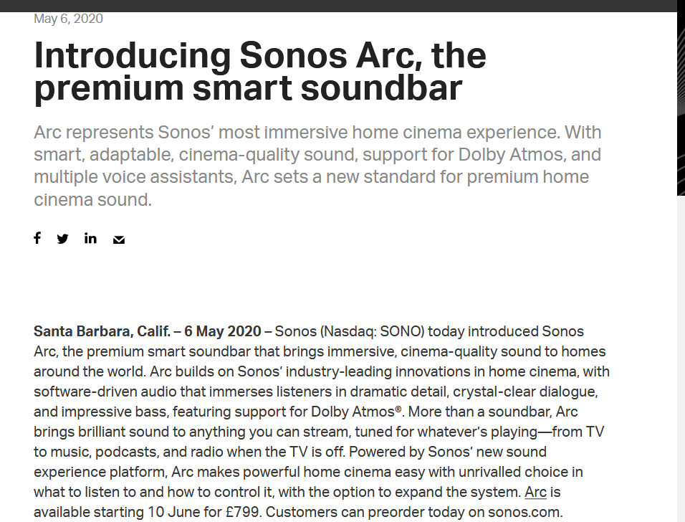
Home appliance can do more as you think
Television、HiFi、refrigerator can connect to internet

Slide 4
Have more and more smart device with everyone
A single laptop is enough as before
Now have laptop, smart phone, smart watch…etc and all need connect to internet

Slide 5
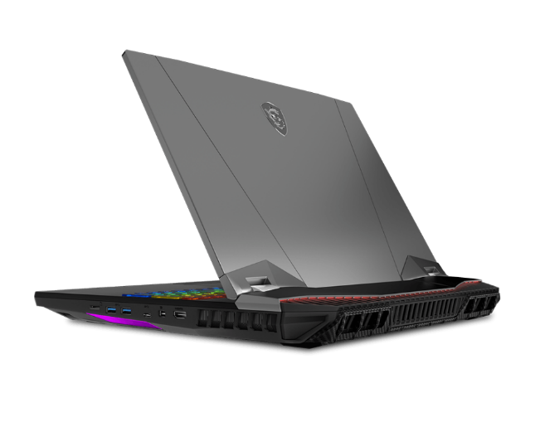
How can you play video game or watch high quality video without 2.5GbE
Network speed decide stability of online game
Network speed decide quality of online streaming
More and more mainboard and laptop support 2.5GbE network card
Asus ROG MAXIMUS XII EXTREME
MSI GT76 Titan

Slide 6
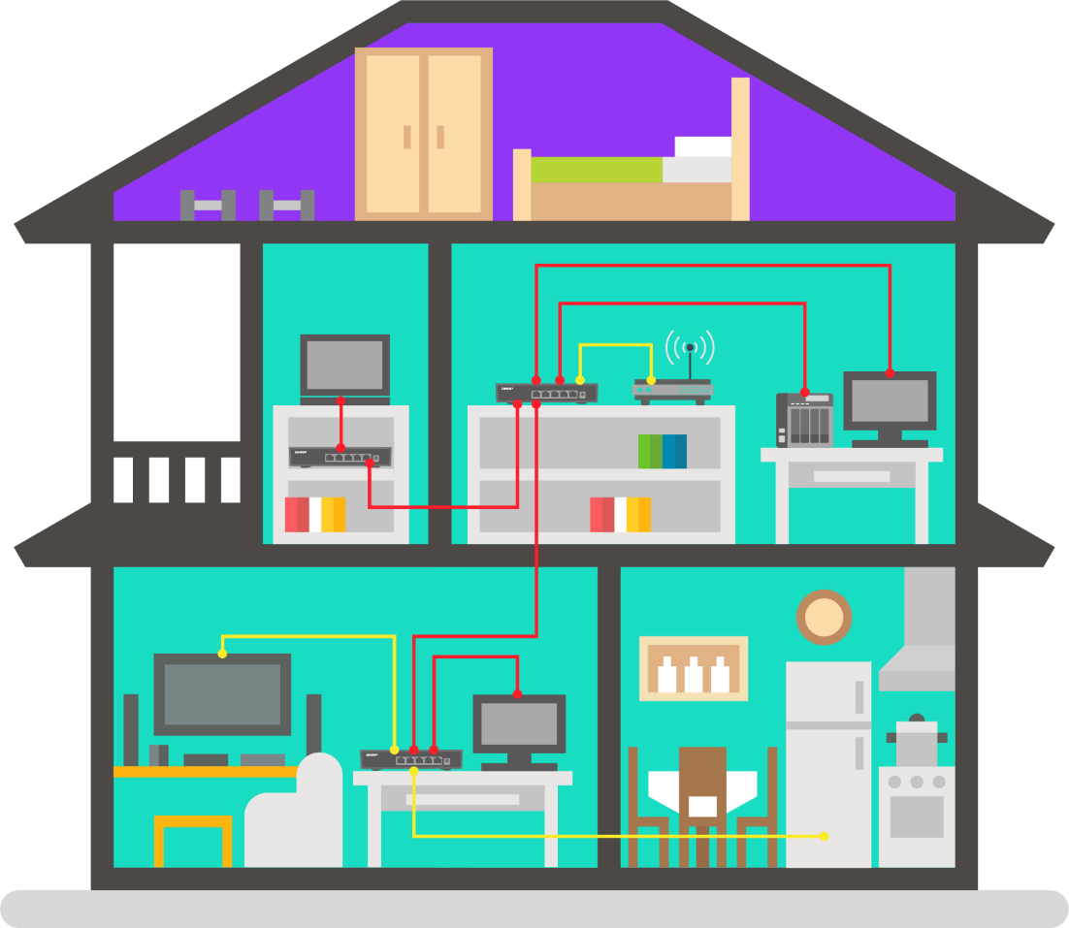
Home deploy – now
More and more end point device at home
Need high network speed for each device
Need high speed backbone network
Can enjoy high quality of streaming if you have high speed network
Can give you smooth and no delay video game quality if you have high speed network
1GbE
2.5GbE

Slide 7
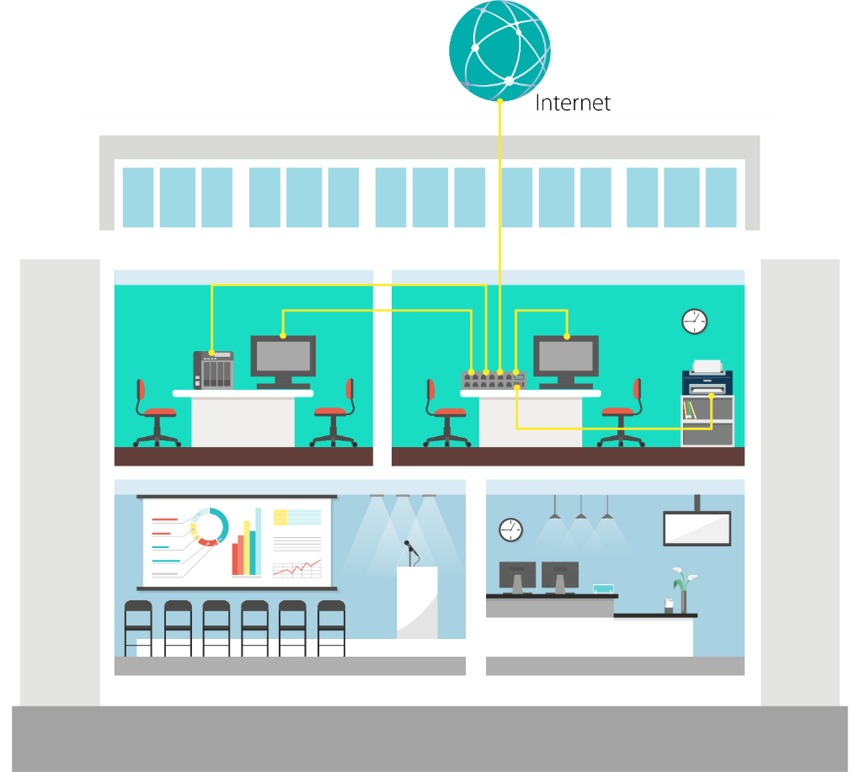
SOHO deploy - before
No high speed network request for end point device
1GbE network enough for data transfer
Uplink backbone only support 1GbE
1GbE

Slide 8
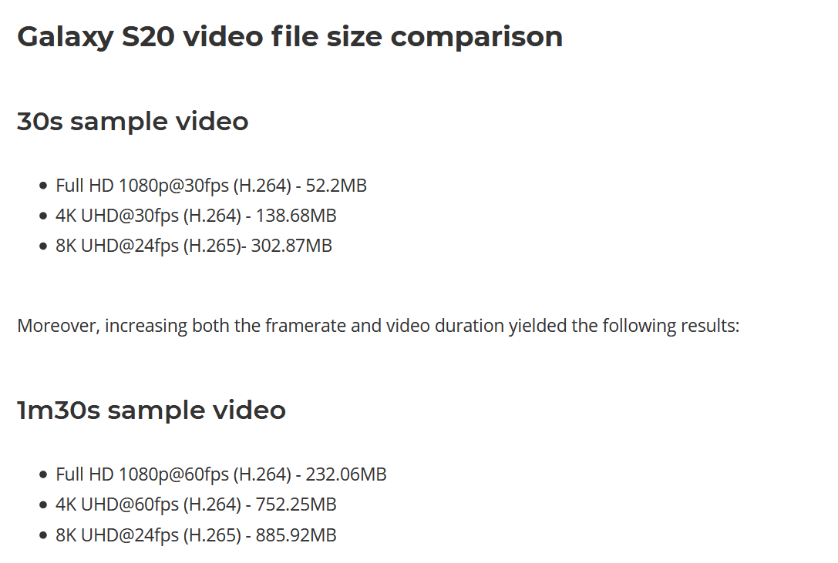
File size getting larger then before
Pursuing high quality streaming or files means file size will increase

Slide 9
Need high speed network for transferring large file size of documents
Data transfer efficiency will decrease if don’t have high speed network for transferring large size documents

Slide 10
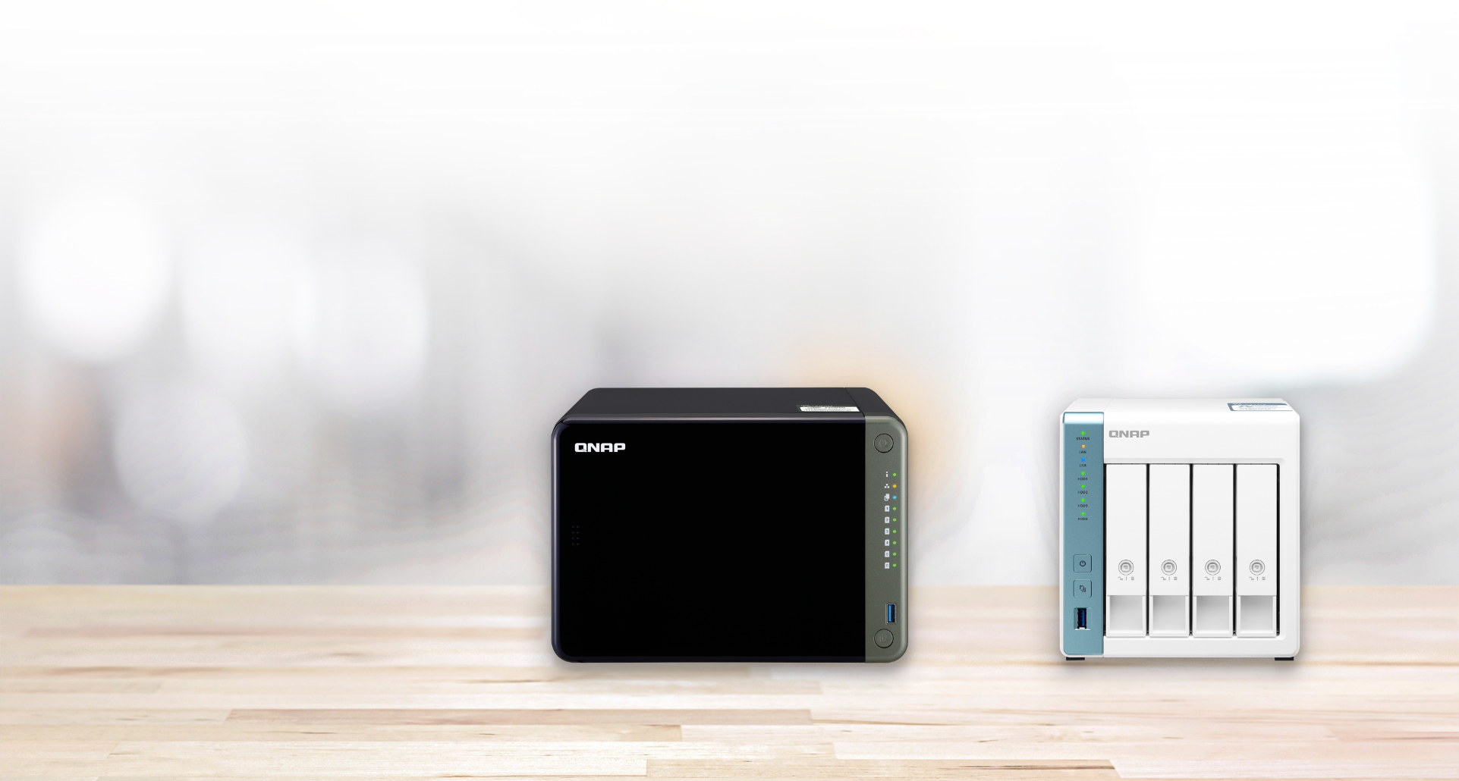
Using larger storage and high speed NAS for handling such large documents
Enough storage space for files
High speed network keep high quality of network efficiency
TS-653D
TS-431P3

Slide 11
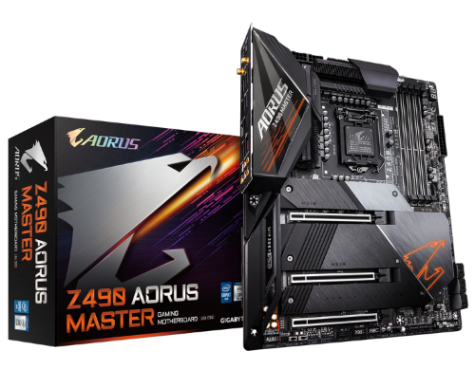
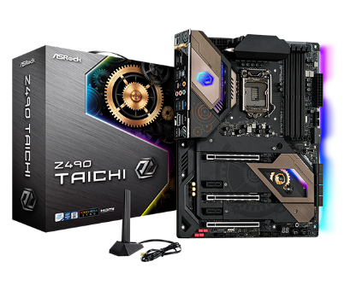
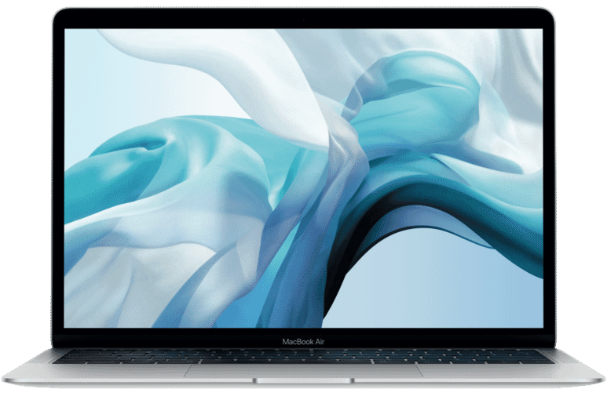
Slow network speed hinder efficiency of office work
Mainboard support 2.5GbE
Laptop support 2.5GbE
Keep you stay with high speed network without latency
Gigabyte Z490 AORUS MASTER
Apple MacBook
Asrock Z490 Taichi

Slide 12
SOHO deploy – now
Office network device support higher network speed
File size getting larger
Uplink network getting higher
Have high speed network at office can increasing efficiency of working
1GbE
2.5GbE

Slide 13
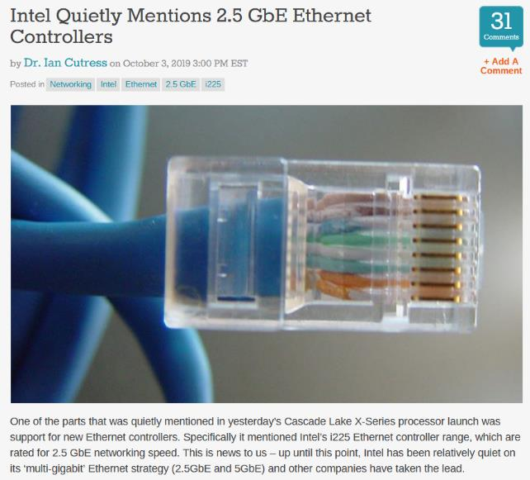
Network speed get into next generation
Intel already highlight how important it is of 2.5GbE
Chipset support 2.5GbE since 2019
Start marking the advantage of 2.5GbE before 2019
Notes:
https://www.anandtech.com/show/14937/intel-quietly-mentions-25-gbe-ethernet-controllers

Slide 14
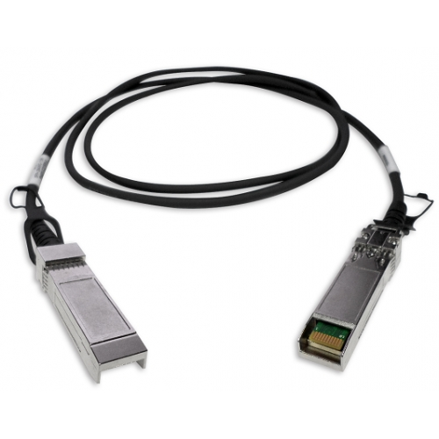
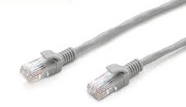
Do we need also upgrade our network cable?
To increase our network speed, I already swap my switch to 2.5GbE, do I need swap network cable also?

Slide 15
You can use original Cat 5e network cable directly
Don’t need worry about redeploy your network cable
 | CAT 5e | CAT 6 | CAT 6A
100M | ✓ | ✓ | ✓
1G | ✓ | ✓ | ✓
2.5G | ✓ | ✓ | ✓
5G | ✓ | ✓ | ✓
10G | X | ✓(55m) | ✓

Slide 16
2.5GbE is the best choice of low-cost for upgrading network speed
How much $$$ to have a 10GbE switch?
How much $$$ to upgrade your network cable?
Device cost
Cable cost
Device cost
Cable cost
1GbE → 2.5GbE
1GbE → 10GbE

Slide 17
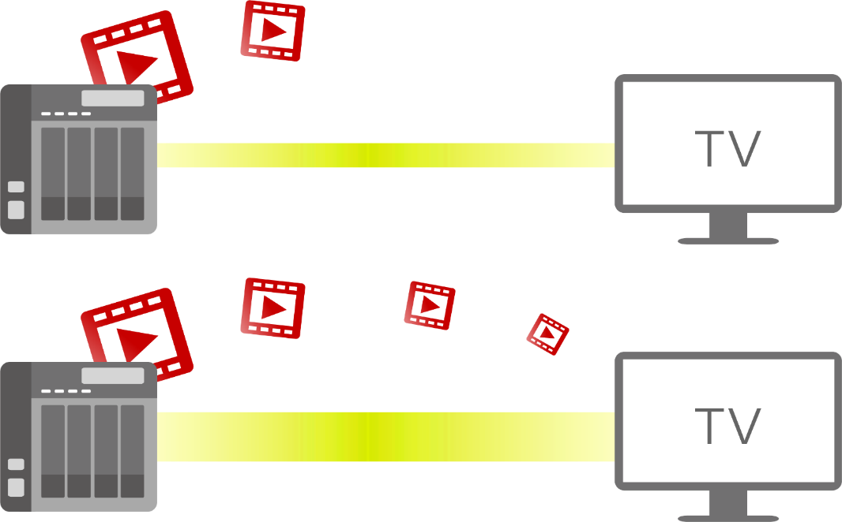
2.5GbE is coming
Don’t let low network speed slow down your steps
1GbE
8K Full HD video
Slow…….
2.5GbE
YA~~that’s what I talking about
8K Full HD video

Slide 18
Let’s use QSW1105-5T take you to high speed network without any pain
Low price 2.5G switch, balancing the cost of increasing network speed and swap new devices
Can use current RJ45 Cat5e cable, saving money for swap cable
2.5GbE solution
10GbE solution

Slide 19
Hardware highlight

Slide 20
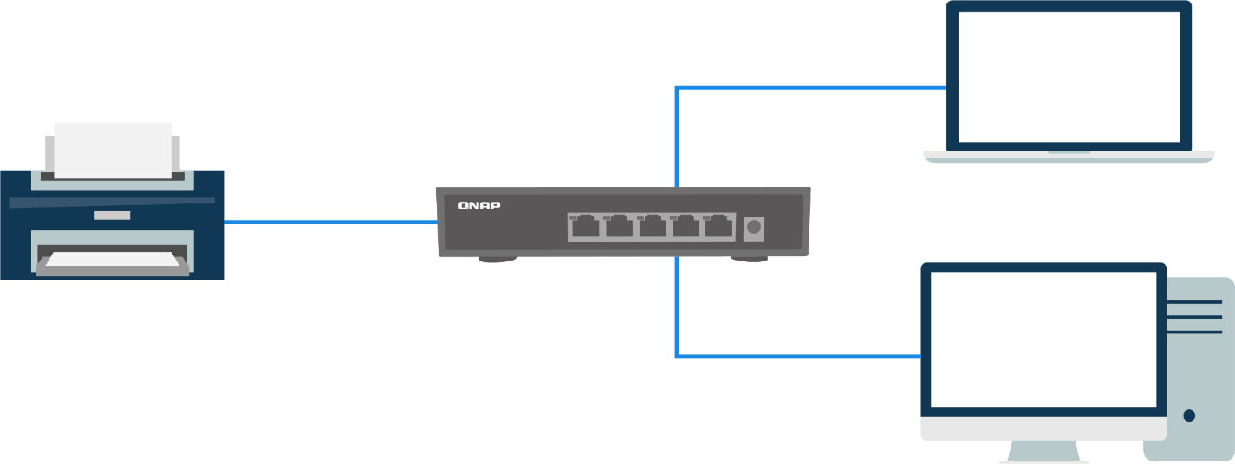
Connect your current end point device directly
5 ports 2.5GbE design
1GbE or 100MbE devices can connect to it directly, feel free plug in your current devices
2.5GbE
100MbE
1GbE

Slide 21
Fanless design, without bothering
Desktop fanless high quality housing design
Don’t worry about noise even you put at home

Slide 22
Software highlight

Slide 23
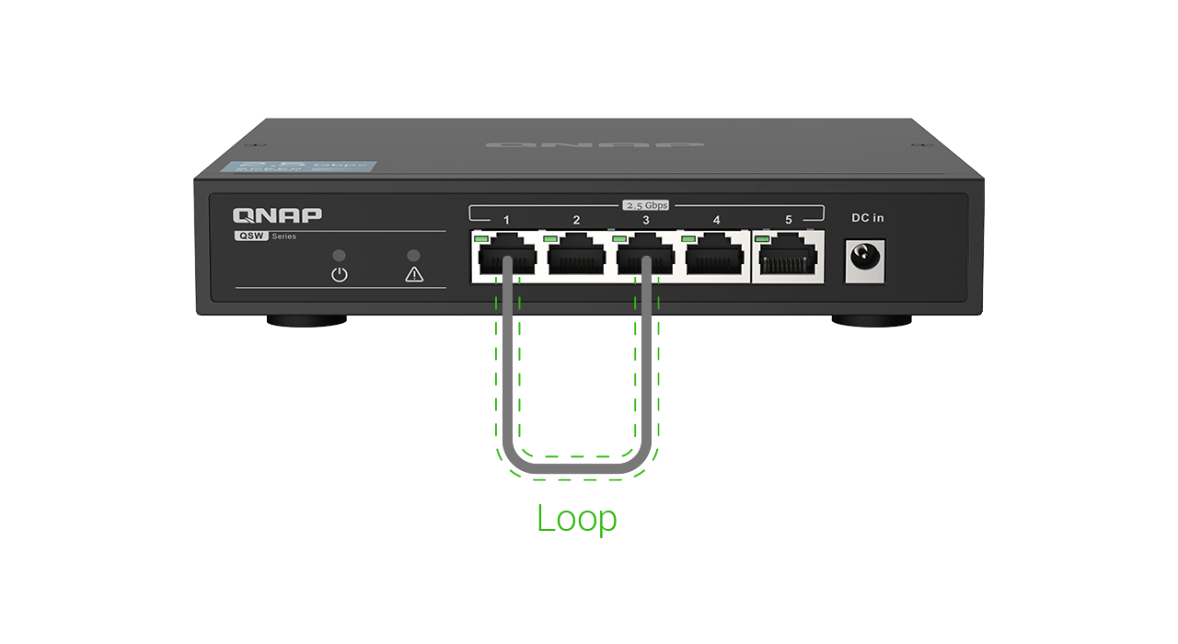
Loop guard keep away with wrong cable connected
Loop guard usually support at high level with GUI configuration management switch
Auto detect loop mess and block it directly, no manual configuration needed
LED light steady when loop occur

Slide 24
Automatically working without any configuration
Plug and play
No configuration needed, everyone can set it up

Slide 25
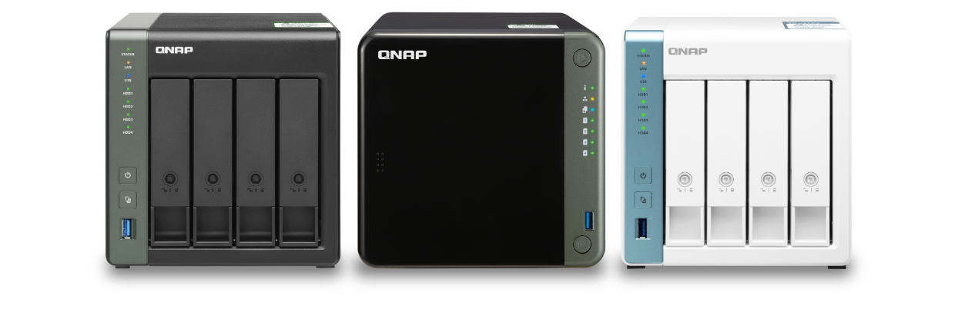
Perfect with QNAP 2.5GbE NAS

Slide 26
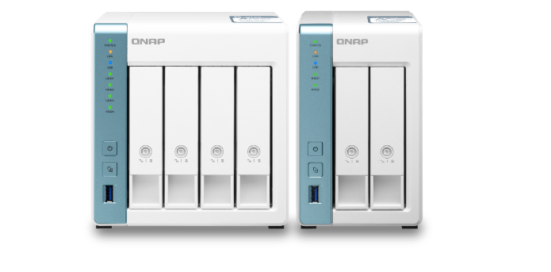
QNAP 2.5GbE teams give you perfect experience of high speed network
Professional high efficiency network storage
Digital home with high quality of streaming
Annapurna Labs AL-314 4 cores 1.7GHz, 1 x 10GbE SFP+, 1 x 2.5GbE
Annapurna Labs AL-314
4 cores 1.7GHz, 1 x 2.5GbE
Intel Celeron J4125 4 cores 2.0GHz, 2 x 2.5GbE,
PCIe extend M.2 NVMe/ SATA SSD or 10GbE
TS-653D
TS-453D
TS-253D
TS-431X3
TS-231P3
TS-431P3

Slide 27
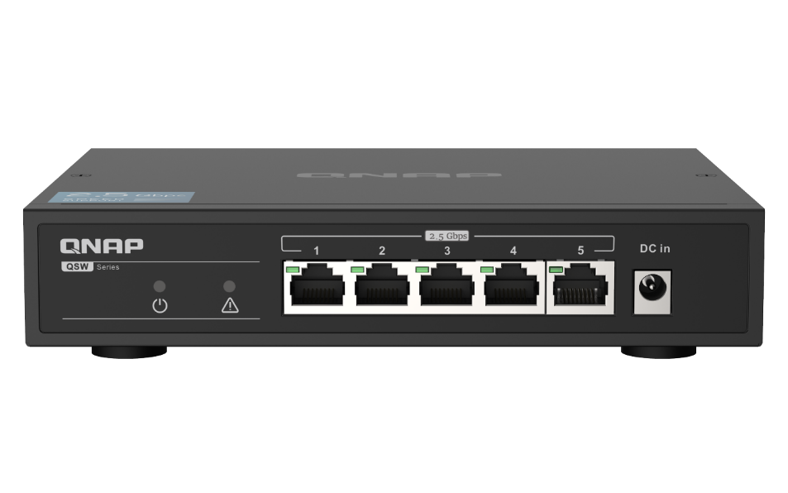
QSW-1105-5T 2.5GbE is your best choice of low-cost for upgrading network speed
Copyright © 2020 QNAP Systems, Inc. All rights reserved. QNAP® and other names of QNAP Products are proprietary marks or registered trademarks of QNAP Systems, Inc. Other products and company names mentioned herein are trademarks of their respective holders.

