Slide 2
ZFS Operating System
QuTS hero

Slide 3


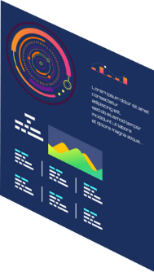

The 3rd QuTS hero dedicated machine launched by QNAP:
Why we choose ZFS file system for our enterprise NAS
Because we know that enterprises all value these ...
Enterprises have used a lot of All Flash solutions, and SSD consumption has become the key to IT cost structure
Digital transformation relies on massive data analysis and requires PB-level storage space
Corporation data cannot allow unintentional error; it is essential to ensure data integrity.
Instant disaster recovery capability & complete data backup protection are the competitiveness indexes of an enterprise

Slide 4




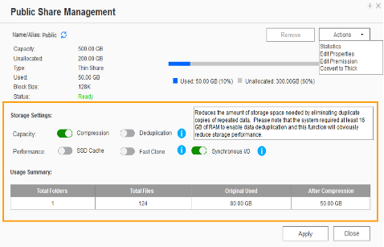



Powerful data reduction:
Extend the SSD endurance
only available when inline dedup/compress enabled
ZFS file system with inline deduplication & inline compression features.
The ZFS file system can be the best choice to pair with the all-flash and SSD storage because it reduces the data size and pattern that need to be written to the SSD directly.
Write
A
B
C
D
A
B
C
D
A
B
C
D
D
C
A
B
D
C
A
B
Original Data
Compressed Data
Deduplicated Data
SSD Pool
Compression
Deduplication
Write to SSDs as sequential as much as possible.

Slide 5





Amazing massive storage –
The best data carrier of big data analysis/edge computing/AI inference
Only PB-level shared folder is enough to store the huge data matrix .
200TB is not enough
Data
Model building
Model validation
Parameter adjustment
Deep Learning

Slide 6




Silent data corruption & self-healing
Application
Application
Application
ZFS RAID
ZFS RAID
ZFS RAID
Avoid data loss that occurred on the running system.

Slide 7





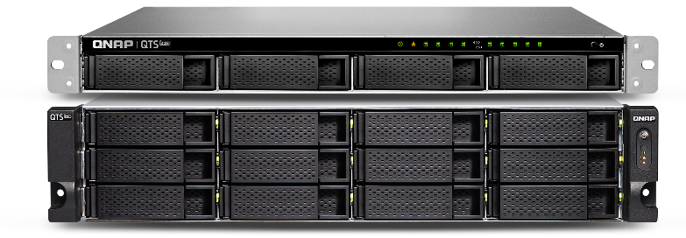
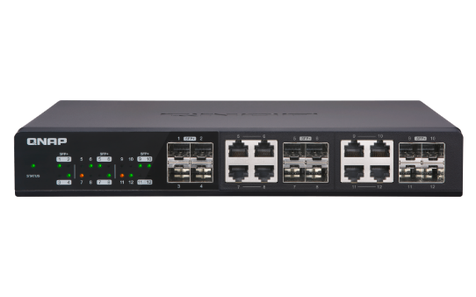

Three-layer backup solution :
Provide you the most complete data backup protection
HBS 3 :
RPO : daily / schedule
File level, multi-version management
Snapshot & Replica:
RPO : hourly / 24 hr / 365 day
Block level, multi-version management, ZFS provides the most lightweight snapshot without affecting storage performance at all.
SnapSync:
Real-time
SnapSync
RPO : Real-time
Real-time
SnapSync
Block level, Mirror the data copy and always kept up to date.
QTS 4.4.x

Slide 8

WORM (Write Once Read Many times)
WORM is used to avoid modification of saved data. Once this feature is enabled, data in shared folders can only be read and cannot be deleted or modified to ensure data integrity.
  Enterprise Mode : remove the shared folder through QTS hero UI or SSH commands (QCLI).
  Compliance Mode : Have to take the Storage Pool offline and remove the Pool if want to destroy data.

Slide 9
GM-1000
Specifications

Slide 10



Storage Requirements in Business
Business requires multiple NAS for:
Serving different applications
  E.g.：virtualization、file sharing、data archive
Serving different departmentsw
Data backup or disaster recovery

Slide 11


Storage Investment in Business
The dilemma of old NAS
Poor performance for new applications
Run out of storage
Hardware reached its service life
The destiny of old NAS
Dispose of the old NAS and buy a new one
Move the old NAS to other applications (Has the hardware reached its life？？)
How to make an economic investment?

Slide 12

GM-1000
GM-1000
Dual NAS with double performance
  Two independent NAS within a 3U enclosure
  Two NAS shares 770W redundant PSU
  Ship with QuTS hero OS
B-side TNS-h1083X
A-side TNS-h1083X

Slide 13
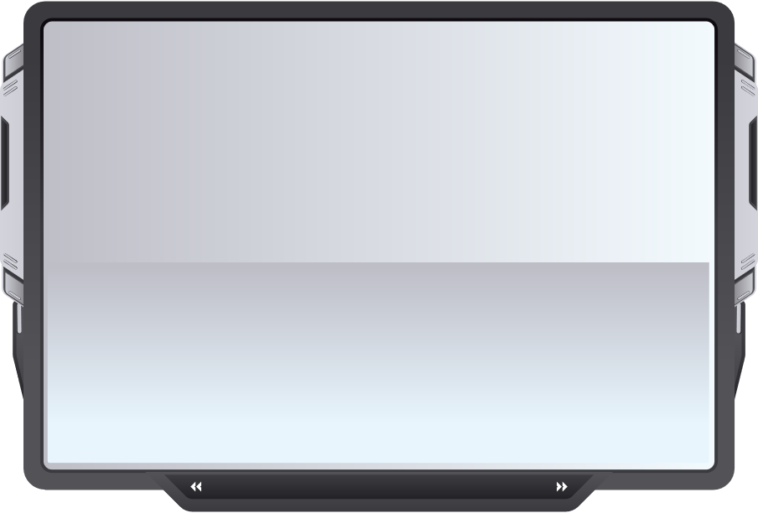
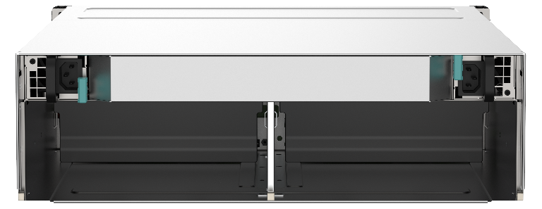
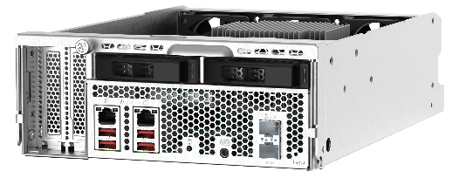

Composition of the GM-1000
Swappable NAS design
Easy maintenance and parts upgrade
System upgrade by replacing the NAS node only. Save money on enclosure purchasing
1 x TEC-2N16 enclosure
2 x TNS-h1083X NAS
Model name：TEC-2N16-770W
3U 16-bay chassis
Support two NAS nodes
16 x 3.5”/2.5” SATA drive carrier
2 x 770W redundant PSU
Intel Xeon E processor
4 x DDR4 DIMM
2 x 10GbE SFP+ and 2 x 2.5GbE LAN port
2 x U.2 NVMe Gen3 x4/ SATA 6Gb/s port
2 x M.2port (NVMe Gen3 x2)

Slide 14

Hard Disk Assignment
  Each NAS supports 10 drives
A-side NAS
B-side NAS
2 x U.2 port
2 x U.2 port
  8 x 3.5”/2.5” SATA HDD
  2 x 2.5”U.2 SSD
    Supports NVMe Gen3 x4 SSD
    Supports SATA 6Gb/s SSD
    Supports QDA-UMP/QDA-U2MP
QDA-U2MP
U.2 to 2 x NVMe M.2 SSD
HDD for A-side NAS
HDD for B-side NAS
QDA-UMP
U.2 to 1 x NVMe M.2 SSD

Slide 15
High Speed U.2 SSD for System Drives
ZFS file system require high speed SSD to improve system read/ write performance
TNS-h1083X provides two U.2 SSD ports which support NVMe Gen3 x4. It can provide up to 800K rand read IOPS and 100K random write IOPS.
Notes:
NVMe: Samsung PM1725b
SAS 12G: Samsung PM1643a
SATA 6G: Samsung PM883

Slide 16
Economic and Space Saving Design
VS.
2 x TS-883XU-RP
1 x GM-1000
Space requirement | 4U space in a rack | Only 3U space in a rack
Power supply | 300W x4 | 770W x2
Maintenance | Need to remove the complete NAS system from rack | Swappable NAS node. Ease of hardware upgrade and repair service
Upgradeability | Need to purchase a new system | Upgrade by replace new NAS node

Slide 17
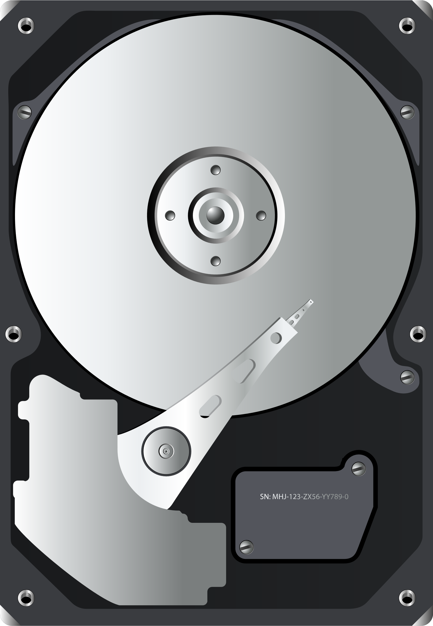




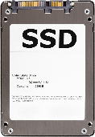
System Block Diagram
TEC-2N16
TNS-h1083X
TNS-h1083X
4 x memory DIMM slot
Xeon CPU
PCIe Gen3 x4
4 x memory DIMM slot
Xeon CPU
PCIe Gen3 x4
PCIe Gen3 x8 slot (CPU)
PCIe Gen3 x4
PCIe Gen3 x8 slot (CPU)
PCIe Gen3 x4
PCIe Gen3 x4 slot (PCH)
PCIe Gen3 x4 slot (PCH)
SATA x8
SATA x8
2 x 2.5GbE
PCH
2 x 2.5GbE
PCH
2 x 10GbE SFP+
2 x 10GbE SFP+
SATA
controller
SATA
controller
2 x M.2 port
2 x M.2 埠
2 x U.2 port (rear side)
2 x U.2 port (rear side)

Slide 18
TEC-2N16 Enclosure Specifications
HDD for A-side NAS
HDD for B-side NAS
A-side NAS
OLED/LED
indicators
B-side NAS
OLED/LED
indicators
OLED on/off button
OLED on/off button
Lockable tray

Slide 19

Front Panel Indicator
NAS power status
NAS fan status
NAS system temperature
A/B side indicator
Enclosure power status
NAS system status
OLED on/off button

Slide 20
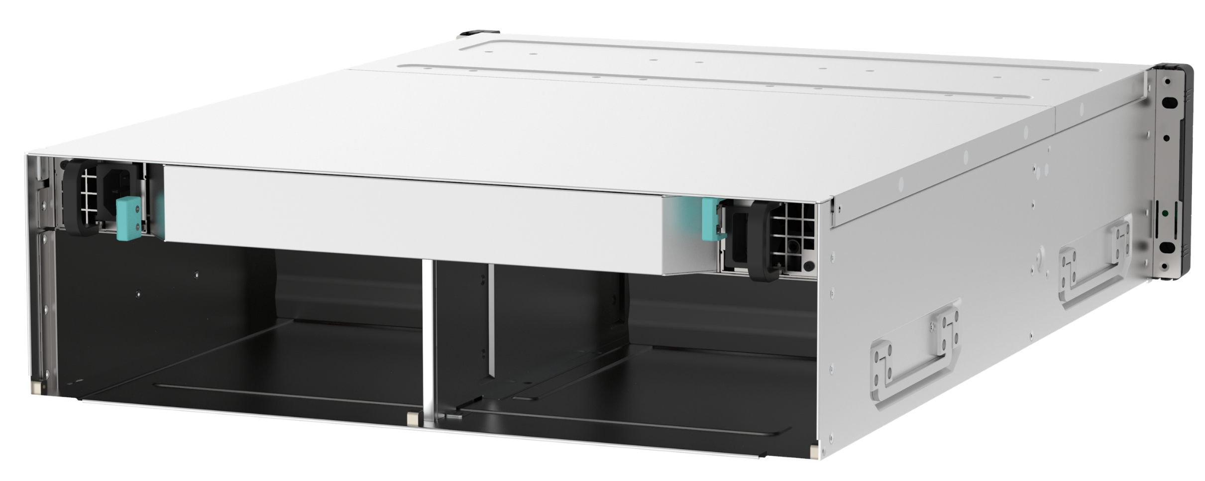
TEC-2N16 Rear View
770W redundant PSU
(Shared by two NAS)
B-side NAS drawer
A-side NAS drawer

Slide 21
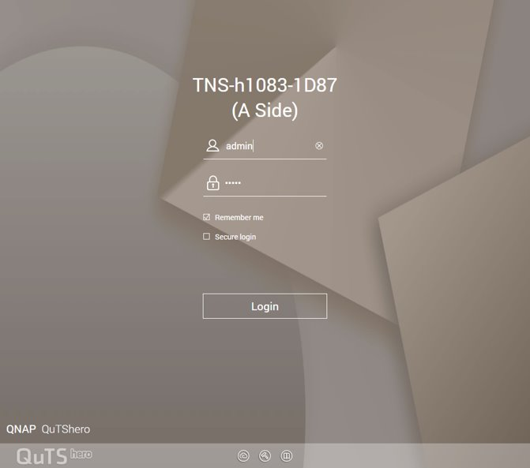
User Interface – Login Page
Login device

Slide 22
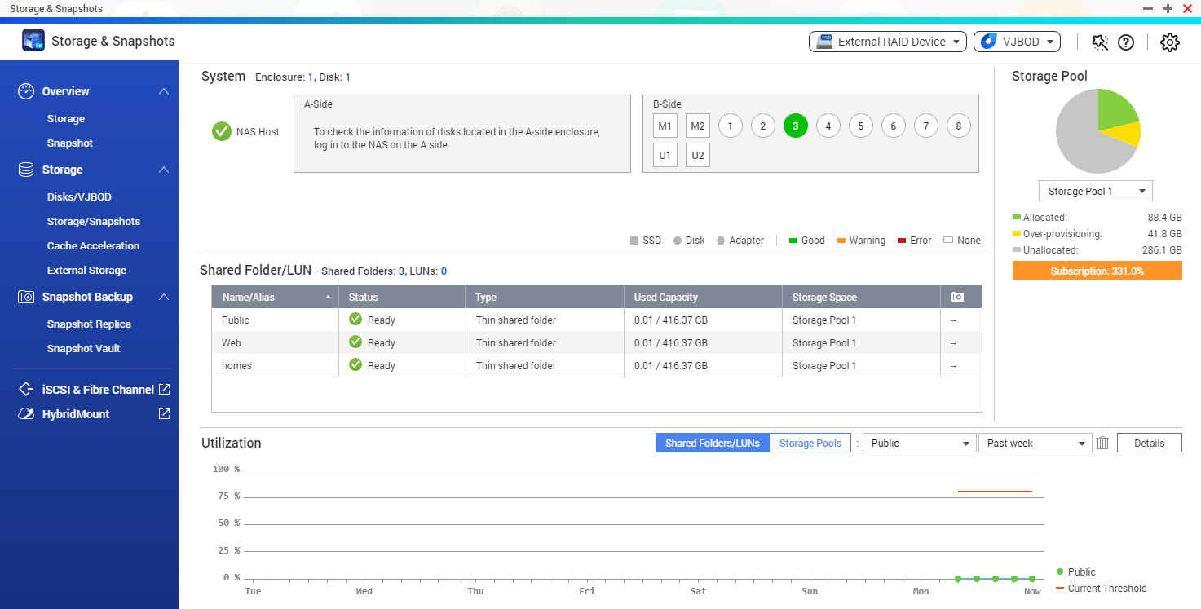
User Interface– Storage Manager
Display Disk info of the side.

Slide 23
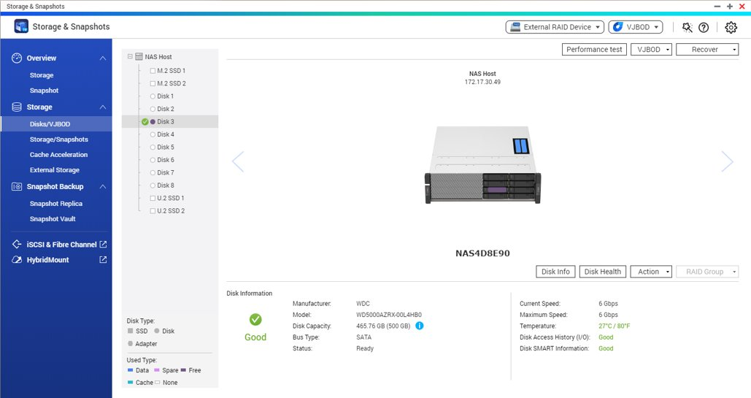
User Interface– Storage Manager
Display the selected disk

Slide 24
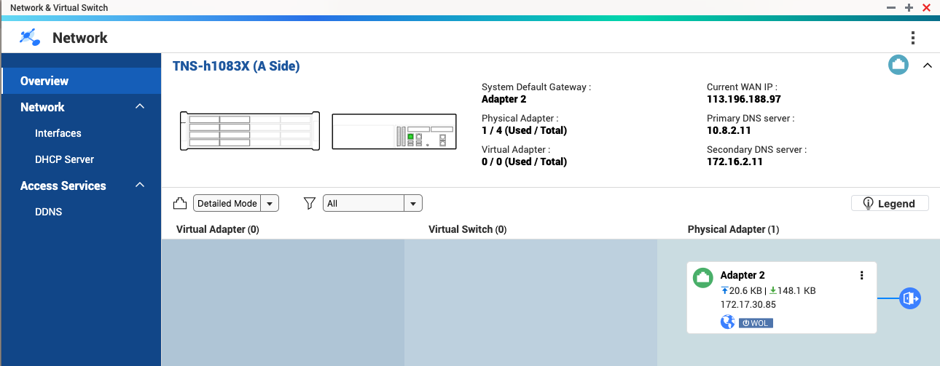
User Interface – Network and Virtual Switch
Display LAN info of the side

Slide 25


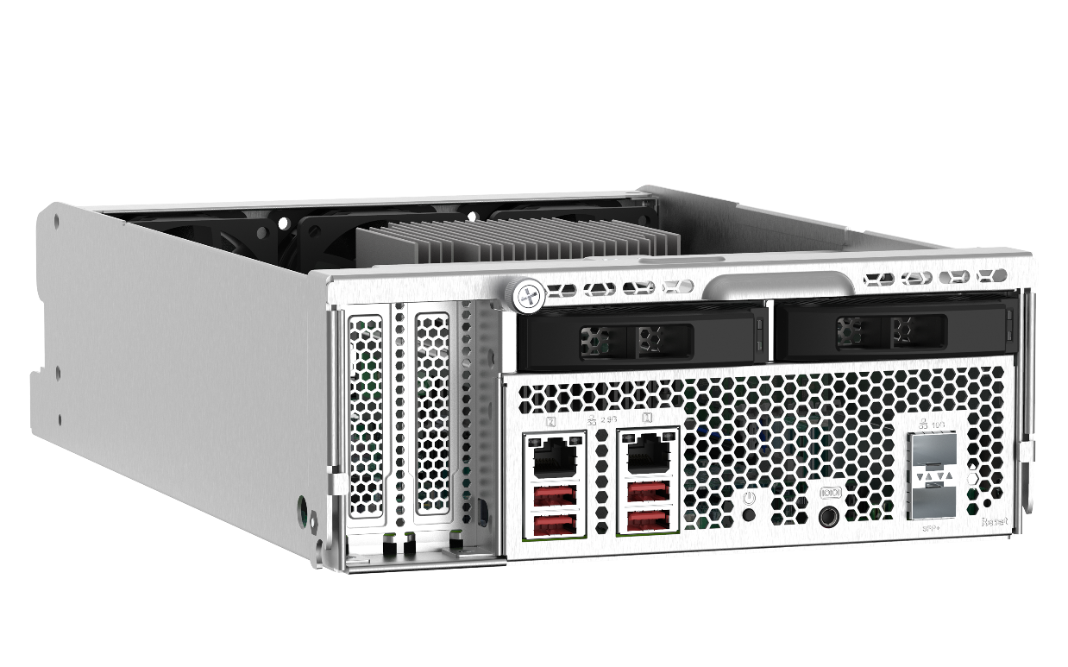

TNS-h1083X NAS Node Specifications
TNS-h1083X-E2234-8G
TNS-h1083X-E2236-16G
Intel® Xeon® E-2234 4-core /
8-thread 3.6 GHz processor, Max. turbo boost to 4.8 GHz
8GB DDR4 ECC RAM (2 x 4GB)
2 x 10GbE SFP+ and 2 x 2.5GbE LAN port
2 x U.2 port (NVMe Gen3 x4/ SATA 6Gb/s)
2 x M.2 port (NVMe Gen3 x2)
Intel® Xeon® E-2236 6-core /
12-thread 3.4 GHz processor, Max. turbo boost to 4.8 GHz
16GB DDR4 ECC RAM (2 x 8GB)
2 x 10GbE SFP+ and 2 x 2.5GbE LAN port
2 x U.2 port (NVMe Gen3 x4/ SATA 6Gb/s)
2 x M.2 port (NVMe Gen3 x2)

Slide 26

Intel Xeon D Enterprise Processor
Intel® Xeon® E-2236
  6-core / 12 thread processor
  3.4 GHz, max. boost to 4.8 GHz
Intel® Xeon® E-2234
  4-core / 8 thread processor
  3.6 GHz, max. boost to 4.8 GHz

Slide 27
Support ECC Memory (Error Correcting Code)
Running reliably without data corruption
Intel Xeon processors support ECC which automatically detects and repairs single-bit error on-the-fly.
Supports up to 128GB

Slide 28

TNS-h1083X NAS Node Rear View
2 x U.2 port
- Supports NVMe Gen3 x4 / SATA 6Gb/s SSD
2 x 2.5 GbE LAN port
2 x 10GbE SFP+ LAN port
Console port
Power button
2 x PCIe slot
- PCIe #1: PCIe Gen3 x8 (CPU)
- PCIe #2: PCIe Gen3 x4 (PCH)
4 x USB 3.2 Gen 2
(Type-A)

Slide 29
TNS-h1083X NAS Node Internal Design
3 x 6cm system cooling fan
2 x 2280 M.2 NVMe Gen3 x2 port
Intel Xeon CPU
2 x PCIe slot
4 x DDR4 long-DIMM
2 x U.2 drive carrier

Slide 30
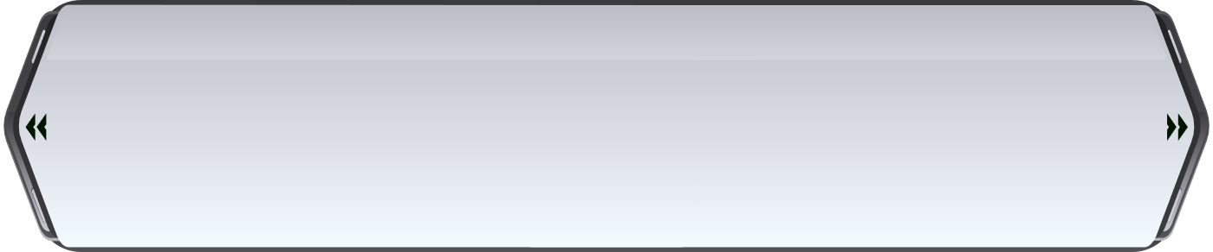
Ordering Information
SKUs | Enclosure | NAS node | CPU | Memory
GM-1001 | 1 x TEC-2N16-770W | 2 x TNS-h1083X-E2234-8G | Intel Xeon E-2234 | 8 GB (2 x 4GB)
GM-1002 |  | 2 x TNS-h1083X-E2236-16G | Intel Xeon E-2236 | 16 GB (2 x 8GB)

Slide 31
GM-1000
Applications

Slide 32
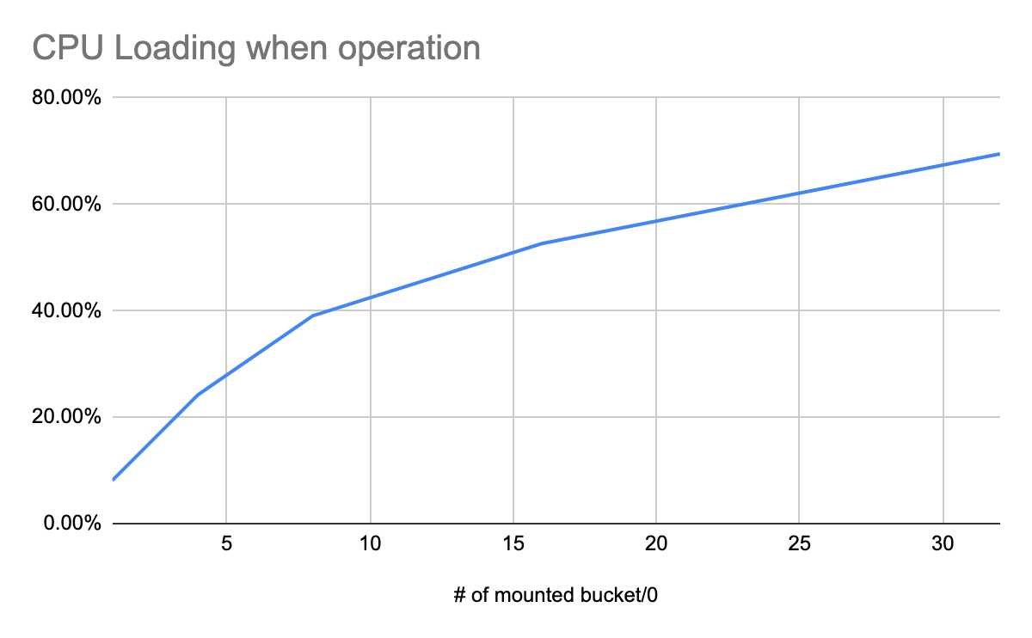
Hardware Requirement for HybridMount
CPU Loading when operation
  HybridMount consume CPU resources
  CPU computing power and cores are the key factors

Slide 33

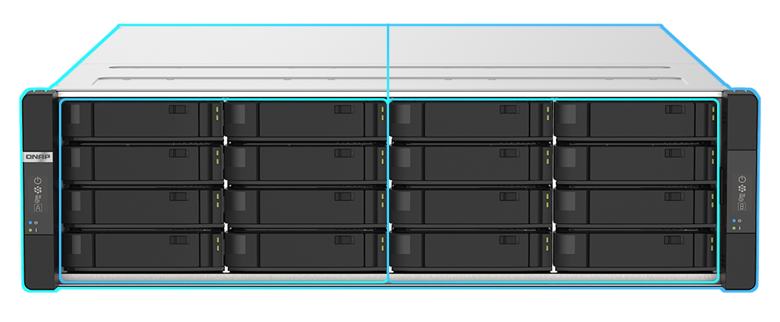


















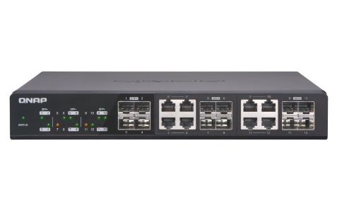
The Best NAS for QNAP HybridMount
Two NAS double up the computing power
Each NAS provides different cloud gateway services
A-side NAS
B-side NAS
10GbE switch
PC/ notebook

Slide 34


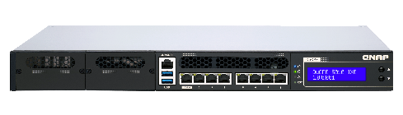
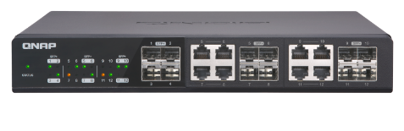
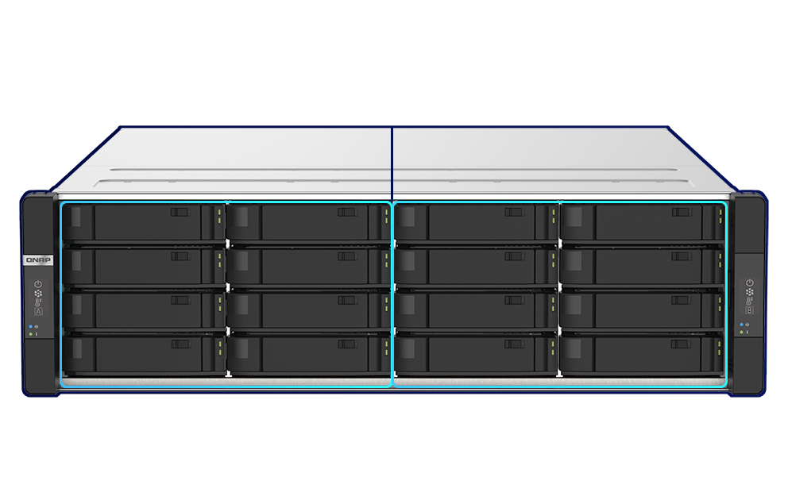


Services Offload and Cross Back up
10GbE switch
VM
VM
VM
PC/ notebook
Hypervisor host
A –side NAS provides file sharing via CIFS/FTP service
A-side NAS
B-side NAS
B-side NAS provides iSCSI service
10GbE connection
Backup
Backup
QNAP Snapsync (block based)
HBS backup (file based)
QuTS hero SnapSync will be ready on Q2 2020

Slide 35

Affordable Data Backup NAS for Multiple ES NAS
QES and QuTS hero are ZFS-based operating systems
SnapSync offers an efficient way to synchronize and back up data
ES2486dc
10GbE switch
ES2486dc
ES1686dc
A-side NAS
B-side NAS
QuTS hero SnapSync will be ready on Q2 2020
Requires QES 2.1 and above

Slide 36
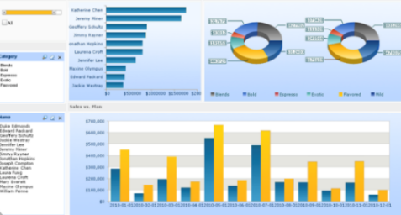





FC-SAN Storage, Backup and Copy Data Management
VMware
SAN switch
Ethernet switch
Hypervisor Host
4
1
A-side NAS provide FC storage service
B-side NAS
Mount the iSCSI LUN for CDM
A-side NAS
2
10GbE connection
3
Sync FC LUN to B-side NAS via 10GbE LAN
Clone an iSCSI LUN via QNAP Snapshot Clone
FC LUN
LUN
iSCSI
LUN
SnapSync
Snapshot
clone
QuTS hero SnapSyncwill be ready on Q2 2020

Slide 37
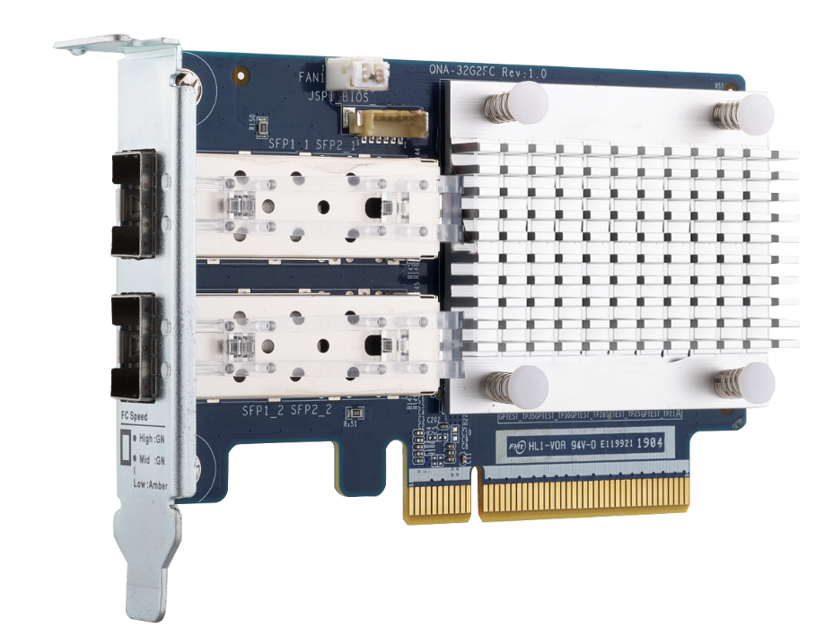

QNAP 32Gb/16Gb Fiber Channel Adapter
QNA-32G2FC
Dual-port 32Gbps
FC adapter
High-speed yet economical QNAP FC storage adapters for QNAP NAS*
*Not supporting Windows/Linux hosts
QNA-16G2FC
Dual-port 16Gbps
FC adapter
Optional FC transceiver
TRX-32GFCSFP-SR
  32Gb/16Gb/8Gb
TRX-16GFCSFP-SR
  16Gb/8Gb/4Gb

Slide 38
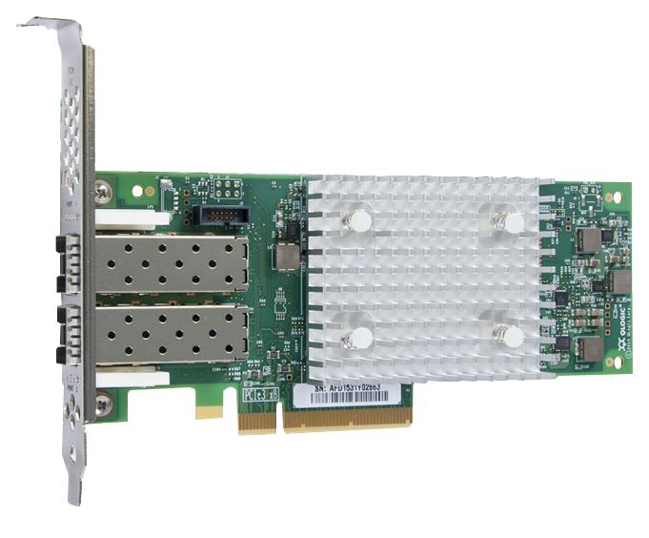
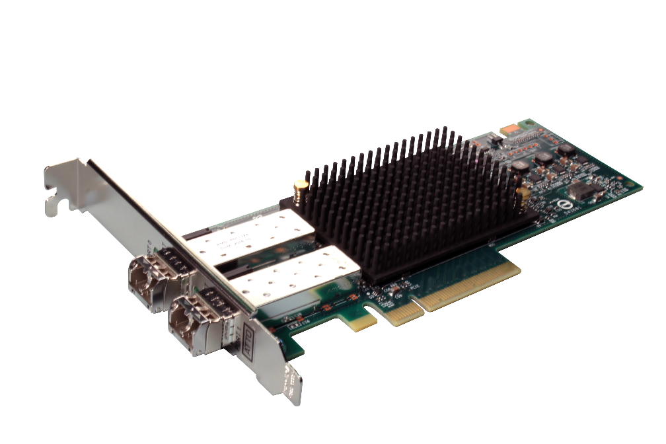


Supported Fibre Channel Adapters
Partnering with industry-leading FC adapters vendors for the most economical FC SAN storage solution
Support Marvell
Qlogic 32Gb/16Gb/8Gb/4Gb FC adapters
Support ATTO
Celerity 32Gb/16Gb FC adapters
Compatibility list: https://www.qnap.com/compatibility/

Slide 39

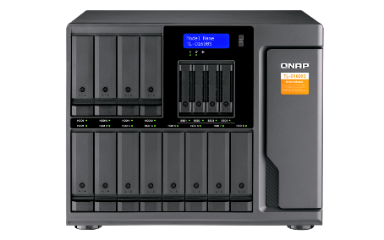
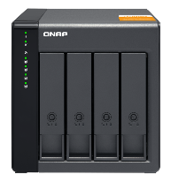
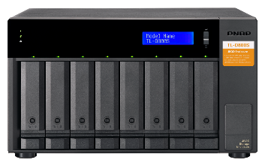

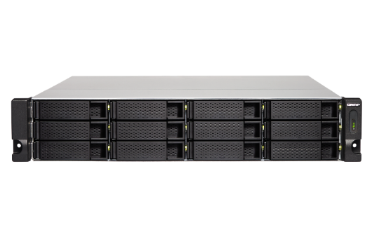
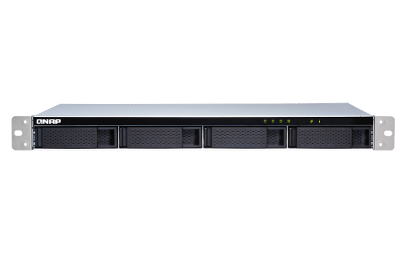

TL SATA JBOD series enclosures with multi-channel SATA 6Gb/s transfer
A single SFF-8088 cable for up to 4 x SATA 6Gb/s = 24 Gb/s transfer speed. Using multiple cables can achieve up to 64 Gb/s between the host and JBOD.
Ready to use by including a QXP PCIe SATA expansion card and SFF cable(s) with the TL unit
TL-D400S
TL-D800S
TL-D1600S
Support NAS QTS / QTS hero, Windows, Ubuntu / Linux
TL-R1200S-RP
TL-R400S

Slide 40

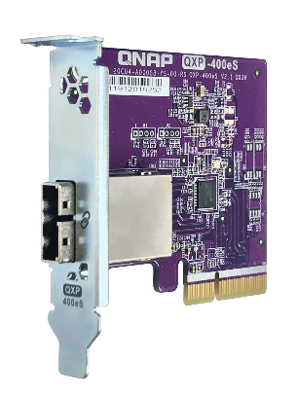
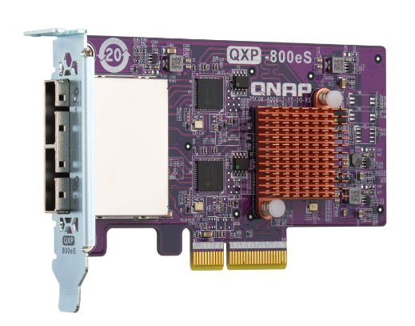
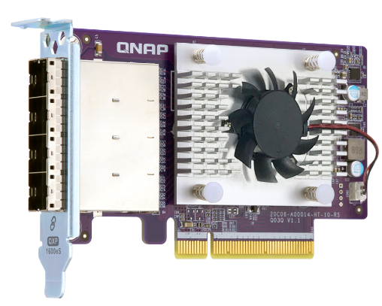



A QXP card for multiple SATA 6Gb/s connectivity to the host for fast transfer
QXP-400eS-A1164
PCIe 4-port SATA card
QXP-800eS-A1164
PCIe 8-port SATA card
QXP-1600eS
PCIe 16-port SATA card
External port: 1 x SFF-8088
Disk drive: 4 x SATA 6Gb/s
Max speed: PCIe 3.0 x2 (1.97 GB/s)
Dimension: 78.8 x 68.9 mm half-height
Bundled in TL-D400S & TL-R400S
External port: 2 x SFF-8088
Disk drive: 8 x SATA 6Gb/s
Max speed: PCIe 3.0 x4 (3.94 GB/s)
Dimension: 117.15 x 68.9 mm half-height
Bundled in TL-D800S
External port: 4 x SFF-8644
Disk drive: 16 x SATA 6Gb/s
Max speed: PCIe 3.0 x8 (7.88 GB/s)
Dimension: 117.15 x 68.9 mm half-height
Bundled in TL-D1600S & TL-R1200S-RP
Different brackets included for various hosts
Can be purchased separately for installation in multiple hosts and future card replacement.

Slide 41

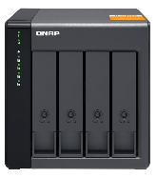
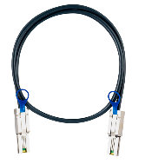

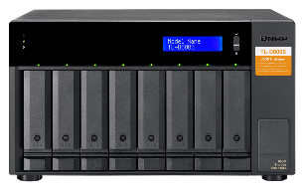


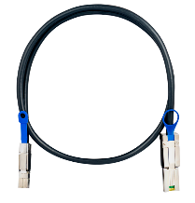
Ready to use with included QXP card and cables
+
+
+
+
TL-D400S
1 x QXP-400eS-A1164
PCIe 4-port SATA card
1 x 1M SFF-8088 cable
TL-D800S
1 x QXP-800eS-A1164
PCIe 8-port SATA card
2 x 1M SFF-8088 cable
+
+
1 x QXP-1600eS
PCIe 16-port SATA card
TL-D1600S
4 x 1M SFF-8088 to SFF-8644 cables

Slide 42
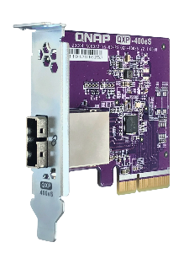
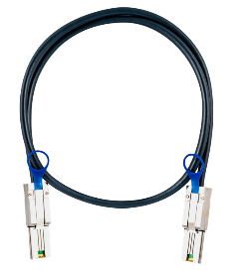
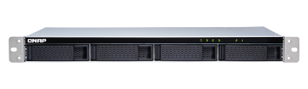

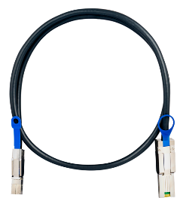
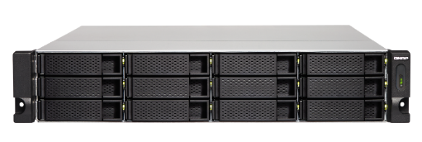
Ready to use with included QXP card and cables
+
+
TL-R400S
1 x QXP-400eS-A1164
PCIe 4-port SATA card
1 x 1M SFF-8088 cable
+
+
TL-R1200S-RP
1 x QXP-1600eS
PCIe 16-port SATA card
3 x 1M SFF-8088 to SFF-8644 cable

Slide 43
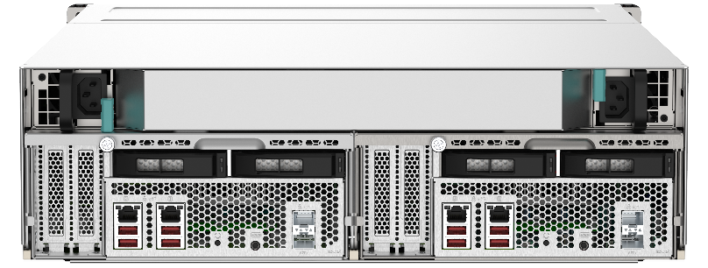

Expand Storage Space with SAS 12Gb/s JBOD
  SAS-12G2E SAS adapter (optional)
  Daisy-chain up to 8 QNAP SAS JBOD (REXP series)
  Each NAS supports up to 138 HDD and 1 PB+ raw capacity
REXP-1620U-RP
REXP-1620U-RP

Slide 44



Versatile Expansion Possibilities
QNAP QM2
expansion card
40/25/10GbE
network adapter
FC adapter
USB 3.2 Gen 2
expansion card
SAS 12Gb/s
adapter

Slide 45
IS YOUR BEST CHOICE !
Copyright© 2020 QNAP Systems, Inc. All rights reserved. QNAP® and other names of QNAP Products are proprietary marks or registered trademarks of QNAP Systems, Inc. Other products and company names mentioned herein are trademarks of their respective holders.​​​

Slide 46











Power by QuTS hero – a ZFS-based OS
Data Efficiency
Data Protection
Dara Integrity
System Stability
APP & Converged
Offers inline compression & inline deduplication for better storage utilization​
ZIL / L2ARC: provides a better cache mechanism
The native ZFS snapshot feature allows smart definitions of guaranteed snapshots​
A nearly unlimited number of 65,536 snapshots​ (supports folder/LUN)​
SnapSync
More RAID types available
WORM (write once read many)​
QTS hero no longer needs file system checks (FSCK), with ZFS Mirror layer, COW (copy on Write) could keep the data integrity.
Provide ECC RAM supported model to reach the enterprise level stability​
Provide the faster RAID Rebuild function: Resilver
Provide the service of SSD/HDD life prediction​
Supports all app, VMs, and containers. Users could easily deploy the vRouter/ vFirewall, and use many popular packages like nginx/httpd/mangoDB/ redis/ShadowSocks.​
​

Slide 47







QNAP Cloud Gateway - HybridMount ​
  Perfectly integrate private and public cloud storage
Local applications
Cloud Storage
File Services
SMB
Object Storage
Object Storage
Object Storage
HybridMount
File-based cloud gateway
NFS
Dedecate cache space
File Access
AFP
Virtual File System
Object Storage Connector
Local User
File Access
Dedecate cache space
FTP
Cache Engine
Cloud File Connector
Web
DAV
Cloud File Storage
Cloud File Storage
Cloud File Storage
Local Disks/SSDs
Qsync

Slide 48
QuTS hero User Interface
Live Demo

