Slide 2
2.5GbE is gaining popularity
TS-253D
2.5GbE TS-x53D NAS series with PCIe expandability
Advanced apps
for SOHO and SMBs
TS-653D
TS-453D

Slide 3
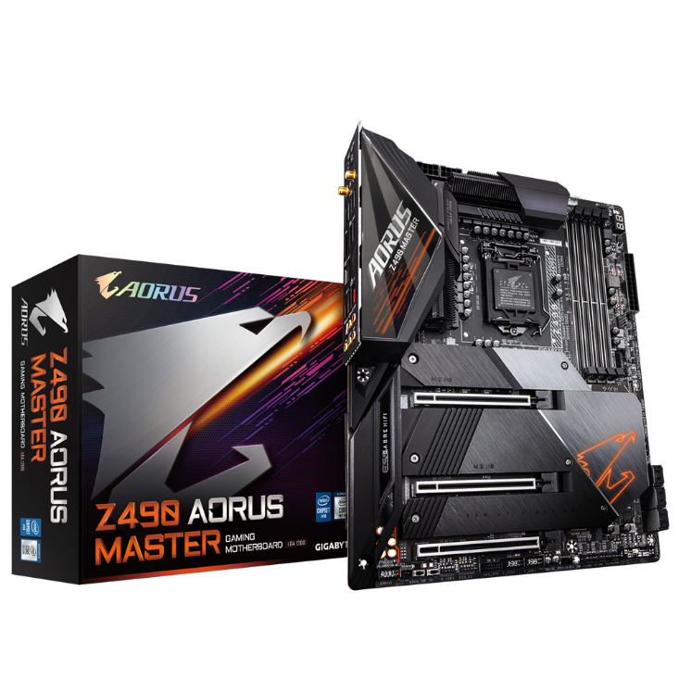
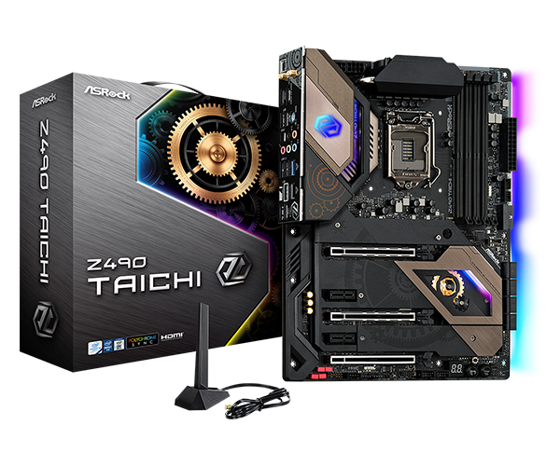
The 20-year-old 1GbE is getting slow. Now newer motherboards are equipped with 2.5GbE!
Asus ROG MAXIMUS XII EXTREME
Gigabyte Z490 AORUS MASTER
MSI MEG Z490 ACE
Asrock Z490 Taichi

Slide 4
Wi-Fi 6 routers with 2.5GbE WAN/LAN port
When you upgrade to a Wi-Fi 6 router with 2.5GbE WAN/LAN, and if the router's 2.5GbE interface is set to a LAN port, a 2.5GbE NAS is best for the multiple clients of Wi-Fi 6 wireless and GbE wired access to efficiently utilize the full 2.5GbE bandwidth!
TP-Link
TL-XDR6060
Asus
AX6600M
Netgear
RAX120

Slide 5
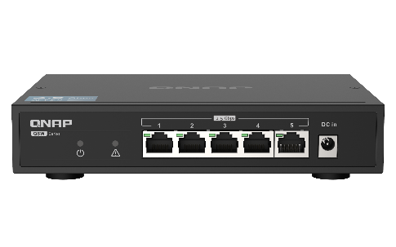
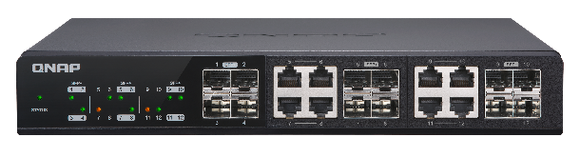
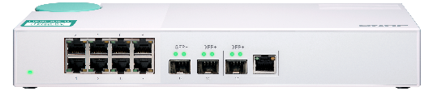
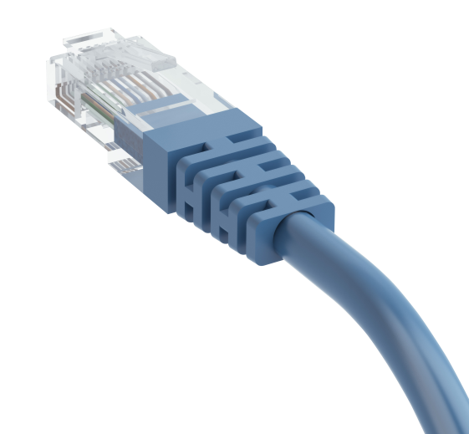
With the same LAN cable, 2.5GbE switch for multi-device environment
Multiple QNAP switches supporting 2.5GbE
Use the existing wiring infrastructure to support 2.5GbE
Coming 2020 Q3!
 | CAT 5e | CAT 6 | CAT 6A
100M | ✔ | ✔ | ✔
1G | ✔ | ✔ | ✔
2.5G | ✔ | ✔ | ✔
5G | ✔ | ✔ | ✔
10G | X | ✔(55m) | ✔
QSW-1105-5T (Unmanaged)
5 x 2.5G
RJ45 Multi-Gig
Fanless & metal housing
QSW-1208-8C (Unmanaged)
QSW-308-1C (Unmanaged)
8 x 10G/5G/2.5G
RJ45 Multi-Gig
1 x 10G/5G/2.5G
RJ45 Multi-Gig
QSW-M408-4C (Managed)
QSW-M408-2C (Managed)
4 x 10G/5G/2.5G
RJ45 Multi-Gig
2 x 10G/5G/2.5G
RJ45 Multi-Gig

Slide 6


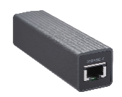

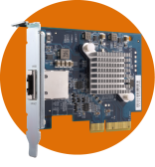
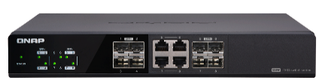
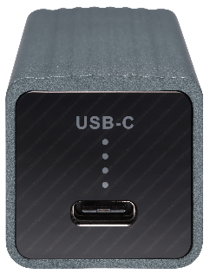




QNAP 10GbE/5GbE accessories for PC / Server / NAS to get 10GbE/5GbE/2.5GbE via PCIe or USB
QNAP
QNA-UC5G1T:
USB 3.2 Gen 1 to
5GbE/2.5GbE/1GbE
adapter
QXG-10G1T
QXG-5G1T-111C
QNA-UC5G1T
5GbE
Cat 5e
QNAP 10G switch
5GbE
Cat 5e
Same wiring
TS-451+
Same wiring
QNA adapter in QTS does not support:
Port trunking (LACP) / DHCP server
RADVD server / static route

Slide 7

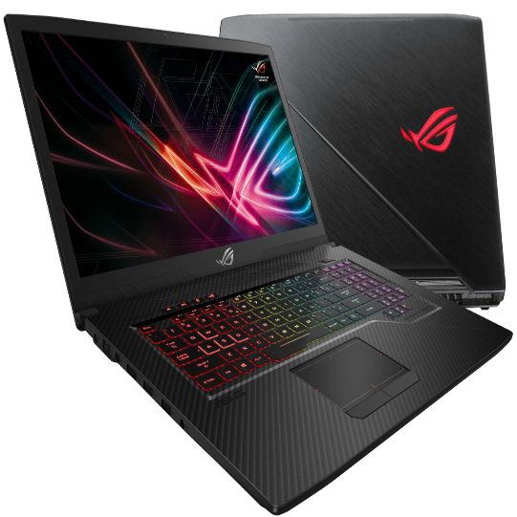
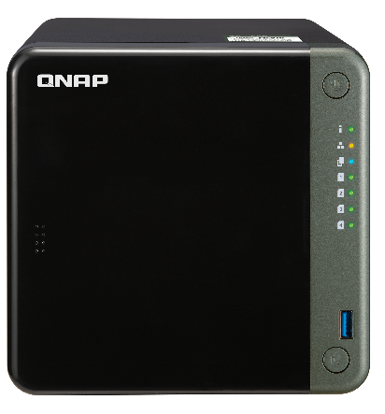
Storage is also after higher speed! Dual 2.5GbE TS-x53D NAS for large file transfer and intensive access
No more bandwidth restriction by 1GbE interface on NAS! No more DIY to install the 2.5GbE driver to your other brand NAS!! TS-x53D NAS is built in with 2 independent 2.5GbE NICs for faster and smoother multi-device networking experience.
iSCSI 2.5GbE connection
Save space in your laptop with the large capacity NAS for more games and applications.
2.5GbE
Lower NAS CPU utilization
2.5GbE
Better TCP & UDP for more users

Slide 8
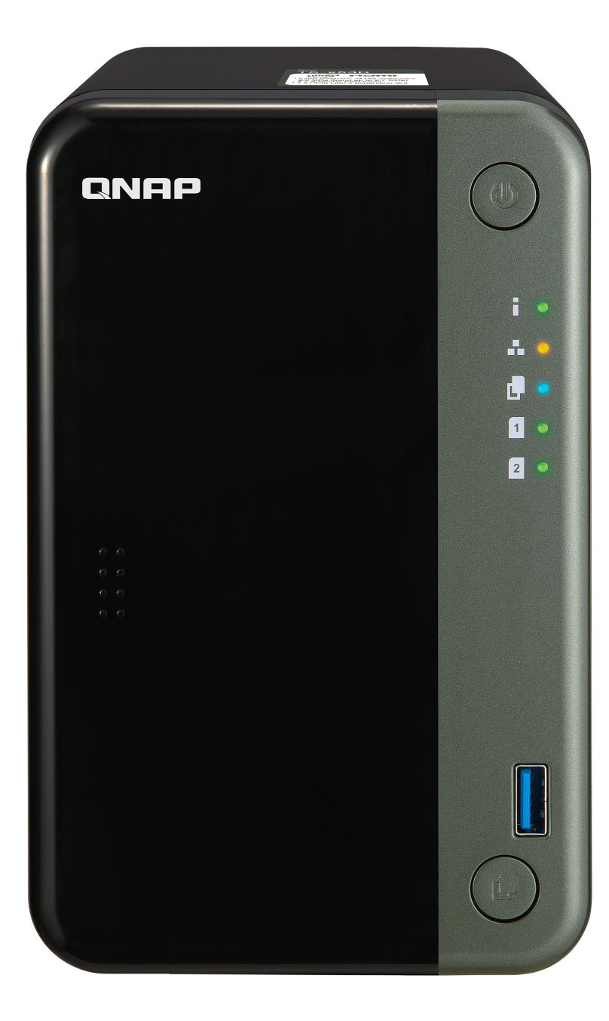
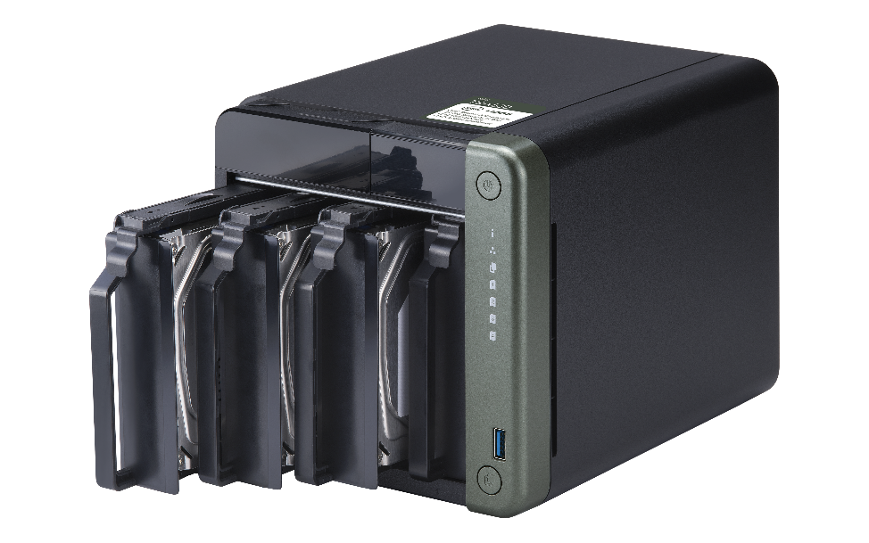
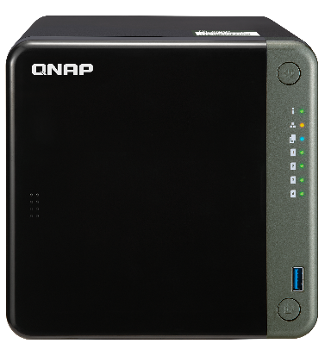
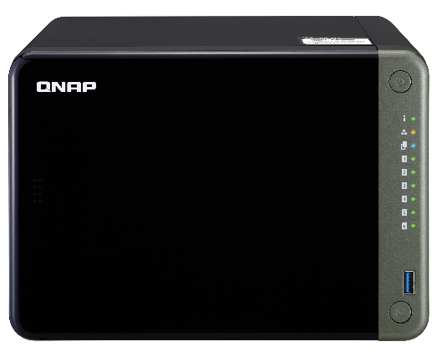
TS-253D, TS-453D, TS-653D front view
Power button
LED indicators with adjustable brightness:
Status, LAN, Drive, USB Copy
2/4/6 x SATA 6Gb/s
3.5”/2.5” HDD/SSD
Lockable magnetic cover
USB 3.2 Gen 1 port
Copy button

Slide 9
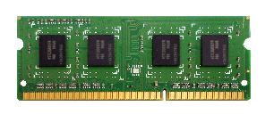
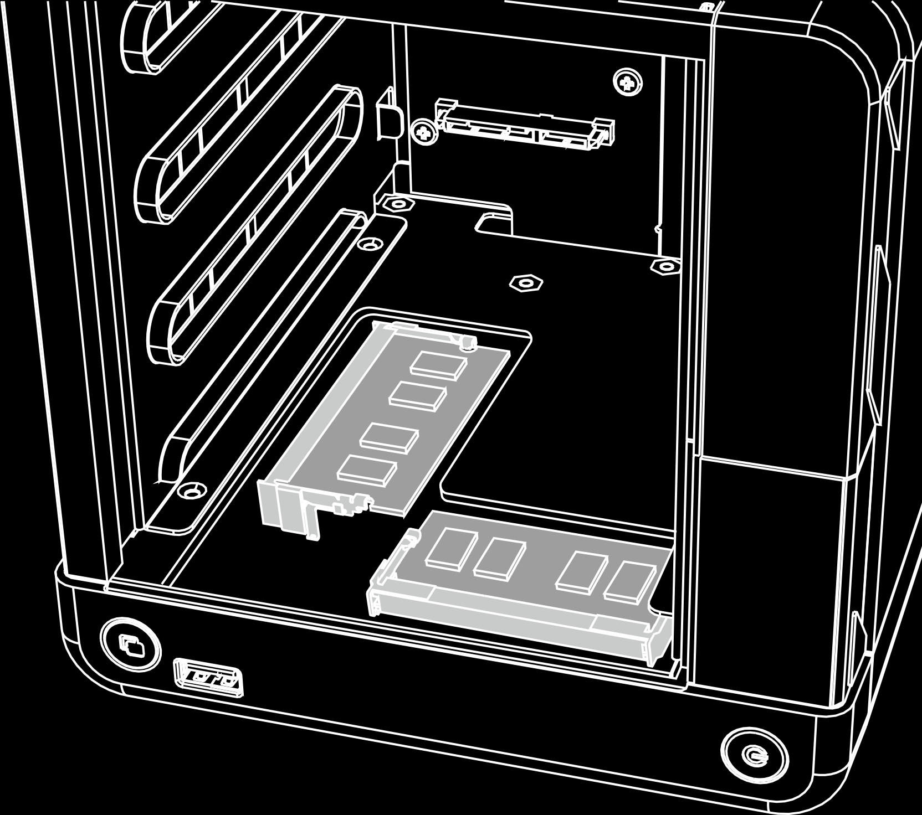
8GB memory for multi-tasking and multi-client access
NAS Models
TS-253D-4G
4 GB RAM (1 x 4 GB)
Dual channel
TS-453D-4G
4 GB RAM (1 x 4 GB)
2 x DDR4 2400 MHz SO-DIMM slots for max
8 GB (2 x 4 GB)
Optional 4GB RAM module (P/N: RAM-4GDR4K0-SO-2666) for 4GB models to become 8GB for higher performance in multi-client and multi-app environment.
TS-453D-8G
8 GB RAM (2 x 4 GB)
TS-653D-4G
4 GB RAM (1 x 4 GB)
TS-653D-8G
8 GB RAM (2 x 4 GB)

Slide 10



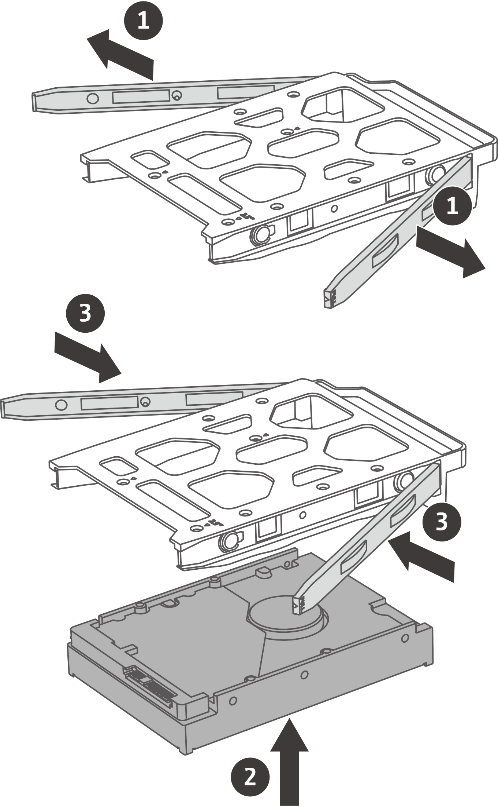
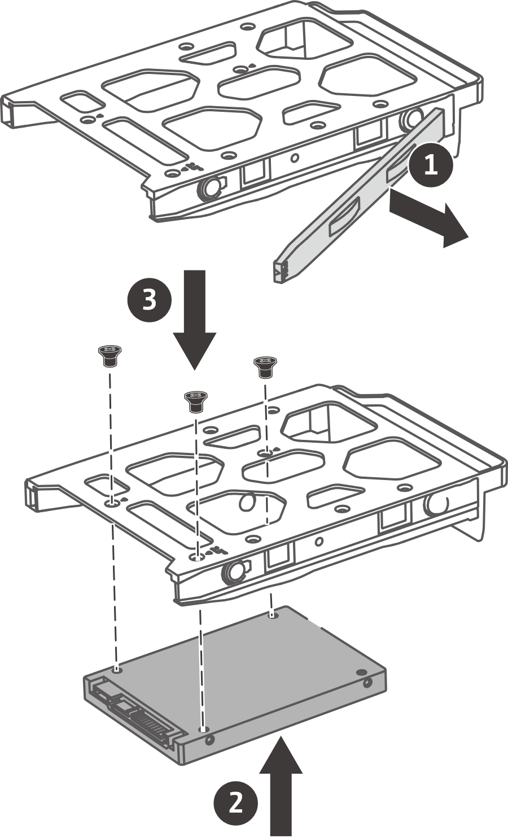
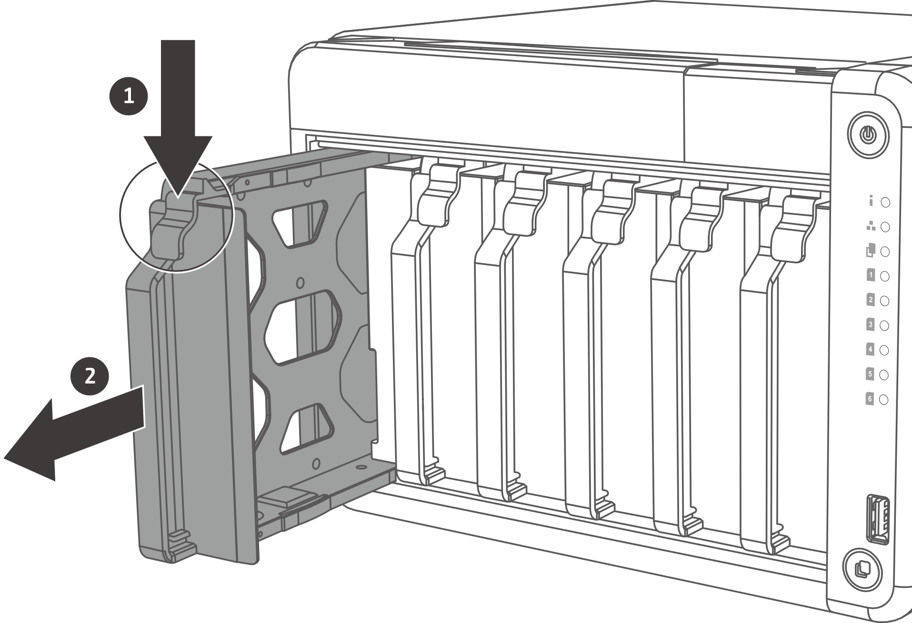
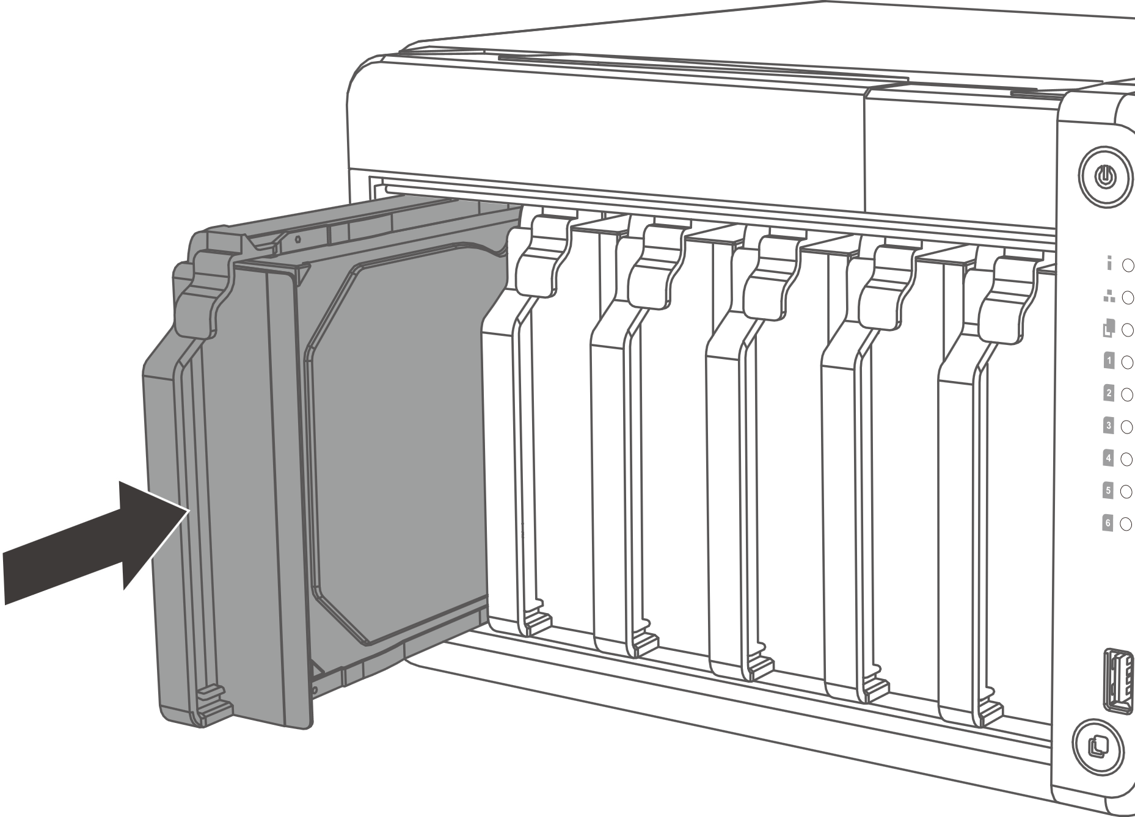
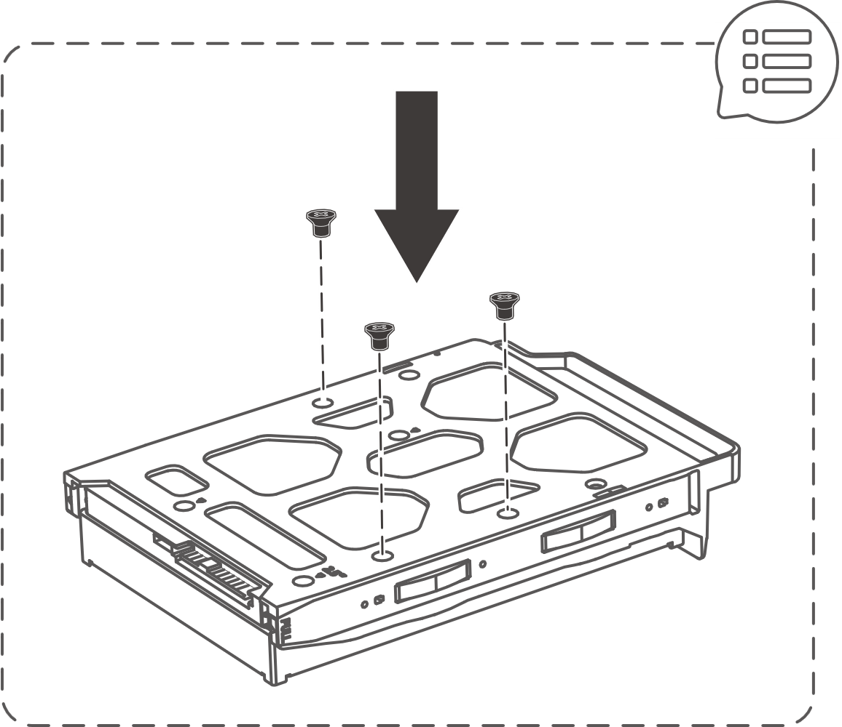
Easy to install HDDs and SSDs
Install 3.5-inch drives without tools
01
02
3.5-inch HDD
2.5-inch HDD / SSD
03

Slide 11
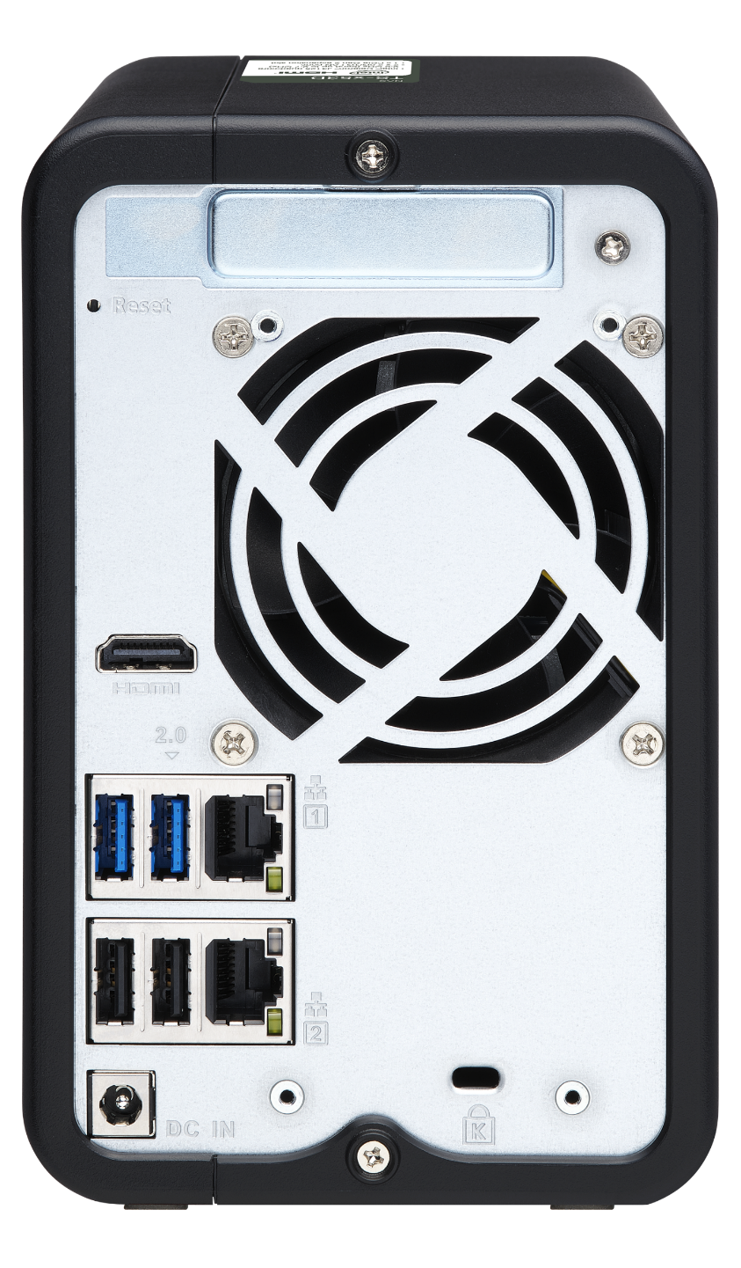
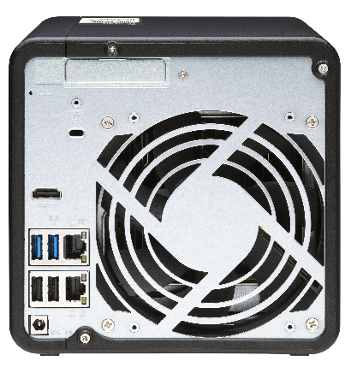
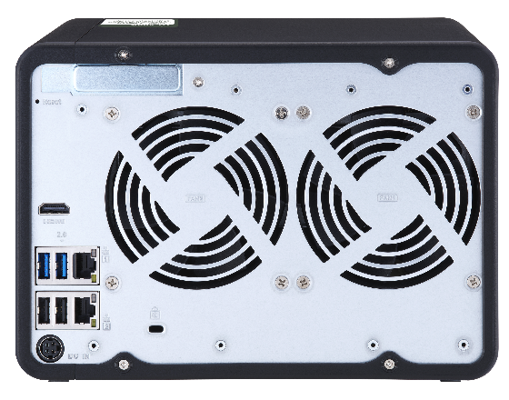
TS-253D, TS-453D, TS-653D rear view
PCIe 2.0 expansion slot
TS-253D: 2.0 x4
TS-453D: 2.0 x2
TS-653D: 2.0 x2
Reset button
Smart FAN
TS-253D: 1 x 70mm
TS-453D: 1 x 120mm
TS-653D: 2 x 90mm
2 x 2.5G/1G/100M RJ45
Port trunking
Load balancing
Fail over
HDMI 2.0 4K 60Hz
Kensington security slot
1 x USB 3.2 Gen 1 port
1 x USB 2.0 port
2 x USB 2.0 ports
DC 12V power inputs

Slide 12


Latest Gen Intel J4125 4-core 2.0GHz, up to 2.7GHz
Low-power J4125
Intel UHD Graphics 600
250 MHz base
750 MHz burst
2.0 GHz base
2.7 GHz burst

Slide 13

Embedded low-power 10W TDP quad-core Intel J4125 CPU
CPU model
J4125
J3455 (previous generation)
Launch date
Q4’19
Q3’16
Cores
4
4
Threads
4
4
Base frequency
2.0 GHz
1.5 GHz
Burst frequency
2.7 GHz
2.3 GHz
Cache
4 MB
2 MB
Memory
DDR4 (2400 MHz)
DDR3L (1866 MHz)
Built-in Graphics
Intel UHD Graphics 600
Intel HD Graphics 500
4K 60Hz support
60Hz (HDMI 2.0)
30Hz only
Source https://ark.intel.com

Slide 14
2.5GbE accelerates large file transfer than 1GbE, suitable for a single client computer/server environment
1 x 2.5GbE
Windows file transfer
1 x 2.5GbE
Windows file transfer
encrypted NAS volume
300
295
289
294
250
252
200
150
100
50
(MB/s)
0
Download
Upload
Download
Upload
Tested in QNAP Labs. Figures may vary by environment.
Test environment:
NAS | TS-453D-4G, QTS 4.4.2, 4 x Samsung 850 Pro 1TB SSDs, RAID 5, thick volume
Client PC | Windows 10 Pro, Intel Core i7-6700 3.4 GHz, 32GB RAM
IOmeter | RAM*4, 30-sec ramp up time, 3-min seq. run time, 2 workers, 64-outstanding

Slide 15
2 x 2.5GbE for the multi-user/device environment for the future growth
In addition to Jumbo Frame support, port trunking / link aggregation provides enhanced performance.
2 x 2.5GbE
Windows sequential transfer
2 x 2.5GbE
Windows sequential transfer
Encrypted NAS volume
600
500
590
586
535
400
433
300
200
100
(MB/s)
0
Read
Write
Read
Write
Tested in QNAP Labs. Figures may vary by environment.
Test environment:
NAS | TS-453D-4G, QTS 4.4.2, 4 x Samsung 850 Pro 1TB SSDs, RAID 5, thick volume
Client PC | Windows 10 Pro, Intel Core i7-6700 3.4 GHz, 32GB RAM
IOmeter | RAM*4, 30-sec ramp up time, 3-min seq. run time, 2 workers, 64-outstanding

Slide 16
PCIe 2.0 slot for various 5GbE & 10GbE PCIe NICs
1 x 10GbE
Windows file transfer
QXG-5G1T-111C
1 x 5G/2.5G/1G/100M
600
686
QXG-5G2T-111C
2 x 5G/2.5G/1G/100M
500
397
QXG-5G4T-111C
4 x 5G/2.5G/1G/100M
400
300
QXG-10G1T
1 x 10G/5G/2.5G/1G/100M
200
QXG-10G2T-107
2 x 10G/5G/2.5G/1G/100M
(MB/s)
100
0
QXG-10G2SF-CX4
2 x 10G SFP+
Download
Upload
Tested in QNAP Labs. Figures may vary by environment.
Test environment:
NAS | TS-453D-4G, QTS 4.4.2, 4 x Samsung 850 Pro 1TB SSDs, RAID 5, thick volume
Client PC | Windows 10 Pro, Intel Core i7-6700 3.4 GHz, 32GB RAM
IOmeter | RAM*4, 30-sec ramp up time, 3-min seq. run time, 2 workers, 64-outstanding

Slide 17
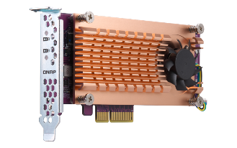
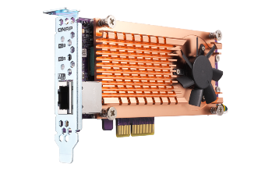

Add two M.2 SSDs with a QM2 PCIe adapter and use SSD cache to enhance IOPS and performance of processing small files
QM2-2S-10G1TA
2 x M.2 SATA 6Gb/s
1 x 10G/5G/2.5G/1G
QM2-2S-220A
2 x M.2 SATA 6Gb/s
QM2-2P-244A
2 x M.2 NVMe PCIe Gen2
QM2-2P10G1TA
2 x M.2 NVMe PCIe Gen2
1 x 10G/5G/2.5G/1G

Slide 18


Wi-Fi 6 enhances wireless network speed and density
AP
Ruckus
R750
Aruba
550
Extreme Networks
AP305C
Computers
Mobile
2.4 Gbps
Wi-Fi 6
PCIe & CNVi NICs
iPad Pro, iPhone 11, Galaxy S20 series
Gigabit LAN
1 Gbps
0.867 Gbps
Wi-Fi 5
0
1Gbps
2Gbps

Slide 19
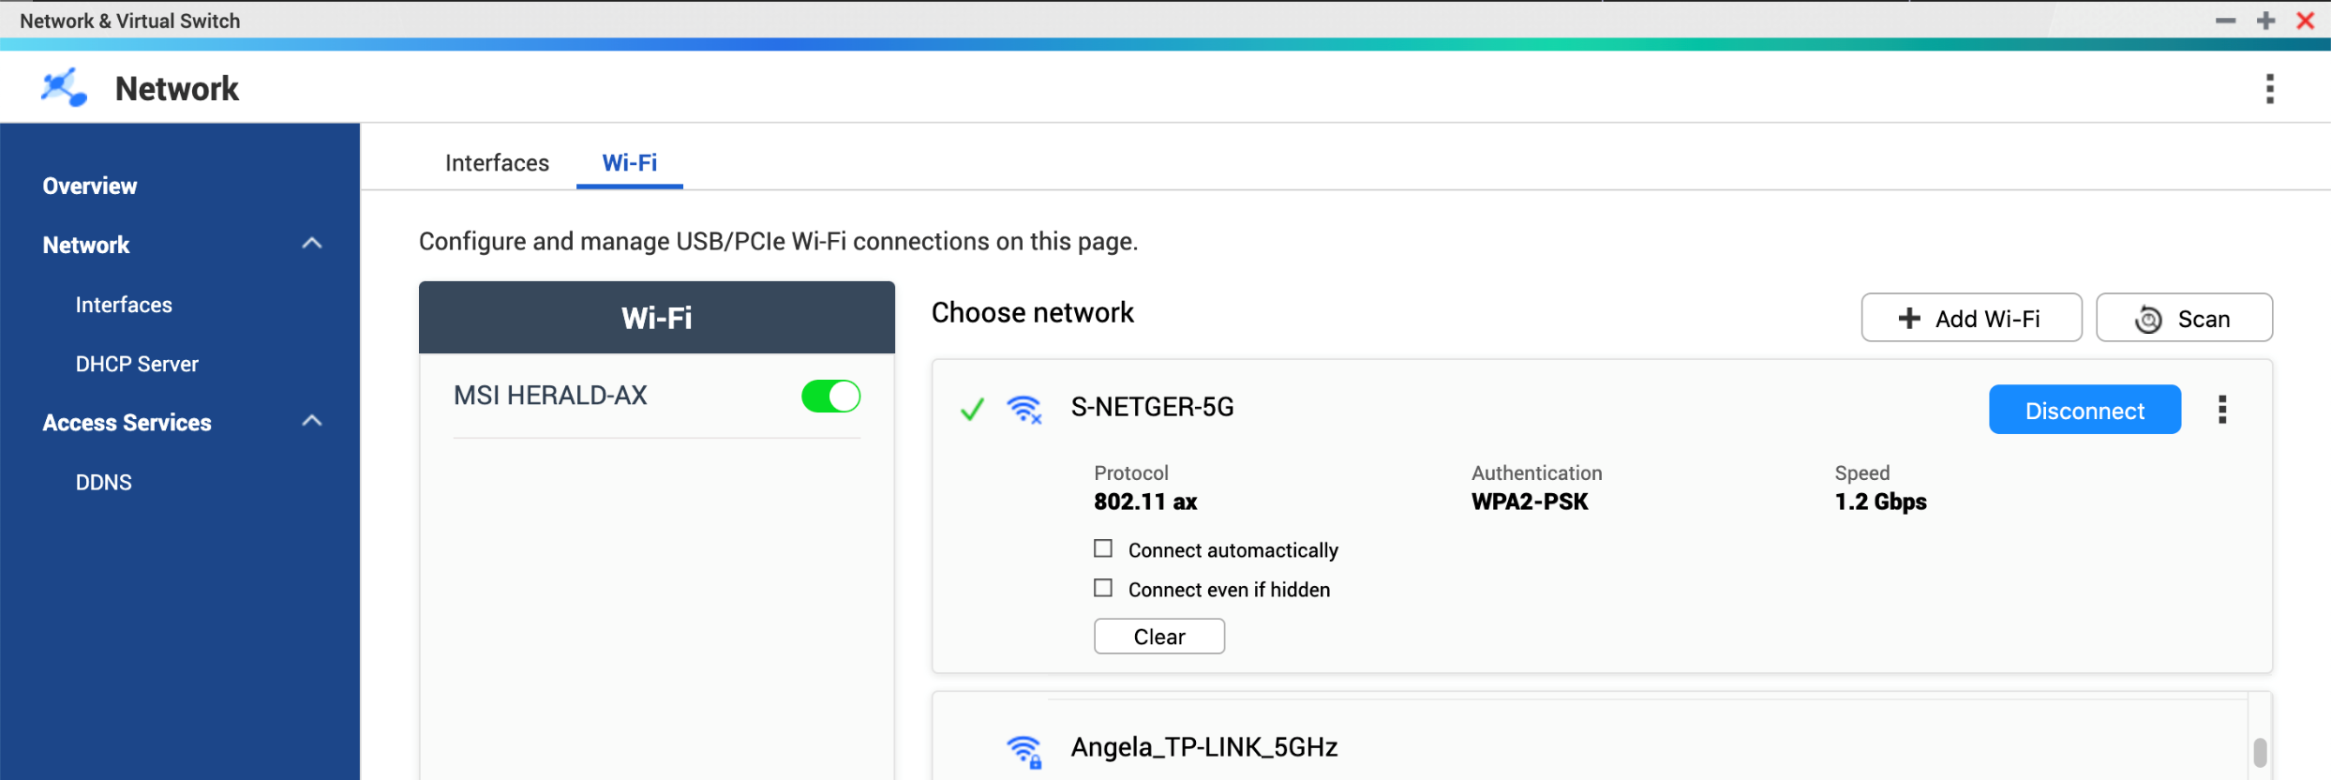
NAS supporting Wi-Fi 6 PCIe NIC to gain fast wireless transfer speed for anywhere placement
Support 802.11AX Wi-Fi 6 PCIe cards based on Intel AX200 chipset.
Gigabyte GC-WBAX200
ASUS PCE-AX58BT
MSI HERALD-AX

Slide 21
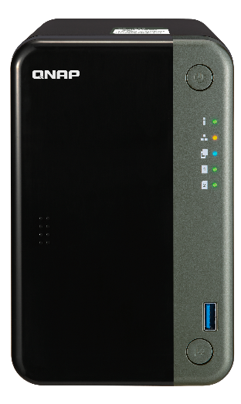


Backup, share, and VM applications all-in-one NAS for professionals and businesses
TS-253D
TS-453D
TS-653D

Slide 22


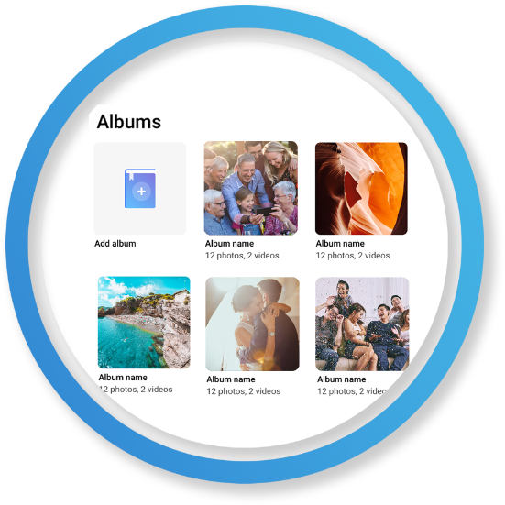
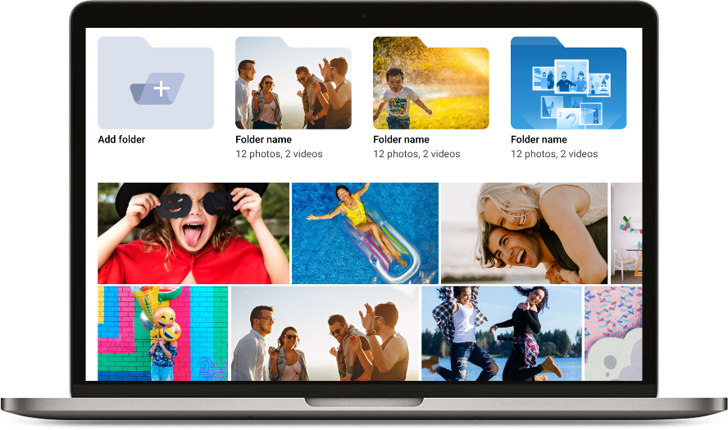

QuMagie smart albums and accelerated AI classification
Organize photos with similar faces using facial recognition
Classify photos into 400 different themes using Subject Detection：
People, tags, dates, events, etc.
Album view
Folder view
TS-253D

Slide 23



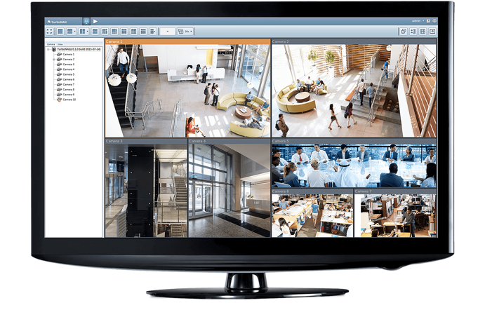
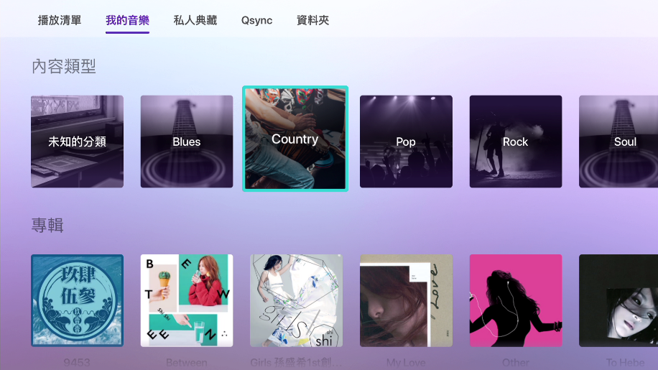

Stream to Smart TV, Apple TV, Chromecast,
Fire TV & Roku
Use the remote control of your media player to navigate
Categorization and multiple sorting methods to enjoy your media content
Filters and keyword searches to locate a file quickly
Qmedia
DLNA, network streaming
TS-453D

Slide 24




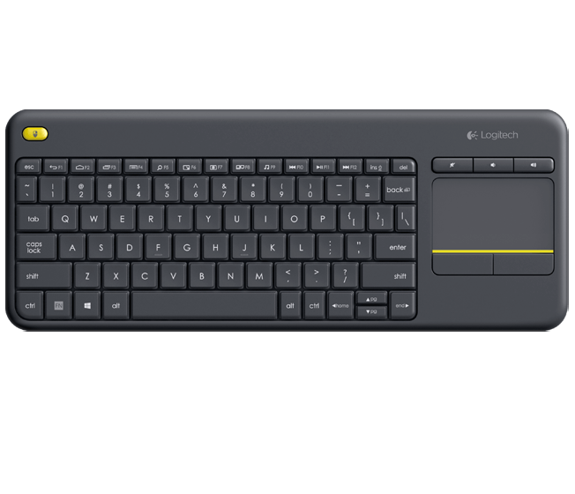
Full 4K UHD multimedia experiences
4K HDMI 2.0 60Hz output
Plex streaming & transcoding
Use Cinema28 for
multi-room streaming
With optional RM-IR004 IR remote control or USB wireless keyboard and mouse

Slide 25

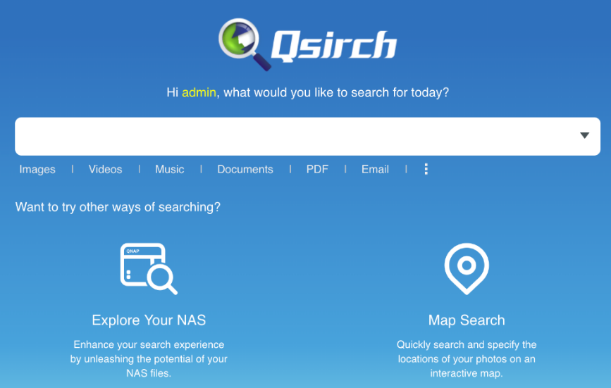










Qsirch 4.0 makes it easy to search for files
Search within NAS and on the Internet
Large file preview pane
Advanced search for complex keyword search
35+ powerful filter conditions
Easy steps from previewing to sharing
1
2
3
Mac Finder
4
Web
Mobile
Browser

Slide 26







QNAP snapshot features for file recovery
1. Fully supports all storage configurations at the storage pool level.
2. Easily take, manage and restore snapshots.
3. Using the mature Ext4 file system for “out of volume” snapshots
RAM Size | Maximum Total Snapshot Number | Maximum Snapshot Number per Volume/LUN
4GB and more | 1024 | 256
• Ransomware cannot overwrite snapshots which are stored out of volume
File Level
Removable Drives
Block
Level
A’
B’
C’
D’
E’
Local Drives
Cloud / NAS
A
B
C
D
E

Slide 27




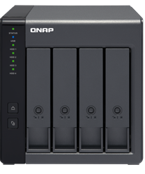
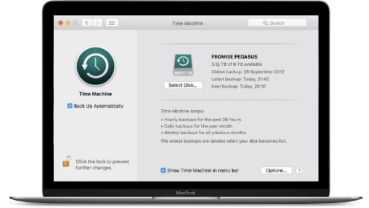


Free macOS Time Machine backup
Copy Time Machine Backup file to NAS via HBS 3, and then synchronize the data from NAS to an external device or the cloud, eg. TR-004 USB RAID DAS
Create the backup job：
1
2
3
Select Time Machine Backup as Source
Select TR-004 as Destination
- Set up Schedule
- Enable QuDedup
Mac Time Machine
TS-453D
TR-004

Slide 28









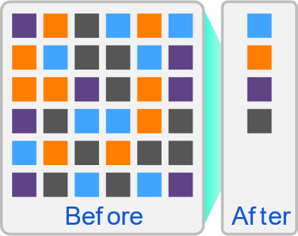







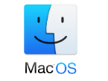


Backup data with deduplication
HBS 3 (Hybrid Backup Sync 3)
From local NAS
(via HBS 3)
From remote NAS
(via File Station )
Carry and Use
(QuDedup Extract Tool)
Backup/Restore
.qdff
Tokyo
Taipei
.qdff
TCP BBR
.qdff
File station with QuDedup (soon)
New York
.qdff
CIFS / NFS / FTP
.qdff
Taipei
File station with QuDedup (soon)
Beijing
Access from Cloud

Slide 29
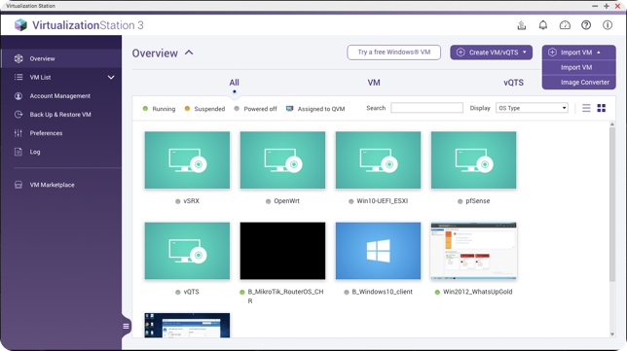

Virtualization Station
With Virtualization Station, you can create multiple virtual machines to run various operating systems such as Windows, Linux, UNIX and Android on a QNAP NAS.
Operate VM via remote desktop or HDMI output with a USB keyboard and a mouse
VM Import/Export
VM backup and snapshot
Virtual switch: support multiple network modes
Support USB device connection

Slide 30

Go beyond your creativity with Container Station
for a x86 Quad-core NAS with up to 8GB RAM
AI, IoT, Commonly-used Container Recommendation
• One-click installation wizard helps you quickly setup
• Supports Docker Compose YAML format to create applications
Easily import/export containers
• Imports images or containers from PC or NAS
• Exports images or containers to NAS as backup
Built-in Docker Hub Marketplace
• Easily downloadable tools

Slide 31




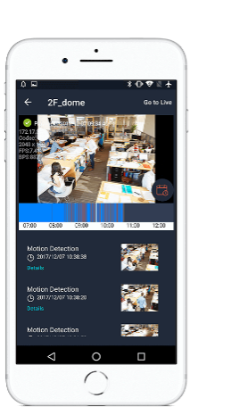

QVR Pro surveillance solution
QVR Pro
5,000+ compatible IP cameras
8 free camera channels
Surveillance Station 5.1
Expandable channels via license
TS-653D & TS-453D: max. 24 recommended
TS-253D: max. 16 recommended
2 free channels
40 channels max. (optional license)
QUSBCam2 for webcam recording
QVR Pro Client
Monitor feeds with iOS& Android mobile devices
NAS HDMI output with USB mouse/ keyboard control

Slide 32






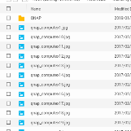














HybridMount provides two modes for file-based cloud storage gateway
 | File Station Mount | File Cloud Gateway
Setup Method | Mount cloud drives | Select “File Cloud Gateway” mode and create a dedicated cache space
Connections | No limit | 2 free and perpetual connections. Purchase license for more connections
Access Performance | Depends on network speed | High performance thanks to caching
Access in File Station | Supported | Supported
Access through SMB / NFS / AFP | Not supported | Supported
Sync with the cloud | Sync only when browsing | Sync constantly for quick access
Integration with QTS Apps | Not supported | Supported ...
Online collaboration
File data analysis
Slower
Internet
NAS
cache
1
2
3
Meta
data
LAN
Faster

Slide 33




Enterprise LUN backup:
VJBOD Cloud block-based gateway
VJBOD Cloud Gateway
Initiator
Local user
iSCSI
Target
Cloud object
storage space
Initiator
iSCSI
Cloud LUN
Client
Application
Server
SMB/NFS/AFP/
FTP/WebDAV
Cloud Volume
/Shared folder
Local user
snapshot
snapshot

Slide 34




Follow the trend and choose a newer technology over the old eSATA
Popularity
Interface
Theoretical speed
eSATA
3 Gb/s
6 Gb/s
USB 3.2 Gen 1
USB 3.2 Gen 2
USB 3.2 Gen 2 x2
5 Gb/s
10 Gb/s
20 Gb/s
Thunderbolt 3
40 Gb/s
SAS 6Gb/s
48 Gb/s
SAS 12Gb/s
96 Gb/s

Slide 35
Economical and flexible QNAP expansion enclosures
QNAP TR RAID and TL JBOD enclosures have many advantages compared to the eSATA JBOD enclosures in the market for NAS capacity expansion.
Bigger capacity
  - 2, 4, 8, 16-bay choices
  - NAS can support up to two expansion enclosures
Higher speed
  - USB 3.2 Gen 1 5Gb/s, USB 3.2 Gen 2 10Gb/s or up to 64Gb/s with multiple miniSAS cables
Better compatibility: NAS or PC/server applications
  - Expand NAS or PC/server storage capacity or data migration between different hosts
  - QNAP External RAID Manager and JBOD Manager for monitoring JBOD status
USB interface
SFF-8088 multiple SATA interface
TR-002
TR-004
TL-D800C
TL-R400S
TL-R800S
TL-R1600S
* TS-x53D can be installed with a QNAP USB 3.2 Gen2 PCIe expansion card, which supports USB 3.2 Gen2 10Gbps.
TS-253D PCIe slot supports Gen2 x4 = 16Gbps while TS-453D & TS-653D PCIe slot support PCIe Gen2 x2 = 8Gbps.

Slide 36







QNAP TR RAID enclosure supports 2 modes on NAS
TS-x53D supports up to two QNAP TR or TL enclosures.
Internal mode with storage pool support or external mode with cross-platform compatibility with Windows/Mac computers.
Mode 1: Expanding the NAS with
a new volume
Mode 2: Work as a backup destination
for snapshot replica
TR & TL enclosures
TS-453D
TR & TL enclosures

Slide 37
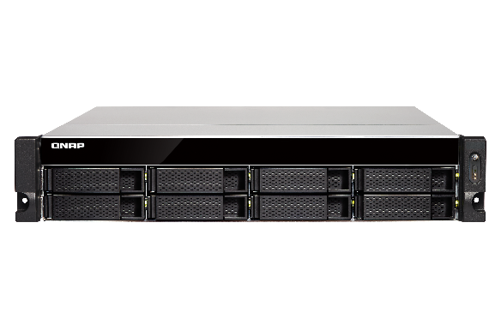


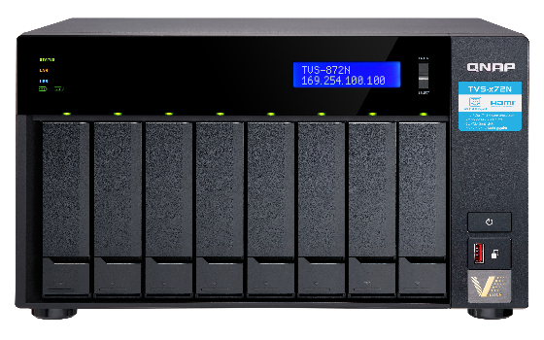
Use Virtual JBOD to expand NAS capacity
Max. 8 VJBOD connections
2.5GbE / 1GbE
iSCSI VJBOD connection
TS-832XU
TS-453D
TVS-872N

Slide 38

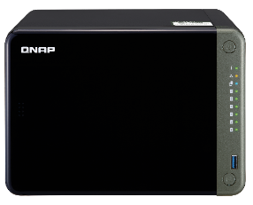
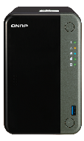
Future-proof 2.5GbE NAS saves money in the long run
Brand | QNAP |  |  | Other vendor 2020 models
Model | TS-253D | TS-453D | TS-653D | 2-bay | 4-bay
Processor | Intel x86 Celeron J4125 quad-core 2.0 GHz, burst up to 2.7 GHz
RAM | 4GB | 4GB or 8GB |  | 2GB | 4GB
RAM slots | 2 (max 8GB) |  |  | 1 (max 6GB) | 1 (max 8GB)
Networking | 2 x 2.5GbE (Read 590 MB/s, Write 535 MB/s) |  |  | 2 x 1GbE (Read 225.99 MB/s, Write 225.90 MB/s)
HDMI | 4K HDMI v2.0 60Hz |  |  | ---
PCIe slot | PCIe 2.0 x4 | PCIe 2.0 x2 |  | ---
USB | 3 x USB 3.2 Gen 1 + 2 x USB 2.0 |  |  | 2 x USB 3.2 Gen 1
M.2 SSD | 2 x M.2 NVMe or SATA SSD via optional QNAP QM2 PCIe adapters |  |  | 2 x M.2 NVMe SSD (expected to be Gen2 x1)
10GbE/5GbE | 10Gbe or 5GbE via optional QNAP QXG PCIe adapters |  |  | ---
Expansion | Up to 2 (or max 16 drives) USB 3.2 Gen 2 10Gb/s or multi-ch SATA TR & TL expansion enclosures |  |  | 1 x (5 drives) eSATA 6Gb/s expansion enclosure
Warranty | 3-year limited hardware warranty

Slide 39
Maximize your NAS investment; every penny counts!
Intel J4125 4-core 2.0 GHz, burst up to 2.7 GHz
Built-in 2 x 2.5GbE for up to 590 MB/s read speed
PCIe expansion slot for M.2 SSDs or 10GbE
Copyright © 2020 QNAP Systems, Inc. All rights reserved. QNAP® and other names of QNAP Products are proprietary marks or registered trademarks of QNAP Systems, Inc. Other products and company names mentioned herein are trademarks of their respective holders.

