Slide 2
Quad-core TS-231P3, TS-431P3, TS-431X3 with new 2.5GbE support
Needs for a larger storage space and efficient file backup and sharing
All models with 2.5GbE support, additional 10GbE SFP+ on
TS-431X3
Ready-to-use applications for worry-free file backup and sharing

Slide 3
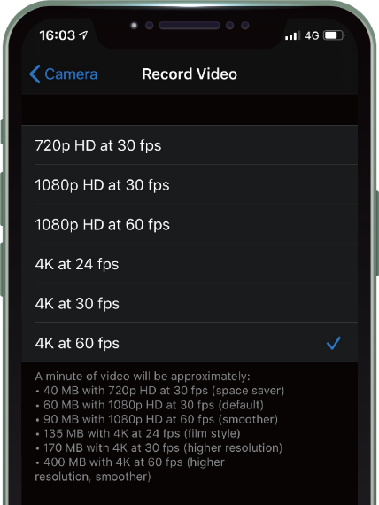

Storage need for shooting many 4K 60P VLOGs?
4K 60FPS video
400MB per minute
= 2.4GB per hour

Slide 4

How to quickly share files or collaborate with multiple users?
Spend $$$ to buy a 10GbE switch?
Spend $$$ to buy a 10GbE NAS?
Spend $$$ to upgrade the LAN cable wiring infrastructure?

Slide 5
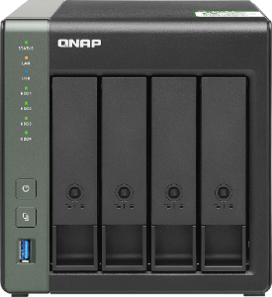
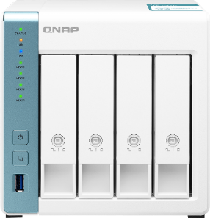
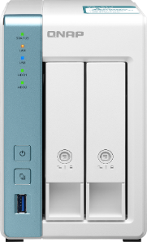


Quad-core 1.7GHz with 2.5GbE/10GbE
TS-431X3
TS-431P3
TS-231P3
1 x 10G SFP+
1 x 2.5G RJ45
1 x 1G RJ45
1 x 2.5G RJ45
1 x 1G RJ45
1 x 2.5G RJ45
1 x 1G RJ45
TS-431X3-4G
4 GB RAM (1 x 4 GB)
TS-431P3-2G
2 GB RAM (1 x 2 GB)
TS-231P3-2G
2 GB RAM (1 x 2 GB)
TS-431P3-4G
4 GB RAM (1 x 4 GB)
TS-231P3-4G
4 GB RAM (1 x 4 GB)

Slide 6
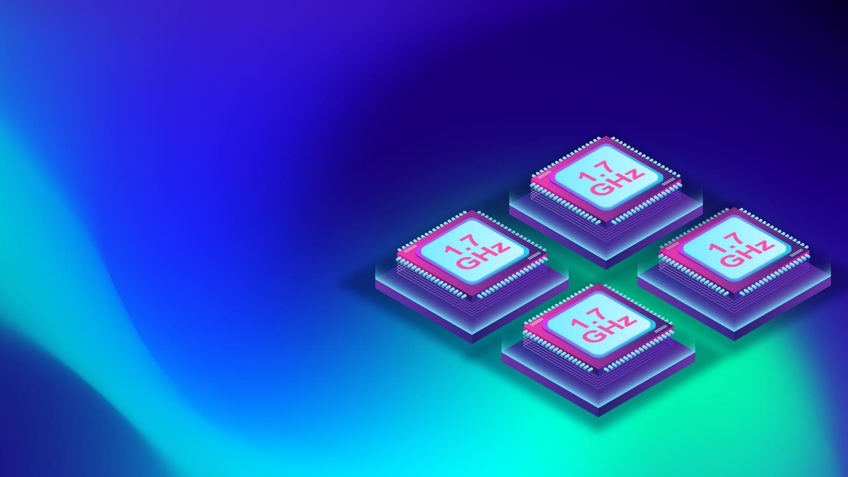

Performance you can count on
4-core 1.7GHz
Alpine AL-314 ARM v7 processor
Native 4 x SATA 6 Gb/s ports for the optimal throughput
Built-in AES 256-bit encryption engine for security and performance
ARM NEON v2 floating point acceleration engine
2MB L2 cache, twice more than the competition!

Slide 7
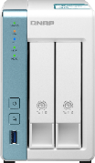
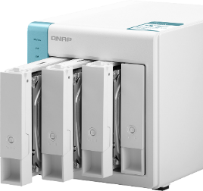
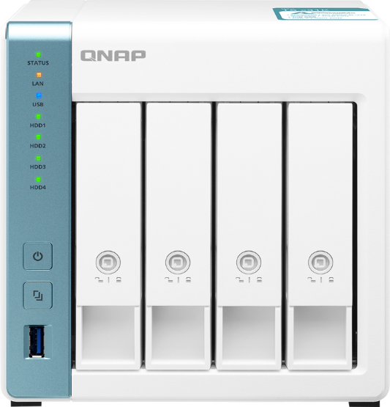


TS-231P3, TS-431P3 front view
4x 3.5-inch /
2.5-inch SATA 6Gb/s HDD bays
LEDs:
Status, LAN, USB
Drive LEDs:
HDD 1, HDD 2,
HDD 3, HDD 4
Power
Lockable drive trays with 2 keys provided
Copy
USB 3.2 Gen 1 port

Slide 8
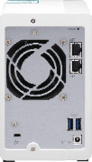
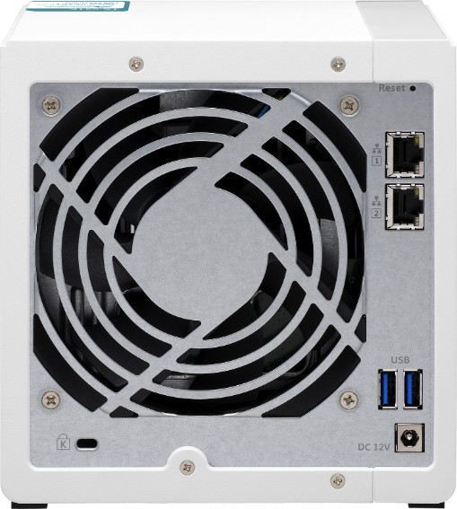
TS-231P3, TS-431P3 rear view
Reset
1 x 2.5 GbE RJ45 port
1 x 1 GbE RJ45 port
Smart fan
TS-431P3: 1 x 120mm
TS-231P3: 1 x 70mm
2 x USB 3.2 Gen 1 (5Gbps) port
Kensington security slot
DC 12V power input

Slide 9

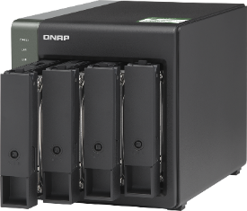
TS-431X3 front view
4x 3.5-inch /
2.5-inch SATA 6Gb/s HDD bays
LEDs:
Status, LAN, USB
Drive LEDs:
HDD 1, HDD 2,
HDD 3, HDD 4
Power
Lockable drive trays with 2 keys provided
Copy
USB 3.2 Gen 1 port

Slide 10
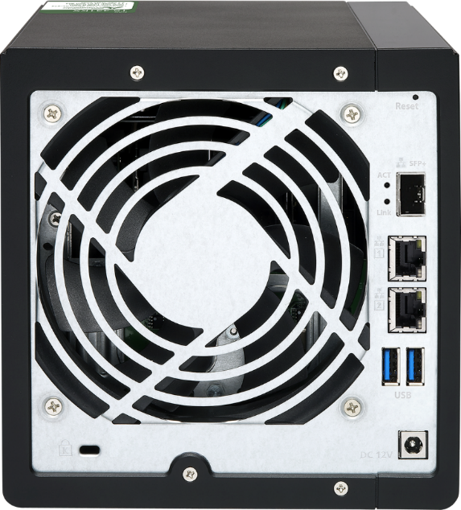
TS-431X3 rear view
Reset
1 x 10 GbE SFP+ port
1 x 2.5 GbE RJ45 port
1 x 120mm smart fan
1 x 1 GbE RJ45 port
2 x USB 3.2 Gen 1 port
(5Gbps)
Kensington security slot
DC 12V power input

Slide 11
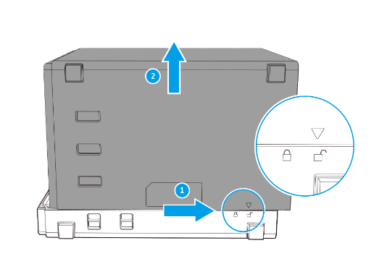
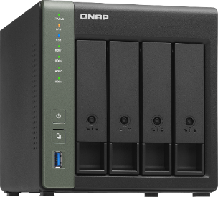



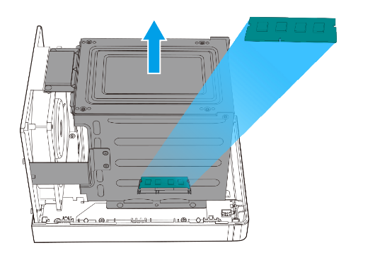
All models support up to 8GB RAM
1. Remove side cover
1 x DDR3L SO-DIMM RAM slot
Up to 8 GB memory support
Ordering information:
2GB: RAM-2GDR3T0-SO-1600
4GB: RAM-4GDR3-SO-1600
8GB: RAM-8GDR3-SO-1600
2. Remove HDD bracket

Slide 12
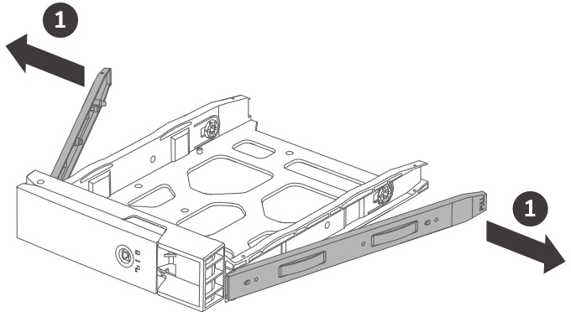
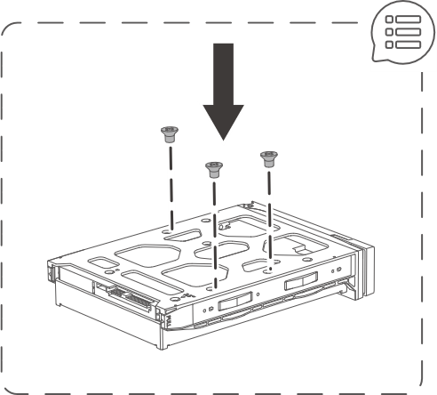
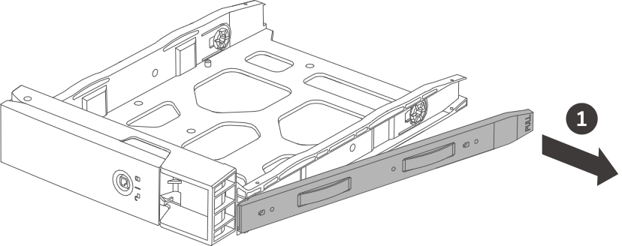
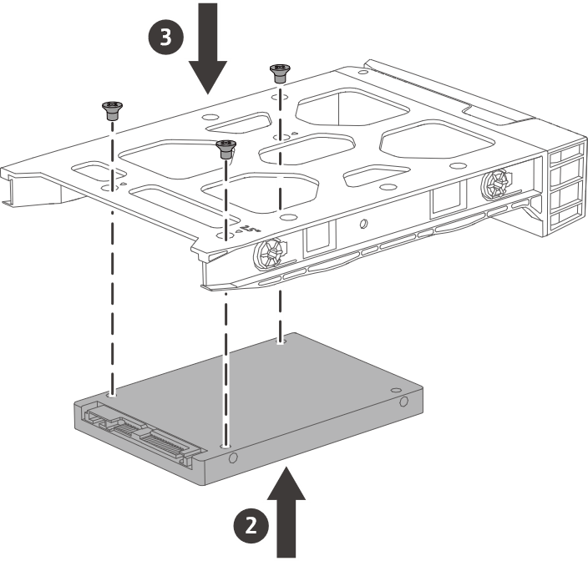
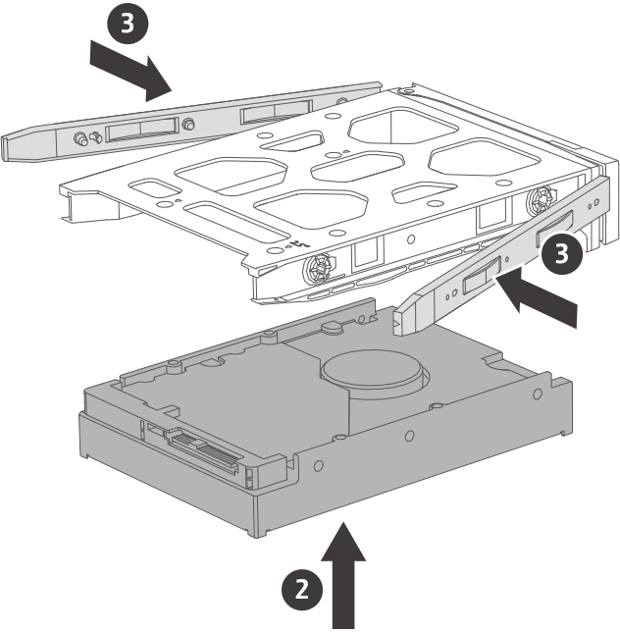
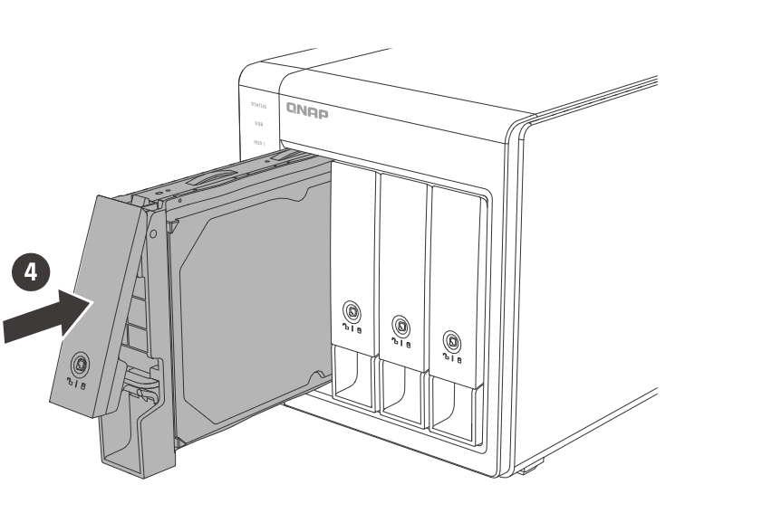
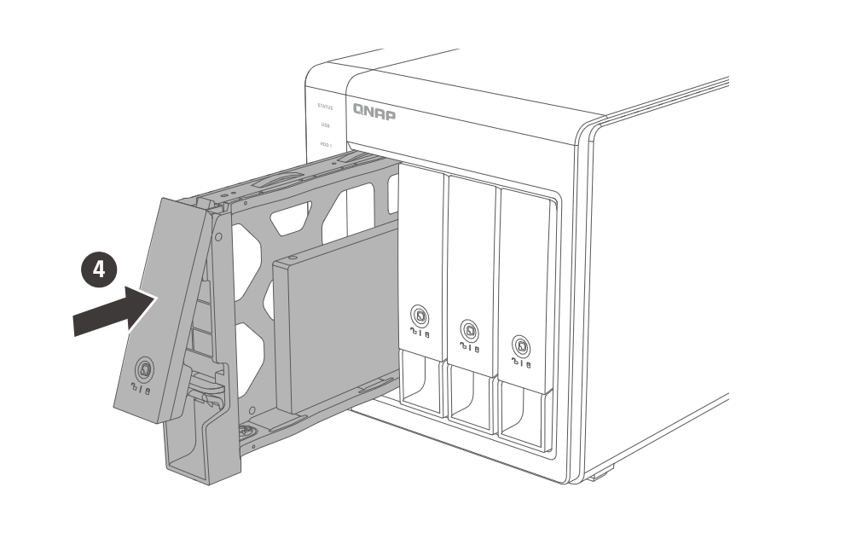
Easy HDD and SSD installations
3.5-inch HDD: tool-less
2.5-inch HDD/SSD: screws

Slide 13


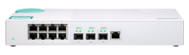
Upgrade to 2.5GbE with existing cable wiring
Multiple QNAP 10G switch supporting 2.5GbE
 | CAT 5e | CAT 6 | CAT 6A
100M | ✓ | ✓ | ✓
1G | ✓ | ✓ | ✓
2.5G | ✓ | ✓ | ✓
5G | ✓ | ✓ | ✓
10G | X | ✓(55m) | ✓
QSW-M408-4C (Managed)
QSW-M408-2C (Managed)
4 x 10G/5G/2.5G
RJ45 Multi-Gig
2 x 10G/5G/2.5G
RJ45 Multi-Gig
QSW-1208-8C
QSW-308-1C
8 x 10G/5G/2.5G
RJ45 Multi-Gig
1 x 10G/5G/2.5G
RJ45 Multi-Gig

Slide 14
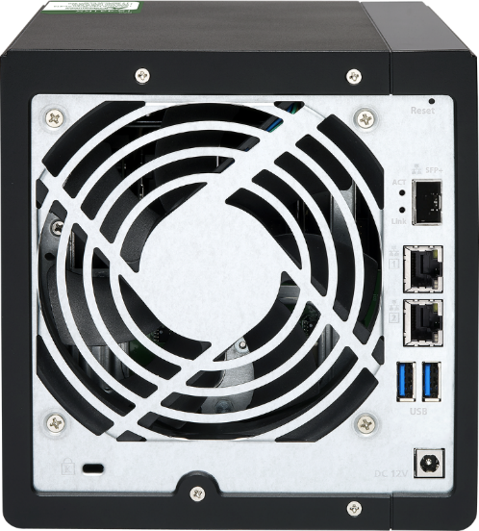

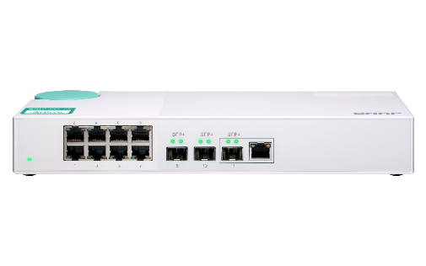
Faster TS-431X3 with 10GbE SFP+
High-speed throughput for large data backup and recovery, multi-user environment, or containerized applications.
QSW-308-1C

Slide 15
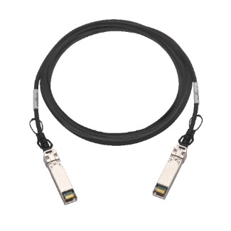
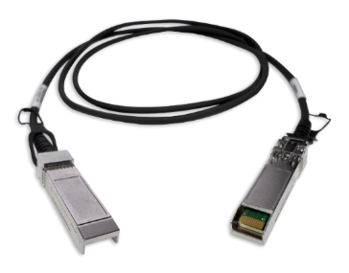
Short distance SFP+ DAC cables
1.5M SFP+ 10GbE
DAC cable
3.0M SFP+ 10GbE
DAC cable
5.0M SFP+ 10GbE
DAC cable
Part number:
CAB-DAC15M-SFPP
Part number:
CAB-DAC30M-SFPP
Part number:
CAB-DAC50M-SFPP

Slide 16

TS-431P3 2.5GbE performance
300
290
278
275
200
220
100
0
(MB/s)
Download
Upload
Download
Upload
Windows file transfer
(RAID 0, 4 x HDDs)
Windows file transfer, encrypted volume (RAID 0, 4 x HDDs)
Tested in QNAP lab. Results vary depending on the environment.
Test Configuration: TS-431P3-2G, QTS 4.4.2, RAID 0,
4 x Seagate ST1000NM0033 HDDs
Client PC：
Intel Core i7-6700 3.4 GHz; 64GB RAM; QNAP LAN-10G2T-X550; MTU 9000,
Microsoft Windows 10 64bit, 10GB file

Slide 17

TS-431X3 10GbE SFP+ performance
1000
997
800
600
400
454
329
200
249
0
(MB/s)
Download
Upload
Download
Upload
Windows file transfer
(RAID 5, 4 x SSDs)
Windows file transfer, encrypted volume (RAID 5, 4 x SSDs)
Tested in QNAP lab. Results vary depending on the environment.
Test Configuration: TS-431X3 -4G, QTS 4.4.2, RAID 5,
4 x Samsung 850 Pro 1TB SSDs
Client PC：
Intel Core i7-6700 3.4 GHz; 64GB RAM; QNAP LAN-10G2T-X550; MTU 9000,
Microsoft Windows 10 64bit, 10GB file, 10G switch

Slide 18


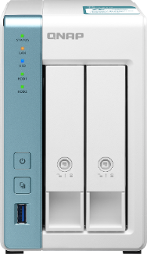




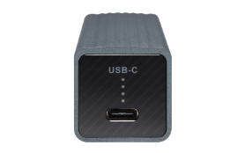


Use USB to 5GbE/2.5GbE to enhance the performance of PC/ other NAS
5GbE
Cat 5e
QXG-10G1T
or QNA-UC5G1T
QNAP
QNA-UC5G1T:
USB 3.2 Gen 1 to
5GbE/2.5GbE/1GbE
adapter
5GbE
Cat 5e
QNAP 10G 8C switch
Existing cable wiring
TS-231K
Tested in QNAP Labs. Figures may vary by environment.
Test environment
NAS: TS-231K,
QTS 4.4.2, RAID 1: thick volume
2 x 512GB Samsung 850 Pro
Client PC：
Intel Core i7-6700 3.4 GHz; 64GB RAM; Intel X550 網卡; Microsoft Windows 10 64bit
300
200
260
255
100
Existing cable wiring
0
(MB/s)
Download
Upload
Windows file transfer
QNA-UC5G1T + TS-231K RAID 1

Slide 19
Live Demo
1 x memory slot for RAM upgrade
2.5GbE & 10GbE performance tests

Slide 20
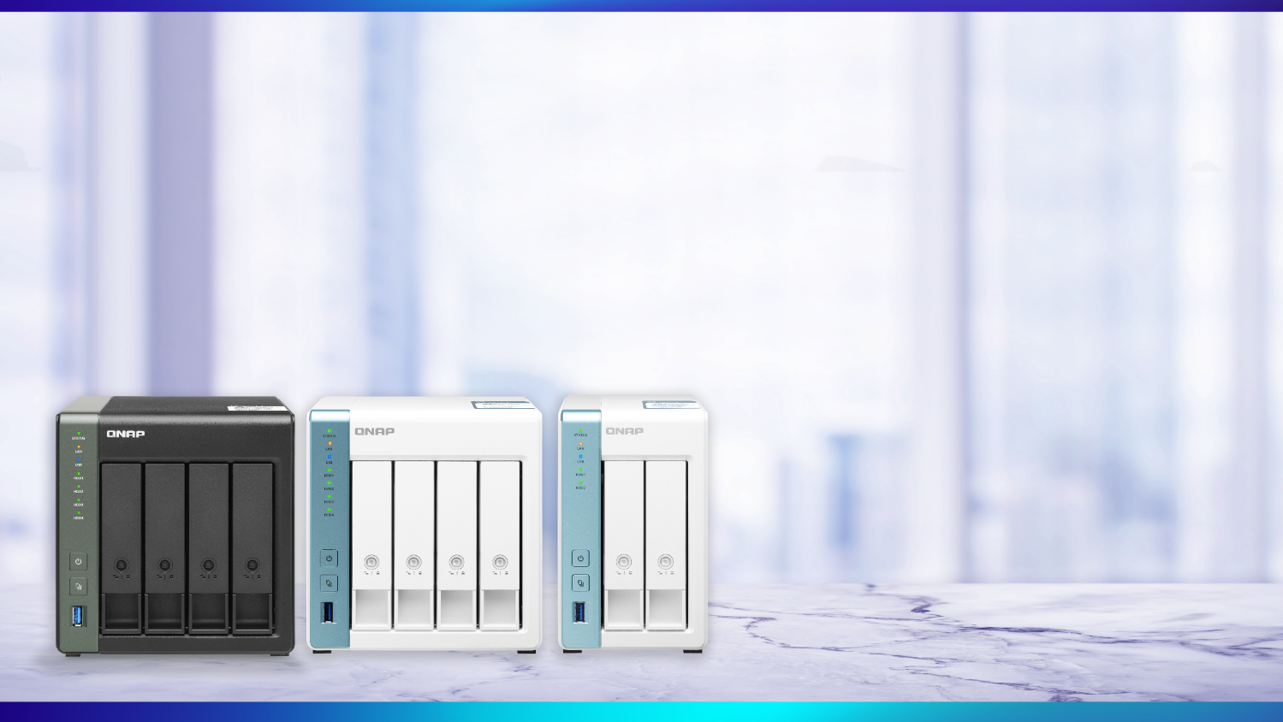

Various NAS applications for your work-from-home needs

Slide 21
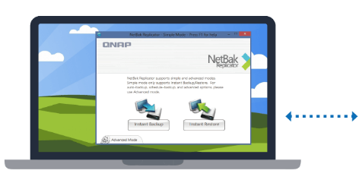
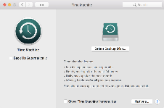
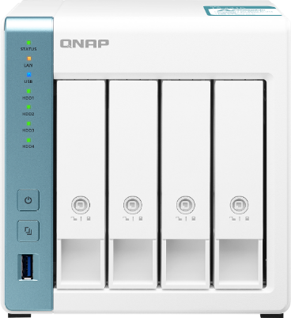
Fight against virus and ransomware
Mac O.S.
Time
Machine
Real-time or scheduled data backup
Windows
NetBak
Replicator
TS-431P3

Slide 22


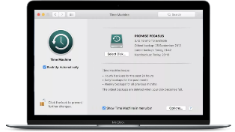
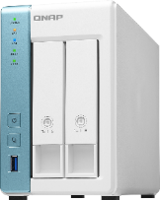

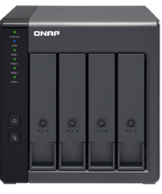


Free Mac Time Machine backup
Mac Time Machine
TS-231P3
TR-004
Create the backup job
Select Time Machine Backup as Source
Select TR-004 as Destination
Setup the backup schedule in HBS 3

Slide 23
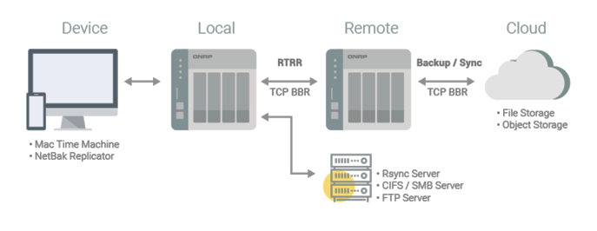
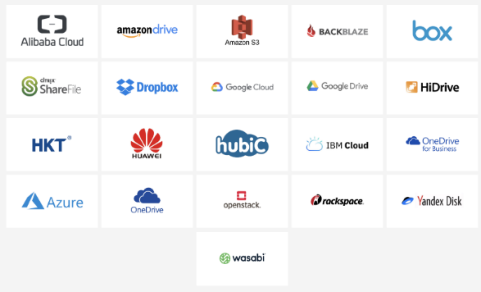

HBS 3 for backup and recovery
Use HBS 3 (Hybrid Backup Sync 3) to easily transfer your data to local, remote and cloud storage spaces as a comprehensive data storage and disaster recovery plan.
Notes:
Carry and use 在不同地點

Slide 24







QNAP snapshot for file recovery
1. Fully supports all storage configurations at the storage pool level.
2. Easily take, manage and restore snapshots.
3. Using the mature Ext4 file system for "out of volume" snapshots
RAM size | NAS models | Maximum total snapshot numbers | Maximum snapshot number per Volume/LUN
2GB | TS-431P3-2G, TS-231P3-2G | 64 | 32
4GB and above | TS-431X3-4G, TS-431P3-4G, TS-231P3-4G | 256 | 64
File level
Removeable drives
Block level
A’
B’
C’
D’
E’
Local drives
Cloud / NAS
A
B
C
D
E

Slide 25

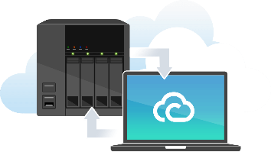

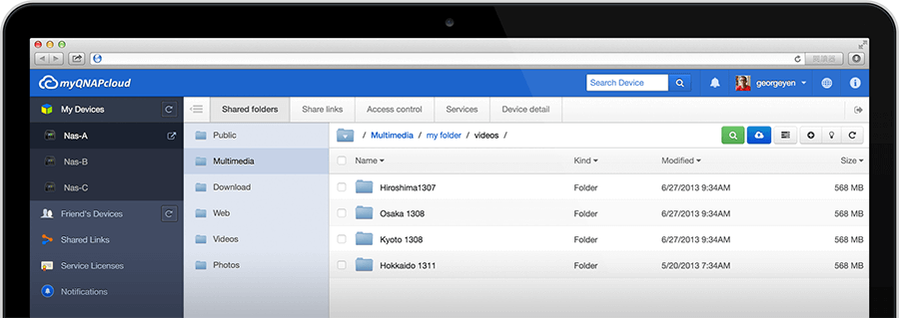
Connect to home or office NAS with myQNAPcloud and QNAP ID (QID)
Anytime / Anywhere
Register and login with Email or phone number

Slide 26





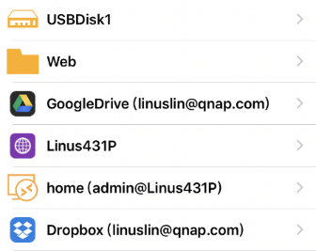

Connect to Dropbox, One Drive,
Google Drive and more
Qfile
File Station
Mobile
Computer
Local
NAS
Remote
NAS
Cloud
storage

Slide 27
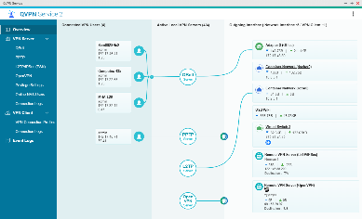

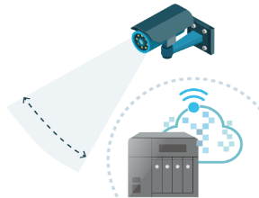




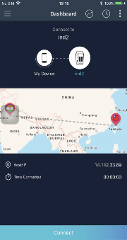
QNAP QVPN and QBelt protocol for anywhere access
Secure Encrypted Connection:
DTLS + SSL +
AES-256 encryption
New QBelt protocol:
Works on desktop and mobile devices
Decreases the chance of being detected
Windows, macOS, Android, iOS

Slide 28


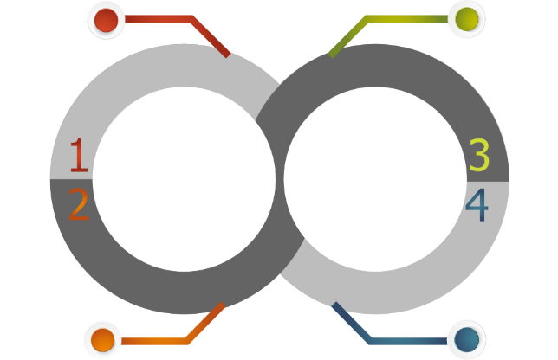



Build your site with the free WordPress
1. Enable SQL server
2. Install phpMyAdmin and create a database
3. Install WordPress from NAS App Center
QNAP file management utilities improve content publishing efficiency
Free personal domain for quickly enabling SSL certificates
From setup to backup, QNAP NAS has it all
Host multiple websites on QNAP NAS with Virtual Hosting
Notes:
網路上有 35% 的網站皆選用 WordPress 服務。

Slide 29
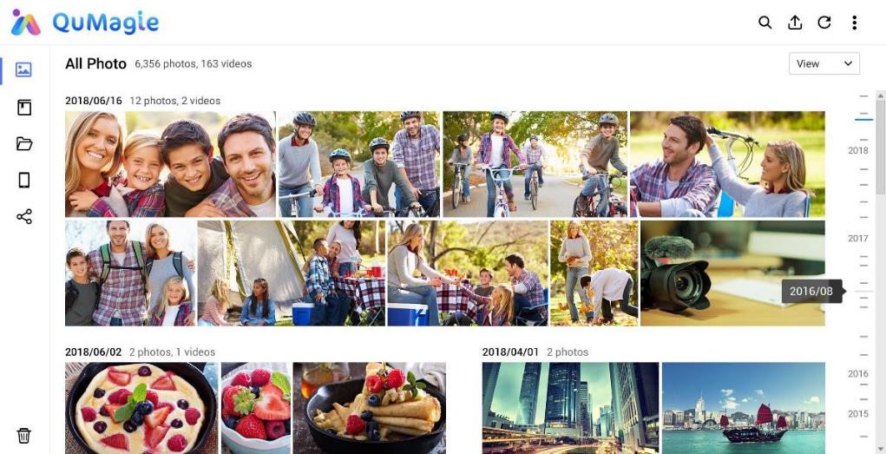
QuMagie photo management
Album view
Folder view
Albums and Smart Albums

Slide 30
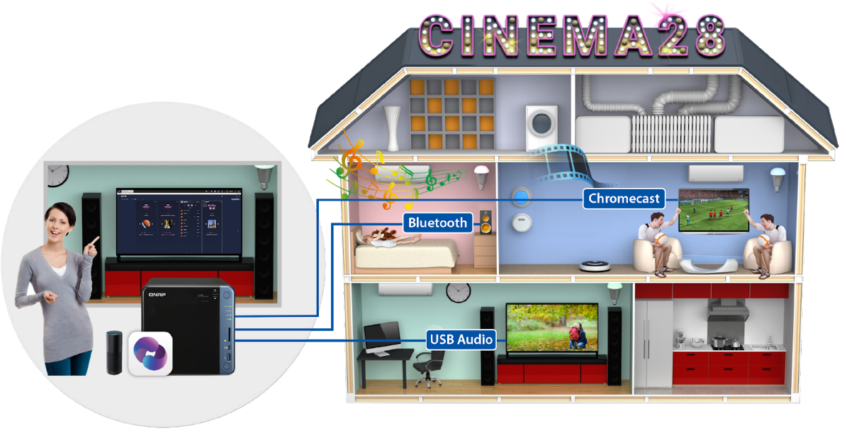

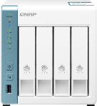

Use Cinema28 for whole-home streaming
Integrate multiple streaming devices and streaming protocols into a single interface for centralized management, allowing users to easily stream digital multimedia files to audio/video devices in every corner of the house.
TS-431P3

Slide 31







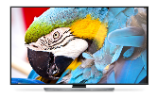





PLEX Server for media streaming
Internet
Streaming Devices
Smart TV
Computer
Phone
Tablet
TS-431P3

Slide 32


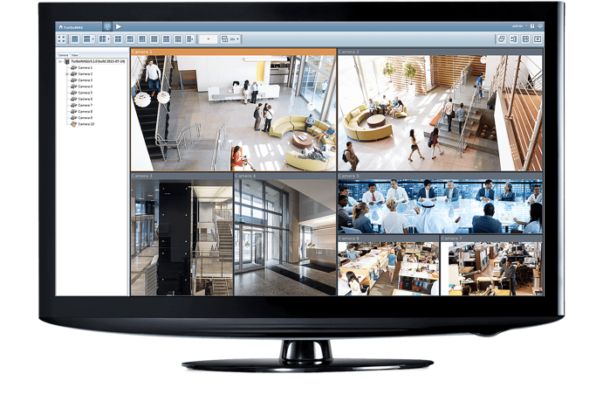





24x7 surveillance for security
Surveillance Station 5.1
Recording channels
Free: 2 Max: 16
Vmobile
TS-231P3

Slide 33


Quad-core w/ max 8GB RAM, best for Container Station to show your creativity
AI, IoT, Commonly-used Container Recommendation
  One-click installation wizard helps you quickly setup
Supports Docker Compose YAML format to create applications
Easily import/export containers
Imports images or containers from PC or NAS
Exports images or containers to NAS as backup
Built-in Docker Hub Marketplace
Easily downloadable tools
Notes:
Max 8GB RAM for x31P3/431X3

Slide 34













QNAP mobiles apps for data on the go
File & System
Multimedia
Productivity
Qfile
File management
Qphoto
Photo library
DJ2 Client
Live streaming
QmailClient
E-mail backup
Qsync
File backup
QuMagie
Photo library
Photo Tagger
Classification tool
Qcontactz
Contacts backup
Qmanager
NAS management
Qvideo
Video library
Qget (Android only)
Download management
Qnotes3
Notes taker
Qmusic
Music library
Vmobile
Mobile surveillance

Slide 35







QNAP TR USB RAID & TL USB JBOD support 2 modes on NAS
NAS supports maximum two QNAP TR-002/TR-004 RAID enclosures or one TL-D800C USB JBOD enclosure (Compatibility list).
Internal mode with storage pool support or external mode with cross-platform compatibility with Windows/Mac computers.
Mode 1: Expanding the NAS with new volume
Mode 2: Work as backup destination for snapshot replica
8-bay TL-D800C
4-bay TR-004
2-bay TR-002
TS-231P3
8-bay TL-D800C
4-bay TR-004
2-bay TR-002

Slide 36




Cost-effective 2.5GbE & 10GbE NAS
NAS model | TS-431X3 | TS-431X2 | TS-431P3/231P3 | TS-431P2/231P2
Processor | AnnapurnaLabs AL-314 Quad-core 1.7 GHz CPU
SKUs | TS-431X3-4G | TS-431X2-8G TS-431X2-2G | TS-431P3-4G TS-431P3-2G TS-231P3-4G TS-231P3-2G | TS-431P2-4G TS-431P2-1G TS-231P2-4G TS-231P2-1G
10GbE port | 1 x 10GbE SFP+ | 1 x 10GbE SFP+ | --- | ---
2.5GbE port | 1 | --- | 1 | ---
GbE port | 1 | 2 | 1 | 2
Lockable drive trays | Yes | --- | Yes | ---
Optional 3-year extended warranty purchase for a total of 5 years
Ordering information:
LIC-NAS-EXTW-GREEN-3Y

Slide 37
The affordable choice for quad-core 1.7GHz NAS with 2.5GbE and 10GbE.
Copyright © 2020 QNAP Systems, Inc. All rights reserved. QNAP® and other names of QNAP Products are proprietary marks or registered trademarks of QNAP Systems, Inc. Other products and company names mentioned herein are trademarks of their respective holders.
TS-431X3
TS-431P3
TS-231P3

