Slide 2
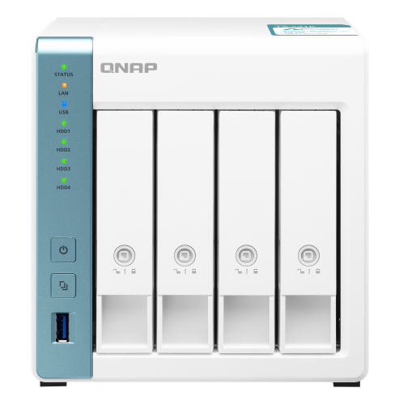
Video Station Revamped
Why do you need Video Station 5.5?
How to start using Video Station?
I've got movies and TV shows. How should I organize them?
I got classic film series. How should I organize them?
Can I organize my videos on my demand?
Where can I watch my videos?

Slide 3
Why do you need
Video Station 5.5?

Slide 4
Why do you need Video Station 5.5？
Q1
Do you have a massive video collection, but you don't know a good way to organize it?
A1
Start building your own video library with Video Station!
Q2
After using Video Station for several years, are you expecting a sleek, modern new look?
A2
Update your Video Station NOW and check what's new!

Slide 5
How to start using Video Station?

Slide 6
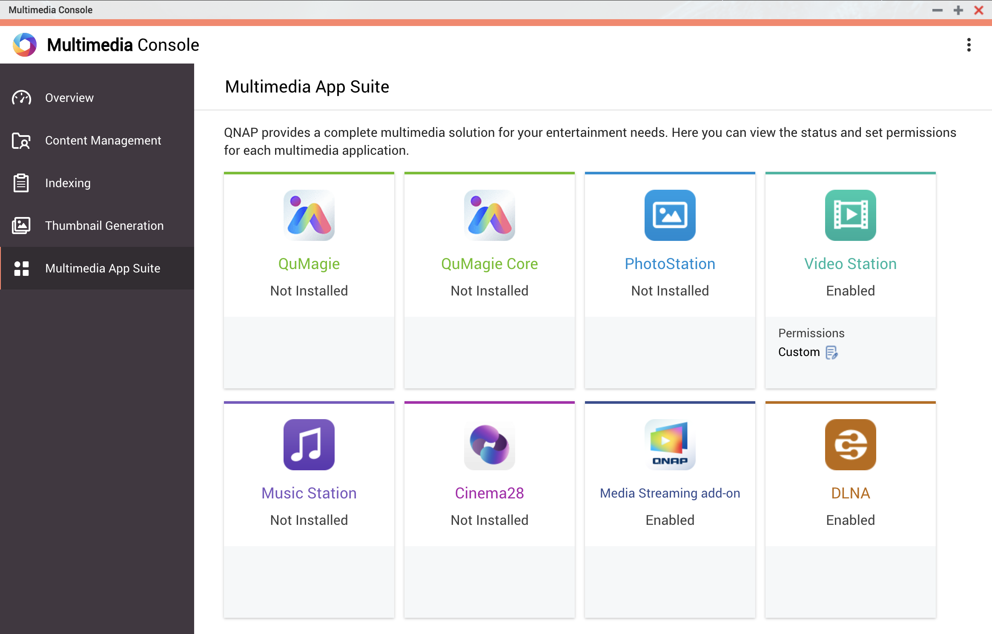
How to start using Video Station?
Step 1: Open Multimedia Console, go to “Overview” and check if “Multimedia Services” is enabled.
Step 2: Go to “Multimedia App Suite”, click Video Station and finish the installation.
Step 3: Go to “Content Management” and set content sources for Video Station.
Step 4: Open Video Station and start building your video library.

Slide 7
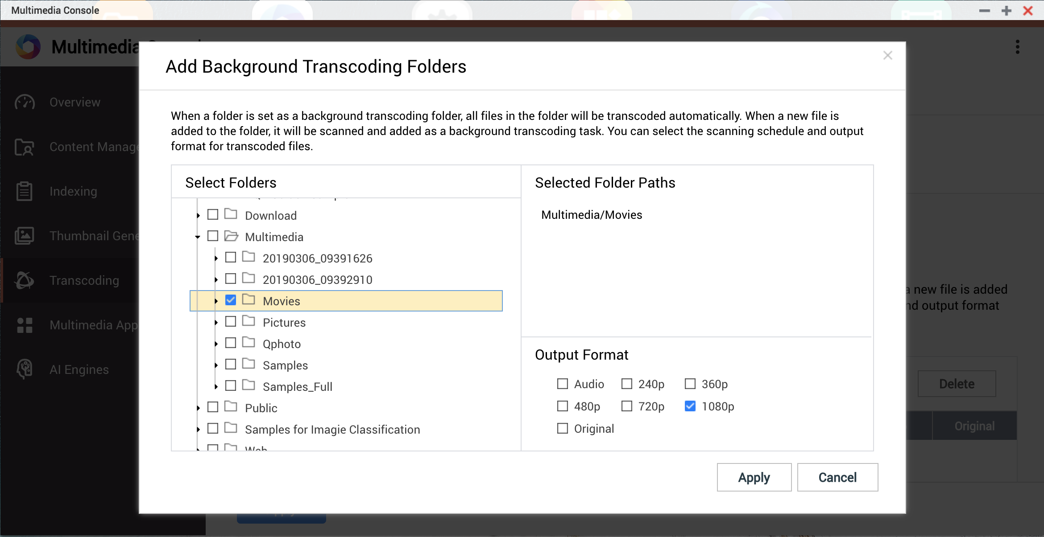
How to start using Video Station?
Tips: Set up “Background Transcoding” to make playback smooth.
Step 1: Go to “Transcoding” and click “Settings”.
Step 2: Click “Add” in “Background Transcoding Folders” section.
Step 3: Select the content source folder of Video Station and set as background transcoding folders.
* Only for NAS with Intel or AMD CPU,
TS-230, TS-328 and TS-428.

Slide 9
I've got movies and TV shows.
How should I organize them?

Slide 10
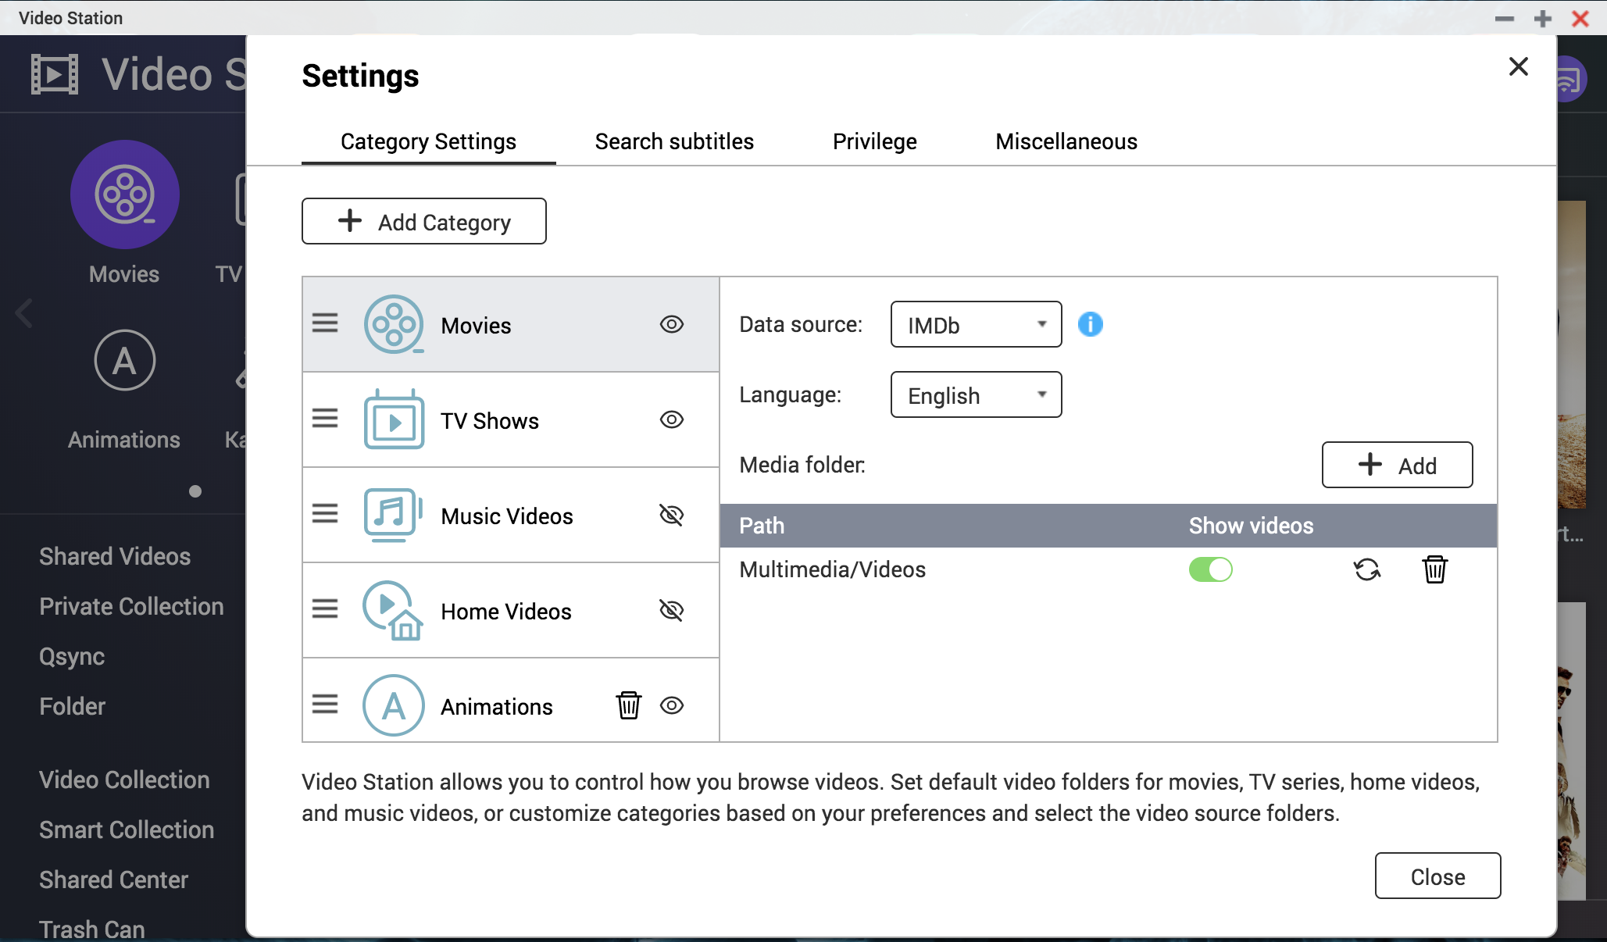
I've got movies and TV shows. How should I organize them?
Step 1: Open Video Station.
Step 2: Go to Settings > Category Settings tab and add folders for different categories.

Slide 11
I've got classic film series.
How should I organize them?

Slide 12
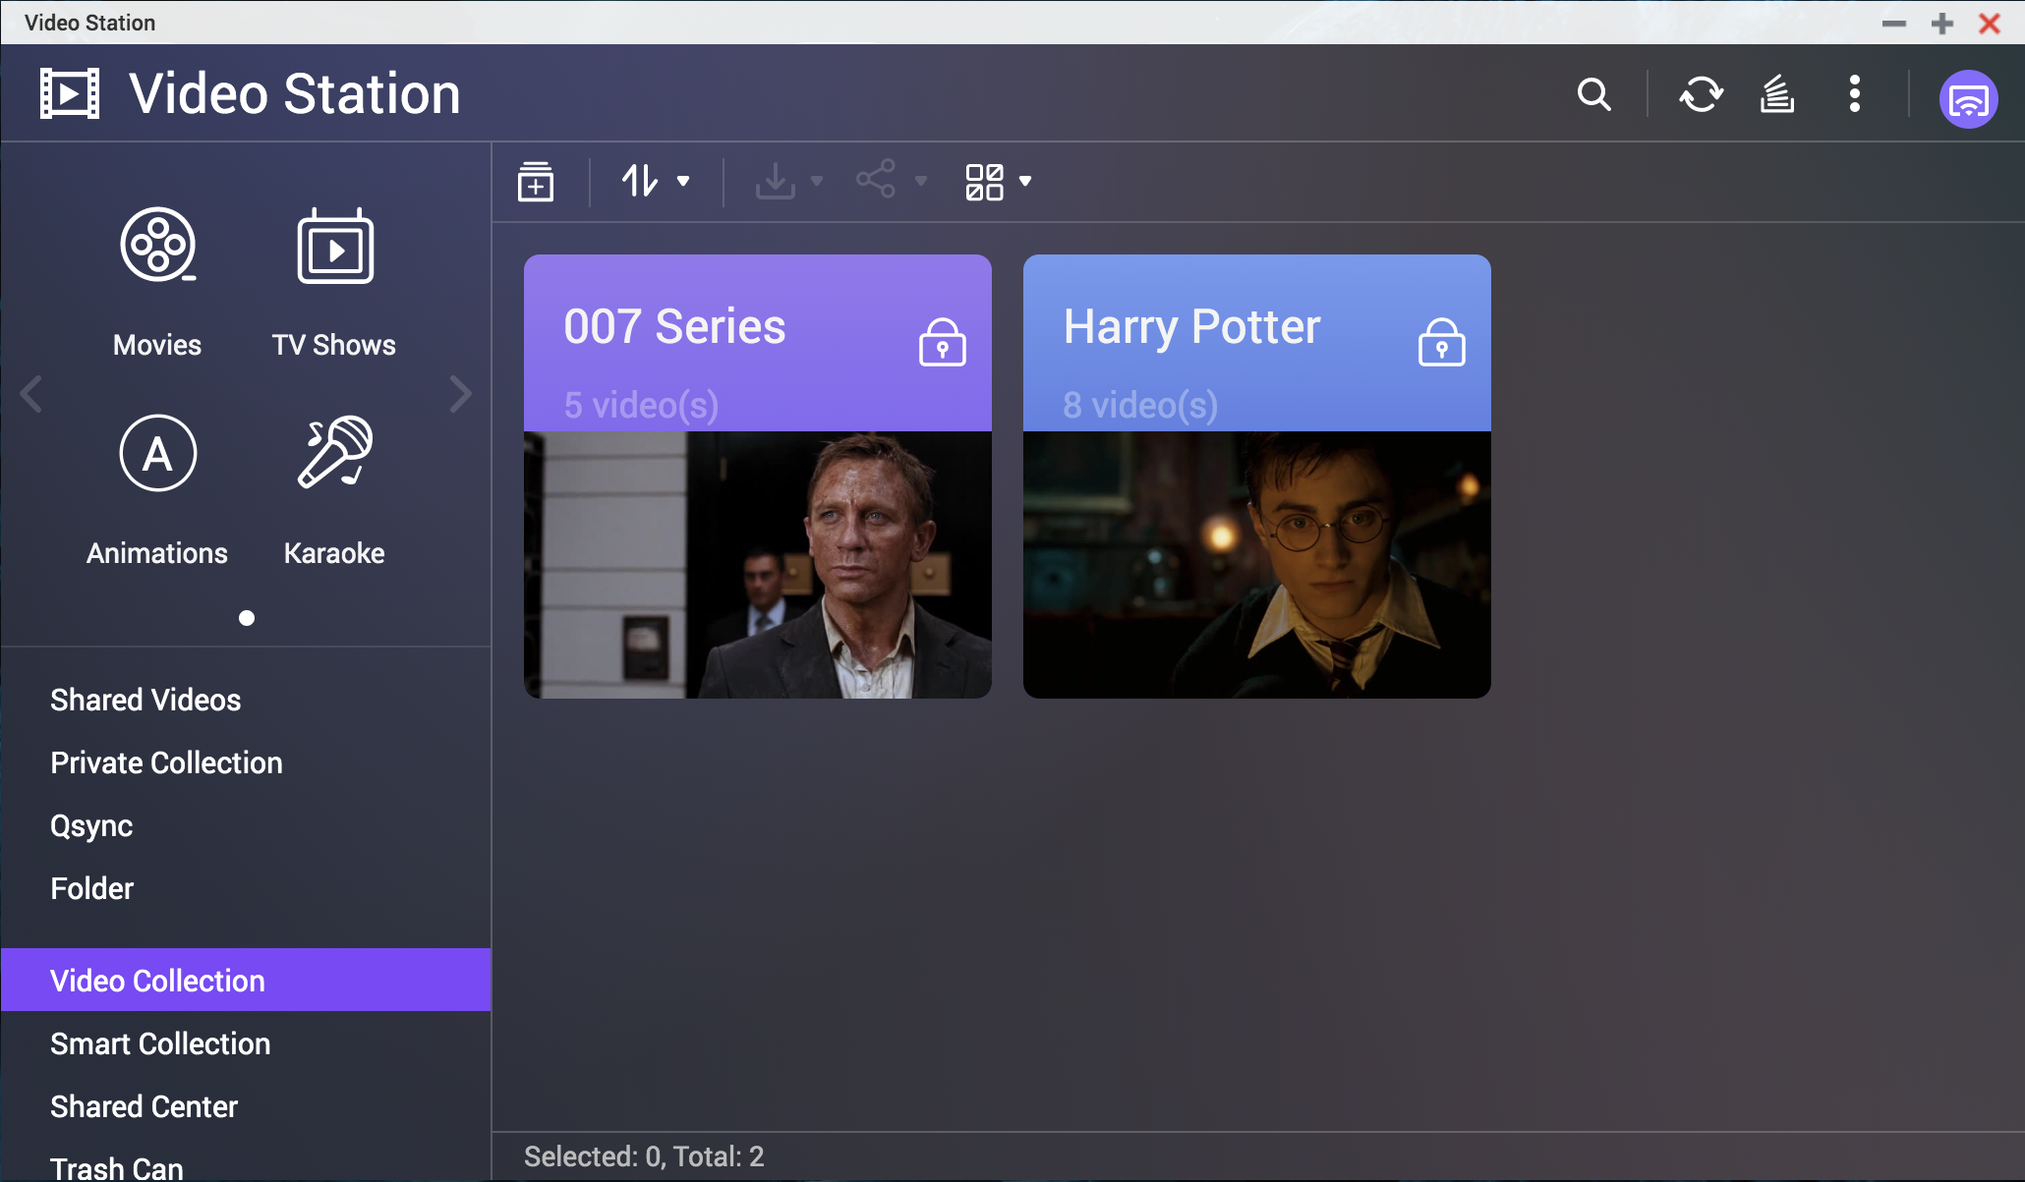
I've got classic film series. How should I organize them?
Step 1: Select the video.
Step 2: Right click and select “Copy to Collection”.
Step 3: Choose a collection or create a new collection.

Slide 13
Can I organize my videos on my demand?

Slide 14
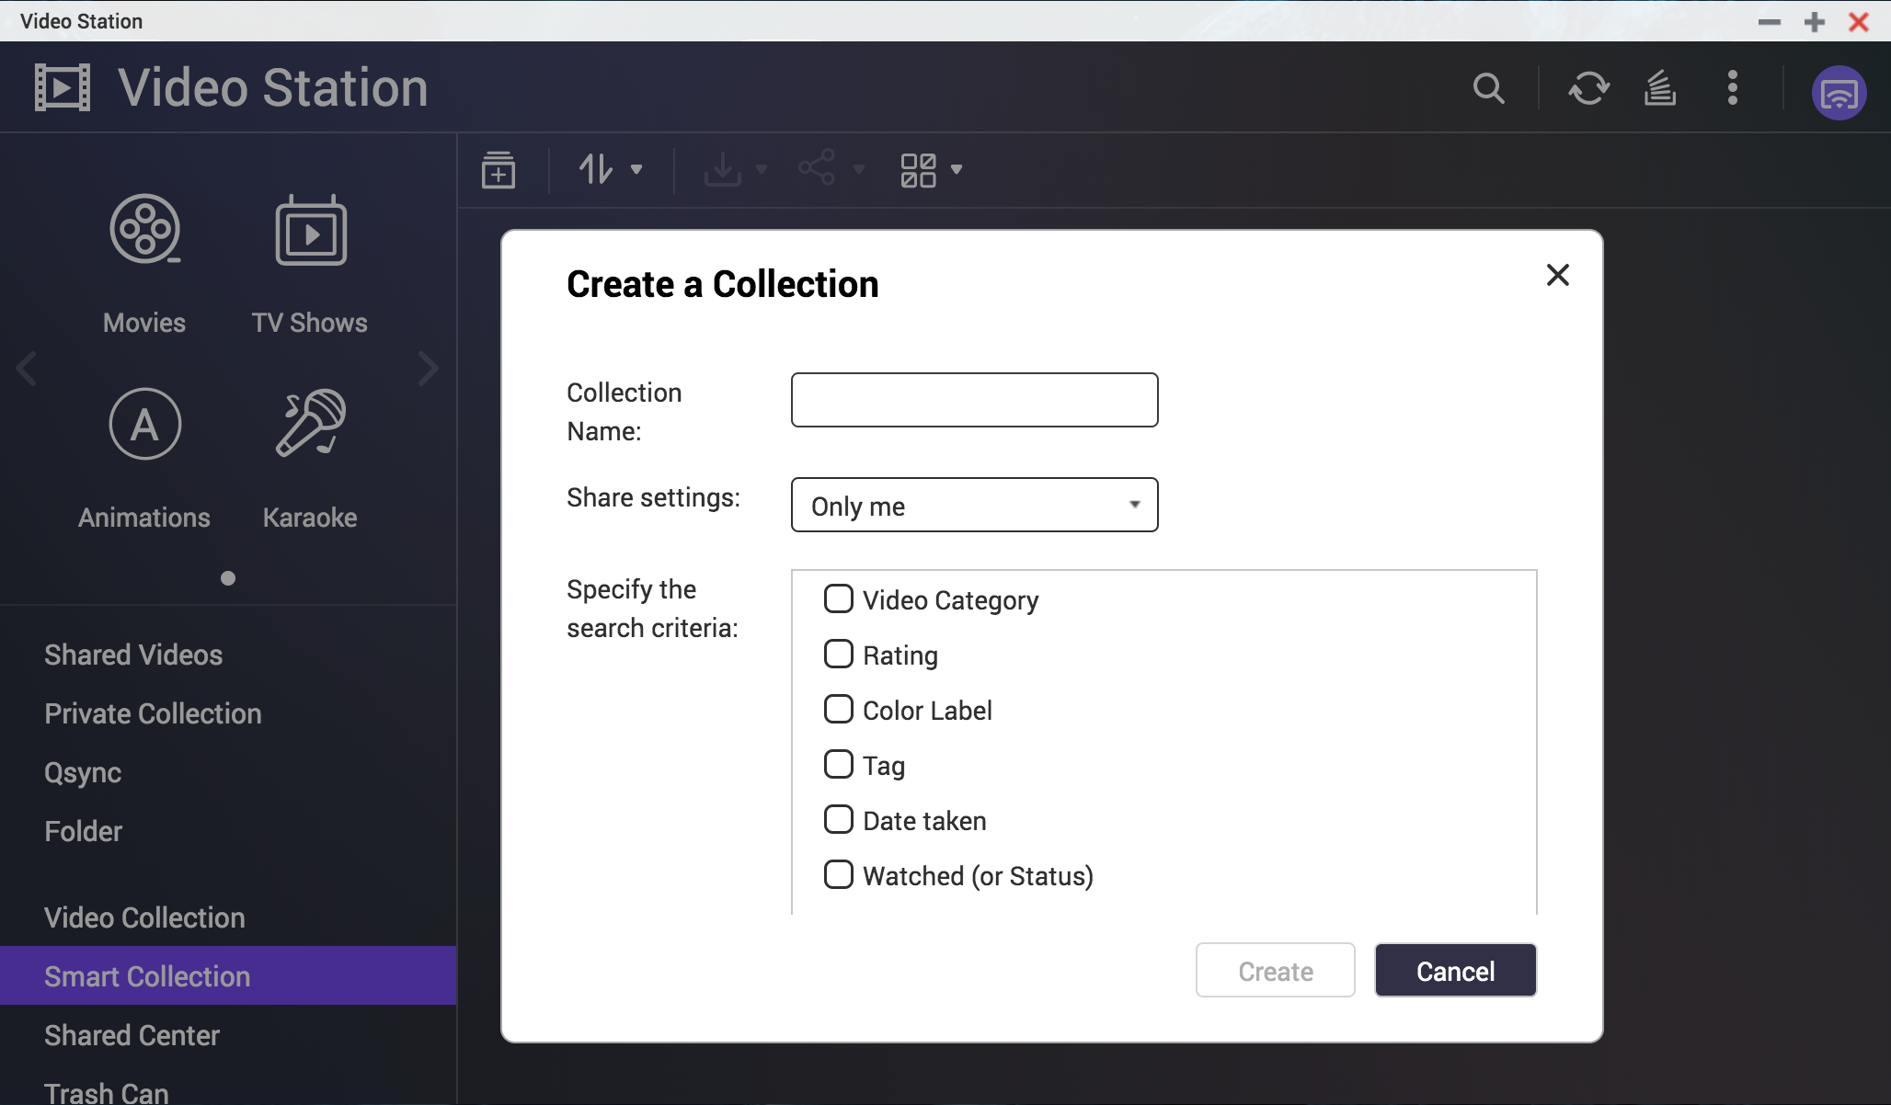
Can I organize my videos on my demand?
Step 1: Go to “Smart Collection”.
Step 2: Create a smart collection with specific search criteria.
Step 3: Videos which match the criteria would be collected automatically.

Slide 16
Where can I watch my videos?

Slide 17
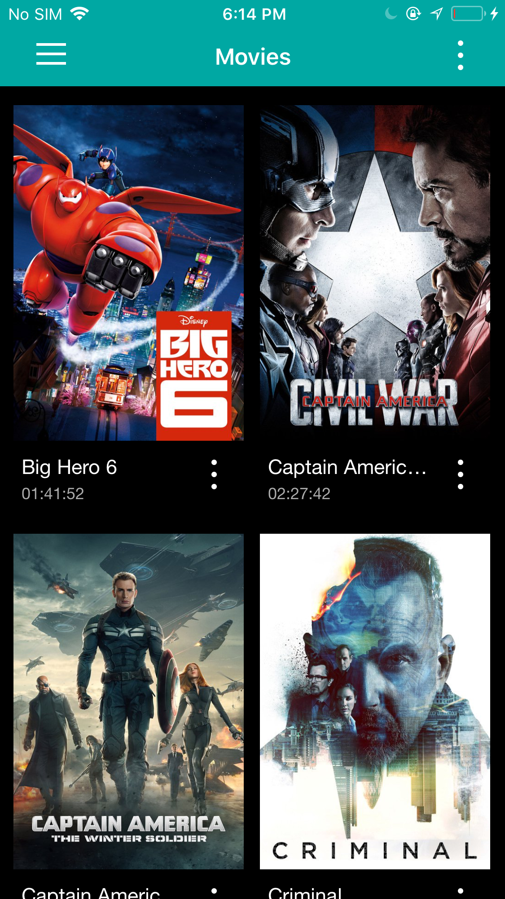
On Mobile Devices
Qvideo
Supports both Android / iOS devices
Fully compatible with Video Station media library
Sync all video play back record
Support 360-degree video playback and VR mode.
Support offline playback
Support Resume Playback
Support play with other players, such as MX Player, VLC Player, KODI etc.
Support Multizone Streaming

Slide 18
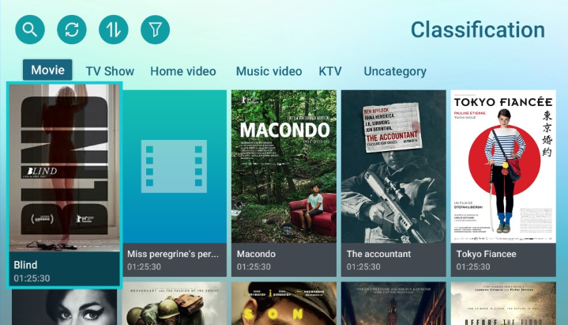
On Smart TV
Qmedia
Streaming multimedia contents from your NAS to smart TVs.
With intuitive operations, all your family members can easily enjoy the entertainment brought by Qmedia.
Apple TV
Fire TV
Roku TV
Android TV

Slide 19
INTRODUCING

Slide 20
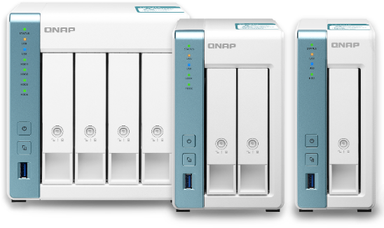
TS-x31K Series
Alpine AL-214 ARM v7 Processor
TS-431K
TS-231K
TS-131K
New Arrival
With a Quad-core 1.7GHz Processor

